Slide 1
Sinkhole
Natural Disaster
Sinkholes are localized depressions in the land surface that result from the collapse of underlying material. They can range in size from a few feet to hundreds of feet wide and deep, and can have a significant impact on human communities.

Slide 2
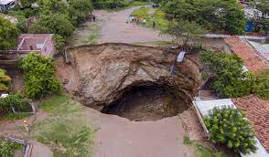
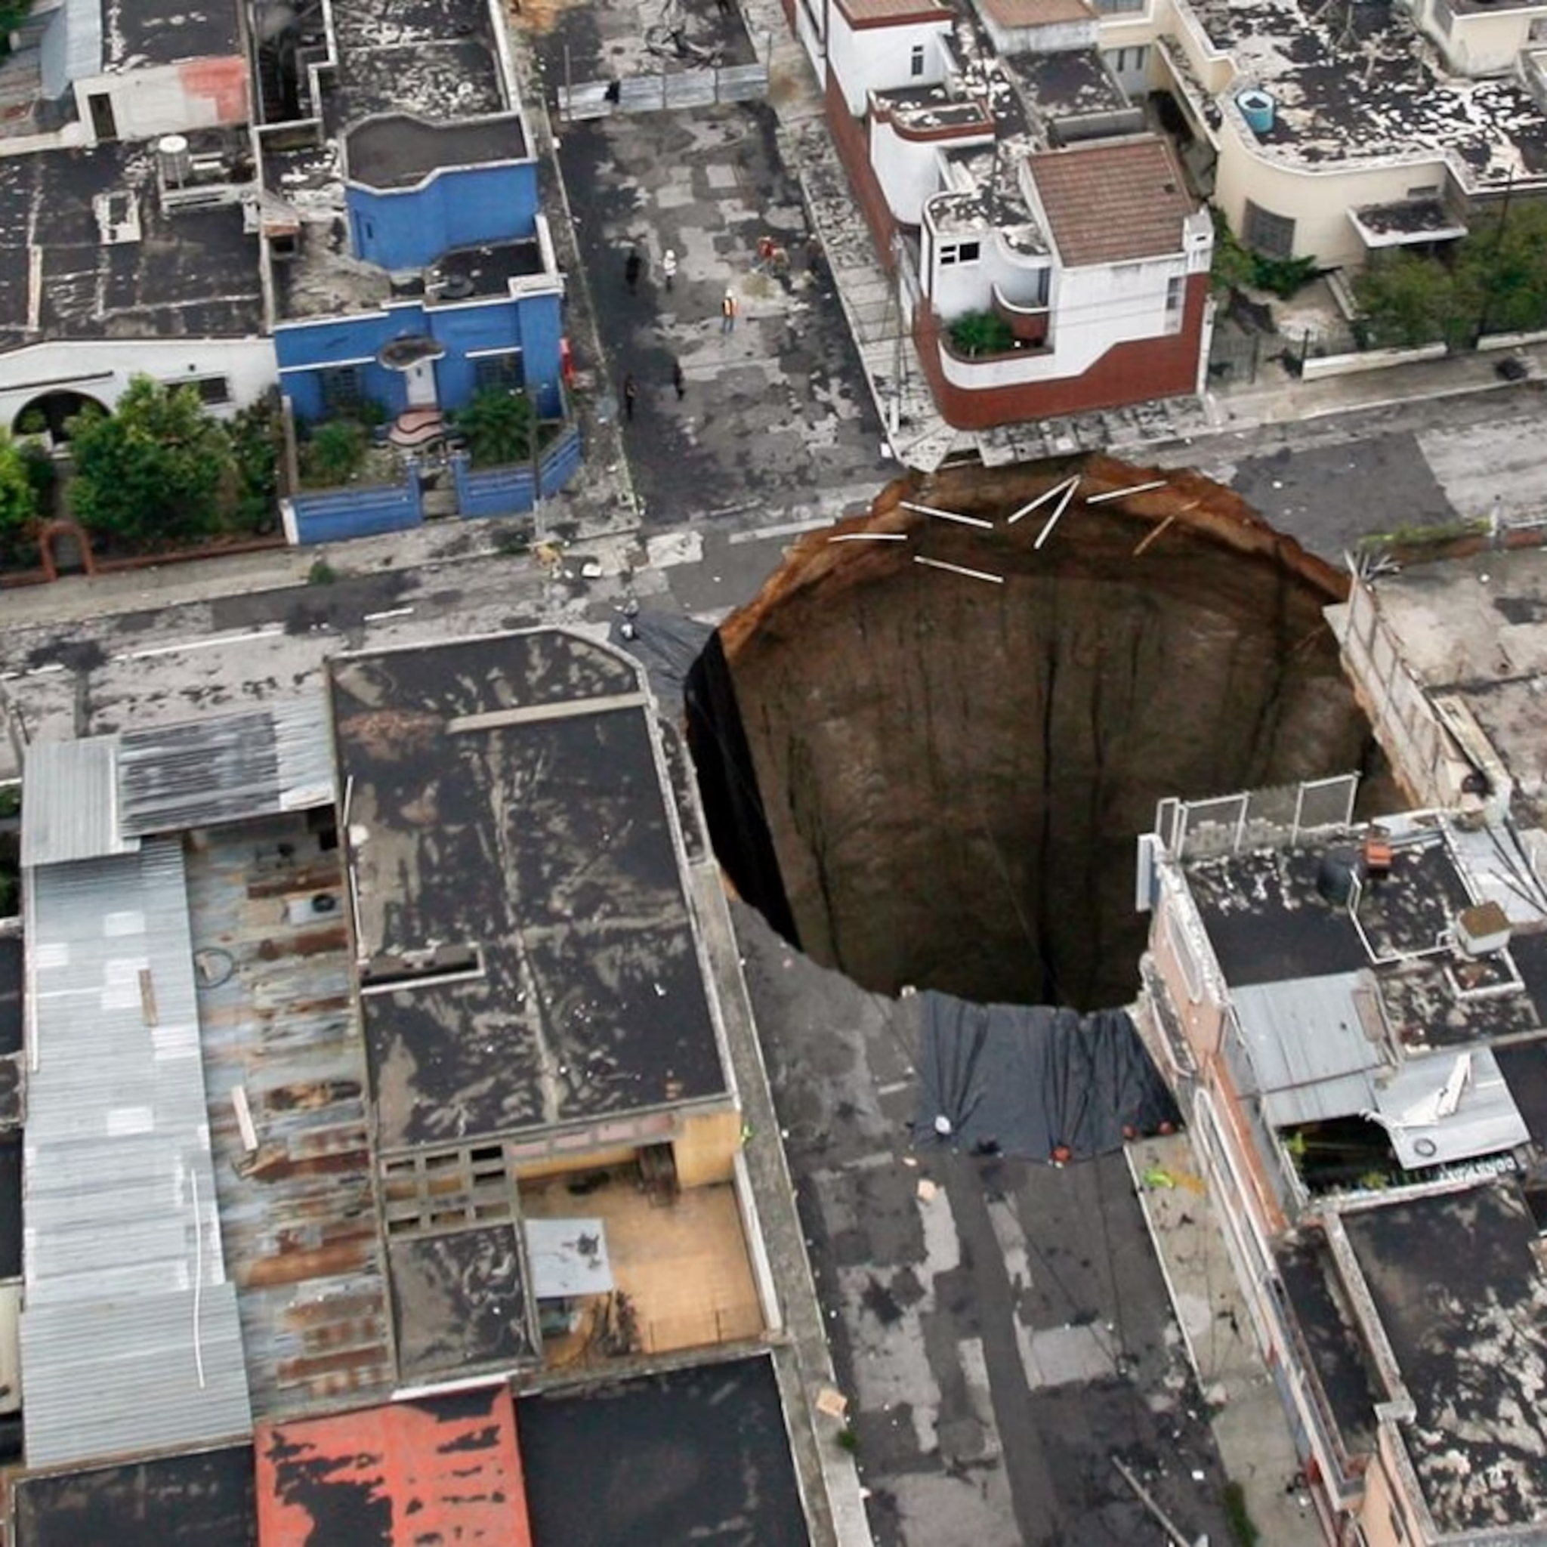
Causes
There are several natural and human-caused factors that can contribute to sinkhole formation. Some of the most common causes include:
Dissolution of soluble rocks: This is one of the most common causes of sinkholes, and it occurs most frequently in areas underlain by limestone or other carbonate rocks. Over time, rainwater percolates through the ground and dissolves the rock, creating cavities that eventually collapse.
Erosion of underground streams: In areas with karst topography, underground streams can erode the bedrock, creating channels and cavities that can eventually collapse.
Human activities: Human activities such as groundwater pumping, overwatering, and construction can accelerate sinkhole formation. Groundwater pumping can lower the water table, making the ground less stable and more prone to collapse. Overwatering can saturate the ground and promote erosion, while construction can disrupt the natural drainage patterns of the land.

Slide 3
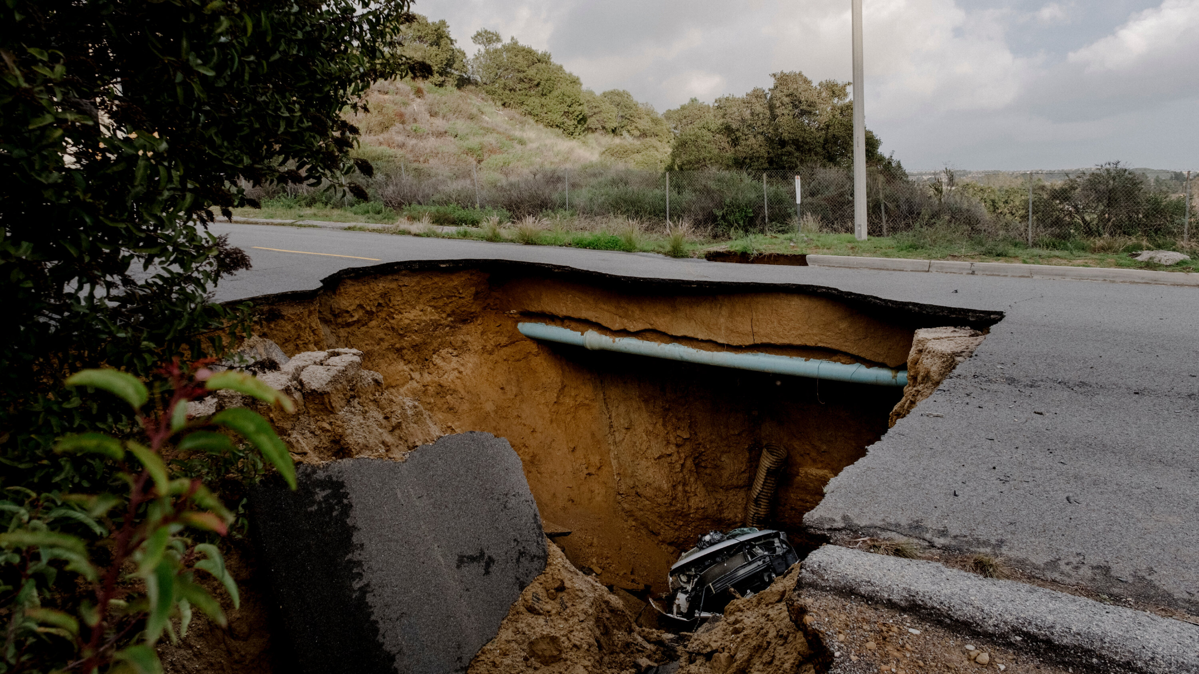
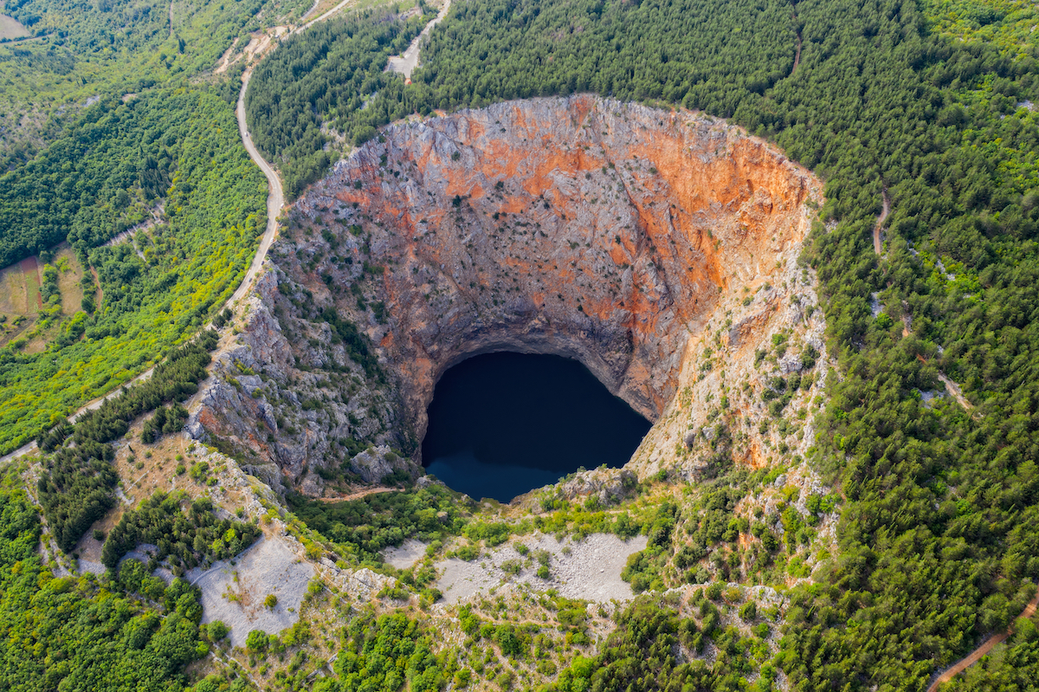
Human Impact
Sinkholes can have a significant impact on human communities. Some of the potential impacts include:
Loss of life and property: Sinkholes can collapse unexpectedly, and they can be large enough to engulf entire buildings or vehicles. In some cases, sinkholes have even caused fatalities.
Damage to infrastructure: Sinkholes can damage roads, bridges, and other infrastructure. This can disrupt transportation and communication systems, and it can also lead to economic losses.
Contamination of water supplies: Sinkholes can allow pollutants to enter groundwater supplies. This can pose a serious health risk to people who rely on groundwater for drinking water.

Slide 4
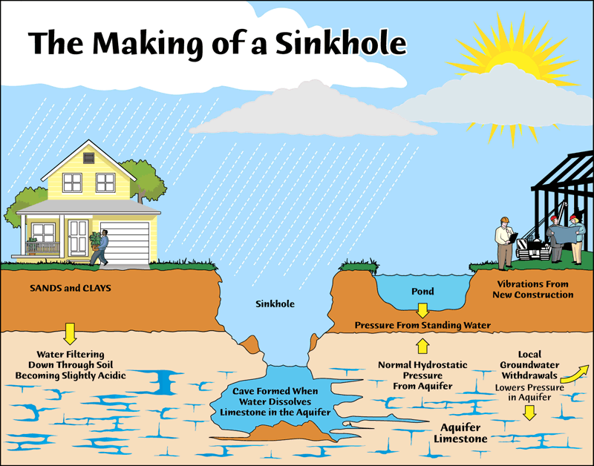
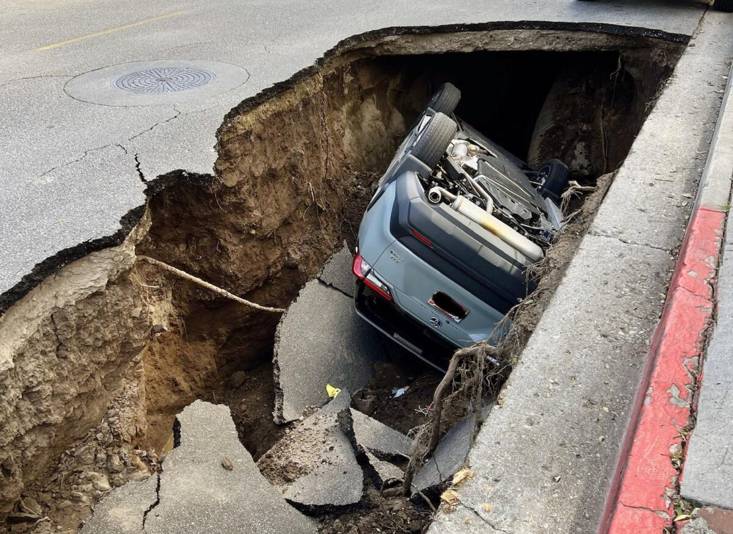
Resource Interruption
Sinkholes can also disrupt the flow of resources such as water, natural gas, and electricity. This can have a significant impact on businesses and residents who rely on these resources.

Slide 5
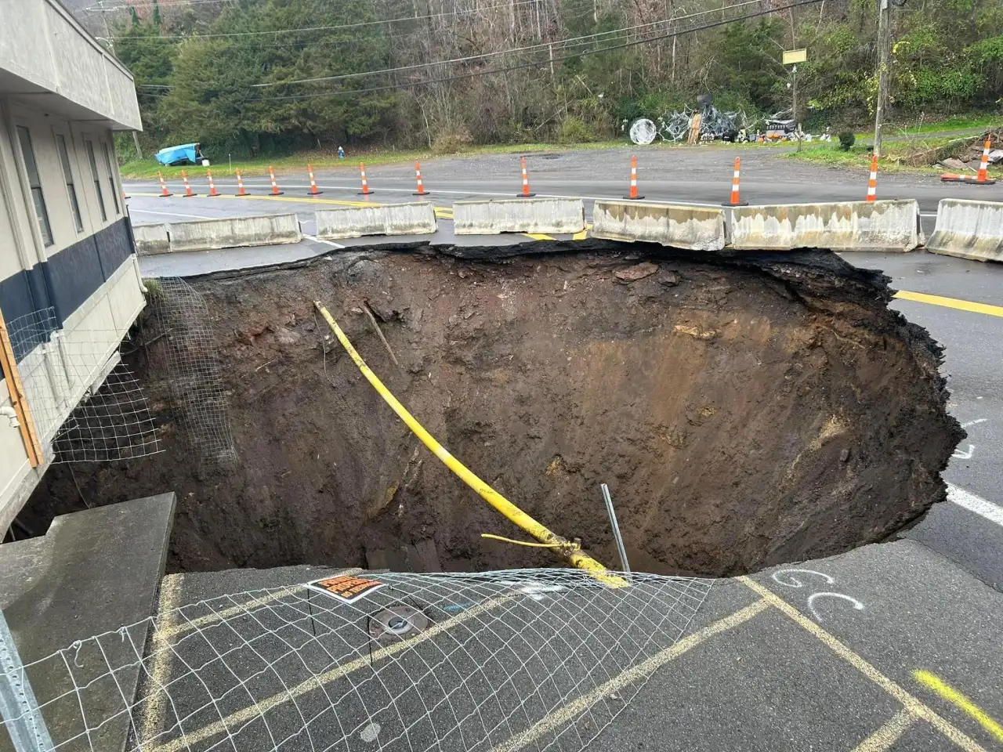
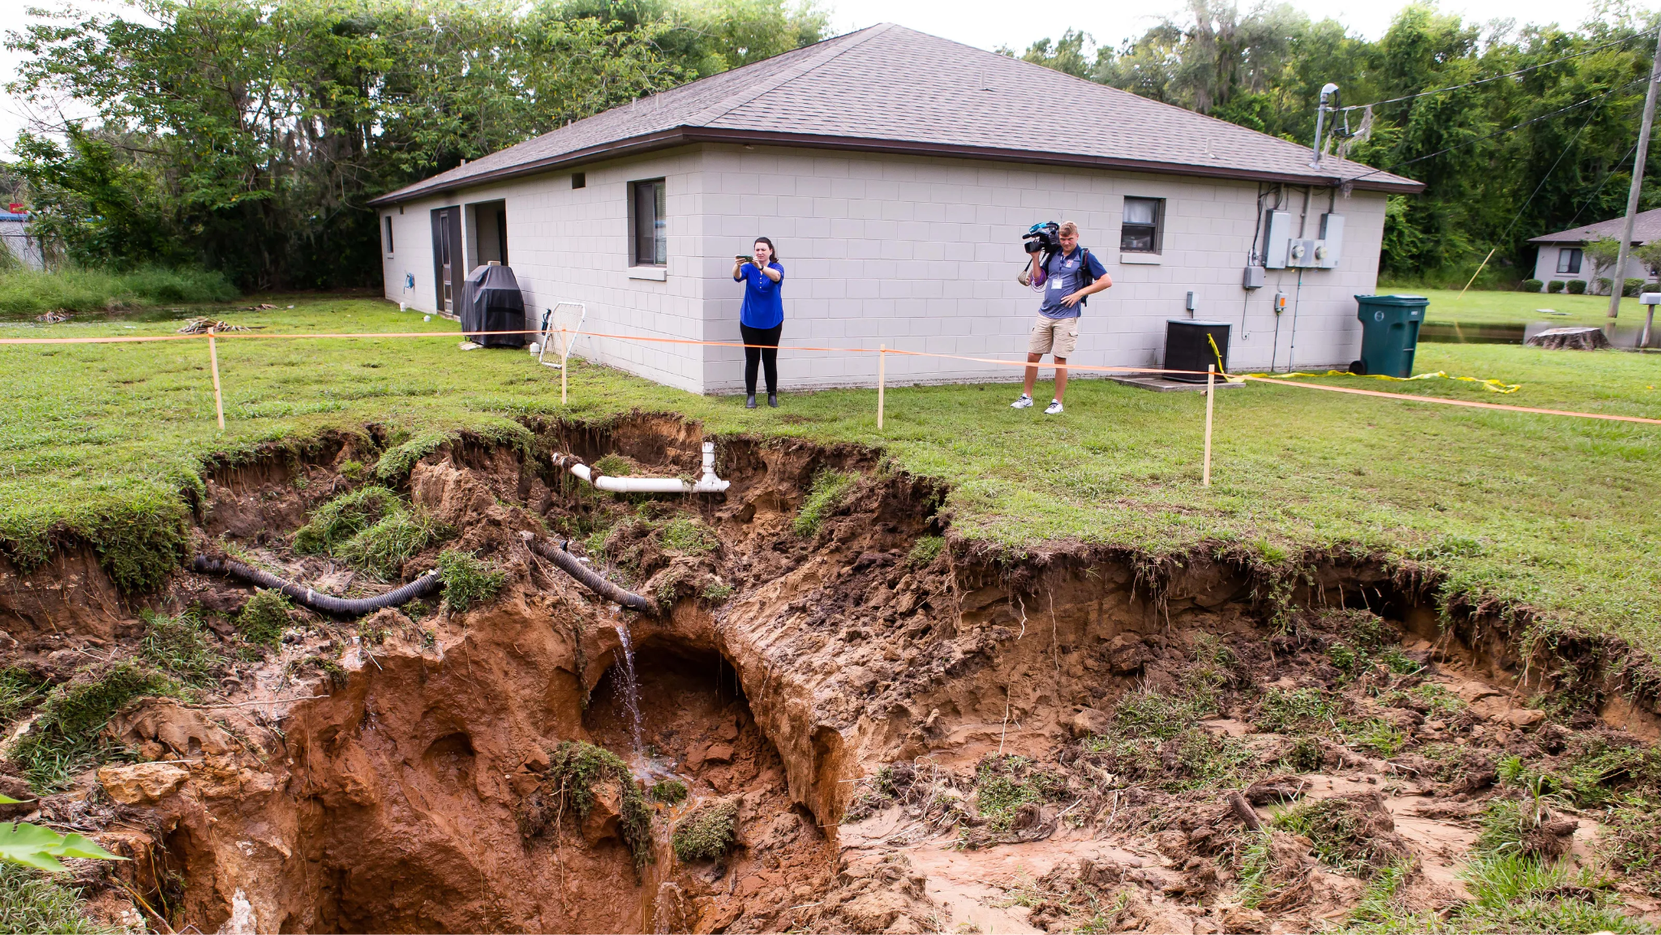
Loss to structure and property
Sinkholes can cause significant damage to structures and property. In some cases, buildings may be completely destroyed. Even if a building is not destroyed, it may be rendered uninhabitable due to structural damage.

Slide 6
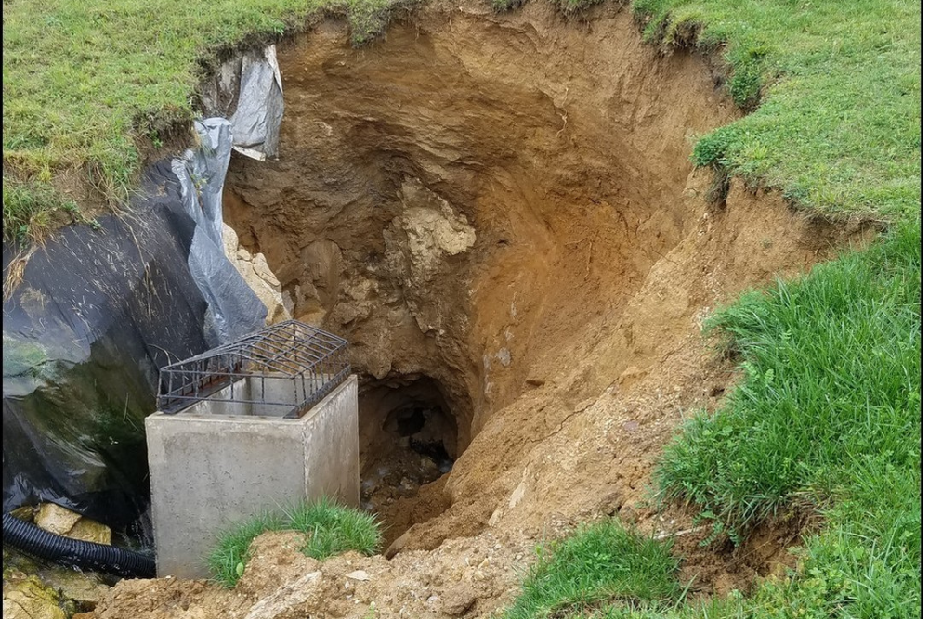
Real Examples
Guatemala City Sinkhole: In 2010, a massive sinkhole opened up in Guatemala City, Guatemala. The sinkhole was approximately 100 feet wide and 300 feet deep, and it engulfed a three-story building.
Winter Park Sinkhole: In 2016, a sinkhole opened up in Winter Park, Florida. The sinkhole was approximately 40 feet wide and 50 feet deep, and it caused the collapse of a home.
Dead Sea Sinkholes: The Dead Sea is known for its high concentration of salt, which makes it a popular tourist destination. However, the Dead Sea is also a sinkhole-prone area. In recent years, there have been several sinkholes that have opened up along the Dead Sea coast, some of which have engulfed homes and businesses.

Slide 7
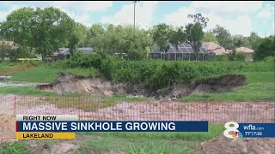
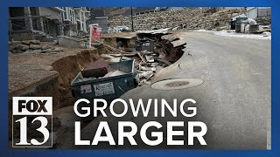
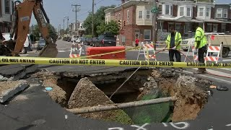
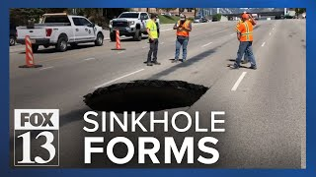
News/Video

Slide 8
Statistics
Fatalities
According to the U.S. Geological Survey (USGS), there have been an average of 25 to 30 sinkhole-related fatalities in the United States per year since the 1970s. However, the actual number of fatalities may be higher, as not all sinkhole-related deaths are reported or recorded.
Property Damage
Sinkholes can cause significant damage to property. In the United States, sinkholes are estimated to cause over $300 million in property damage each year. This includes damage to homes, businesses, infrastructure, and crops.
Number of Sinkholes
It is difficult to estimate the exact number of sinkholes that occur each year, as many sinkholes go unreported. However, the USGS estimates that there are at least 2,000 to 3,000 sinkholes in the United States each year.

Slide 9
Resources/Links
U.S. Geological Survey (USGS): https://www.usgs.gov/special-topics/water-science-school/science/sinkholes)
National Association of Home Builders (NAHB): https://digitalcommons.usf.edu/sinkhole_2020/ProceedingswithProgram/Geomorphology_Formation_of_karst_and_sinkholes/2/
Florida Sinkhole Research Institute (FSRI): https://www.foundationprosfl.com/what-happened-to-the-florida-sinkhole-research-institute-fsri/
Texas Sinkhole Information Service: https://www.catsweb.txst.edu/students.html)
Missouri Department of Natural Resources (MDNR): https://dnr.mo.gov/land-geology/hazards/sinkholes)
Kentucky Geological Survey (KGS): https://eec.ky.gov/Environmental-Protection/Pages/default.aspx)
Tennessee Department of Environment and Conservation (TDEC): https://www.tn.gov/environment.html

Slide 10

3D-RST is supported by the NSF under grant number #DRL-2101383

