Slide 1
Landslide
Natural Disaster
A landslide natural disaster is a mass movement of rock, debris, or earth down a slope.

Slide 2
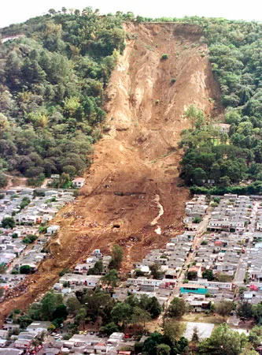
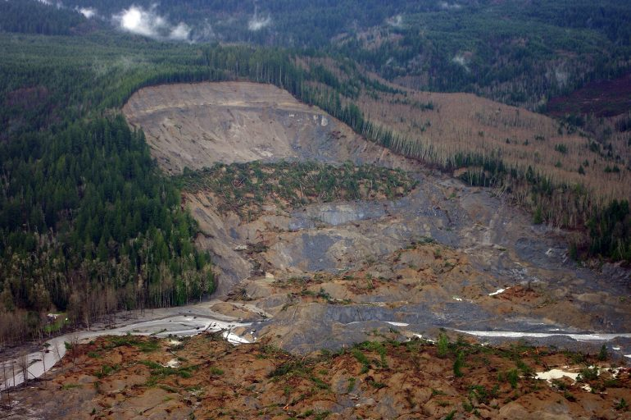
Causes
Landslides are the downslope movement of rock, debris, or earth due to gravity. They can be caused by a variety of factors, including:
Heavy rainfall: Heavy rainfall can saturate the ground, making it more likely to slide.
Earthquakes: Earthquakes can trigger landslides by shaking the ground and destabilizing slopes.
Volcanic eruptions: Volcanic eruptions can produce lahars, which are fast-moving flows of mud and debris.
Deforestation: Deforestation can remove trees and other vegetation that help to hold soil in place.
Human activity: Human activities such as mining, road construction, and irrigation can also contribute to landslides.

Slide 3
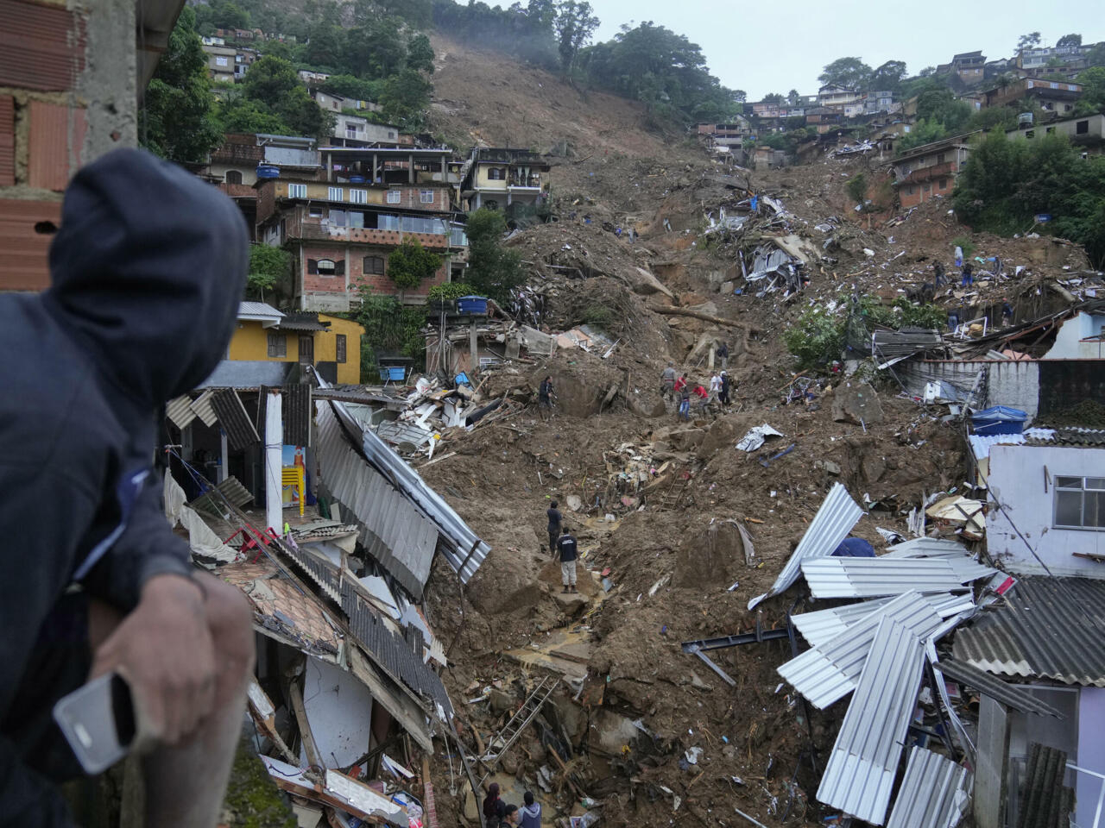
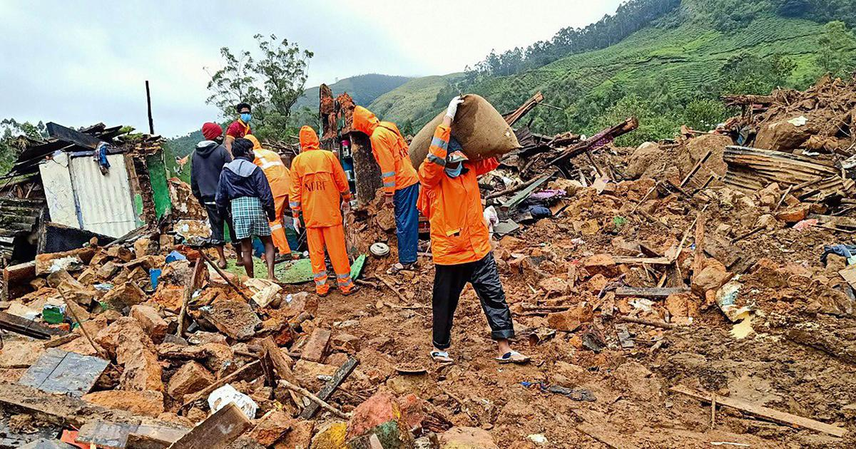
Human Impact
Landslides can have a devastating impact on human populations. They can lead to:
Loss of life: Landslides can bury people and homes, causing loss of life.
Injury: Landslides can injure people by throwing debris or collapsing buildings.
Homelessness: Landslides can damage or destroy homes, leaving people homeless.
Economic losses: Landslides can damage roads, bridges, and other infrastructure, leading to economic losses.
Disruption of essential services: Landslides can disrupt essential services such as water, electricity, and transportation.

Slide 4
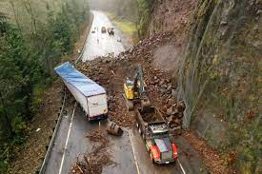
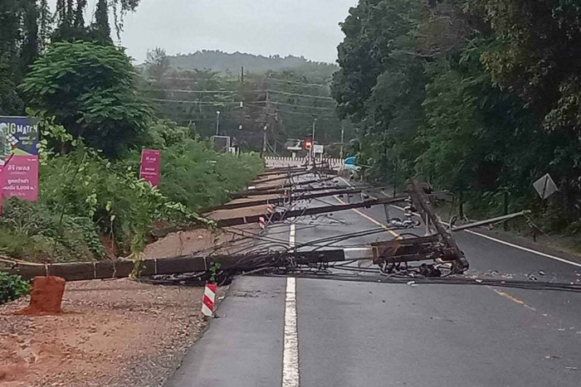
Resource Interruption
Landslides can interrupt the supply of essential resources, such as water, electricity, and transportation. This can have a significant impact on businesses, industries, and communities.
For example, landslides can damage water pipes and power lines, disrupting water and electricity supplies. They can also damage roads and bridges, making it difficult to transport people and goods.

Slide 5
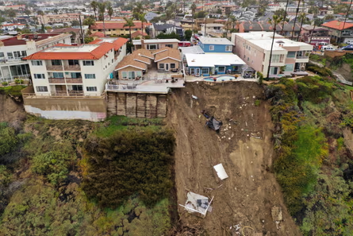
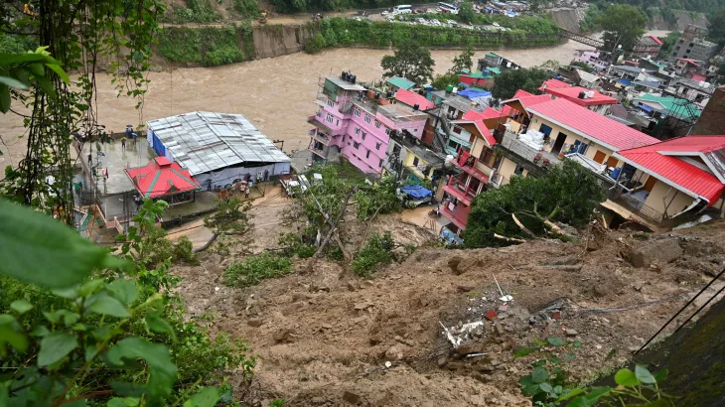
Loss to structure and property
Landslides can cause significant damage to structures and property. Buildings, bridges, roads, and other infrastructure can be damaged or destroyed by landslides. This can lead to billions of dollars in economic losses.

Slide 6
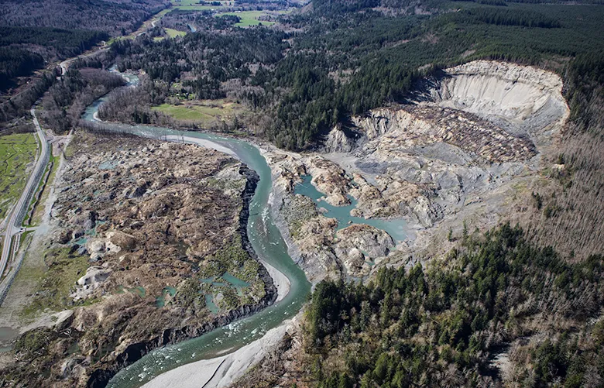
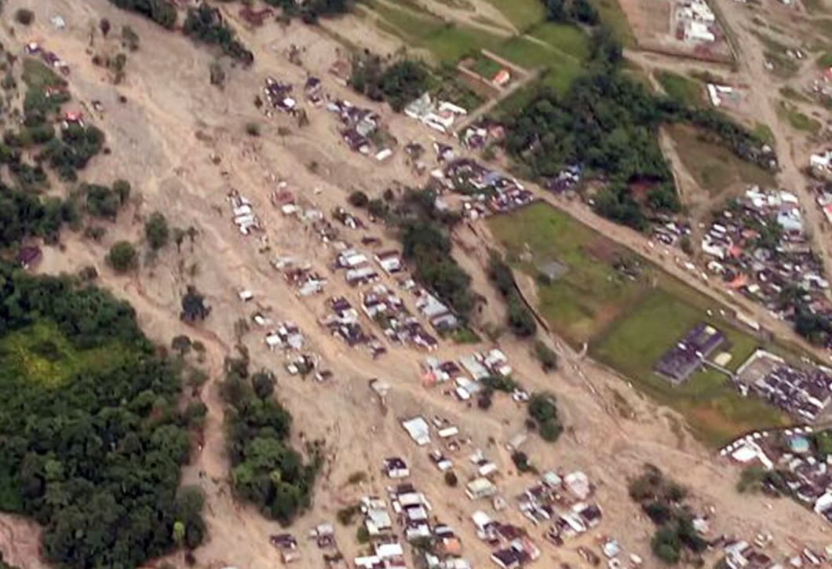
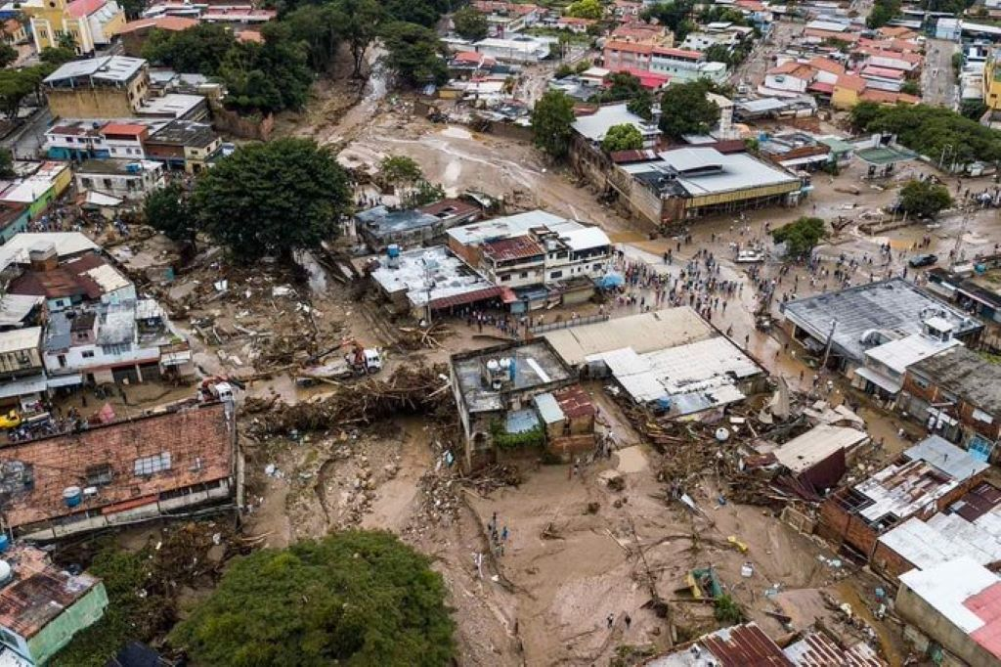
Real Examples
The 2015 Oso mudslide in Washington state killed 43 people and destroyed over 40 homes.
The 2018 Mocoa mudslide in Colombia killed over 317 people and buried hundreds of homes.
The 2020 Las Tejerías mudslide in Venezuela killed over 50 people and damaged or destroyed over 10,000 homes.

Slide 7
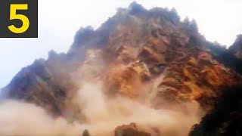
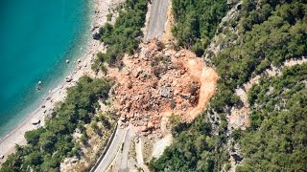
News/Video

Slide 8
Statistics
Every year, landslides in the U.S. cause roughly $3.5 billion in damage and kill between 25 and 50 people.[5]
It is not just on earth in which landslides occur. Throughout the solar system there has been evidence that landslides have occurred, on Mars and Venus specifically. Scientists have had trained satellites orbiting the planets to view the landslides[8]
The May 1980 eruption of Mount St. Helens caused the largest landslide in history. A rockslide debris avalanche large enough to fill 250 million dump trucks to the brim traveled about 14 miles, destroying, amoung many things, nine highway bridges.[9]
On steep hillsides, debris flows begin as shallow landslides that liquefy and accelerate. A typical landslide travels at 10 miler per hour, but can exceed 35 miles per hour.[11]

Slide 9
Resources/Links

Slide 10

3D-RST is supported by the NSF under grant number #DRL-2101383

