Slide 1
Flood
Natural Disaster
A flood as a natural disaster is defined as an overflow of water that submerges land that is usually dry, caused by natural phenomena such as heavy rainfall, rapid snowmelt, storm surge, or dam or levee failure.

Slide 2
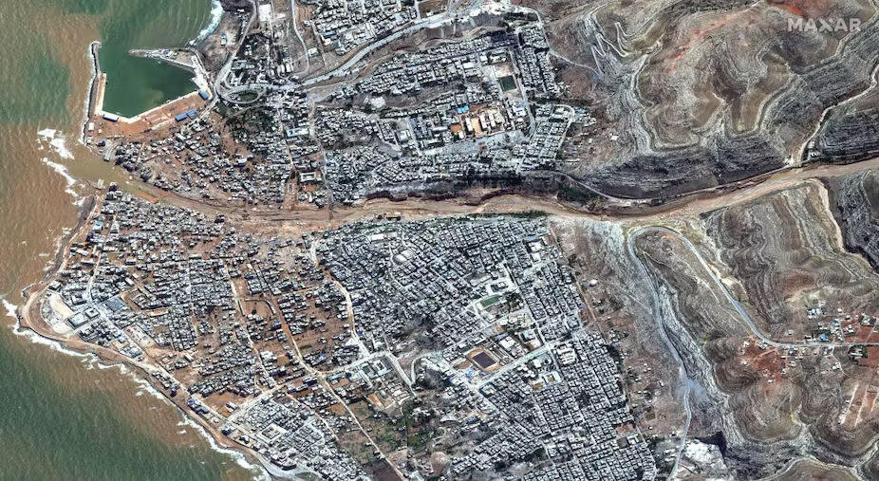
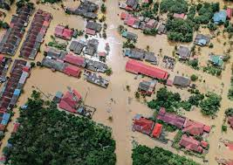
Causes
Floods are the most common natural disaster in the world. They can be caused by a variety of factors, including:
Heavy rainfall: Floods are most commonly caused by heavy rainfall, which can overwhelm rivers, streams, and drainage systems.
Rapid snowmelt: Floods can also be caused by rapid snowmelt, which can release a large amount of water in a short period of time.
Storm surge: Storm surge is a rise in sea level caused by a tropical cyclone or hurricane. Storm surge can cause flooding in coastal areas.
Dam or levee failure: If a dam or levee fails, it can release a large amount of water in a short period of time, causing a flood.

Slide 3
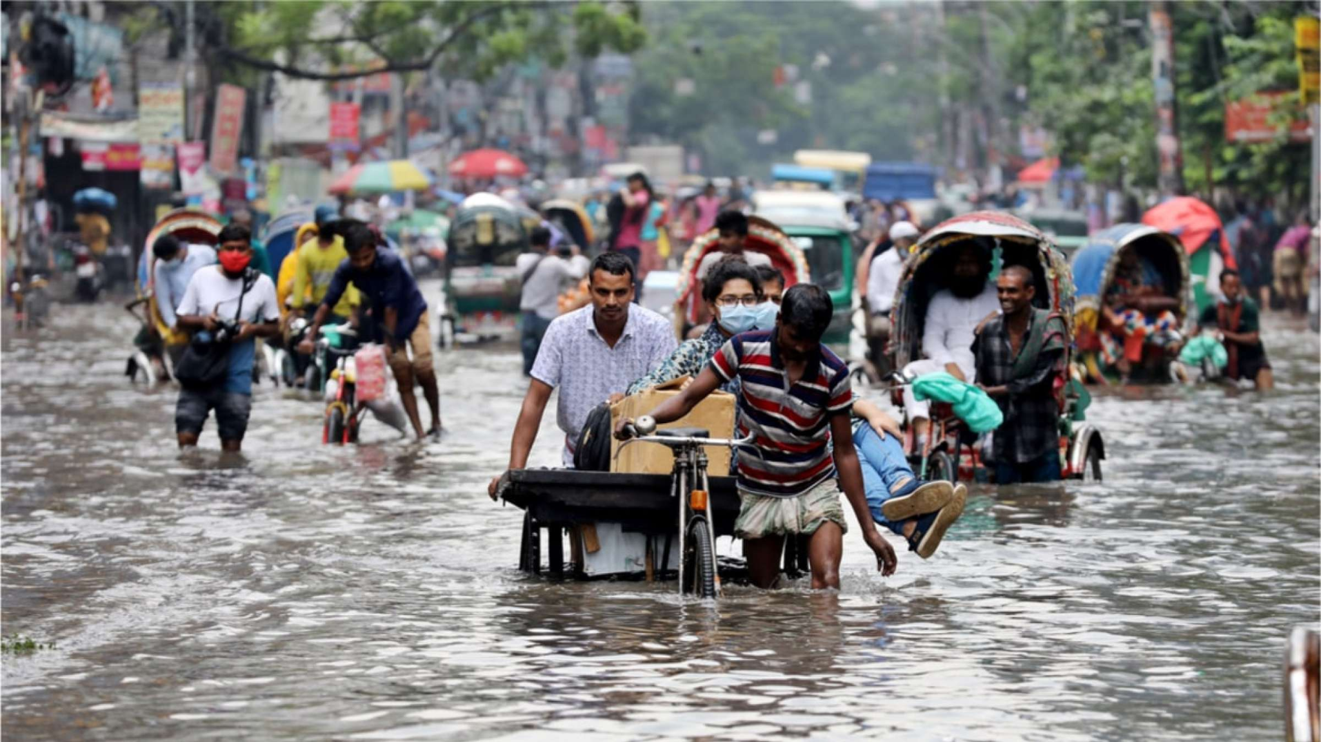

Human Impact
Floods can have a devastating impact on human populations. They can lead to:
Loss of life: Floods can cause people to drown or be swept away by floodwaters.
Injury: Floods can cause people to be injured by debris or by falling into floodwaters.
Homelessness: Floods can damage or destroy homes, leaving people homeless.
Disease: Floods can increase the risk of waterborne diseases, such as cholera and typhoid fever.
Economic losses: Floods can damage businesses and infrastructure, leading to economic losses.
Social unrest: Floods can disrupt communities and lead to social unrest.

Slide 4
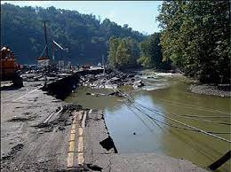
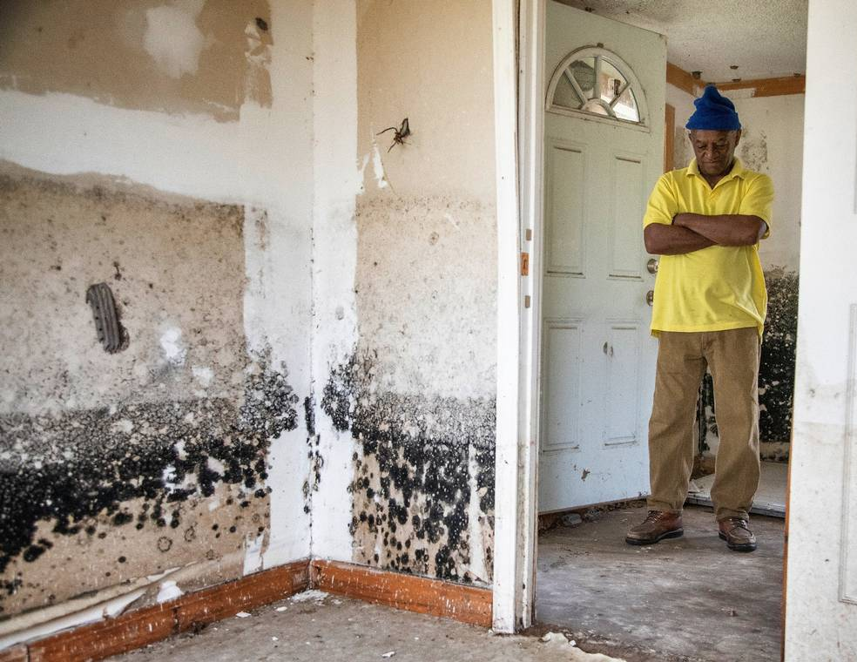
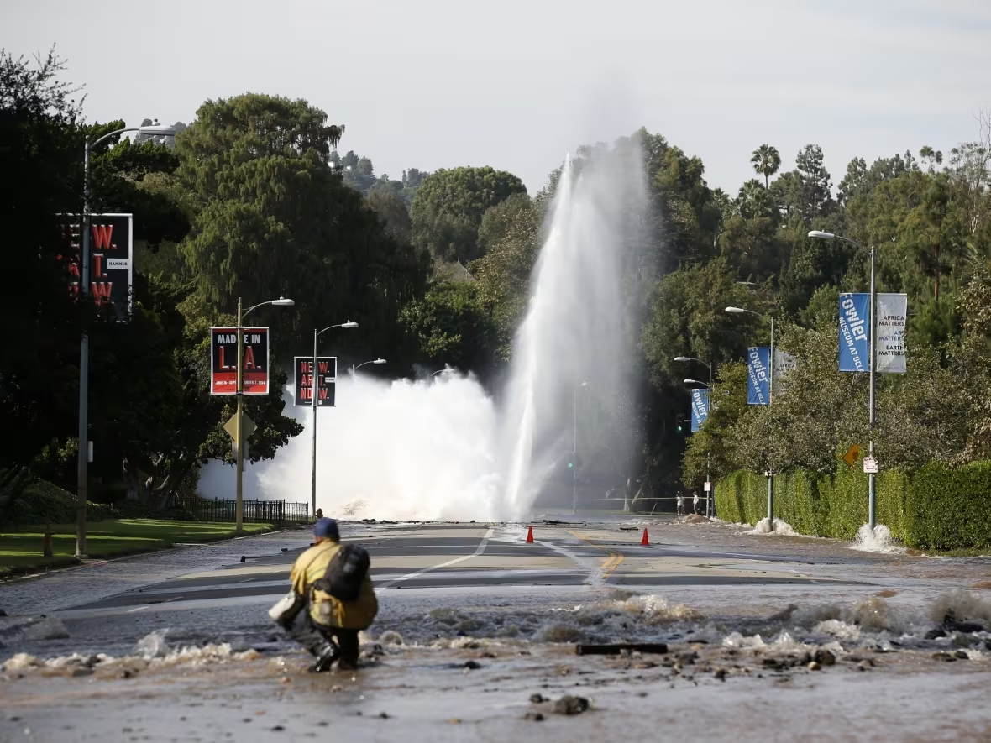
Resource Interruption
Floods can interrupt the supply of essential resources, such as water, electricity, and transportation. This can have a significant impact on businesses, industries, and communities.
For example, floods can damage water pipes and power lines, disrupting water and electricity supplies. They can also damage roads and bridges, making it difficult to transport people and goods.

Slide 5
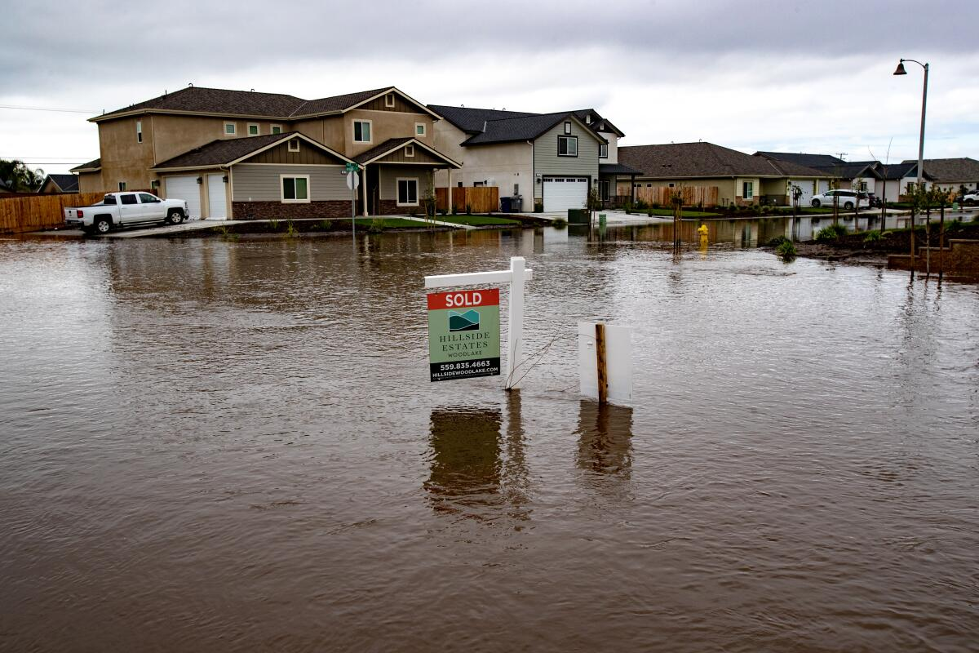
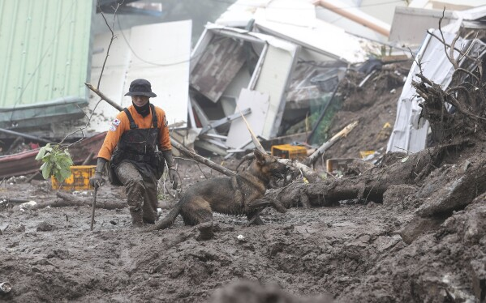
Loss to structure and property
Floods can cause significant damage to structures and property. Buildings, bridges, roads, and other infrastructure can be damaged or destroyed by floods. This can lead to billions of dollars in economic losses.

Slide 6
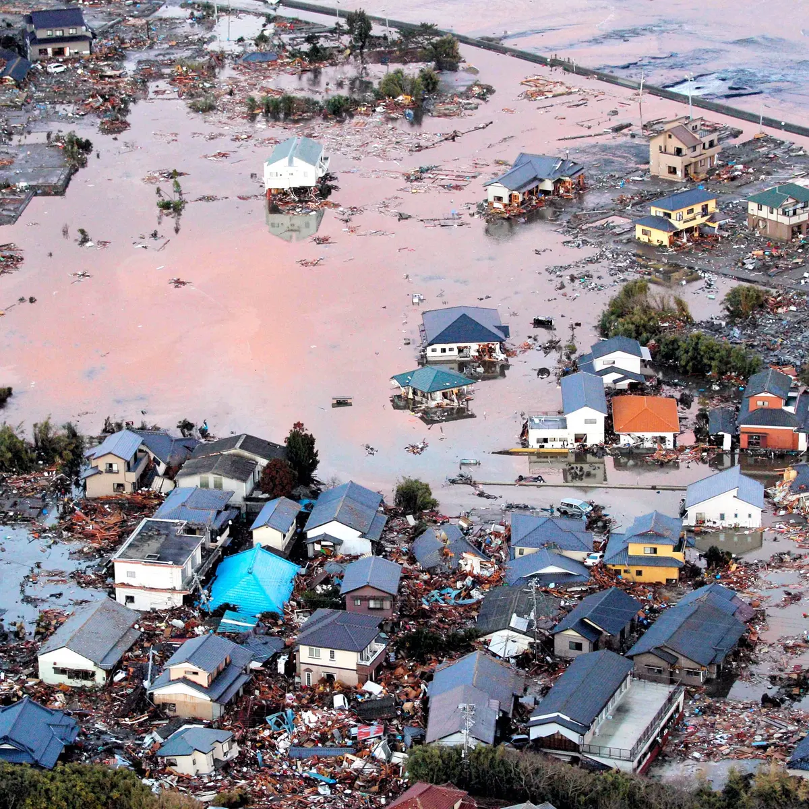
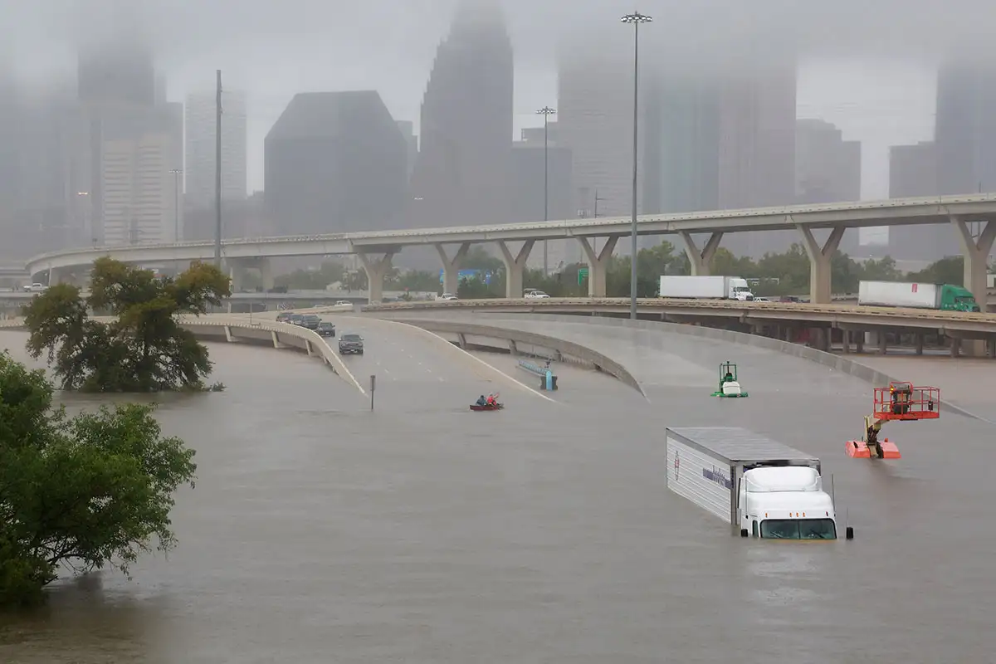
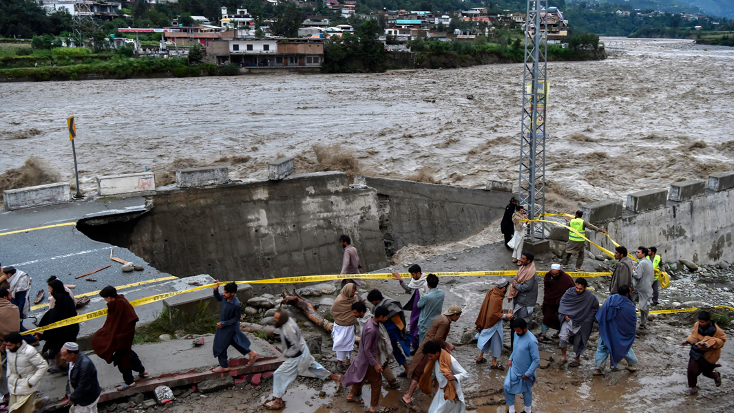
Real Examples
Here are some real examples of the devastating impacts of floods:
The 2011 Great East Japan Earthquake and Tsunami: The 2011 Great East Japan Earthquake and Tsunami caused widespread flooding in Japan. The tsunami waves reached heights of up to 133 feet and caused an estimated $300 billion in damage.
The 2017 Hurricane Harvey: Hurricane Harvey caused widespread flooding in Texas and Louisiana. The storm dumped up to 50 inches of rain in some areas, causing an estimated $125 billion in damage.
The 2022 Pakistan Floods: The 2022 Pakistan Floods were the worst floods in the country's history. The floods affected over 33 million people and caused an estimated $30 billion in damage.

Slide 7
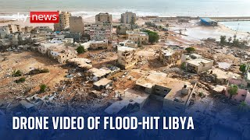
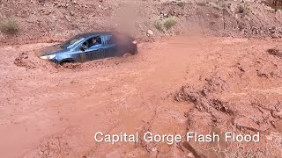
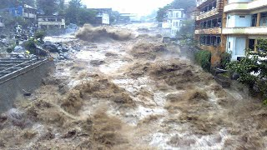
News/Video

Slide 8
Statistics
Flooding is the most common natural disaster in the world, accounting for 40% of all natural disasters.
Every year, floods affect over 250 million people worldwide.
Floods cause an estimated $10 billion in economic losses each year.
Asia is the most flood-prone continent in the world, accounting for 60% of all flood-related deaths.
Africa is the second most flood-prone continent in the world, accounting for 30% of all flood-related deaths.
The United States is the most flood-prone country in the developed world, with over $8 billion in flood damage each year.
In 2022, there were 176 flood disasters recorded in the United States.
In 2021, there were 222 flood disasters recorded in the United States, the second-highest figure recorded in the past 30 years.
The National Flood Insurance Program pays out an average of $1.5 billion in flood claims each year.
Only about 40% of homeowners in high-risk flood areas have flood insurance.
The US Federal Emergency Management Agency (FEMA) estimates that floods cause an average of $10 billion in damage to the United States each year. However, the actual cost of flooding is likely much higher, as it does not include indirect costs such as lost productivity and business disruption.

Slide 9
Resources/Links

Slide 10

3D-RST is supported by the NSF under grant number #DRL-2101383

