Slide 1
Extreme Heat
Natural Disaster
Extreme heat as a natural disaster is a period of high temperatures and humidity that is significantly hotter than average for a particular location.

Slide 2
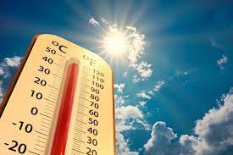
Causes
Extreme heat can be caused by a variety of factors, including:
Climate change: Climate change is the primary cause of extreme heat. As the planet warms, heat waves are becoming more frequent and severe.
Urban heat island effect: The urban heat island effect is a phenomenon in which urban areas are hotter than surrounding rural areas. This is because urban areas have more pavement and less vegetation, which absorbs and traps heat.
Heat waves: Heat waves are periods of abnormally high temperatures that can persist for days or even weeks.
Natural variability in climate: Natural variability in climate can also lead to extreme heat events. For example, El Niño can cause prolonged periods of drought and heat in the southwestern United States.

Slide 3
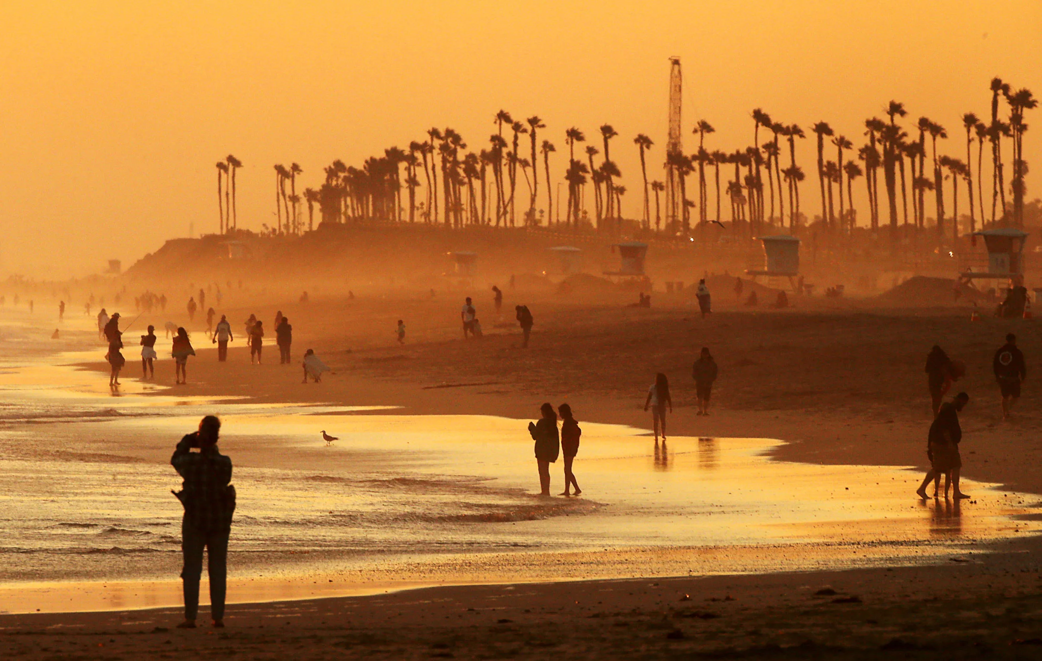
Human Impact
Extreme heat can have a devastating impact on human health. It can lead to a variety of heat-related illnesses, including:
Heatstroke: Heatstroke is the most serious heat-related illness. It can occur when the body is unable to cool itself down, and it can lead to death.
Heat exhaustion: Heat exhaustion is a less serious heat-related illness, but it can still be dangerous. It can cause symptoms such as dizziness, nausea, and vomiting.
Heat cramps: Heat cramps are painful muscle contractions that can occur in the legs, abdomen, and arms.
Extreme heat can also exacerbate existing health conditions, such as heart disease, respiratory problems, and mental health issues.

Slide 4
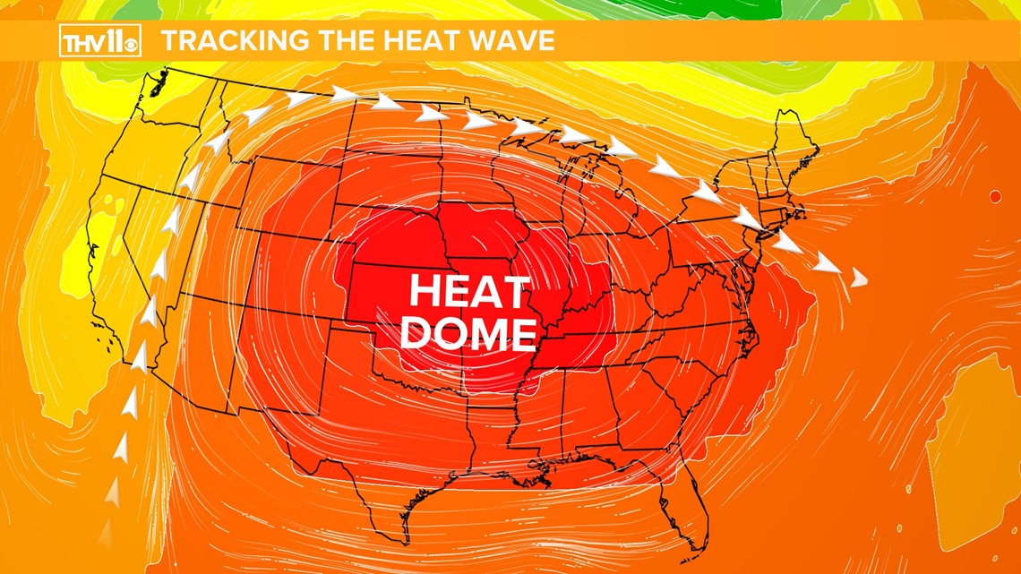
Resource Interruption
Extreme heat can also disrupt essential services, such as water and electricity. This is because extreme heat can increase demand for water and electricity, and it can also damage infrastructure.
For example, extreme heat can lead to water shortages if demand for water exceeds supply. Extreme heat can also damage power lines, leading to power outages.

Slide 5

Loss to structure and property
Extreme heat can also damage structures and property. For example, extreme heat can cause roads to buckle and buildings to expand and contract, which can lead to cracking and other damage. Extreme heat can also increase the risk of wildfires, which can damage or destroy homes and businesses.

Slide 6

Real Examples
Here are some real examples of the devastating impacts of extreme heat as a natural disaster:
The 2003 European heat wave caused over 70,000 deaths.
The 2010 Russian heat wave caused over 55,000 deaths.
The 2021 Pacific Northwest heat wave caused over 1,000 deaths in the United States and Canada.

Slide 7
News/Video
https://www.cnn.com/2023/08/01/weather/phoenix-us-heatwave-streak-climate/index.html
https://www.france24.com/en/europe/20230710-europe-s-summer-2022-heatwaves-killed-61-000-people

Slide 8
Resources/Links

Slide 9
Statistics (if not covered in AI article)
In 2004, 297 Americans died from excessive natural heat, the lowest figure recorded over the past two decades. In 2018, 1,008 Americans died as a direct result of heat exposure. But in 2021, heat-related deaths increased to 1,600, a 59% uptick from only four years earlier, and a 439% increase from 2004.

Slide 10

3D-RST is supported by the NSF under grant number #DRL-2101383

