Slide 1
Earthquake
Natural Disaster
An earthquake is a sudden shaking of the Earth's crust caused by the release of energy. This energy can be released by the movement of tectonic plates, volcanic eruptions, or landslides.

Slide 2
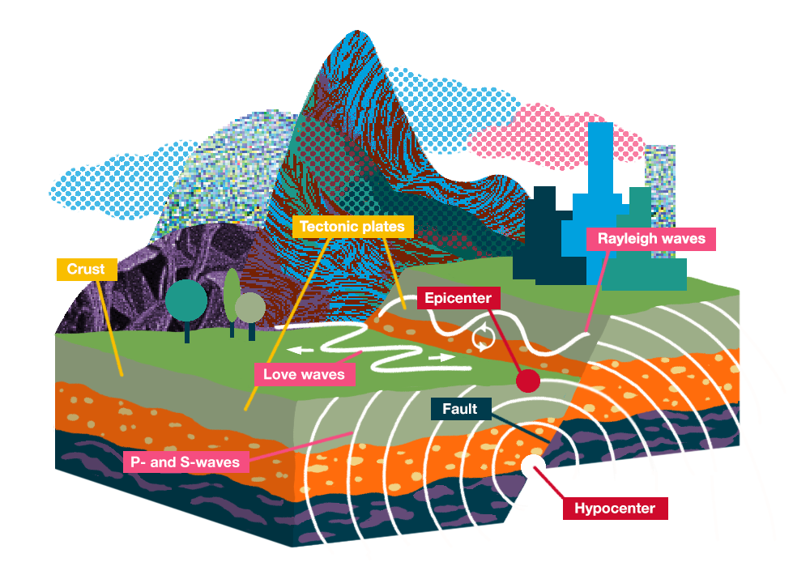
Causes
Causes
Earthquakes are caused by the sudden release of energy in the Earth's crust. This energy can be released by the movement of tectonic plates, volcanic eruptions, or landslides.
The Earth's crust is made up of tectonic plates, which are constantly moving. When two tectonic plates collide, one plate may be forced under the other. This process is called subduction. As the plate sinks deeper into the Earth's mantle, it melts and releases water vapor. This water vapor lowers the melting point of the surrounding rocks, causing them to melt and become magma. The magma then rises to the surface and erupts as lava.
Volcanic eruptions can also cause earthquakes. When a volcano erupts, the pressure inside the volcano is suddenly released. This can cause the ground to shake violently.
Landslides can also cause earthquakes. When a landslide occurs, a large mass of rock or soil slides down a slope. This can cause the ground to shake and can also damage buildings and infrastructure.

Slide 3
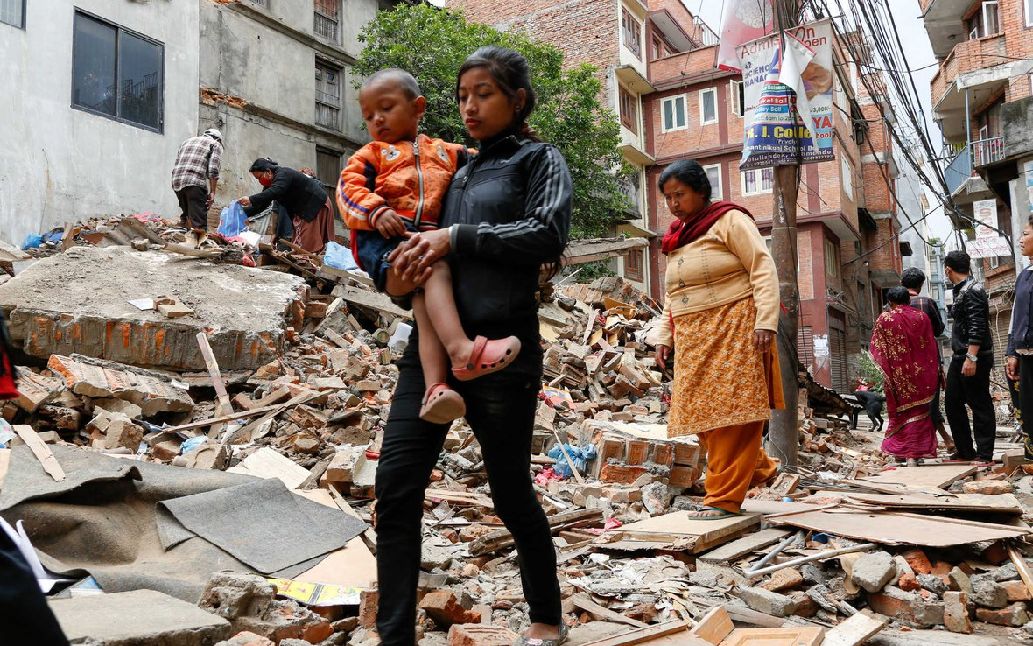
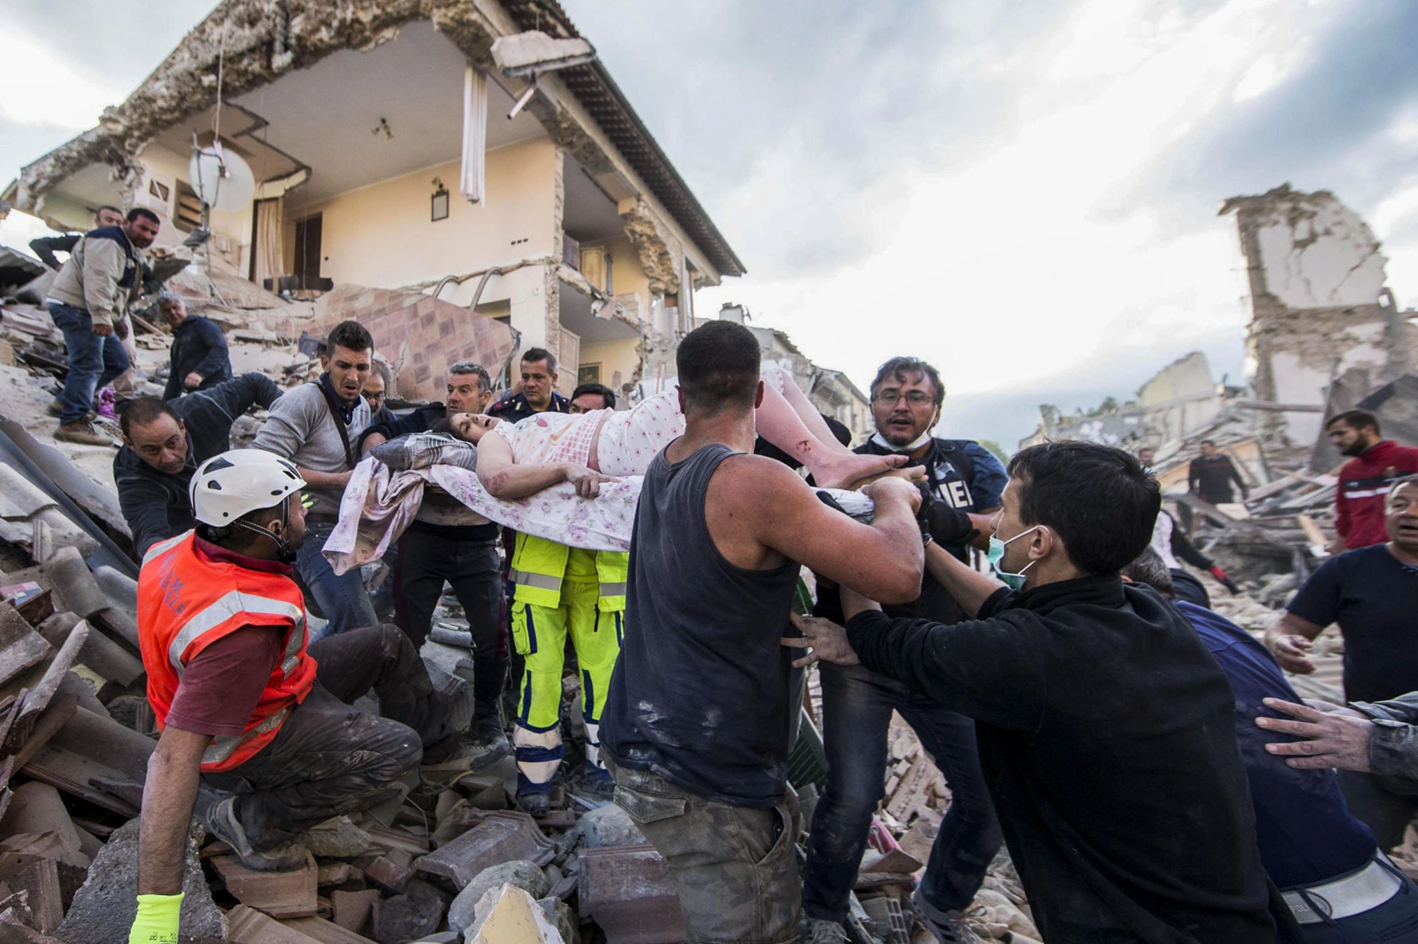
Human Impact
Earthquakes can have a devastating impact on human populations. They can lead to:
Death and injury: Earthquakes can cause buildings to collapse and can also trigger landslides and tsunamis. These events can lead to death and injuries.
Homelessness: Earthquakes can damage or destroy homes, leaving people homeless.
Economic losses: Earthquakes can damage businesses and infrastructure, leading to economic losses.
Social unrest: Earthquakes can disrupt communities and lead to social unrest.

Slide 4
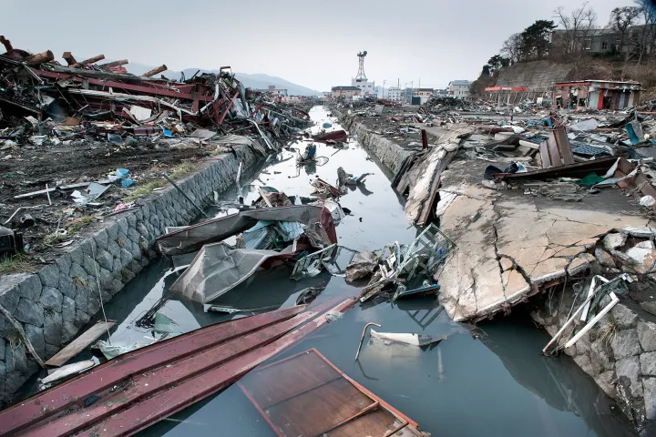
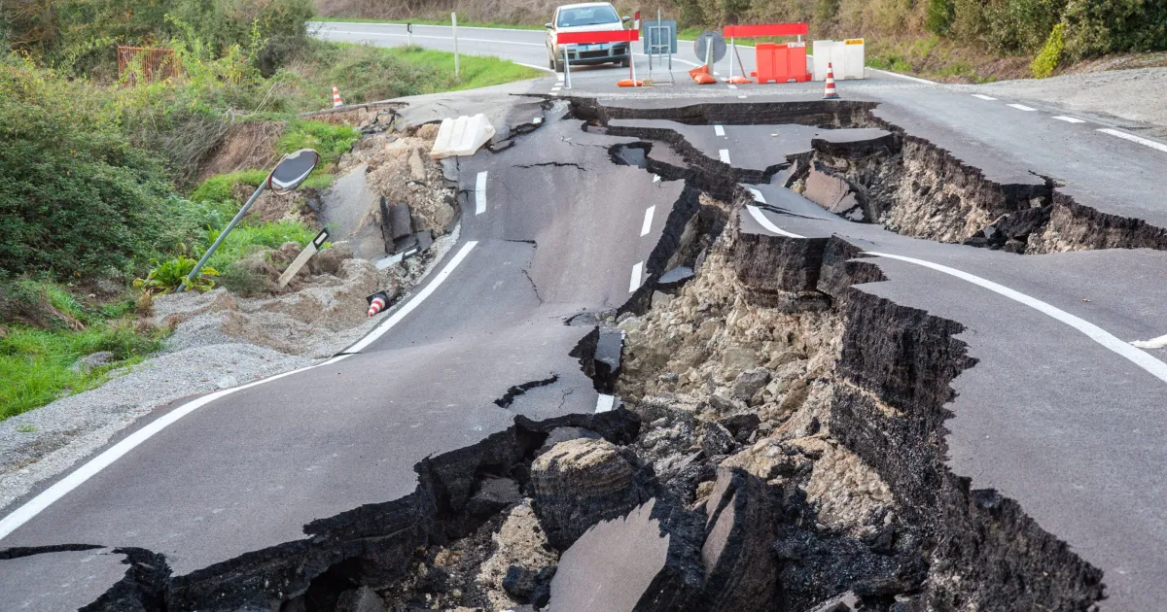
Resource Interruption
Earthquakes can interrupt the supply of essential resources, such as water, electricity, and transportation. This can have a significant impact on businesses, industries, and communities.
For example, earthquakes can damage water pipes and power lines, disrupting water and electricity supplies. They can also damage roads and bridges, making it difficult to transport people and goods.

Slide 5
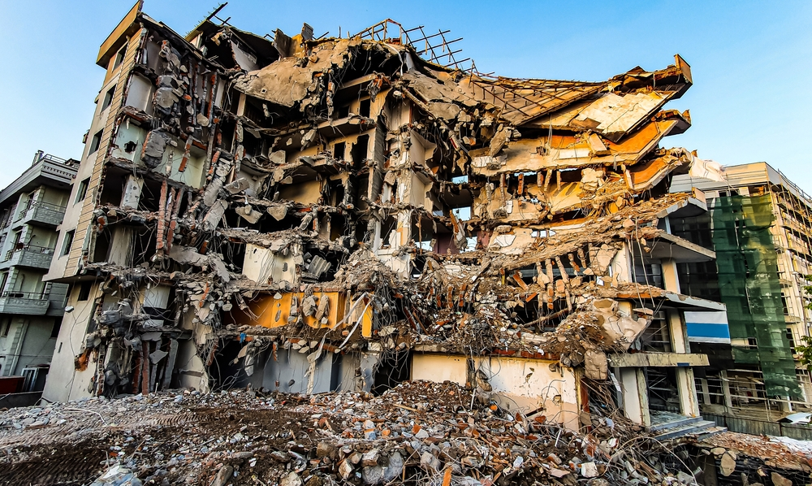
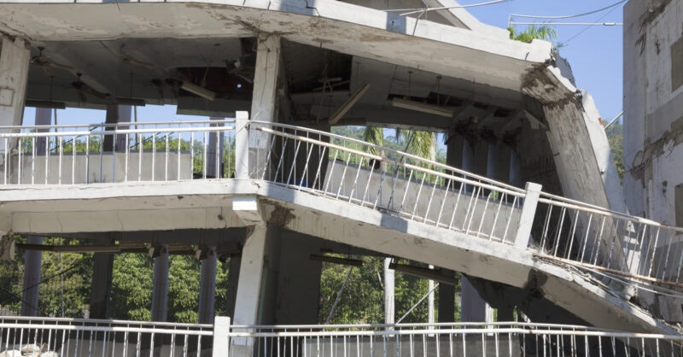
Loss to structure and property
Earthquakes can cause significant damage to structures and property. Buildings, bridges, roads, and other infrastructure can be damaged or destroyed by earthquakes. This can lead to billions of dollars in economic losses.

Slide 6
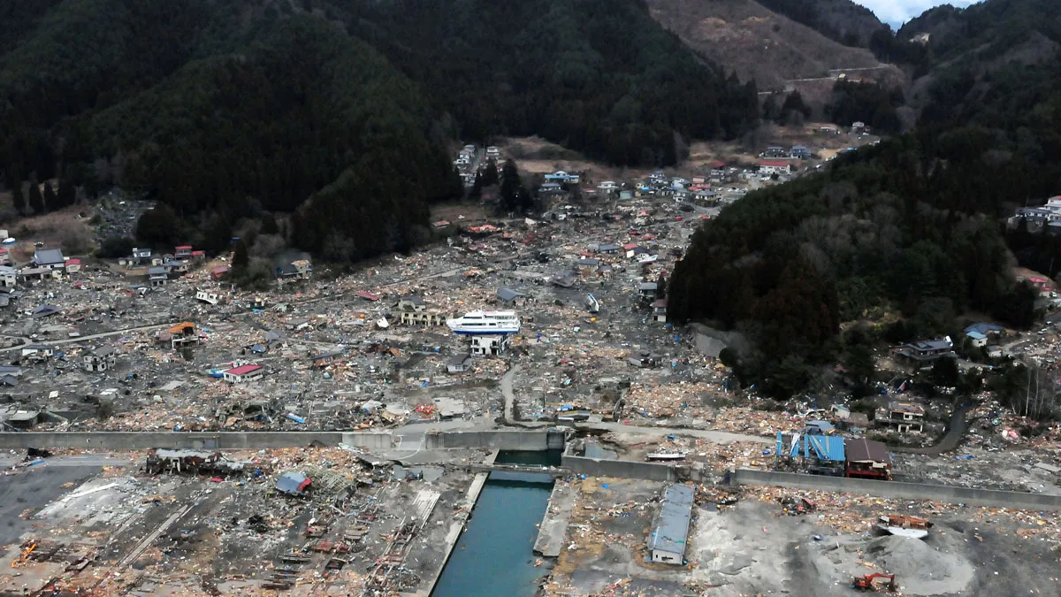
Real Examples
Here are some real examples of the devastating impacts of earthquakes:
The 2011 Tōhoku earthquake and tsunami: The 2011 Tōhoku earthquake and tsunami was one of the most powerful earthquakes in recorded history. It caused a massive tsunami that devastated the coast of Japan. The earthquake and tsunami killed over 15,000 people and caused over $300 billion in damage.
The 2010 Haiti earthquake: The 2010 Haiti earthquake was a magnitude 7.0 earthquake that struck Haiti on January 12, 2010. The earthquake killed over 220,000 people and caused over $10 billion in damage.
The 2004 Indian Ocean earthquake and tsunami: The 2004 Indian Ocean earthquake and tsunami was a magnitude 9.1 earthquake that struck off the coast of Sumatra, Indonesia on December 26, 2004. The earthquake triggered a tsunami that devastated the coastlines of Indonesia, Sri Lanka, Thailand, India, and other countries. The earthquake and tsunami killed over 230,000 people.

Slide 7
News/Video
https://www.cnn.com/2023/02/07/middleeast/earthquake-turkey-syria-why-deadly-intl/index.html
https://www.reuters.com/world/asia-pacific/magnitude-63-earthquake-strikes-northwestern-afghanistan-gfz-2023-10-11/

Slide 8
Resources/Links

Slide 9
Statistics (if not covered in AI article)

Slide 10

3D-RST is supported by the NSF under grant number #DRL-2101383

