Slide 1
Drought
Natural Disaster
A drought is a period of abnormally dry weather that persists long enough to cause serious hydrological imbalance in the affected area. It is characterized by a lack of precipitation, which can lead to reduced soil moisture, groundwater, stream flow, crop damage, and a general water shortage.

Slide 2
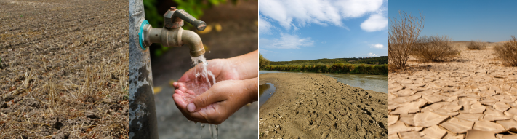
Causes
Drought is a prolonged period of abnormally low rainfall, leading to a shortage of water. It is a natural disaster that can be caused by a variety of factors, including:
Natural variability in climate: Droughts can occur naturally due to changes in weather patterns, such as El Niño and La Niña.
Climate change: Climate change is making droughts more frequent and severe. As global temperatures rise, more water evaporates from the land and oceans, leading to drier conditions.
Human activity: Human activities such as deforestation, overgrazing, and excessive water use can also contribute to drought.

Slide 3
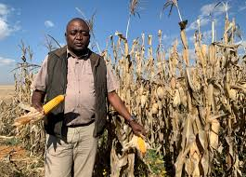
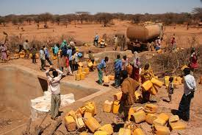
Human Impact
Drought can have a devastating impact on human populations. It can lead to:
Food shortages: Drought can damage crops and livestock, leading to food shortages and malnutrition.
Water scarcity: Drought can reduce water supplies for drinking, irrigation, and sanitation. This can lead to waterborne diseases and health problems.
Economic hardship: Drought can damage crops and livestock, leading to economic losses for farmers and ranchers. It can also disrupt businesses and industries that rely on water.
Social unrest: Drought can lead to conflict and social unrest over scarce resources. It can also displace people from their homes and communities.

Slide 4
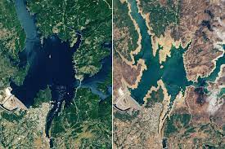
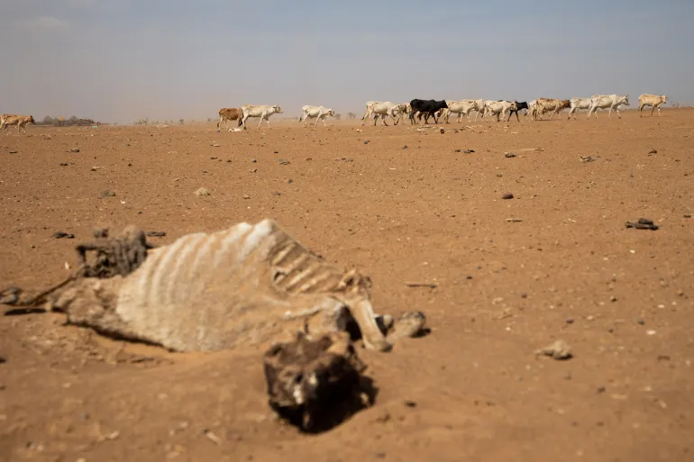
Resource Interruption
Earthquakes can interrupt the supply of essential resources, such as water, electricity, and transportation. This can have a significant impact on businesses, industries, and communities.
For example, earthquakes can damage water pipes and power lines, disrupting water and electricity supplies. They can also damage roads and bridges, making it difficult to transport people and goods.

Slide 5
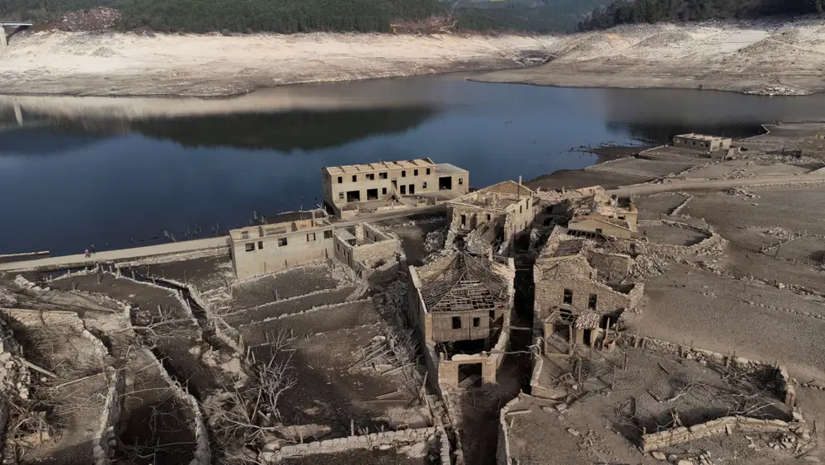
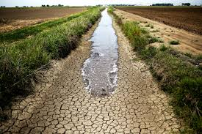
Loss to structure and property
Drought can also lead to loss of structure and property. For example, drought can cause the ground to shrink and crack, damaging buildings and roads. It can also lead to wildfires, which can destroy homes and businesses.

Slide 6
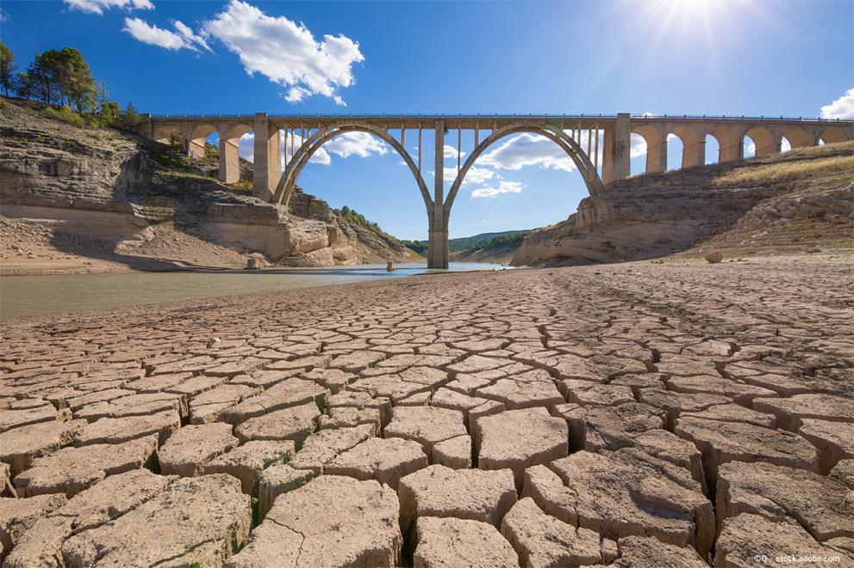
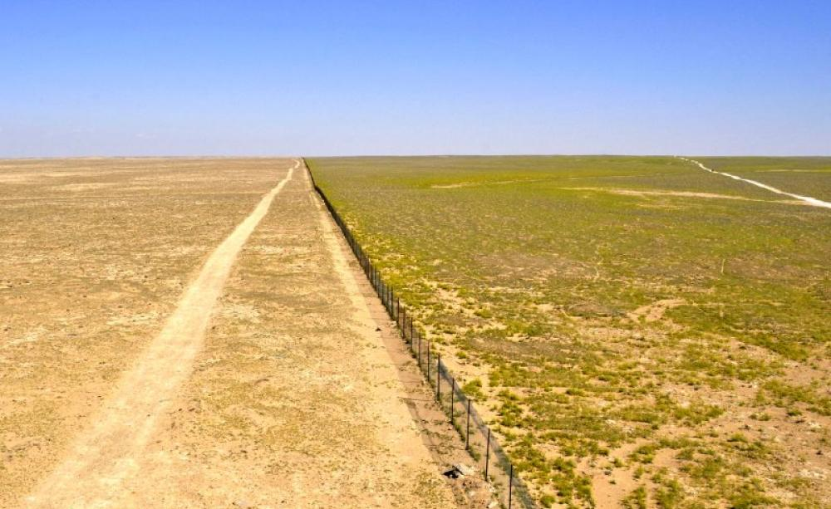
Real Examples
Here are some real examples of the devastating impacts of drought:
The California Drought (2012-2016): The California Drought was one of the worst droughts in the state's history. It led to widespread water shortages, crop failures, and wildfires. The drought also had a significant economic impact, costing the state billions of dollars.
The East African Drought (2011-2012): The East African Drought was one of the most severe droughts in the region in decades. It affected millions of people and led to a food crisis. The drought also exacerbated conflict and instability in the region.
The Syrian Civil War (2011-present): The Syrian Civil War is one of the deadliest conflicts in recent history. Drought has been a major contributing factor to the conflict. The drought has led to food shortages and economic hardship, which has displaced millions of people and fueled social unrest.

Slide 7
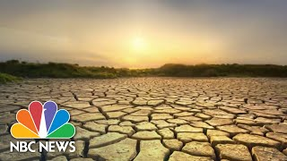
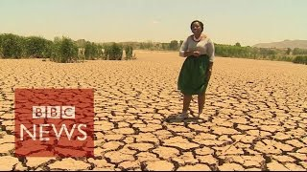
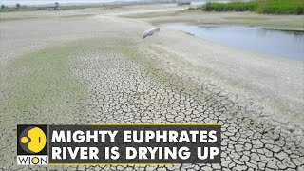
News/Video

Slide 8
Resources/Links

Slide 9
Statistics
Since 2000, the number and duration of droughts has risen 29%
From 1970 to 2019, weather, climate and water hazards accounted for 50% of disasters and 45% of disaster-related deaths, mostly in developing countries
Droughts represent 15% of natural disasters but took the largest human toll, approximately 650,000 deaths from 1970-2019
From 1998 to 2017, droughts caused global economic losses of roughly USD 124 billion
In 2022, more than 2.3 billion people face water stress; almost 160 million children are exposed to severe and prolonged droughts

Slide 10

3D-RST is supported by the NSF under grant number #DRL-2101383

