Slide 1
Blizzards
Natural Disaster
Blizzards can occur in any region that experiences cold winters, but they are most common in temperate and polar regions, as well as high mountains. Blizzards can cause significant damage to property and infrastructure, and can be deadly for people who are caught outdoors or who do not have adequate shelter.

Slide 2
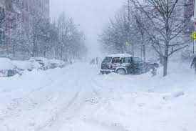
Causes of Blizzard Disasters
Blizzards are severe winter storms that combine blowing snow and strong winds, resulting in low visibility. They are typically caused by a combination of factors, including:
A large, cold air mass
A strong area of low pressure
A warm conveyor belt of moist air
A sharp temperature gradient between the warm and cold air masses
These conditions can create strong winds that pick up snow and blow it around, creating whiteout conditions.

Slide 3
Human Impact of Blizzard Disasters
Blizzards can have a significant impact on human populations, both directly and indirectly. Some of the most common human impacts of blizzards include:
Loss of life: Blizzards can be deadly, especially for people who are caught outdoors or who do not have adequate shelter.
Injury: Blizzards can cause injuries from hypothermia, frostbite, and snowplow accidents.
Power outages: Blizzards can damage power lines and cause widespread power outages. This can lead to problems with heating, cooling, and communication.
Transportation disruptions: Blizzards can make roads and highways impassable, disrupting travel and commerce.
Economic losses: Blizzards can cause billions of dollars in economic losses each year due to damage to property, lost productivity, and increased healthcare costs.

Slide 4
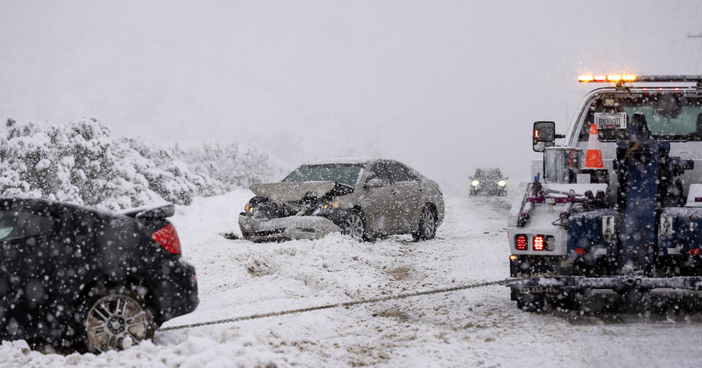
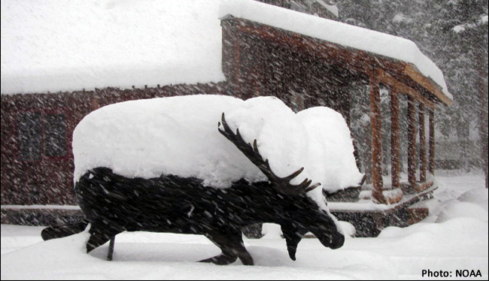
Resource Interruption
Blizzards can interrupt the supply of essential resources, such as electricity, food, and water. This can be a serious problem, especially for people who are elderly, disabled, or have other health conditions.

Slide 5
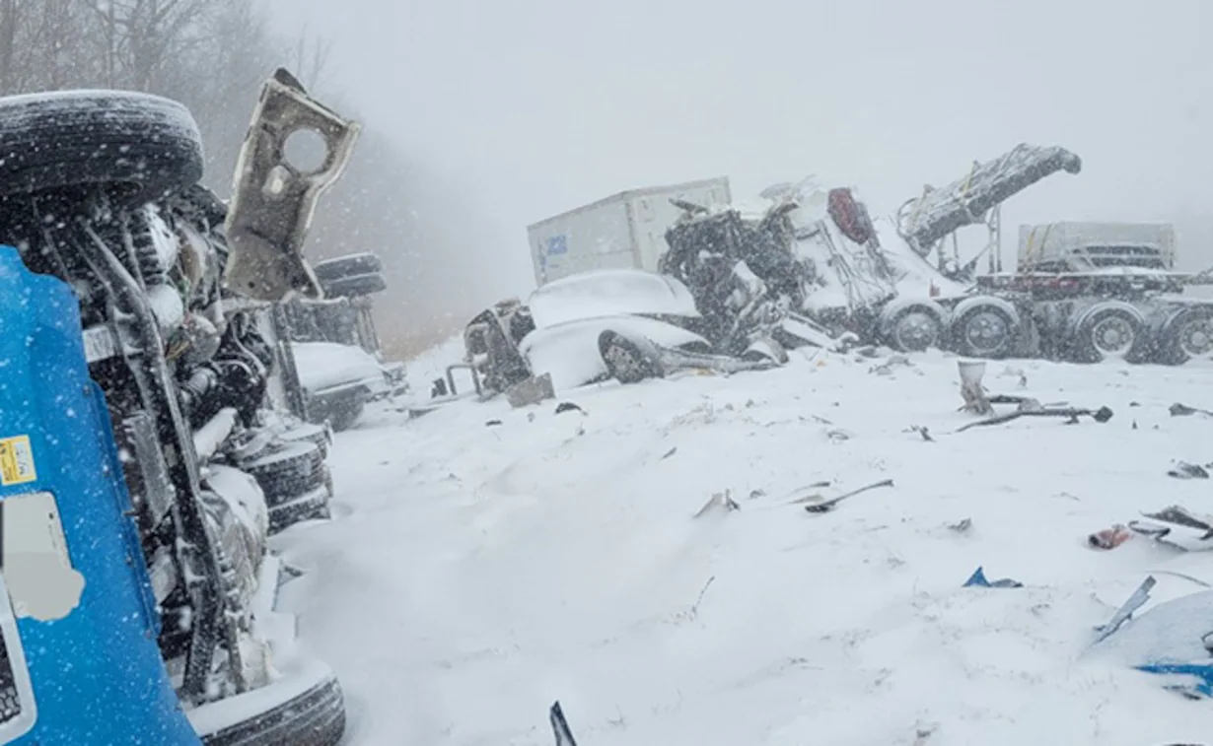
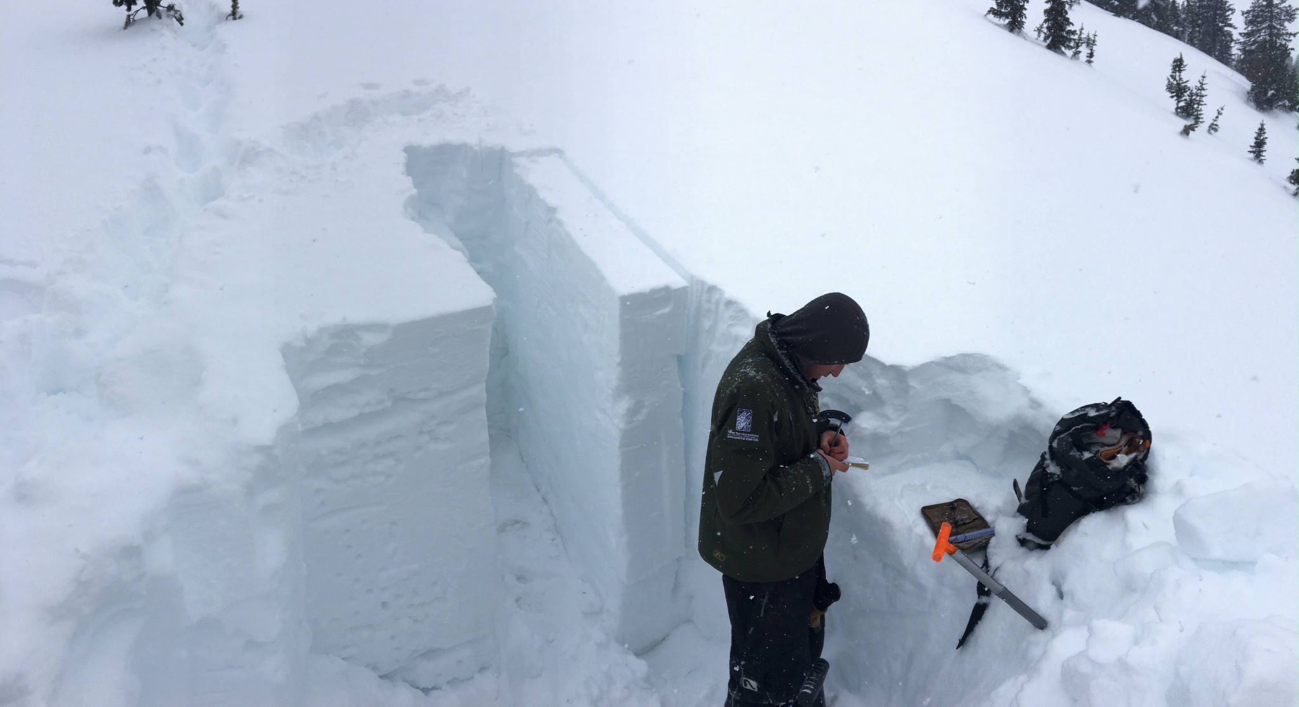
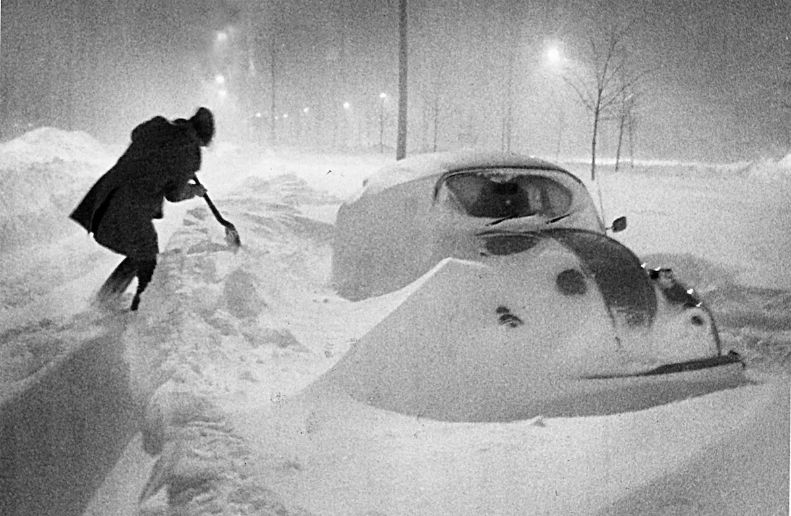
Loss to Structure and Property
Blizzards can cause significant damage to structures and property. Heavy snowfall can collapse roofs, and strong winds can damage power lines, trees, and other structures. Blizzards can also cause flooding if heavy snow melts rapidly.

Slide 6
Real-World Examples
Some of the most notable blizzards in recent history include:
The North American Blizzard of 1977: This blizzard caused widespread damage and power outages across the eastern United States and Canada, killing over 100 people.
The Iran Blizzard of 1978: This blizzard killed over 4,000 people, making it one of the deadliest blizzards in recorded history.
The Blizzard of 2013: This blizzard caused widespread damage and power outages across the northeastern United States, killing over 30 people.
The Bomb Cyclone of 2018: This blizzard caused extensive flooding and damage in the northeastern United States, killing over 20 people.

Slide 7
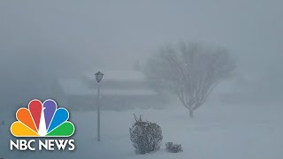
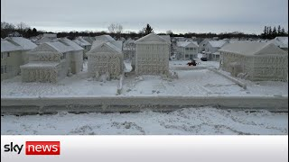
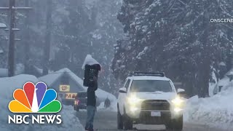
News/Video
https://apnews.com/article/california-snowstorm-stranded-blizzard-rescue-shovel-64156f6065c78d5b356c933b82ab7084

Slide 8
Statistics
Life loss:
The National Weather Service estimates that blizzards kill an average of 35 people each year in the United States.
The deadliest blizzard on record occurred in 1978 in Iran, killing over 4,000 people.
Other notable blizzards that caused significant loss of life include the North American Blizzard of 1977 (over 100 deaths) and the Blizzard of 1996 (over 150 deaths).
Property loss:
Blizzards can cause billions of dollars in property damage each year.
In 2022, blizzards caused nearly $6 billion in insured losses in the United States, the second-highest year on record for winter storm insured losses in the last ten years, according to Aon.
The third costliest winter event since 1950 occurred in December 2022, amounting to $3.5 billion insured losses.
Common types of property damage caused by blizzards include collapsed roofs, downed power lines, and flooding.
In addition to the direct loss of life and property, blizzards can also have a significant indirect impact on communities. For example, blizzards can disrupt transportation and commerce, lead to power outages, and interrupt the supply of essential resources. This can have a negative impact on the economy and quality of life for residents.

Slide 9
Resources/Links
National Oceanic and Atmospheric Administration (NOAA): https://www.noaa.gov/
National Weather Service (NWS): https://www.weather.gov/

Slide 10

3D-RST is supported by the NSF under grant number #DRL-2101383

