Slide 1
Agricultural Disease/Pests
Agricultural diseases and pests are a major threat to global food security. They can cause significant crop losses, reduce livestock productivity, and disrupt agricultural production systems. In severe cases, they can lead to famine and other humanitarian crises.

Slide 2
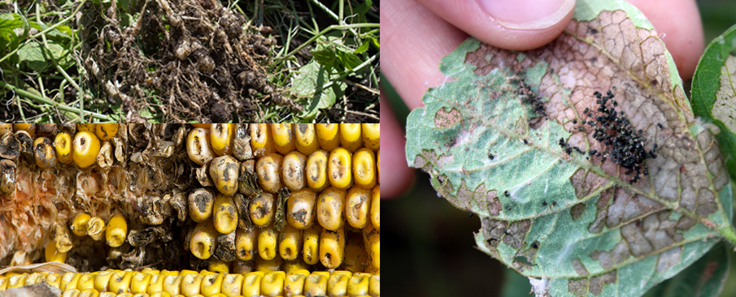
Agricultural disease is any condition that harms a plant or animal and reduces its productivity or yield. Agricultural diseases can be caused by a variety of pathogens, including fungi, bacteria, viruses, nematodes, and mycoplasmas.
Agricultural pests are any organisms that feed on or damage plants or animals, reducing their productivity or yield. Agricultural pests can include insects, mites, weeds, and diseases.
Examples of agricultural diseases:
Late blight of potato
Wheat rust
Citrus greening
Foot and mouth disease
Avian influenza
Examples of agricultural pests:
Boll weevil
Corn earworm
Soybean aphid
Japanese beetle
Locusts
Agricultural diseases and pests can have a devastating impact on farmers, ranchers, and consumers. They can cause crop losses, livestock mortality, and economic hardship. Agricultural diseases and pests can also pose a threat to human health and well-being.

Slide 3
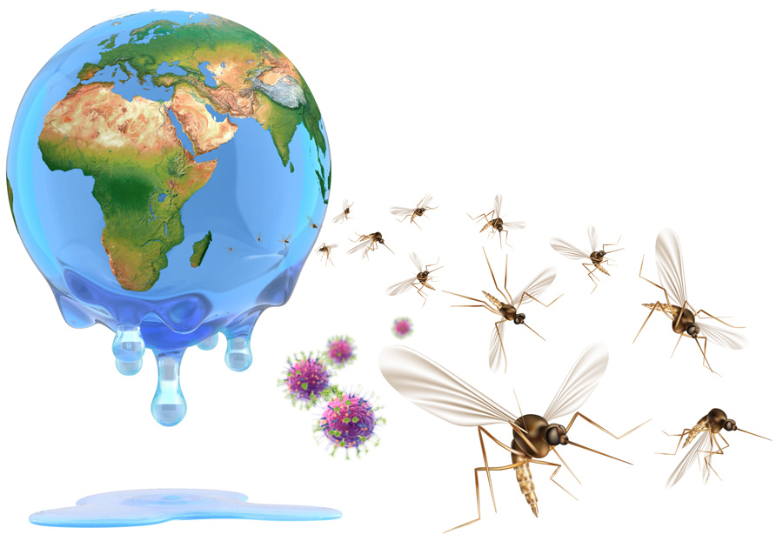
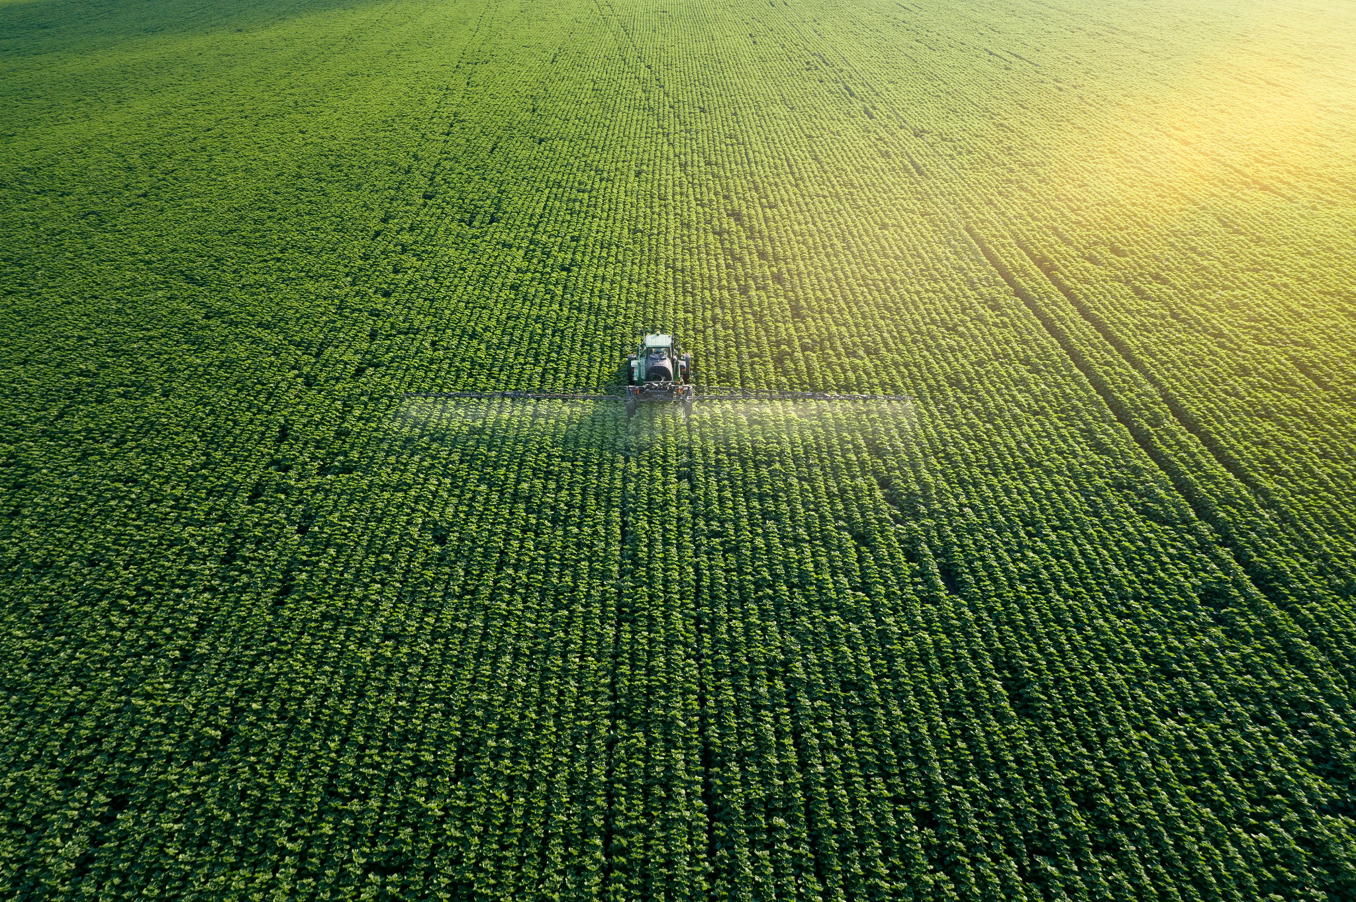
Causes:
Agricultural diseases and pests can be caused by a variety of factors, including:
Climate change: Climate change is creating conditions that are more favorable to the spread of agricultural diseases and pests. For example, warmer temperatures and more extreme weather events can increase the incidence of pests and diseases.
Global trade: Global trade can facilitate the spread of agricultural diseases and pests from one country to another.
Intensive agriculture: Intensive agricultural practices, such as monocropping and the overuse of pesticides, can create conditions that are more favorable to the development of pests and diseases.

Slide 4
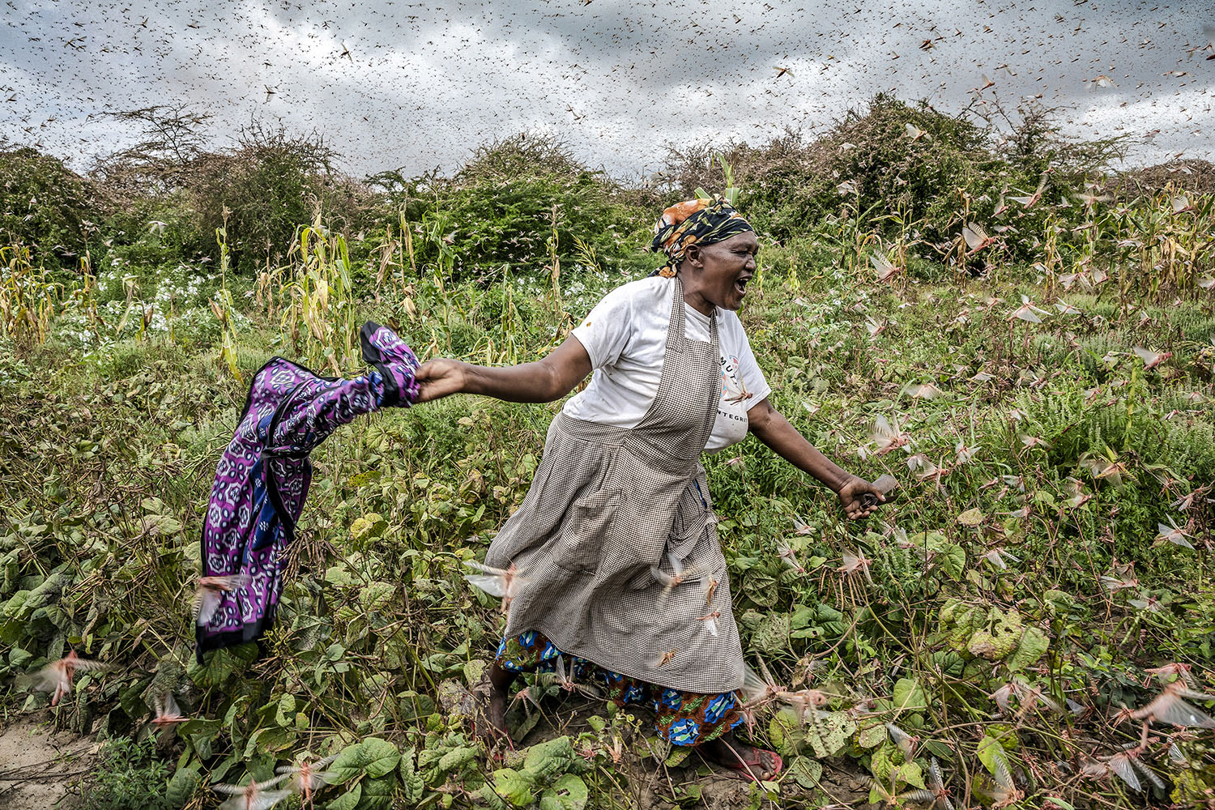
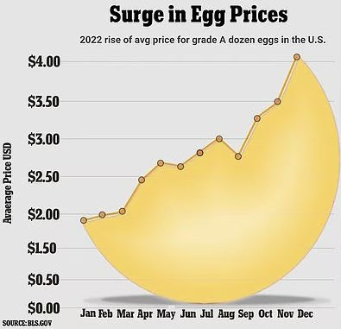
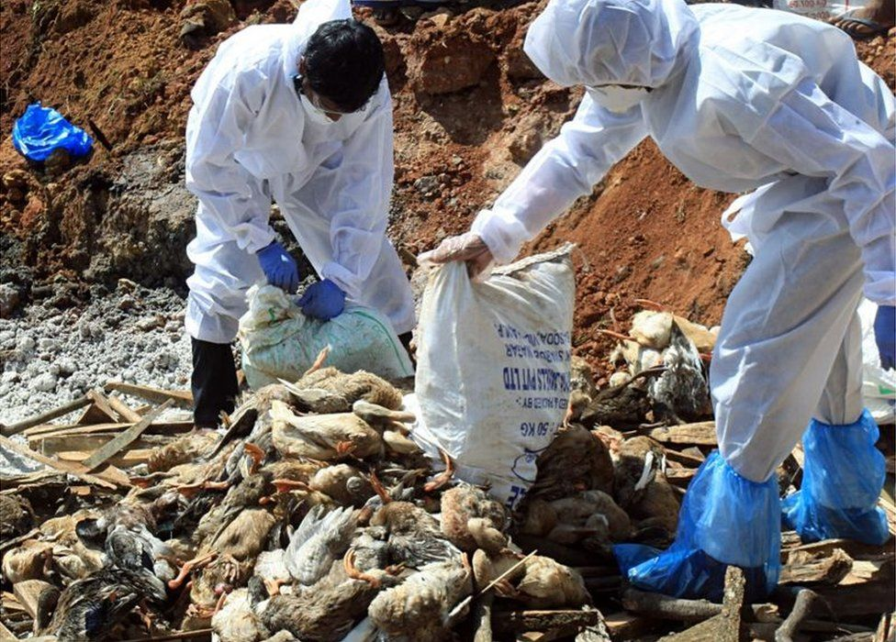
Human Impacts:
Agricultural diseases and pests can have a significant impact on human health and well-being. They can cause:
Food insecurity: Crop losses and livestock mortality can lead to food shortages and price increases, making it difficult for people to access affordable and nutritious food.
Economic hardship: Agricultural diseases and pests can cause significant economic losses for farmers and ranchers. They can also disrupt food supply chains and lead to higher food prices for consumers.
Health problems: Some agricultural diseases and pests can transmit diseases to humans. For example, mosquito-borne diseases such as malaria and dengue fever can be a major problem in areas with poor sanitation and drainage systems.

Slide 5
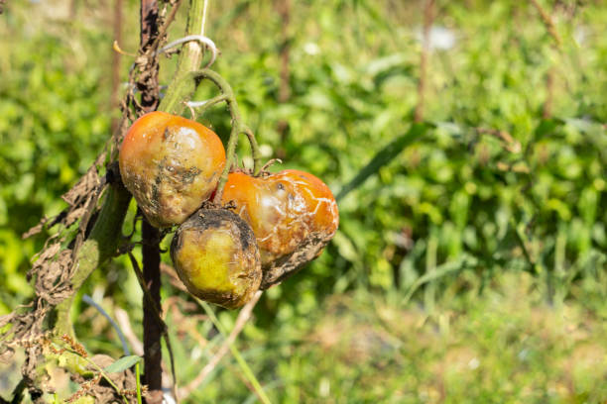
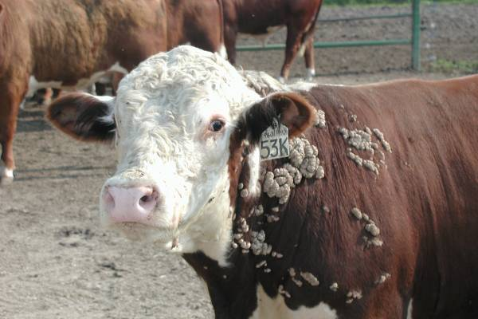
Resource Interruption:
Agricultural diseases and pests can also disrupt the supply of essential resources, such as:
Food: Crop losses and livestock mortality can reduce the availability of food, making it difficult to feed the world's growing population.
Water: Agricultural diseases and pests can contaminate water supplies, making it unsafe to drink and use for irrigation.
Timber: Tree diseases and pests can damage forests, reducing the availability of timber for construction and other uses.

Slide 6
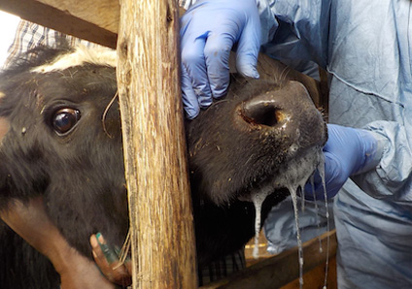
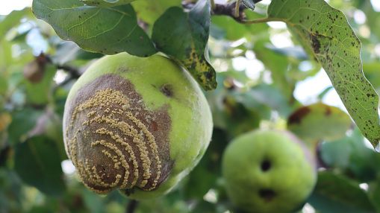
Loss of Property:
Agricultural diseases and pests can also cause significant damage to property, including:
Crops and livestock: Crop losses and livestock mortality can cause significant financial losses for farmers and ranchers.
Agricultural infrastructure: Agricultural diseases and pests can damage irrigation systems, farm equipment, and other agricultural infrastructure.
Homes and businesses: Some agricultural diseases and pests, such as termites and carpenter ants, can damage homes and businesses.

Slide 7
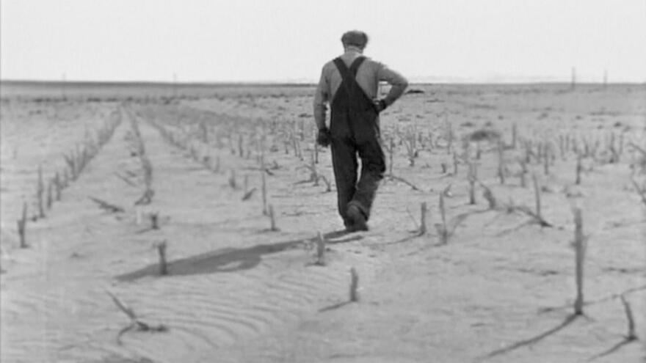
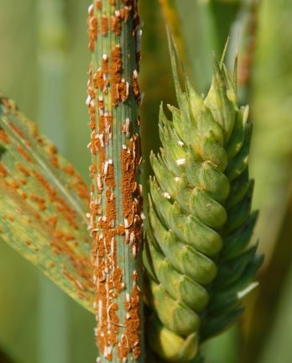
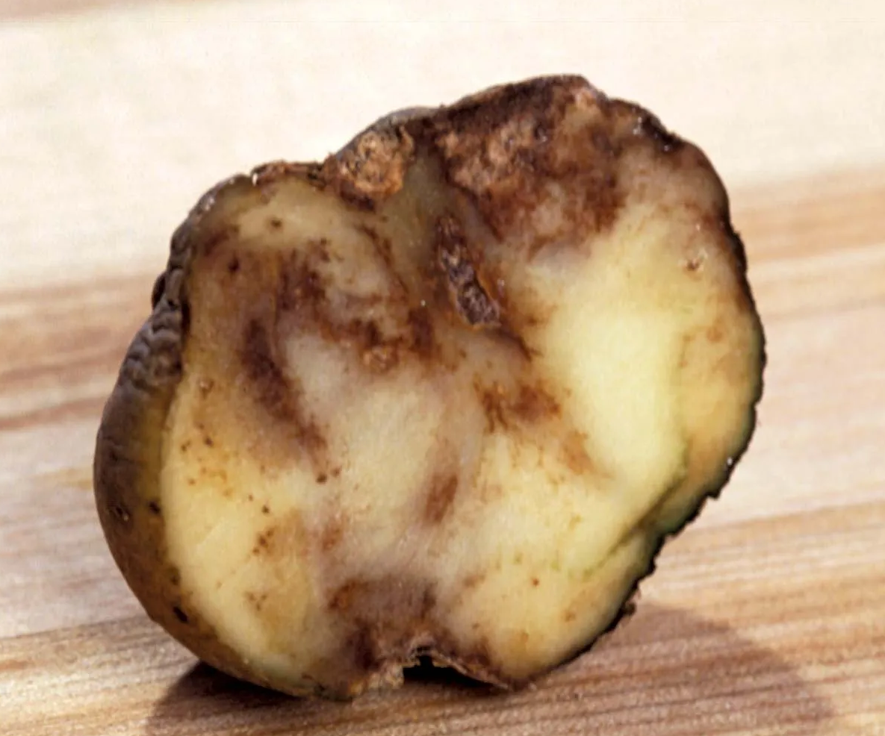
Real Examples:
Here are a few real examples of the devastating impacts of agricultural diseases and pests:
In the 1840s, the Irish potato famine, caused by the fungal disease late blight, killed around one million people and caused another million to emigrate.
In the 1930s, the American Dust Bowl was caused in part by the overproduction of wheat and the depletion of soil nutrients, which made crops more susceptible to pests and diseases.
In the 2000s, the wheat rust Ug99 threatened to cause widespread crop losses in Africa and Asia. However, thanks to the efforts of scientists and farmers, the spread of Ug99 has been controlled.

Slide 8
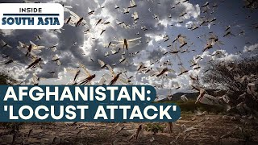

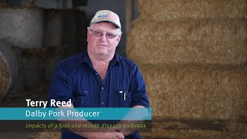
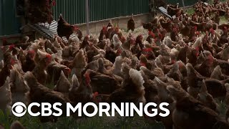

Slide 9
News
-Fungal disease poses threat to apple crop in Uttarkashi

Slide 10
Resources/Links

Slide 11
Statistics (if not covered in AI article)

Slide 12

3D-RST is supported by the NSF under grant number #DRL-2101383

