Slide 1
What’s your plan?
Saving humanity one natural disaster at a time

Slide 2
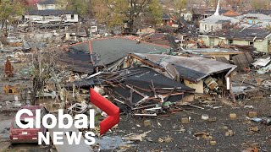
Hurricane Katrina 2005
Notes:
Read this description of Katrina: “The city of New Orleans was once a bustling metropolis, but Hurricane Katrina changed everything. In 2005, the hurricane hit, breaking the levees that carried water from the Mississippi River to the ocean. The city of New Orleans has elevations lower than sea level, causing the water from the Mississippi River to flood the city. The storm caused widespread damage and loss of life, leaving the city in ruins. In the storm’s aftermath, thousands were displaced and forced to flee their homes. The official death toll was listed at 1,833 people; however, some theories suggest as many as 10,000 people actually died. The city’s infrastructure was also severely damaged, costing around $100 billion, which took years to rebuild. Despite the challenges, the people of New Orleans have shown remarkable resilience. They have come together to rebuild their city and restore their pride. Today, New Orleans is once again a thriving community, and its residents are determined never to forget the lessons of Hurricane Katrina.”

Slide 3
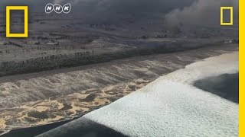
Fukushima Earthquake and Tsunamis - Nuclear Reactor
Notes:
Read the Japan tsunami description: “On March 11, 2011, a magnitude 9.0 earthquake struck off the coast of Japan, triggering a massive tsunami that devastated the country’s northeastern coastline. The tsunami reached up to 40 meters (130 feet) in some areas and swept away entire towns and villages. The tsunami also caused a nuclear disaster at the Fukushima Daiichi Nuclear Power Plant when the plant’s cooling systems were overwhelmed after the flood stopped a pump, and three of its reactors melted down. The disaster released large amounts of radioactive material into the environment, forcing hundreds of thousands of people to evacuate. The official death toll was 15,899 people, with the unofficial number being much higher. The cost of fixing Japan was estimated to be $1 trillion.”

Slide 4
Local Natural Disasters
Drought
Earthquake
Floods
Landslide
Extreme Heat
Wind
Blizzards
Wildfire
Volcano
Sinkhole
Agricultureal Disease
Solar Flares

Slide 5
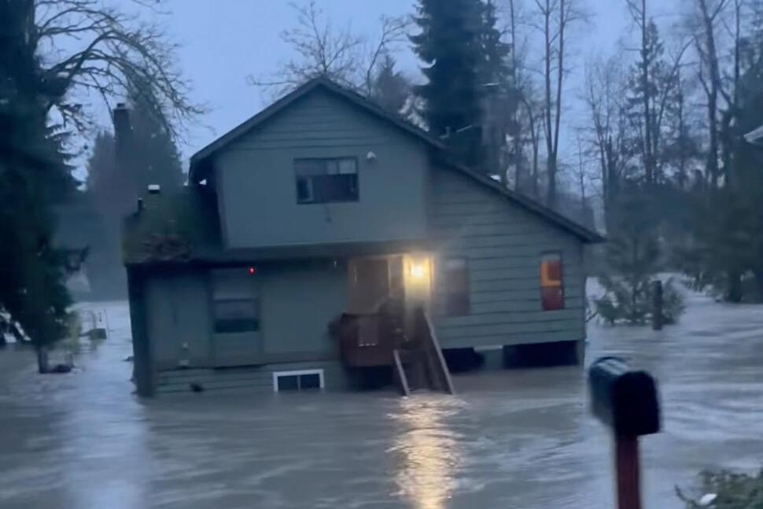
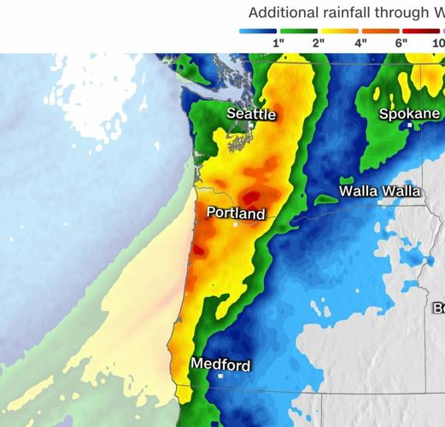
Recent Natural Disaster - Atmospheric River
https://weather.com/news/weather/video/pacific-northwest-atmospheric-river-storm-triggers-flooding

Slide 6
Movie
45 seconds - 2 minutes
Name your Natural Disaster
Present your solution
List Constraints
Possible Constraints:
Logistics
Cost
Stakeholders
Zoning, permits
Location and geology
Resource availability
Trade Offs
Unpredictability of Nature

Slide 7
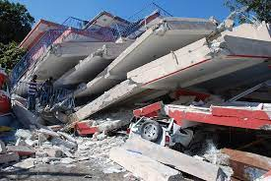
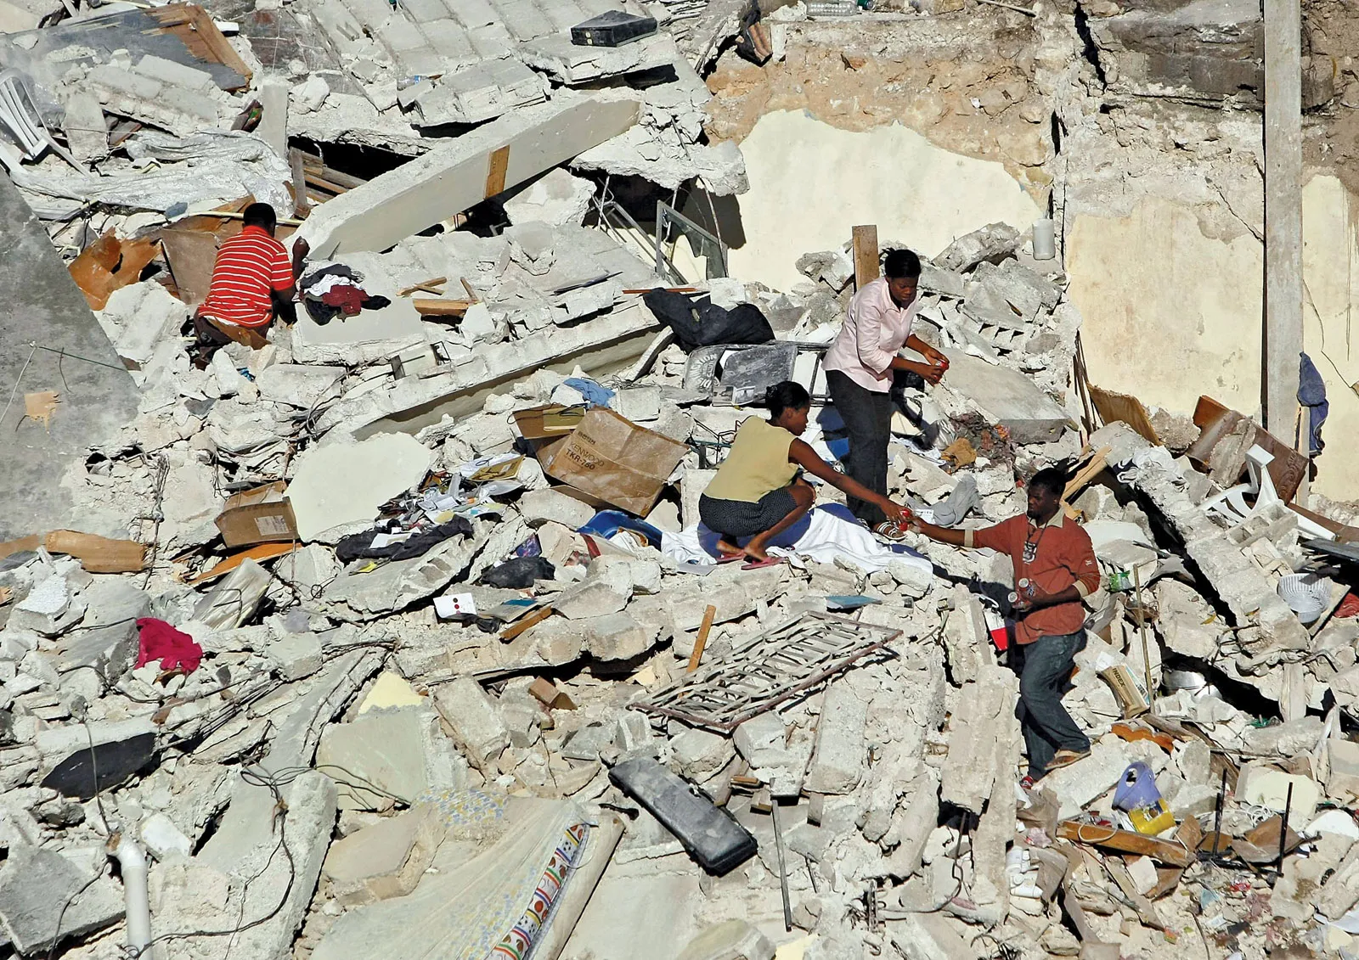
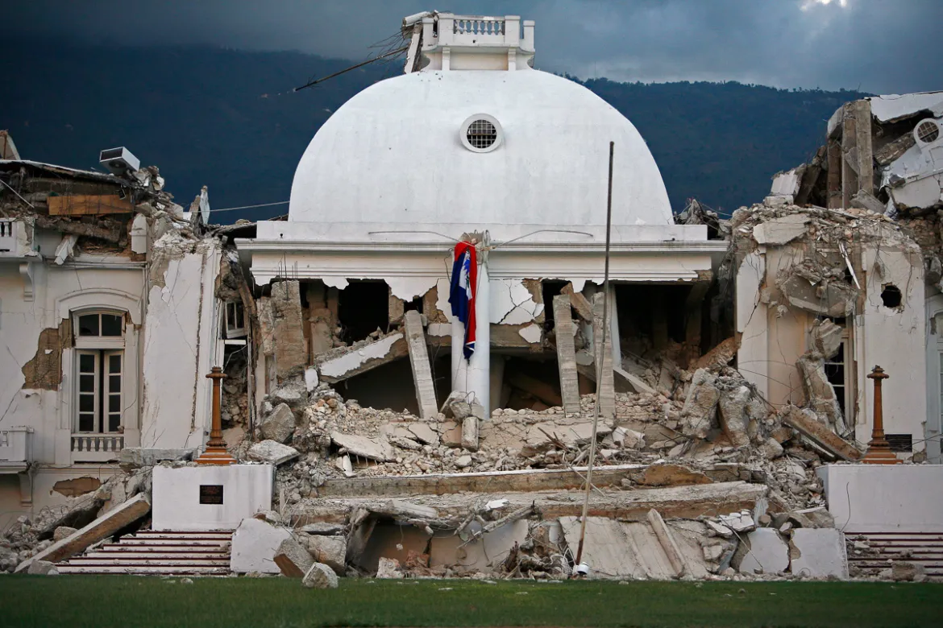
Haiti Earthquake 2010
7.0 Magnitude
Port-au-Prince 78 miles from epicenter
Death toll: 300,000
Notes:
Read the following, “An earthquake struck Haiti on January 12, 2010, with a magnitude of 7.0, and its epicenter was 78 miles from the capital city Port-au-Prince. The city’s buildings were not designed to withstand such a powerful earthquake, and many collapsed, trapping people inside. The earthquake also triggered a tsunami that caused further damage along the Haitian coast. The Haitian government estimated that the earthquake killed between 220,000 and 316,000 people, making it the deadliest earthquake in Haitian history. The earthquake also injured over 300,000 people and left over 1.5 million people homeless. It caused an estimated $8.7 billion in damage to Haiti’s infrastructure, including roads, bridges, hospitals, and schools.

Slide 8
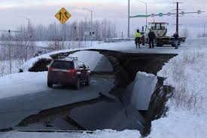
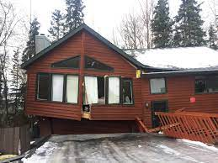
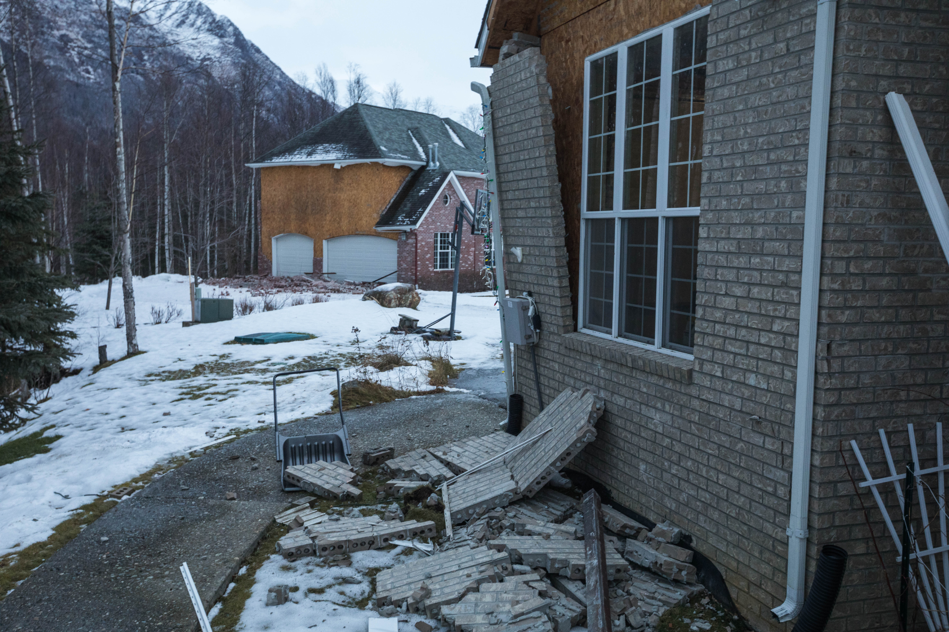
Alaska Earthquake 2018
7.1 Magnitude
10 miles from epicenter
Death toll: 0
Notes:
Read the following, “The Anchorage earthquake was a major natural disaster that struck November 30, 2018. The earthquake occurred about 10 miles north of the city. The earthquake was felt throughout Southcentral Alaska and as far away as Fairbanks. The earthquake caused widespread damage to Anchorage, including collapsed buildings, broken roads, and power outages. The earthquake caused an estimated $3 billion in damage, making it the most costly earthquake in Alaska’s history.”

Slide 9
Alaska 1964 vs Alaska 2018
What did we learn?
Notes:
Read the following, “The 1964 Alaska earthquake, also known as the Great Alaskan earthquake, was a magnitude 9.2 megathrust earthquake that struck Southcentral Alaska on March 27, 1964. The earthquake’s epicenter was near Valdez, about 75 miles east of Anchorage. It was the most powerful earthquake ever recorded in North America and the second-most powerful ever recorded worldwide. The earthquake lasted four minutes and thirty-eight seconds and caused widespread damage throughout Southcentral Alaska. The earthquake killed 131 people and injured thousands more. It also caused an estimated $311 million (1964 USD) in damage, equivalent to over $2.5 billion today. The earthquake profoundly impacted Alaska, and it took many years for the state to recover. The earthquake led to the development of new earthquake-resistant building codes, and it also helped to raise awareness of the dangers of living in an earthquake-prone region.”

Slide 10
Extension: Local Natural Disasters examples
Drought - Lake Powell
Wildfire - Look up closest recent fire
Earthquake- Magna 2020
Volcano - Yellowstone
Floods - Capitol Reef 2022
Sinkholes - La Verkin 1985
Landslide - Thistle 1983
Agriculture Disease
Extreme Heat - Utah/Arizona 2023
Severe Storms -
Wind - East winds wasatch front
Solar Flares - Canada 1989
Blizzards -
Meteor Impact - Upheaval Dome Canyonlands

Slide 11
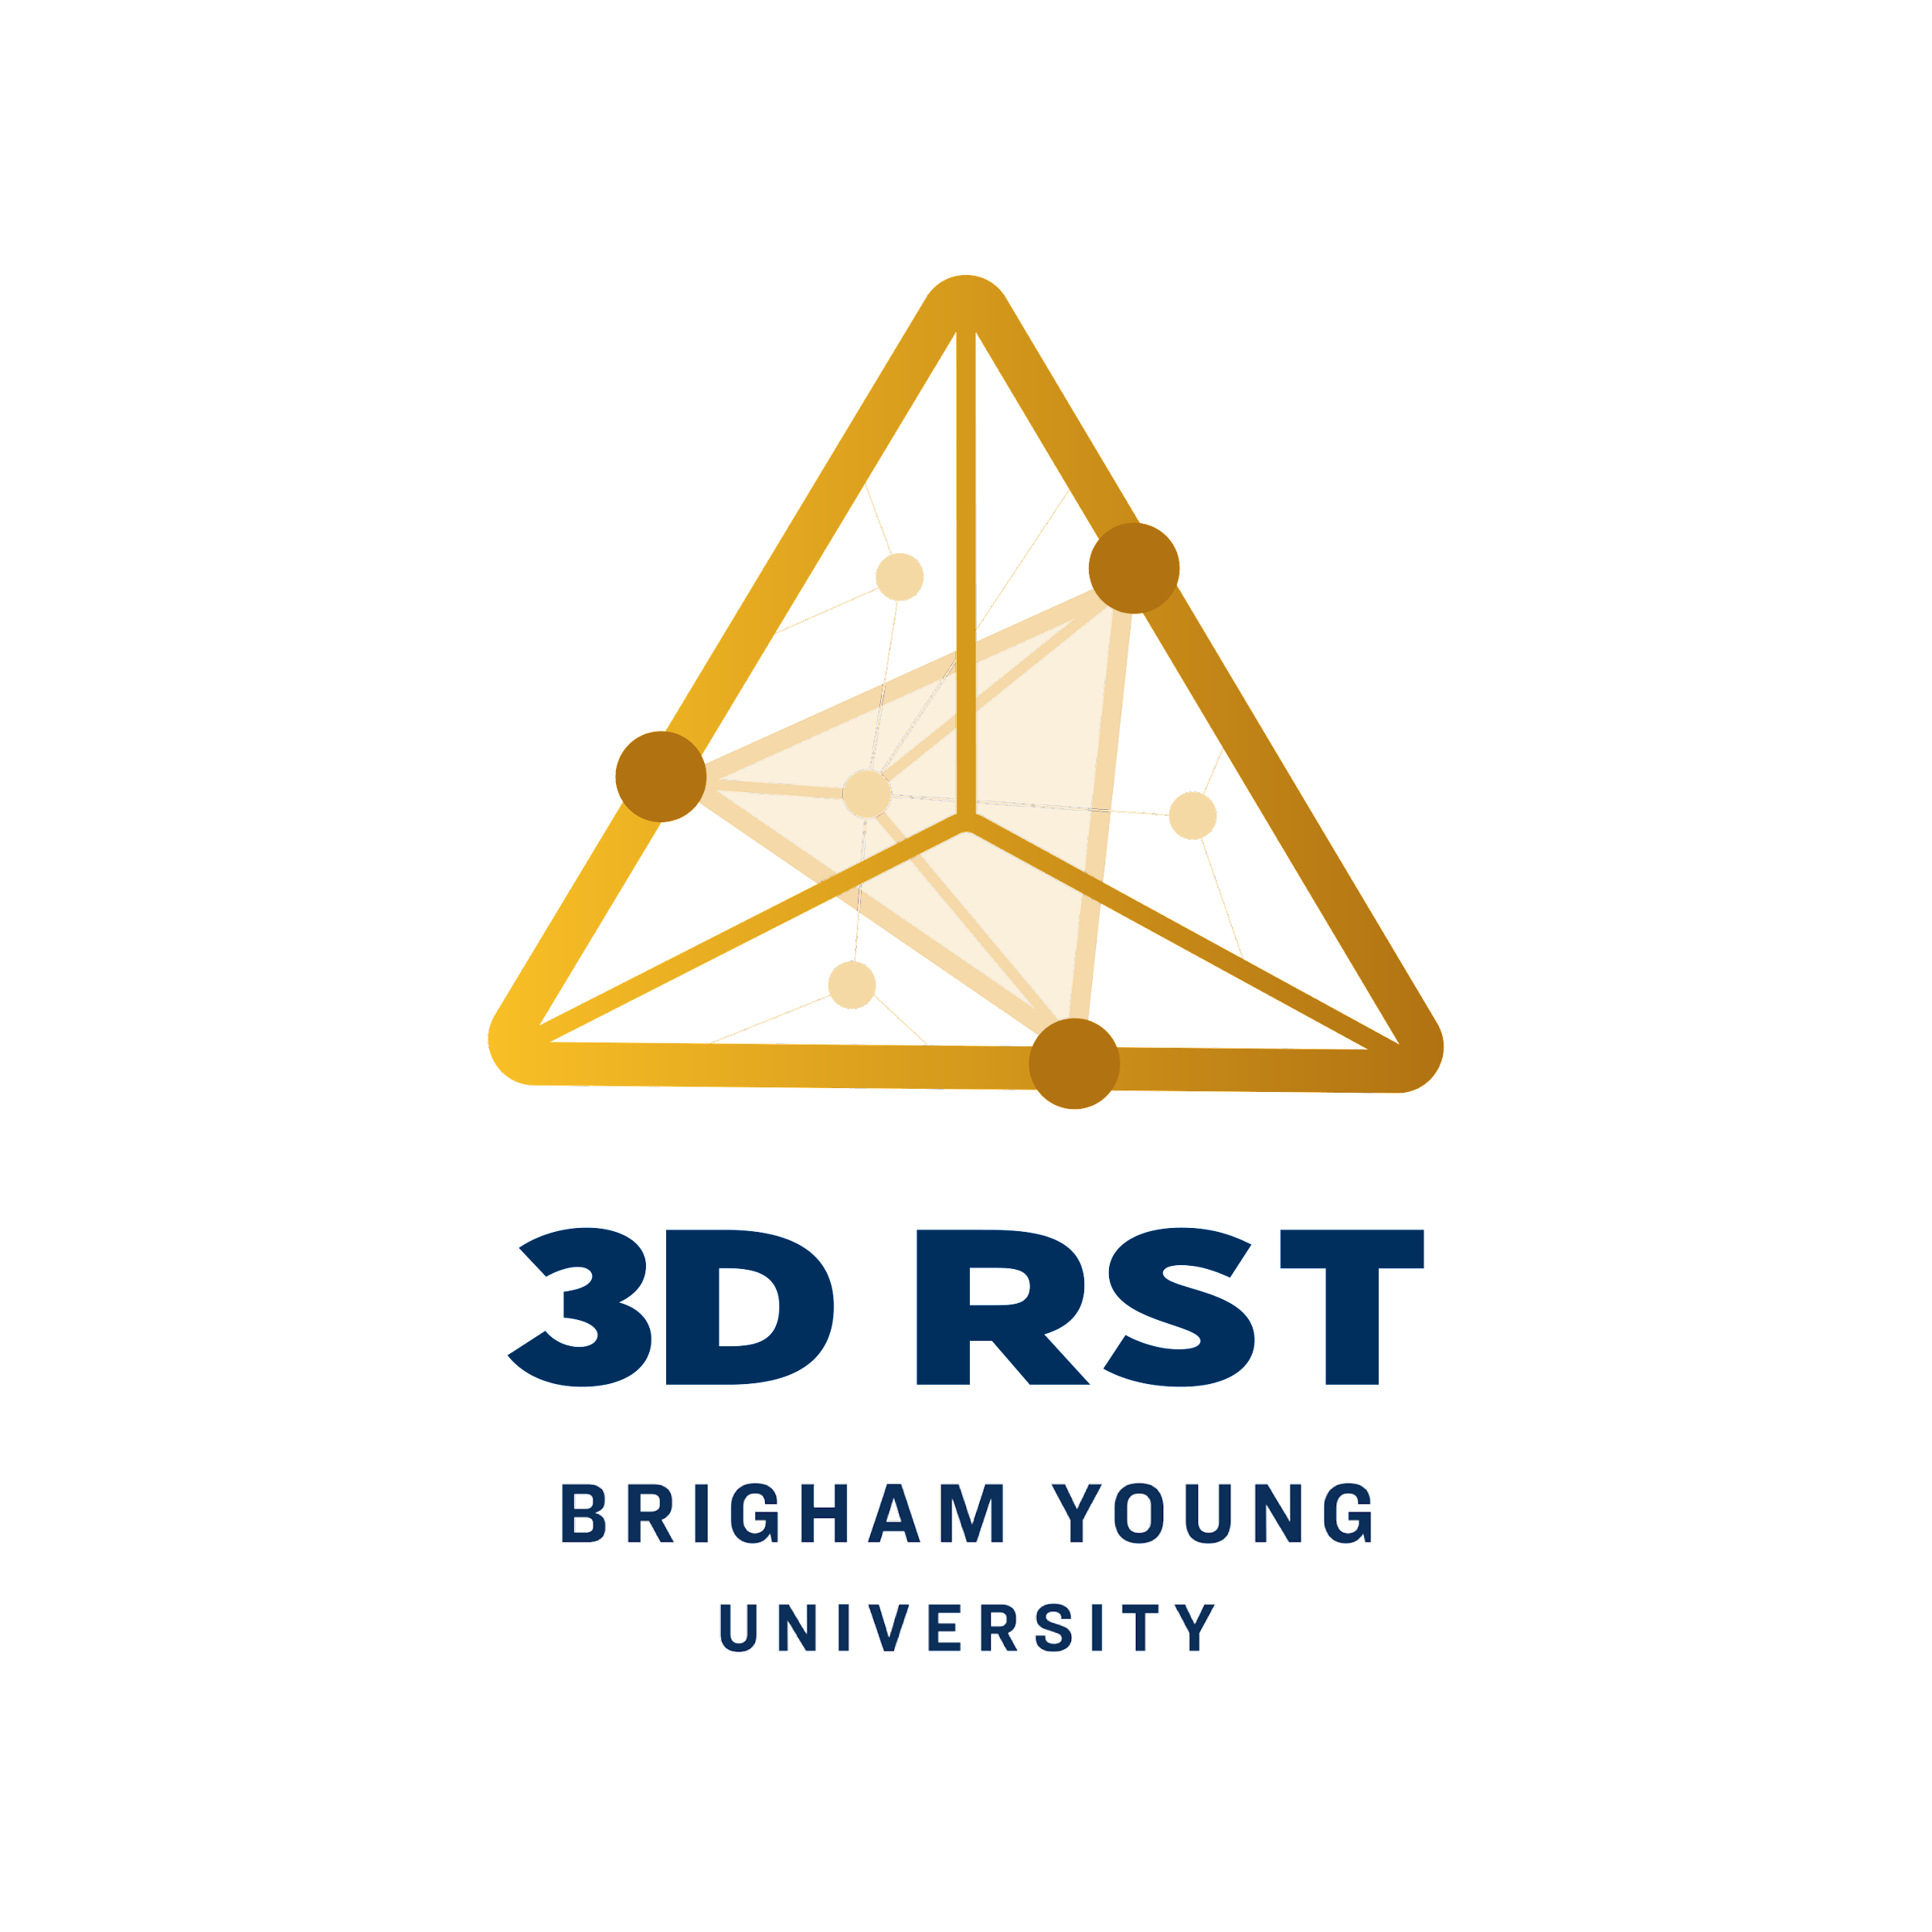

3D-RST is supported by the NSF under grant number #DRL-2101383

