Slide 1
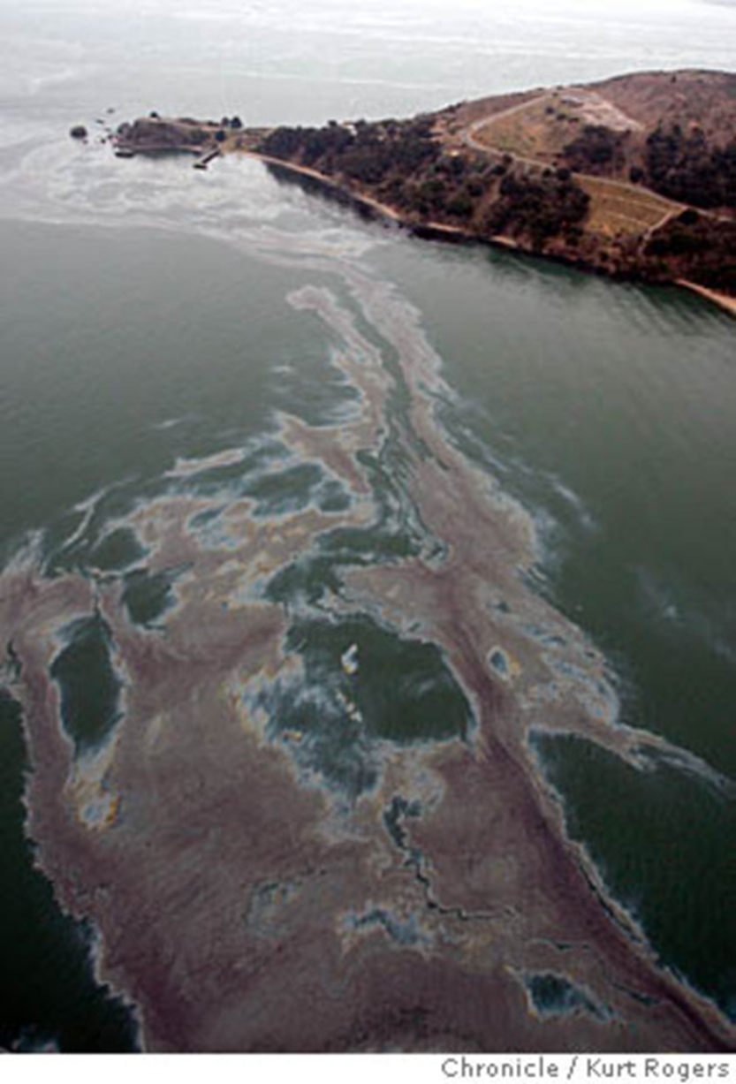


Slick Solutions Worksheet
Standard 8.4.3
I can come up with ways to monitor and mitigate the effects of using natural resources
SEP: Constructing Explanations and Designing Solutions
CCC: Scale, Proportion, Quantity
DCI: Human activities have altered the biosphere, sometimes damaging it, although changes to environments can have different impacts for different living things. Activities and technologies can be engineered to reduce people’s impacts on Earth.
3D-RST is supported by the NSF under grant number #DRL-2101383

Slide 2
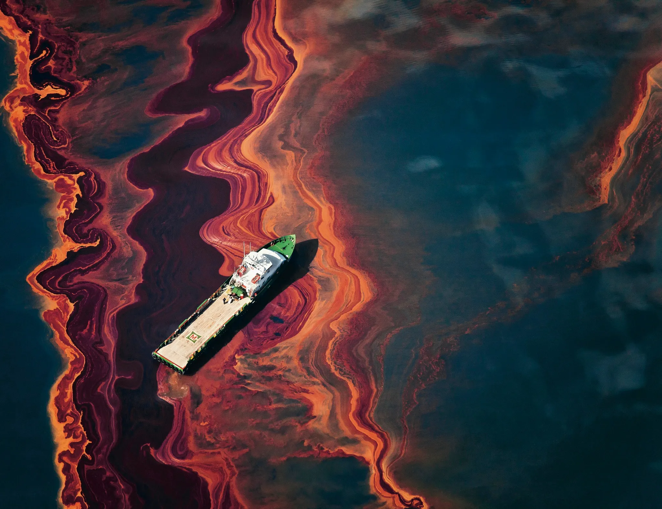
There has been an oil spill and it is your job to try and figure out how to clean it up.
Oil spills have a major impact on our environment, and one of the biggest risks is oil spills in the ocean. This form of ocean pollution is absolutely devastating for our oceans and marine life.
3D-RST is supported by the NSF under grant number #DRL-2101383

Slide 3
What tools or resources do you think will work best to remove the oil from the materials? (Hypothesis)
In groups of 4, you will be assigned a material for your team to evaluate and test. Use the following data sheet to help you gather information. Be specific and record all your findings. Then you will design a project to help mitigate the effects of your oil spill.
Names of the people in your group:
1. 3.
2. 4.
What is an Oil Spill?
Perhaps you have seen on the news that an oil spill has happened, or maybe you have been visiting a local river or waterway and saw the greasy rainbow hues of oil floating on the water. Although oil spills can happen on land, one of the biggest issues is oil spills into bodies of water. An oil spill is the accidental release of oil (petroleum) products into a body of water, either by an oil tanker ship, offshore oil rig, pipelines and even recreational vehicles, etc.
3D-RST is supported by the NSF under grant number #DRL-2101383

Slide 4
Explore each objects interaction with oil and write down your observations:
 | Water (7-10 drops of Oil) | Rock (4-5 Drops of Oil) | Feather (4-5 Drops of Oil) | Plant (4-5 drops of Oil)
Reaction w/ Oil
Evaluate each cleaning tool and determine if its effective at cleaning up the oil give it a score of 1= Not Successful—5=Removes it completely
 | Water (7-10 Drops of Oil) | Rock (4-5 Drops of Oil) | Feather (4-5 Drops of Oil) | Plant (4-5 Drops of Oil)
Dish Soap
Rubbing Alcohol
Sponge
Cotton Ball
String
3D-RST is supported by the NSF under grant number #DRL-2101383

Slide 5
Share your findings with the other groups who did your same substance and decide on what is the best solution for cleaning your substance and record it here.
Name of your substance:____________________
What worked best to clean it: _________________________________
_____________________________________________________________
Use the websites provided to help you learn more about cleaning your material you were given at the start of class. Use this site for Plant, rock, and water. Use this site for animal clean up
Find 3 techniques that are used to clean the type of surface you were assigned at the start of class
How could you use these techniques to make an automated system for cleaning up oil from your surface.
Video presentation to help you get started on your project.
3D-RST is supported by the NSF under grant number #DRL-2101383

Slide 6
Design a solution for how your material could be cleaned up on a large scale. Your design needs to be:
Mostly automated (does the work on its own)
Works on a large scale or higher quantity of oil
Create your blueprint
Requirements:
Using the data from your lab worksheet decide which tool was the best for extracting the oil.
Create a plan as to how you would use this on a Macro (Large) scale for a big area. You can do some research to help you create this plan. Use what you have learned from the lab and articles.
Using the poster paper provided divide it into 3 sections. Label it as follows:
Materials Needed | Draw your Design | Describe your design
3D-RST is supported by the NSF under grant number #DRL-2101383

Slide 7
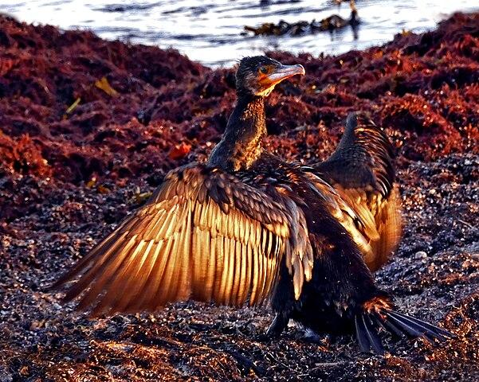
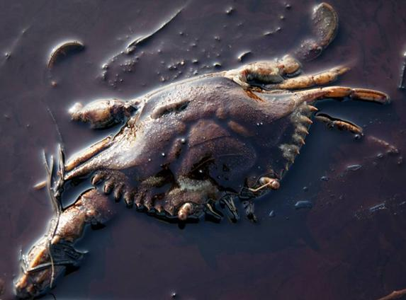
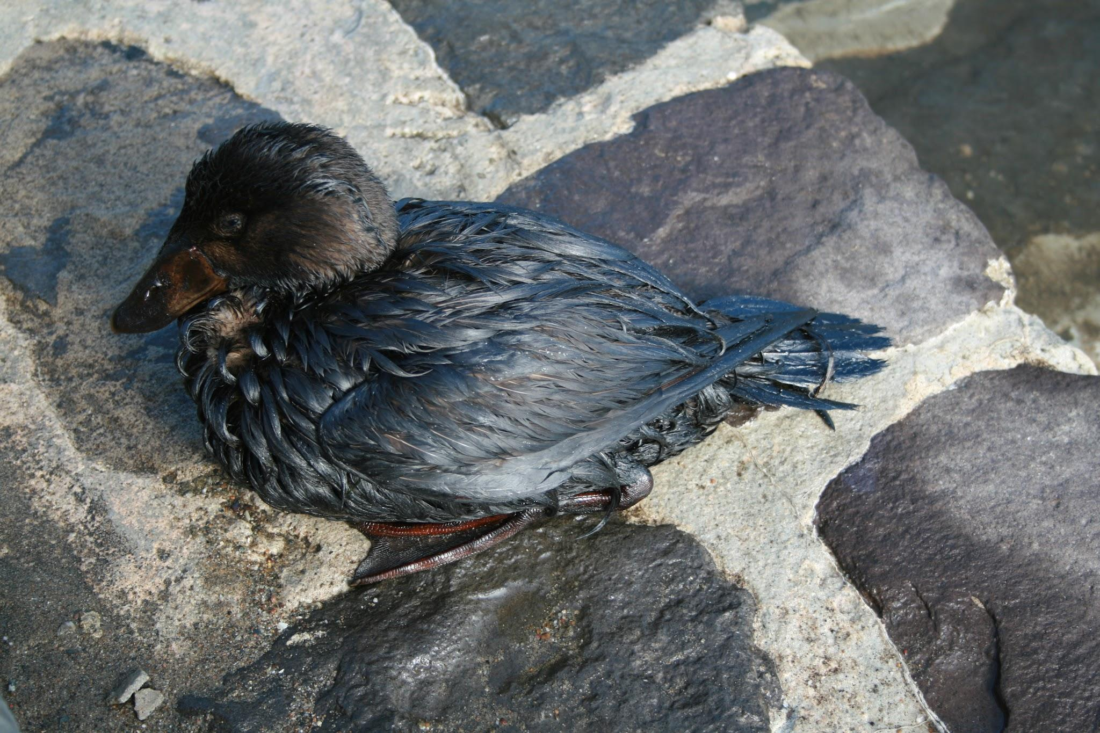
Create your blueprint
Continued…
Put all team members names on the back with your period.
Use your very best handwriting and make sure the picture is clear and labeled with its parts. Must be well organized and have color to receive full credit.
Data sheet = 10pts
Plan = 5pts
Poster = 10pts
Total = 25 pts
3D-RST is supported by the NSF under grant number #DRL-2101383

Slide 8
Rubric
 | 1-2pts | 3pts | 4 pts | 5pts
Data Sheet | Filled out some boxes | Filled in at least half of the boxes | Filled in most of the boxes | Filled in all of the boxes
Plan | Not very clear or well thought out | Have an idea, but still unclear | Good idea with well thought out ideas | Great idea with a detailed plan
Poster | Started a poster but has very little information. | Some information but not colored or clear. Shows some evidence of information from the data sheet. | Poster is well organized and colored. Used some information from the Data sheet | Poster is very well organized and colored and idea is well expressed. Used information from the data sheet.
Clairity | Not neat or very well organized. Partial names & period. Plan is unclear | Clear and somewhat organized. Names & Period on the back. Plan has some good ideas but needs more to be complete. | Neat and organized with everyone’s names & period on the back. Plan may need a few adjustments | Very Neat, good pictures, organized well and everyone's name & Period are one the back. Plan is ready to execute.
Turned in on time | Turned in more than 3 days late. | Turned in two days late. | Turned in one day late. | Turned in on due date.
3D-RST is supported by the NSF under grant number #DRL-2101383

