Slide 1
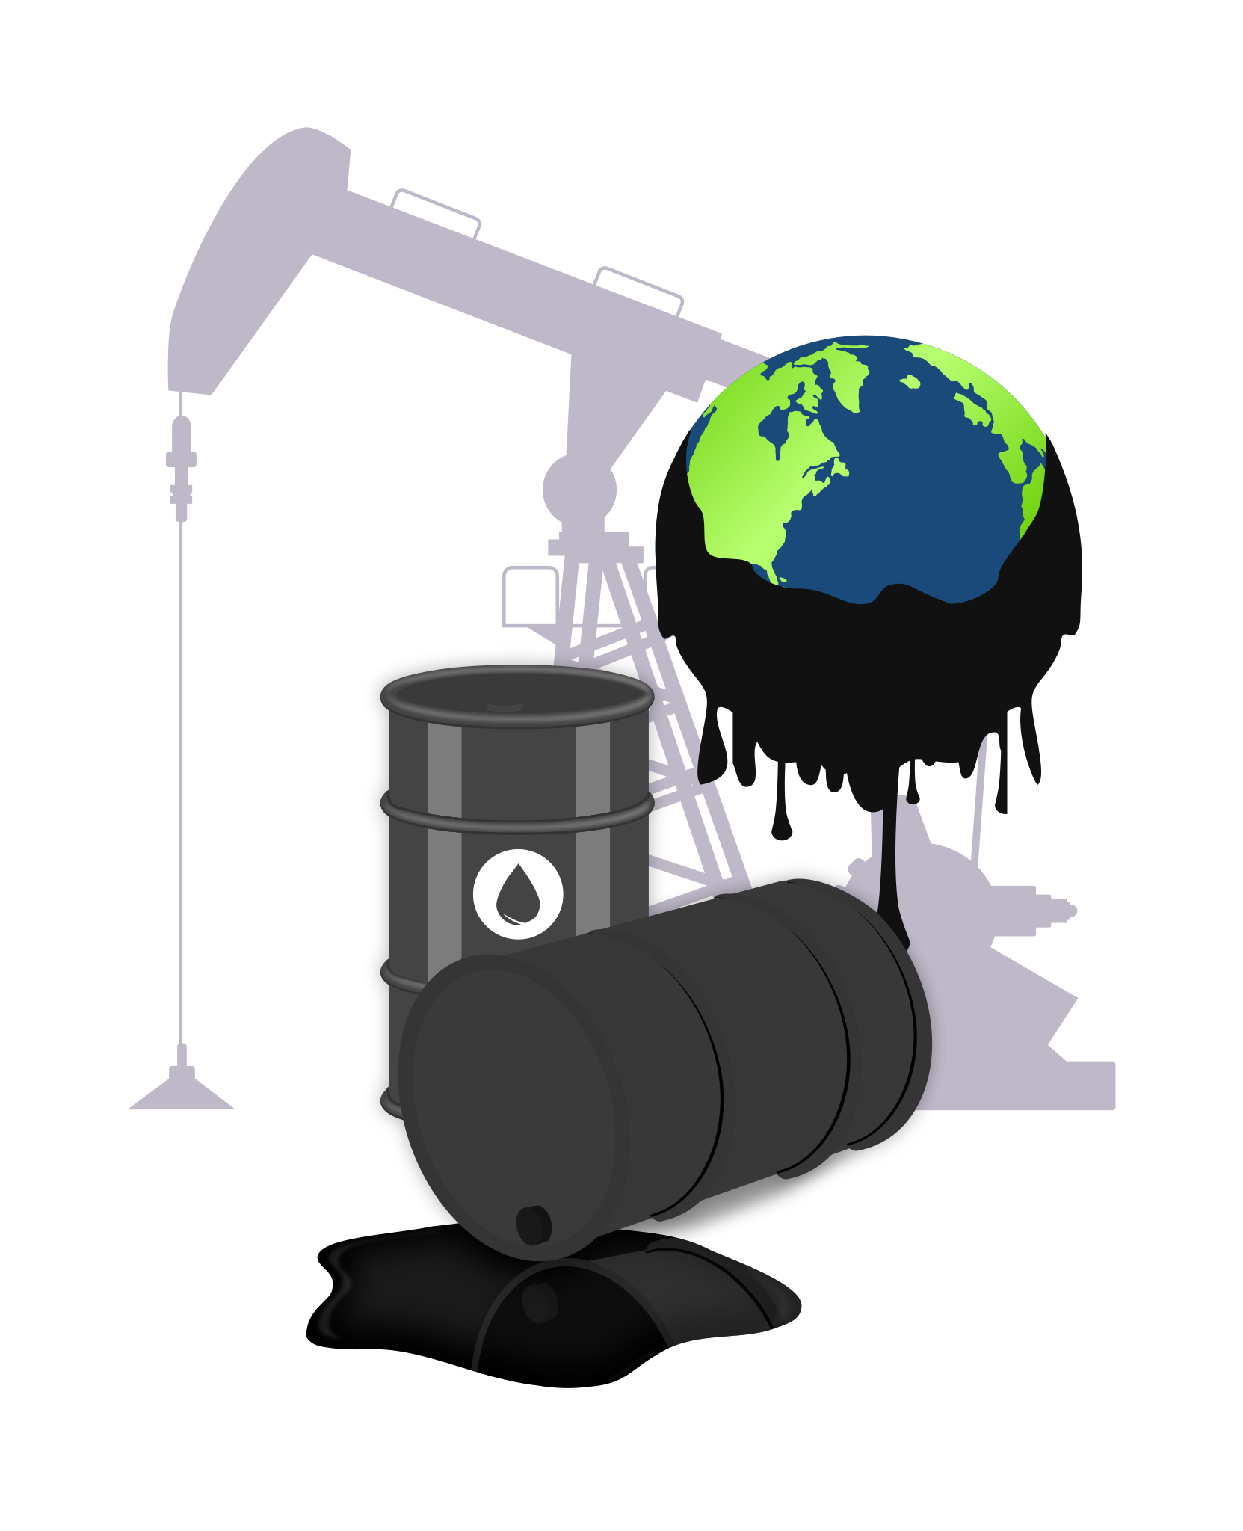
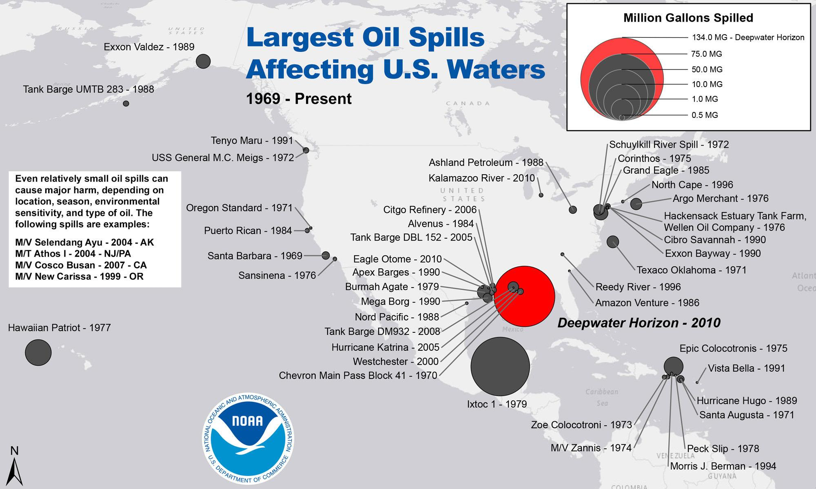


NAME: PERIOD: DATE:
SLICK SOLUTIONS
Write down 3 observations from the phenomenon of the effects caused to the environment by extracting natural resources:
Looking at the image to the left come up with 3 wonderings/questions you have about it:
3D-RST is supported by the NSF under grant number #DRL-2101383

Slide 2
Explore each objects interaction with oil and write down your observations:
 | Water (10ml of Oil) | Rock (4-5 Drops of Oil) | Feather (4-5 Drops of Oil) | Soil (4-5 Drops of Oil) | Plant (4-5 drops of Oil)
Reaction w/ Oil
Evaluate each cleaning tool and determine if its effective at cleaning up the oil and explain why:
 | Water (10ml of Oil) | Rock (4-5 Drops of Oil) | Feather (4-5 Drops of Oil) | Soil (4-5 Drops of Oil) | Plant (4-5 drops of Oil)
String
Sponge
Cotton Ball

Slide 3
Evaluate each cleaning tool and determine if its effective at cleaning up the oil and explain why:
 | Water (10ml of Oil) | Rock (4-5 Drops of Oil) | Feather (4-5 Drops of Oil) | Soil (4-5 Drops of Oil) | Plant (4-5 drops of Oil)
Spoon
Dish Soap
Pipette
3D-RST is supported by the NSF under grant number #DRL-2101383

