Slide 1
Structure and Function of Materials
Spandex vs Cotton
CHEM.2.3 Engage in argument supported by evidence that the functions of natural and designed macromolecules are related to their chemical structures. Emphasize the roles of attractive forces between and within molecules.

Slide 2

Spandex vs Cotton

Slide 3
Prompt:
You work for a river rafting company and need to recommend clothing to wear rafting. You will need good evidence and reasoning for why your customers should follow your recommendation.

Slide 4
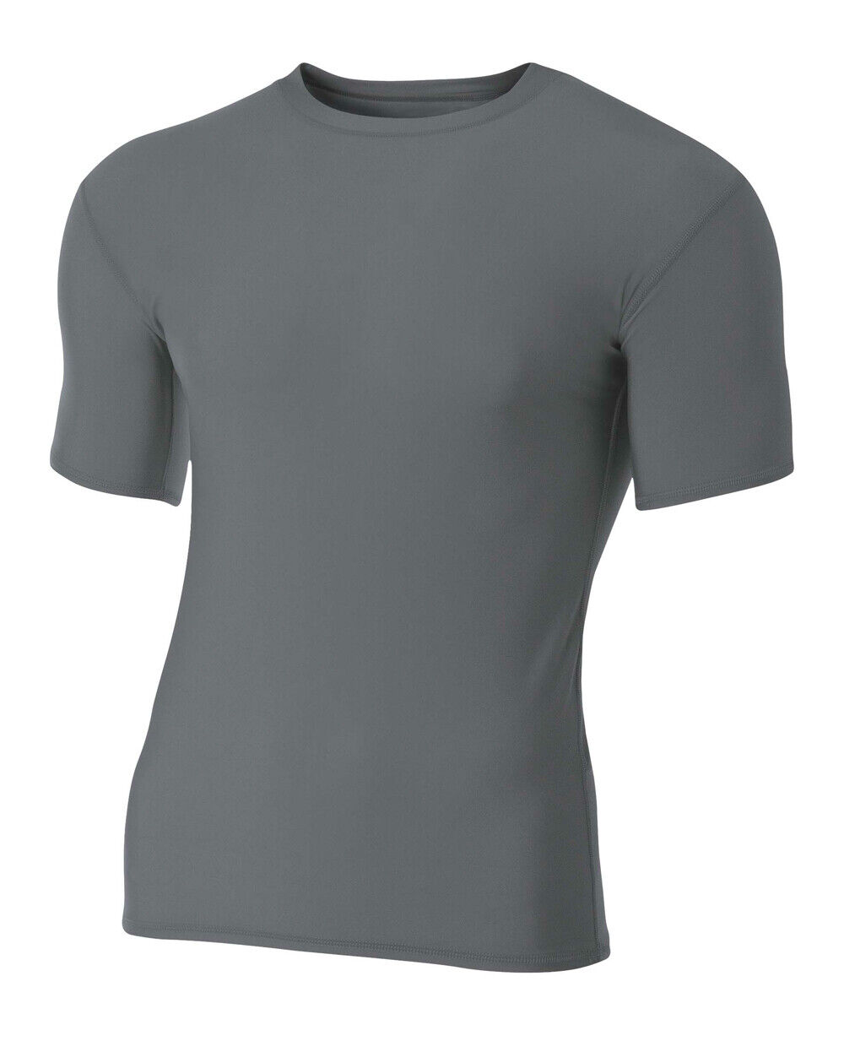
What is Spandex?
Spandex is man-made. Is made from fossil fuels.
Spandex is a synthetic polymer. It is made from fossil fuels. It is also called Elastane Fiber. Chemically, it is made up of a long-chain polyglycol combined with a short di-isocyanate, and contains at least 85% polyurethane. It is an elastomer, which means it can be stretched to a certain degree and it recoils when released. These fibers are superior to rubber because they are stronger, lighter, and more versatile.

Slide 5
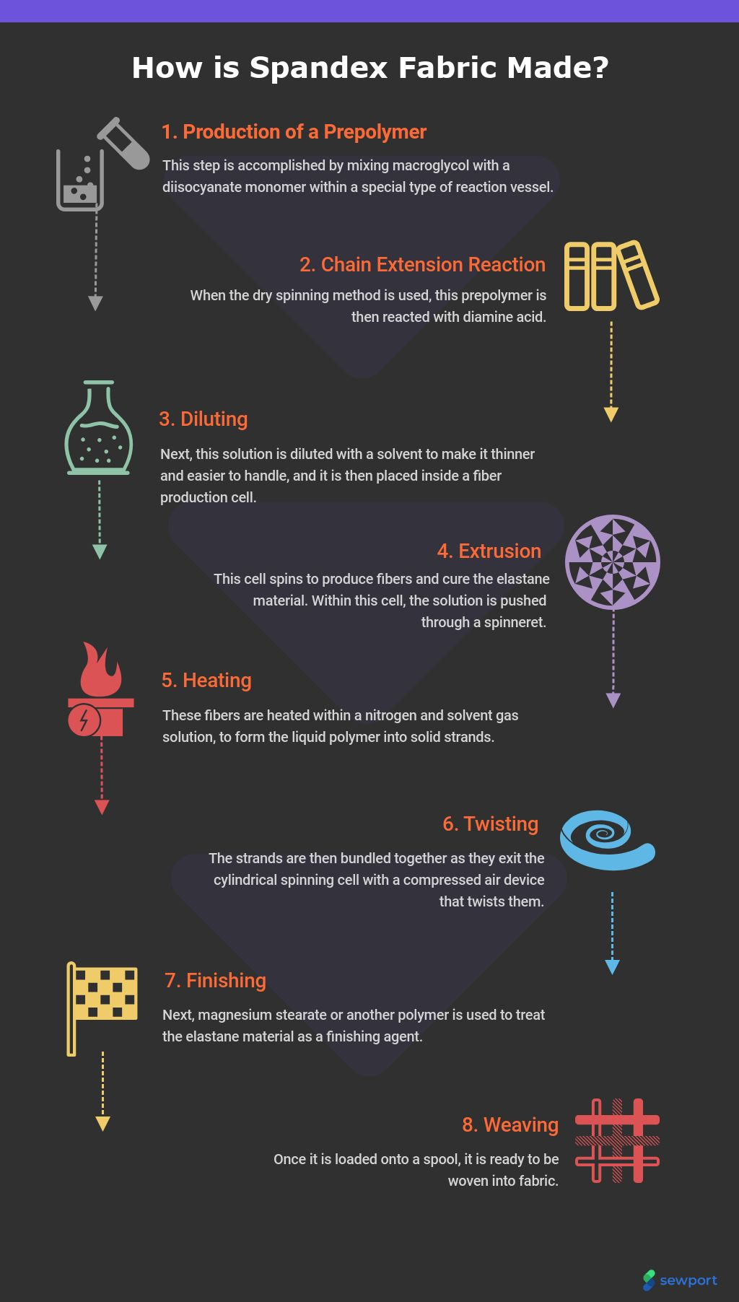
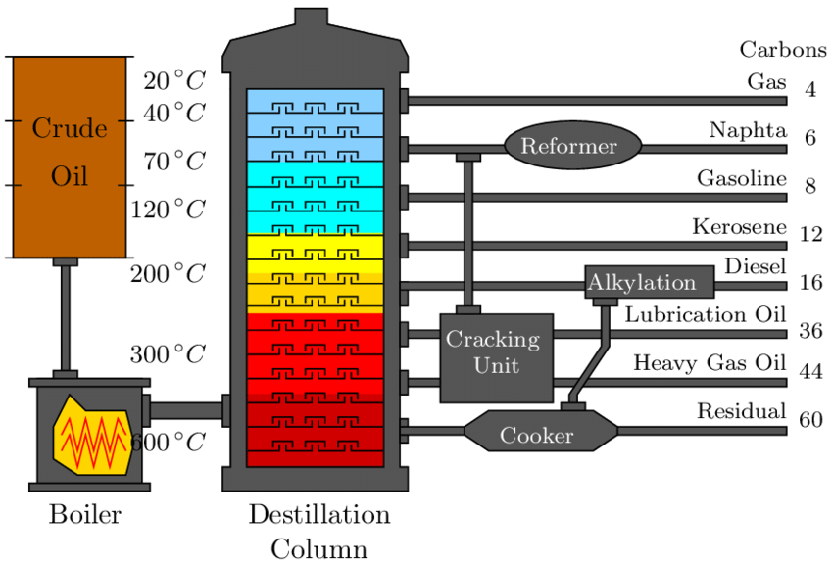
How is Spandex Made?
Oil rigs retrieve petroleum.
Petroleum is separated in a refinery
Then processed in textile factories.
Oil Refinery
Textile Factory

Slide 6
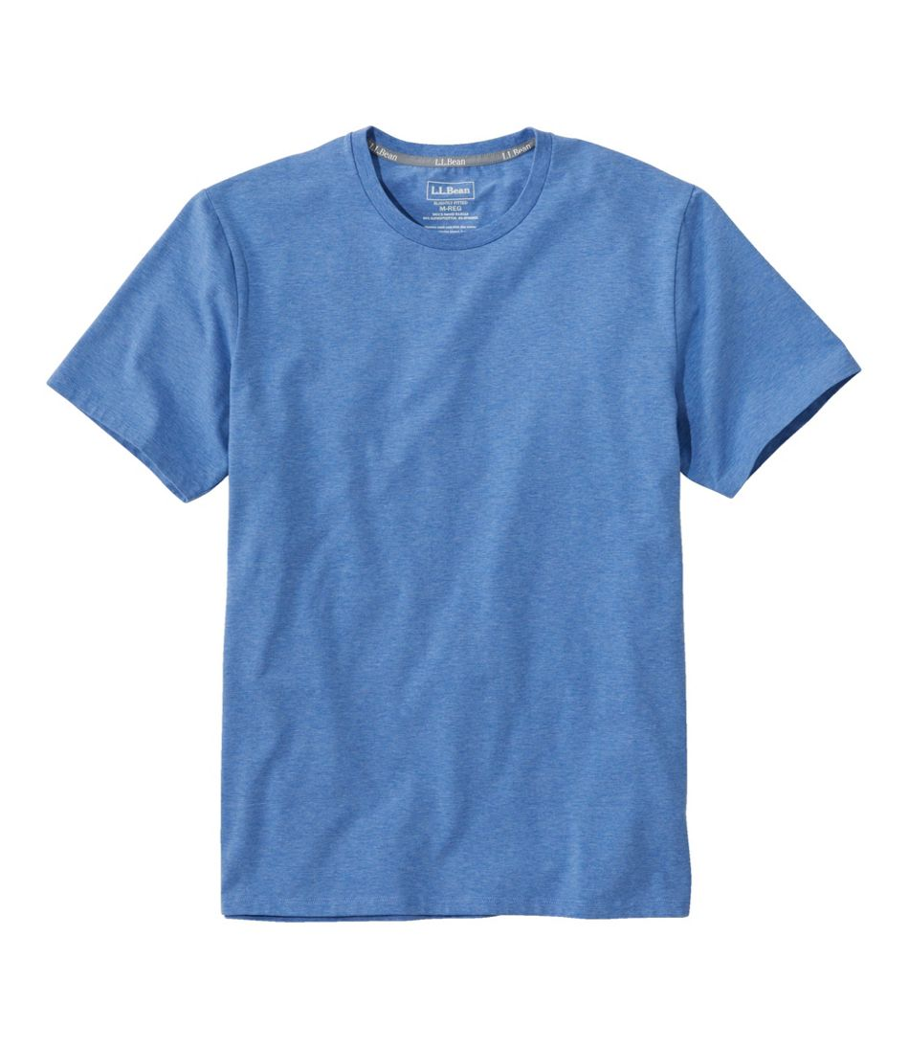
What is Cotton?
Cotton is natural. It is plant material.
Cotton, like most other plant fibers, is made of a carbohydrate called cellulose. Cotton plants make fibers out of thin air! Most of a cotton fiber's mass originates as carbon dioxide. Cellulose is a polymer made up of glucose, a type of sugar. Glucose is made in the leaves of the cotton plant, which are filled with bright green chloroplasts. Chloroplasts carry out the process of photosynthesis: they harness energy from sunlight to turn carbon dioxide (from the air) and water into glucose.

Slide 7
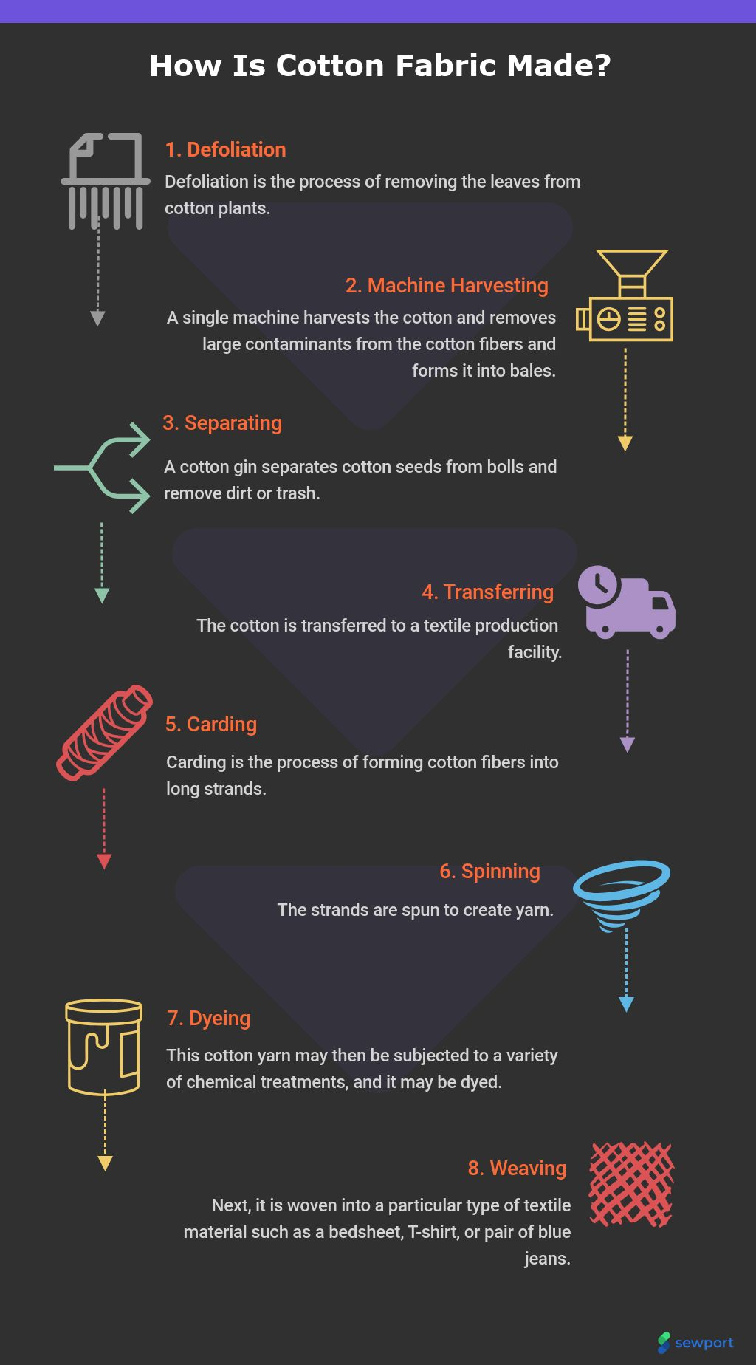
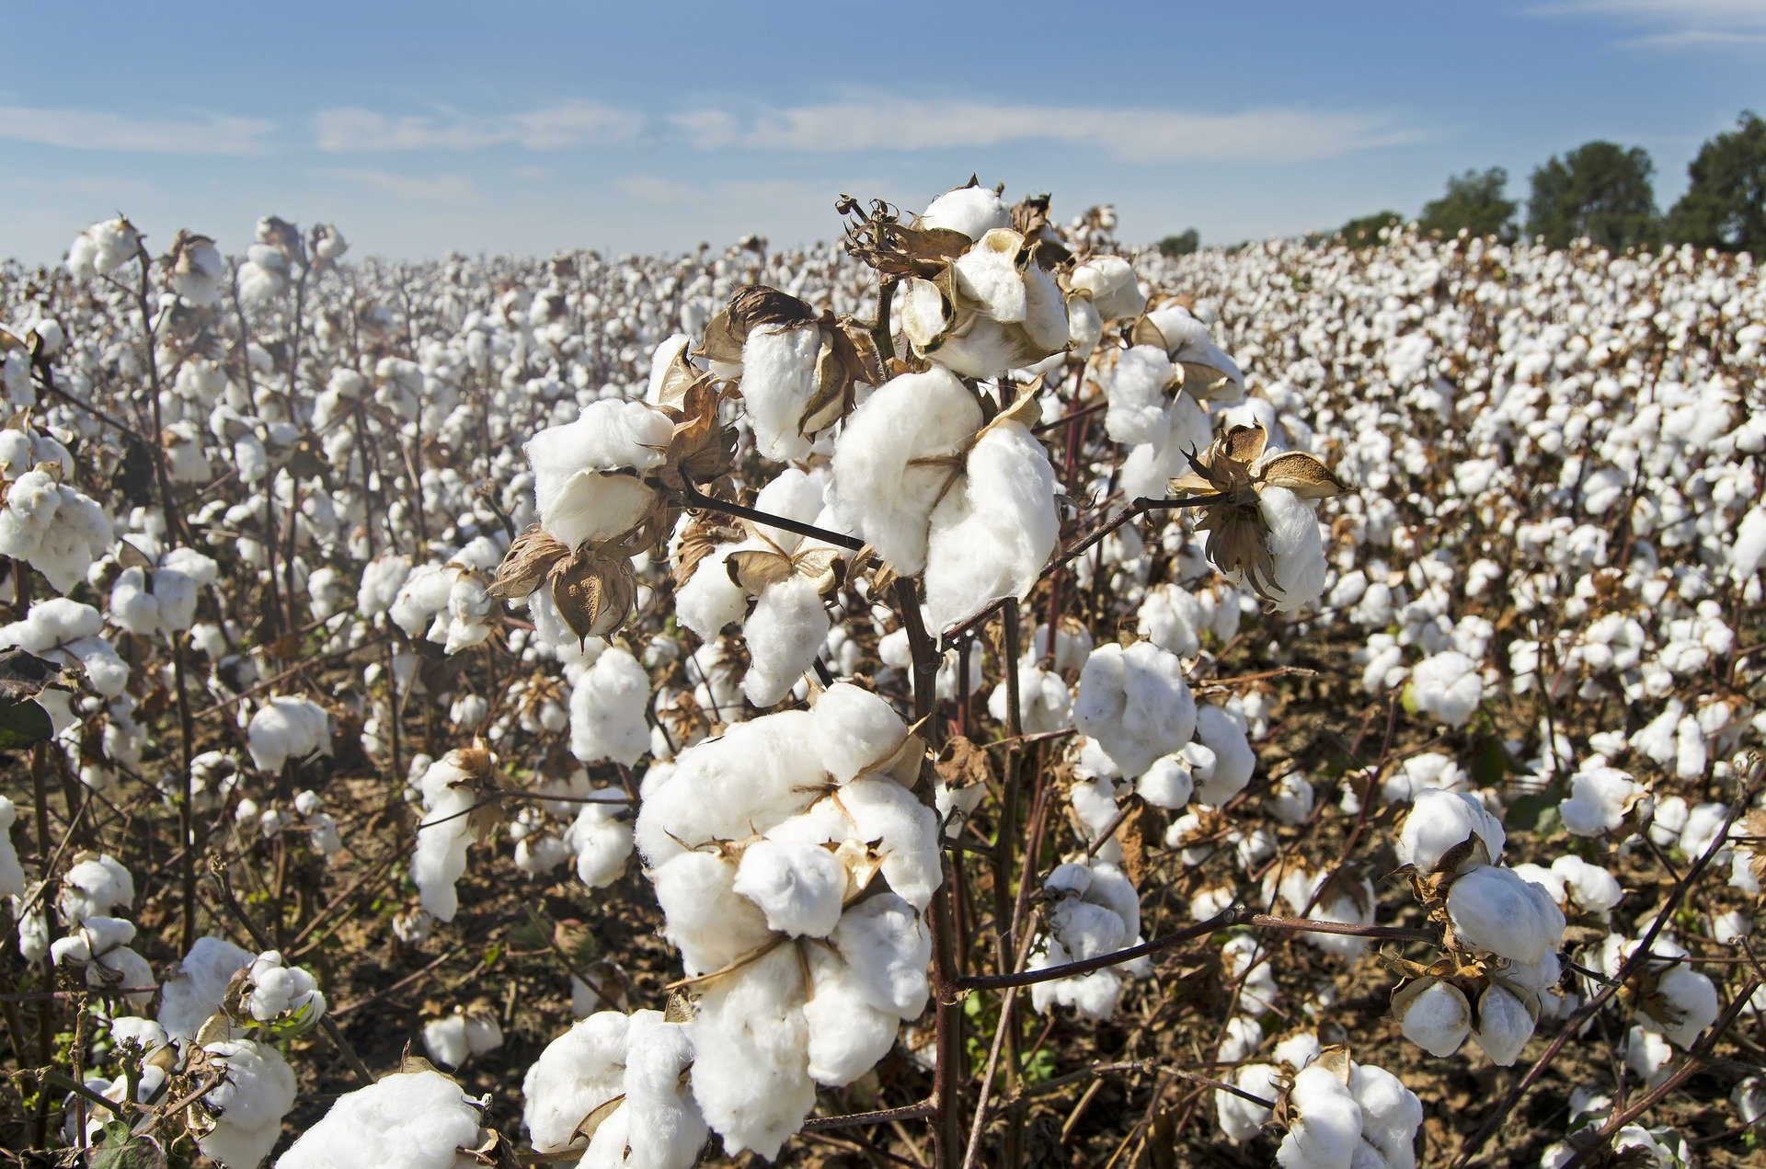
How is Cotton Made?
Cotton is grown in fields.
Picked from the fields with machines or people.
Then processed in textile factories.
Grown in Fields
Textile Factory

Slide 8
Stretch Station
(Physical Property)
Question: What properties of fabric would make you want to wear it river rafting on a cold day?
Burn Test
(Chemical Property)
Water Absorbency
(Physical Property)
Evaporative Cooling
(Physical Property)
Chemical Composition Station
(Chemical Property)
Water Drop Station
(Physical Property)

Slide 9
Wildland firefighters should wear cotton socks.
Evidence for why a firefighter should wear cotton socks over polyester or spandex blends is because it takes longer to catch fire and holds more water. The cotton fiber held 4.5 grams more water from our investigation. Firefighters feet get very hot and sweaty walking on coals. They would hold water and cool the feet. In addition, the cotton took less time to catch fire and did not melt like the spandex. Melting fiber would stick to your feet and hurt. Based on the evaporative cooling you would want to wear cotton because it keeps your temperature down. Our test showed that the temperature was 6 degrees cooler with cotton. The reasons firefighter should wear cotton is because cotton has a better structure for holding water in its molecules. Because of this it will keep the firefighter safer longer.

Slide 10
Prompt:
Your investigation is complete. Now you need to communicate what you have learned. The river rafting company you work for has asked you to present your finding through one of the following methods:
Travel Brochure
Infomercial
Google Sites web page

Slide 11


Slide 12

3D-RST is supported by the NSF under grant number #DRL-2101383

