Slide 1


Stations Setup Instructions
Stretch Station
Materials
Infographic titled “Why is a swimsuit stretchy?”
Several pieces of a shirt that is 100% cotton cut into 10 cm x 10 cm
Several pieces of spandex cut into 10 cm x 10 cm
Ruler
Procedure
Students should read the infographic before doing the activity.
One group member will take one piece of fabric (10 cm x 10 cm) and measure its length on the ruler.
While holding the fabric next to the ruler, the student will stretch it as far as it can go and measure the length they could stretch it to.
Subtract the stretched length of the fabric by the original length and record that number on the worksheet.
Repeat for the other fabric.
Students will then answer the questions in the worksheet under the stretch test.
Water Absorbency Station
Materials
Infographic titled “Why do fabrics absorb different amounts of water?”
Scale
Bowl of water
Weigh bowl
Several pieces of cotton
Several pieces of spandex
Procedure
Students should read the infographic before doing the activity.
After reading the infographic, students will grab a sheet of cotton and weigh the mass of the dry cotton.
Students will then put the piece of cotton in the bowl of water.
When the students take the cotton out of the water, they should let the fabric drip a bit but don’t wring out the cotton.
Next, put the wet cotton in the weigh bowl and record the weight.
Repeat steps 2-5 but with a piece of spandex fabric.
Students will then answer the questions in the Water Absorbency section of the worksheet.
3D-RST is supported by the NSF under grant number #DRL-2101383

Slide 2
Evaporative Cooling Station
Materials
Three Metal thermometer
One wet piece of cotton
One wet piece of spandex
Fan (optional)
Procedure
This station is set up before class by the teacher.
Get a 10cm x 10cm cloth of cotton and get it wet
Ring out excess water.
Fold the cloth over the metal probe of the thermometer–do not wrap it.
Make sure the cloth is in contact with the thermometer probe.
Repeat this with another thermometer and a spandex cloth.
Have a third thermometer reading room temperature.
(Optional) Place all three in front of a fan and allow time for the temperatures to change.
The temperature of the cotton should be lower than the spandex, which should be lower than room temperature. If the cloth is wrapped around the probe multiple times rather than folded over once, it tends to reach a point where it insulates the probe and will give invalid data for this investigation.
Students will read the paragraph at the top of the page titled “Evaporative Cooling” before the activity.
Students will then observe and record the temperatures of both the cotton and the spandex.
Students will then answer the questions under the Evaporative Cooling section on the worksheet.
Chemical Composition & Hydrogen Bonding Station
Materials
Infographics titled “Compare and Contrast Chemical Composition.” (One for cotton and one for spandex)
Infographic titled “Hydrogen Bonding”
Cotton and Spandex models
Water molecules (printed)
Procedure
Print the cotton and spandex models. Cut out the strips and glue them end to end. Some middle strips can be left out if lab tables are not long enough.
Print the water molecules on a transparency sheet or a different color of paper from the models.
Tape the cotton and spandex models to the lab table.
Have the water molecules in a bowl or beaker.
Students should only have water molecules placed on the spandex model on the right side where the -NH groups are located. They should have water molecules along the entire length of the cotton model on the -OH groups.
Students will read through all infographics.
Students will place water molecules on the cotton and spandex models in places where hydrogen bonding could occur.
Students will find similarities and differences in the chemical compositions between the two fabrics.
3D-RST is supported by the NSF under grant number #DRL-2101383

Slide 3
Water Drop Station
Materials
One large cloth of cotton
One large cloth of spandex
Bowl of water
Pipettes
Infographic titled “Water Drop”
Procedure
Students will fill a pipette with water from the bowl
They will put 2-3 drops of water on a dry spot of cotton and 2-3 drops of water on a dry spot of spandex.
It would be good not to use a super dark piece of spandex so students can observe what is happening.
Students will make observations about the spot of water on the cloth and answer the questions in the worksheet.
You may want to help students understand the difference between hydrophobic and hydrophilic at this station.
Burn Test Station
Materials
Small pieces of spandex cloth
Small pieces of cotton cloth
Tweezers/ forceps
Candle/burner
Aluminum foil (to put underneath the burning fabrics)
Infographic titled “Burn Test.”
Procedure
Make sure you do this test in a well-ventilated area.
A teacher will light the burner/candle.
Students will put a small piece of spandex into the flame using tweezers.
Hold the burning fabric over the aluminum foil and observe how it burns, such as the smell, how quickly it burns, and the flame itself.
Repeat steps 2 and 3 with a small piece of cotton fabric.
Record your observations on both fabrics and answer the questions in the worksheet.
3D-RST is supported by the NSF under grant number #DRL-2101383

Slide 4
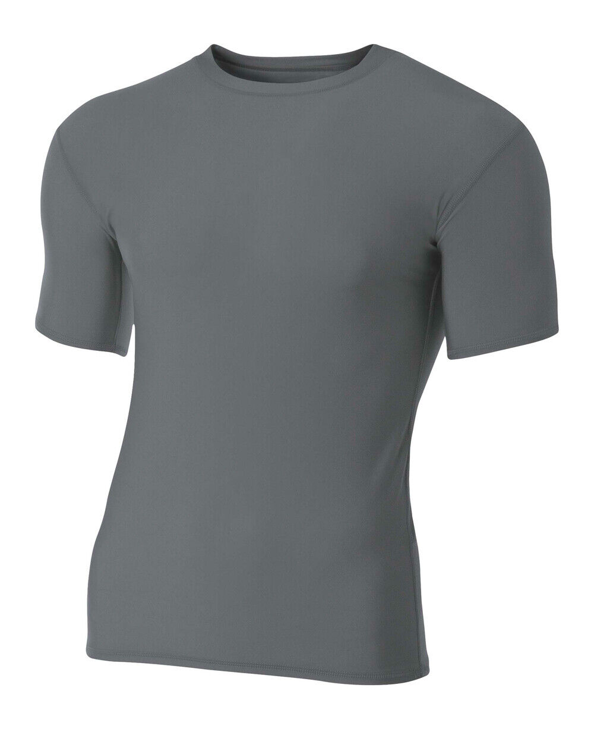
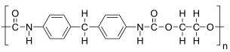
What is Spandex?
Spandex is man made. It is a synthetic product created from several chemical processes. The natural resource used to create most of spandex is fossil fuels retrieved from the ground.
Spandex is a synthetic polymer. It is made from fossil fuels. It is also called Elastane Fiber.
Chemically, it is 85% polyurethane molecules. These polymers are composed mostly of organic units of carbon rings joined by -NH-groups to link more together.
Polyurethane molecule
Carbon rings (6 carbons forming a hexagon)
-NH-
urethane groups
3D-RST is supported by the NSF under grant number #DRL-2101383

Slide 5


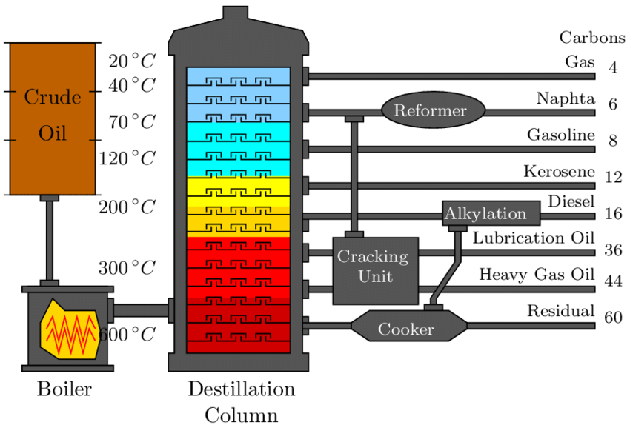

How is Spandex Made?
Oil is pumped from the ground.
Oil is pumped in pipes or transferred in trucks to an oil refinery.
There it is separated by distillation into different grades or oil products.
The top of the distillation is the gas products, this is where ethene (C₂H₄) is extracted.
The ethene is then shipped to factories where it undergoes several chemical processes (production of polymers, several thinning, diluting, stretching and heating stages) then its bundled then the fibers are weaved together
Once the fabric is weaved it is then shipped to fabric shops where they sew it into clothing.
Oil Field
oil
Shipping
Oil Refinery
Factory
3D-RST is supported by the NSF under grant number #DRL-2101383

Slide 6
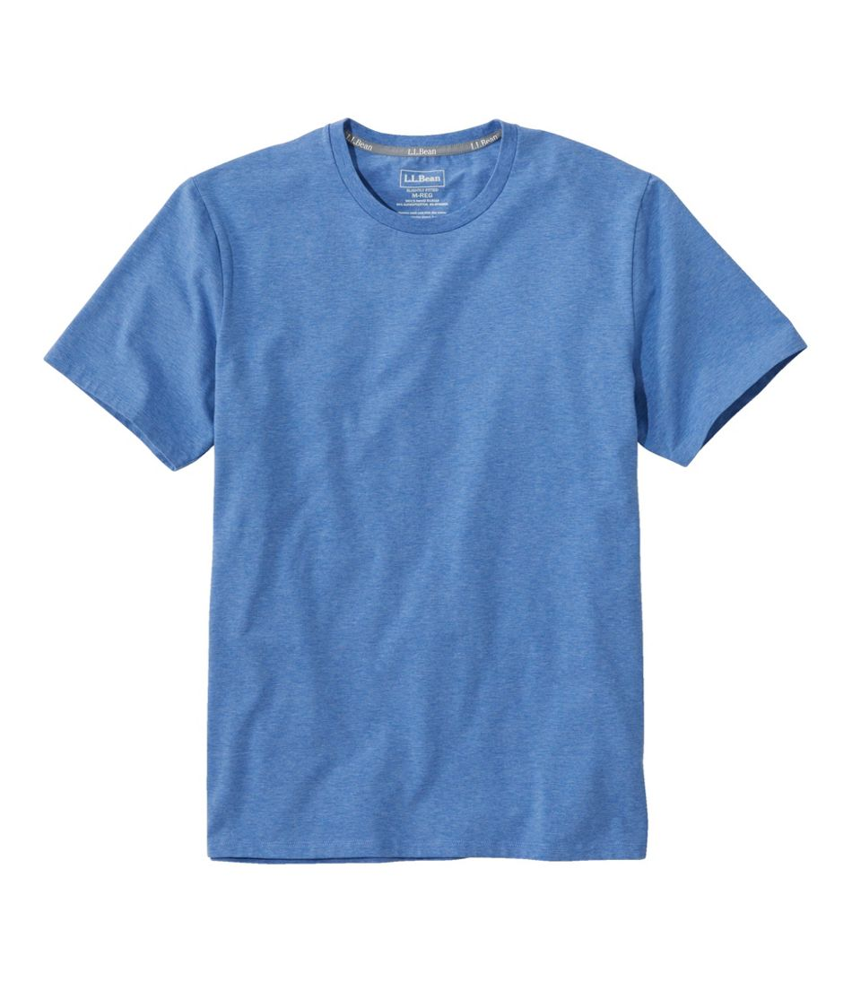
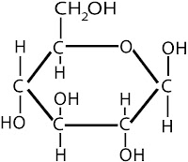
What is Cotton?
Cotton is a natural product. It is created by photosynthesis in cotton plants. The most common atom by mass in cotton is carbon and oxygen.
Carbon and oxygen came from carbon dioxide (CO2) that originally was in the air but due to photosynthesis in the plant changed into carbon hexagon rings.
The cotton plant produces seeds that are protected by the cotton fibers. The cotton can be collected and woven into fabrics.
Carbon rings are very common in organic molecules. They usually all have carbon, oxygen and hydrogen in their ring shaped molecules. Cotton contains billions of these molecules linked in chains. The OH (Oxygen and Hydrogen) groups surround most the molecule.
Carbon hexagon ring
3D-RST is supported by the NSF under grant number #DRL-2101383

Slide 7

How is Cotton Made?
Cotton is planted and grown in fields
Once the cotton produces seeds it is picked either by machines or by hand.
The cotton is then shipped to a tactile production facility.
There it is carded, a process of forming long cotton fiber strands.
It is spun into yarn.
Usually it is dyed.
It is then woven into different types of fabrics.
Usually it is shipped to another facility where it is then cut and sewed into clothing.
3D-RST is supported by the NSF under grant number #DRL-2101383

Slide 8
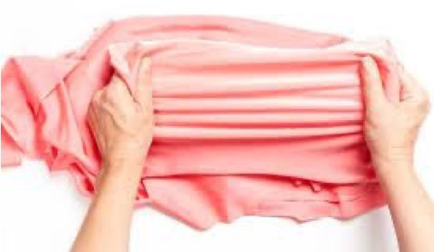
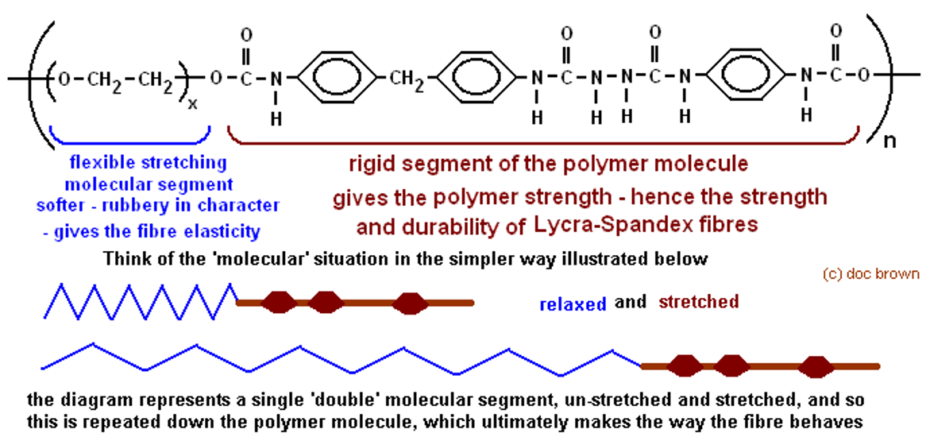
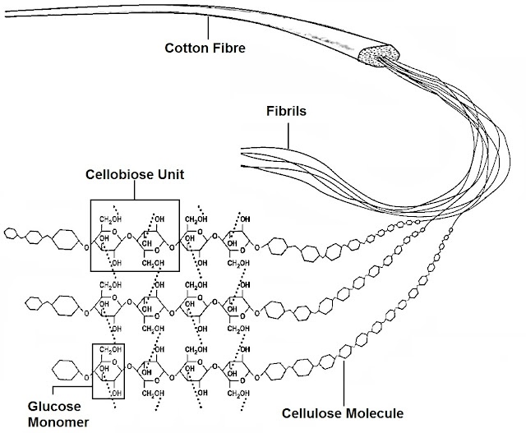
Why is a swimsuit stretchy?
Spandex fabric is made from long chains of plastic known as polyurethane. These chains are arranged in a way that allows the fabric to stretch and bounce back to its original shape. It's like a bunch of interconnected springs. The spandex macromolecule has two sides a springy tail and a rigid head.
tail
head
Cotton is also composed of long chains of carbon rings but there are no sections that act as “springs.” Therefore, the fibers do not stretch.
3D-RST is supported by the NSF under grant number #DRL-2101383

Slide 9
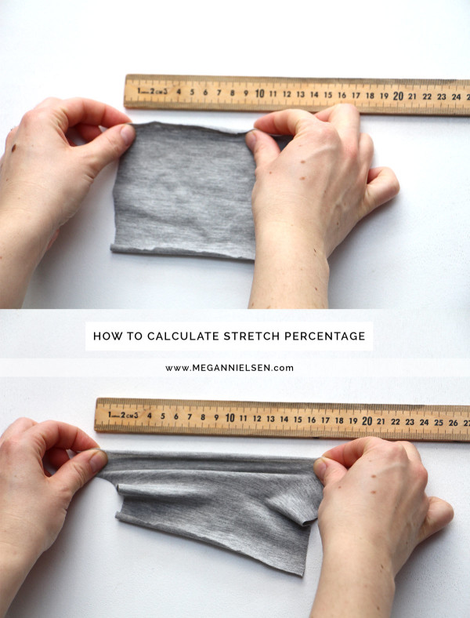
Stretch Test
Read the infographic about stretching.
Place each material at the zero end of the ruler (use the centimeter side- metric units!).
Pull the material as far as it will stretch.
Record the distance in centimeters that the material was able to stretch.
Distance stretched
Distance relaxed
Ex. 16.7 cm
- 10.4 cm
record 6.3 cm
Record the distance stretched in centimeters (cm)
3D-RST is supported by the NSF under grant number #DRL-2101383

Slide 10
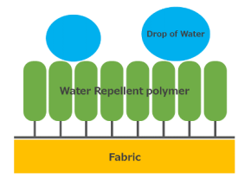
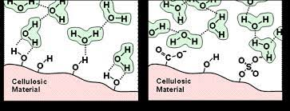
Why do fabrics absorb different amounts of water?
Spandex:
Spandex, also called lycra and elastane, is a type of polyurethane. It is hydrophobic, which means it repels water. Polyurethane is also used to make foam, coatings for decks and boats, and many other applications.
Cotton:
Cotton is pure cellulose, a naturally occurring polymer. Cellulose is a carbohydrate, and the molecule is a long chain of glucose (sugar) molecules. If you look at the structure of a cellulose molecule you can see the OH- groups that are on the outer edge. These negatively charged groups attract water molecules and make cellulose in the cotton absorb water well. Cotton can absorb about 25 times its weight in water. Chemists refer to substances like cotton as hydrophilic, which means that they attract water molecules.
OH- is attracted to the water molecules by electrons creating polarity and intermolecular forces hold the water to the cotton molecules.
3D-RST is supported by the NSF under grant number #DRL-2101383

Slide 11


Water Absorbency Test
Water absorbency is a measure of how much water a given material can hold in relation to its mass.
Instructions:
Before beginning the experiment make sure the weigh boats are dry.
Measure the mass of the square of fabric and record.
Saturate the fabric with water. Let it drip several times before you take it to the weigh boats.
While the fabric is still wet, place it in the weigh boat. Record the mass of the water and the fabric.
Subtract the mass.
Next, divide the mass of the wet material by the mass of the dry material. Then multiple by 100 to get the percent change of mass in the fabric.
Example:
Material | Mass of Dry Material (grams) | Mass of Wet Material (grams) | Mass of Water (grams) | Percent Change (%)
X | 2.4g | 3.5g | 1.1g | +146%
Wet cloth
Weigh boat - zero before you add the fabric
3D-RST is supported by the NSF under grant number #DRL-2101383

Slide 12
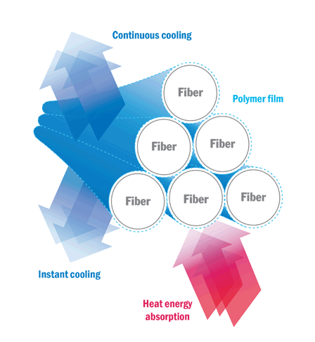
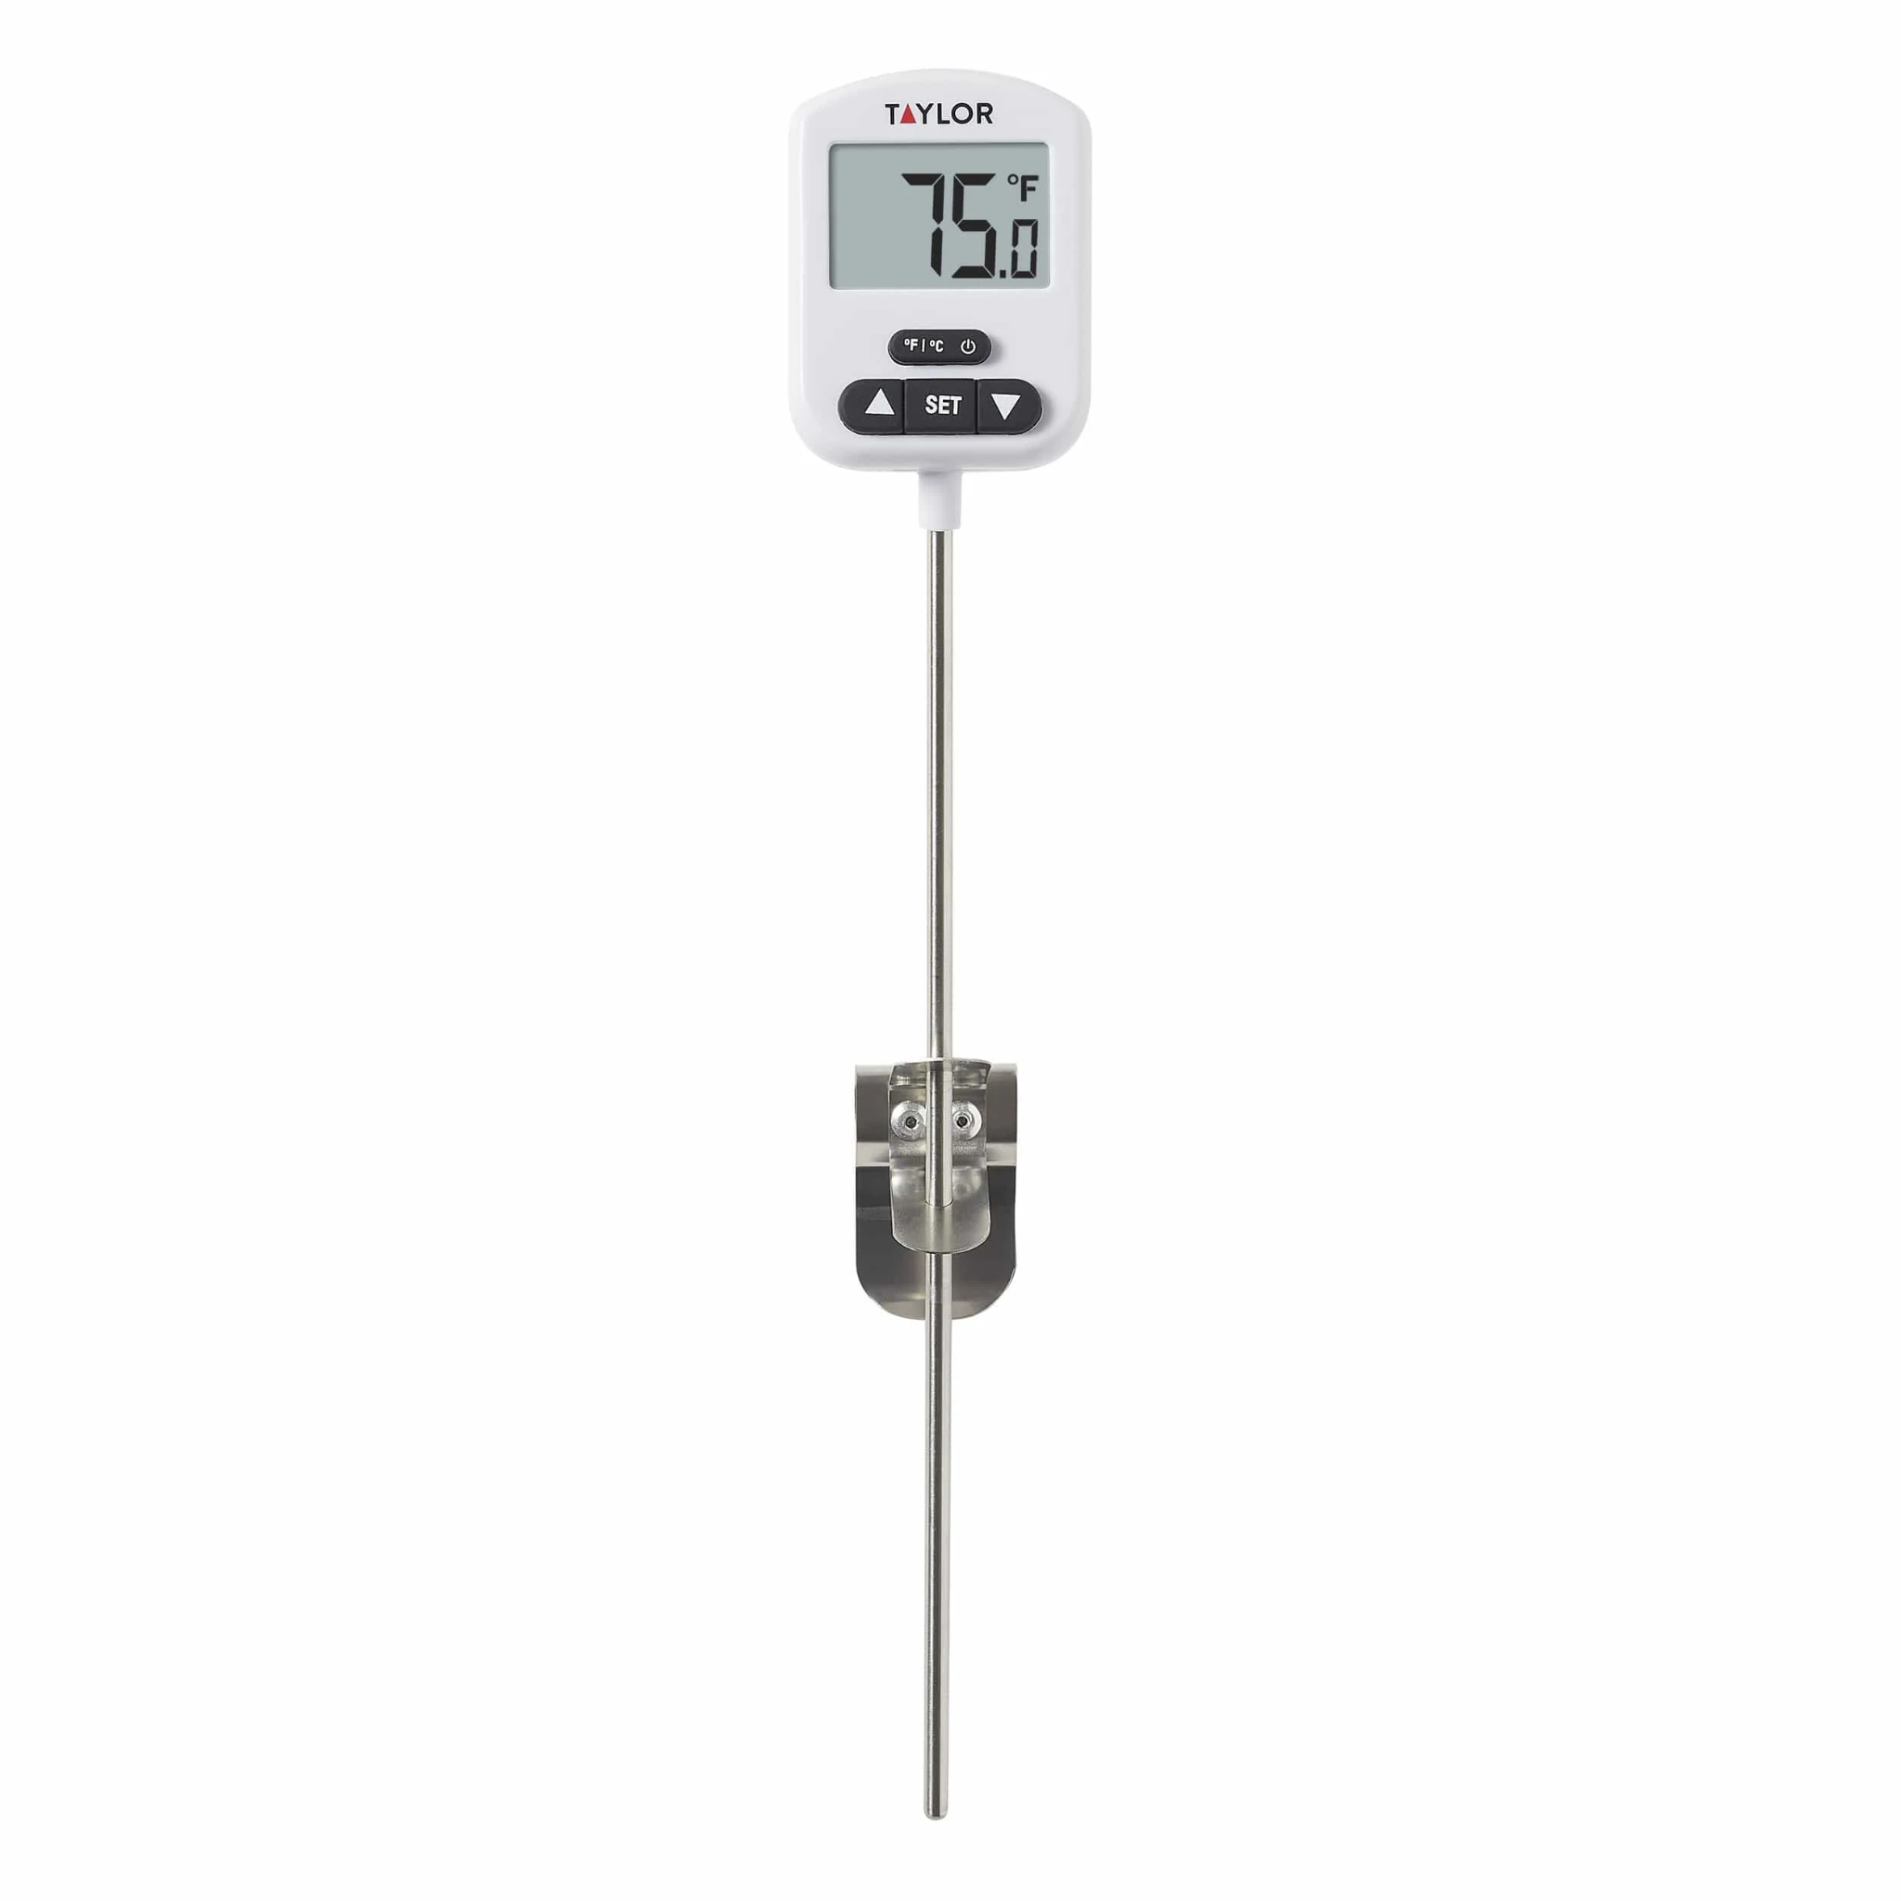
Evaporative Cooling Test
Evaporative cooling uses evaporation to help cool the air. Based on the principles of evaporation, hot and dry outside air is drawn through water-soaked cooling pads. As the air is pushed through these pads, the water evaporates and the heat in the air is absorbed, which lowers the air temperature.
Instructions:
Record the temperature in the room with the dry bulb thermometer.
Record the temperature with the spandex and cotton fabric wrapped around them.
Make sure the tip of the thermometer stays covered completely while you read the thermometer.
3D-RST is supported by the NSF under grant number #DRL-2101383

Slide 13
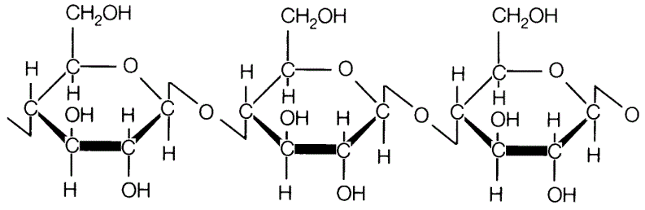
Compare and Contrast Chemical Composition
The chemical formula of cellulose is (C₆H₁₀O₅)_{n}
COTTON
Cotton, the natural fiber most widely used in apparel, grows around the seeds of cotton plants. It is made of cellulose material.Cellulose is a macromolecule –– a polymer made up of a long chain of glucose molecules. The oxygen-hydrogen (-hydroxyl or -OH) groups that line the edge of cotton's long cellulose molecule attract water, sucking it right up into its fibers.
The chemical of cellulose is a single repeating pattern of the same carbon ring molecule. A single fiber is an elongated cell that is a flat, twisted, hollow, ribbon-like structure.
3D-RST is supported by the NSF under grant number #DRL-2101383

Slide 14
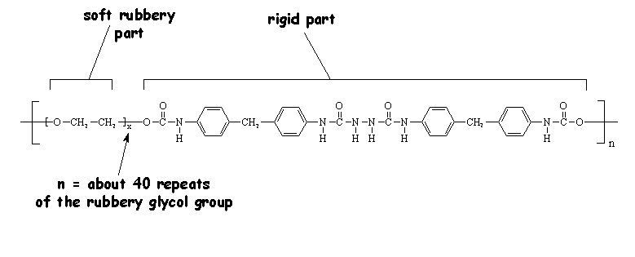
Compare and Contrast Chemical Composition
Tail--
Chemical formula for spandex:
(CH₂CH₂O)_{n}(C₂OC(=O)C(C₄N=C=O)N=C=O)_{n}
SPANDEX
The fiber forming substance used to produce spandex is any long-chain synthetic (human-designed) polymer composed of at least 85% of segmented polyurethane. Polyurethane comes from fossil fuels.
The basic elements of nitrogen, hydrogen, carbon and oxygen are synthesised with other substances to ethyl ester compounds in polymer chains of soft segments called the tail that provide stretch and harder segments that hold the chain together. The N-H (amide) group slightly attracts water.
3D-RST is supported by the NSF under grant number #DRL-2101383

Slide 15
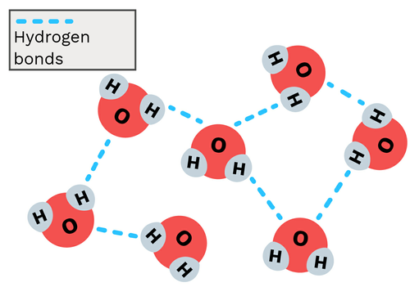
Hydrogen Bonding
Hydrogen bonds occur between molecules with N-H, O-H and H-F bonds. These are polar bonds. Water has a high number of hydrogen bonds between the individual water molecules.
Cellulose fibers have -OH groups that can interact with water and form hydrogen bonds. On average, each -OH group can make around two hydrogen bonds with water. C-H bonds are nonpolar.
O
H
H
O
O
H
H
H
H
OH
OH
Cellulose Fiber
O
Spandex has -NH groups that can also hydrogen bond. Hydrogen bonds with -NH groups are weaker than hydrogen bonds with -OH groups. Each -NH group can form an average of around 1.5 hydrogen bonds with water.
H
H
O
O
H
H
H
H
NH
NH
Spandex Molecule
Instructions:
Find the -OH and -NH groups on the models of cellulose and spandex taped to the table.
Place water molecules by those groups to indicate hydrogen bonds could occur there.
Once all the water molecules are placed, count how many were put on each model.
3D-RST is supported by the NSF under grant number #DRL-2101383

Slide 16
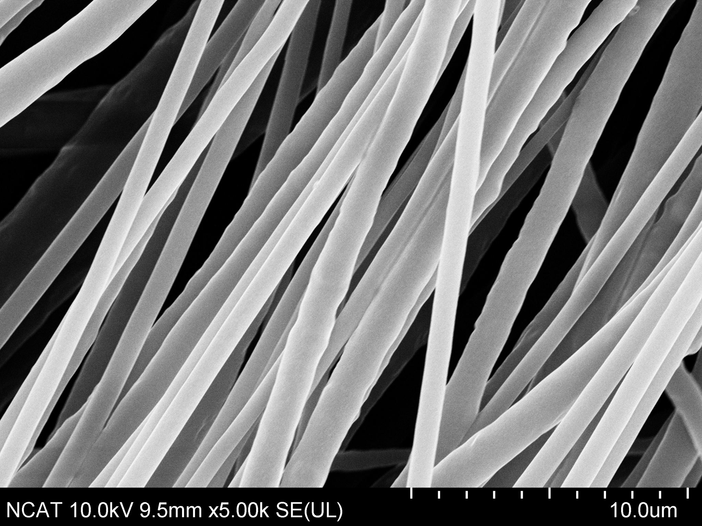
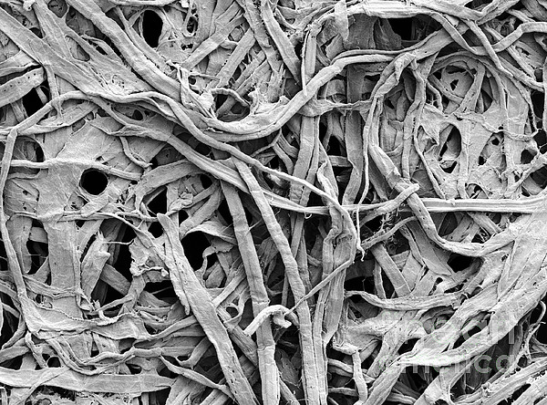
Water Drop Observations
Instructions:
Place a single drop of water on top of each fabric in a dry spot.
Make observations of what happens to the water as it is absorbed by the fabric.
Hydrophobic-water hating | Hydrophilic- water loving
-attractive force between water and macromolecule is weak. -absorption is slow | -attractive force between water and macromolecules is strong. -absorption is fast
Spandex - Electron Microscope
Cotton- Electron Microscope
3D-RST is supported by the NSF under grant number #DRL-2101383

Slide 17

Burn Test
Chemical properties of different molecules can be observed with a flame test. Often to identify different fabrics burning a small amount can give clues to their molecular structures.
Instructions:
Light the candle.
Use the tweezers to move a small piece of fabric into the flame.
Once the fabric is burning, hold it over the aluminum to catch the charred remains.
Make observations and record.
Repeat with the other fabric.
3D-RST is supported by the NSF under grant number #DRL-2101383
Notes:
https://cdn.shopify.com/s/files/1/0289/4249/files/Fabric_Burn_Test_Flowchart_Insta_cf3fb14d-9260-49b0-a941-baa29bdc6935.jpg?v=1613729563

Slide 18
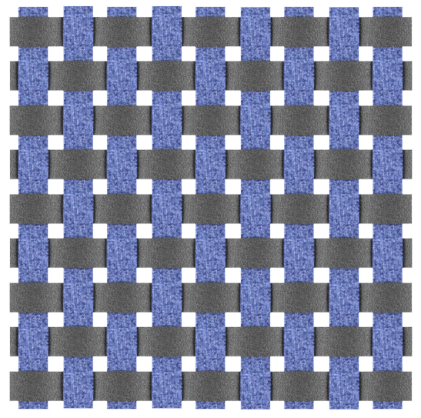

Fibers and Weaves
Woven Fabric
Knitted Fabric
3D-RST is supported by the NSF under grant number #DRL-2101383

