Slide 1
THINK-PAIR-SHARE!
Write down your responses to the PROMPTS below using the "Before vs After" picture that follows.
What do you SEE?
What do you THINK?
What do you WONDER?
Be prepared to share and discuss with your group/class on the above prompts
Notes:
Teachers: This is an instructional page to let students know what they will do on the next slide.

Slide 2
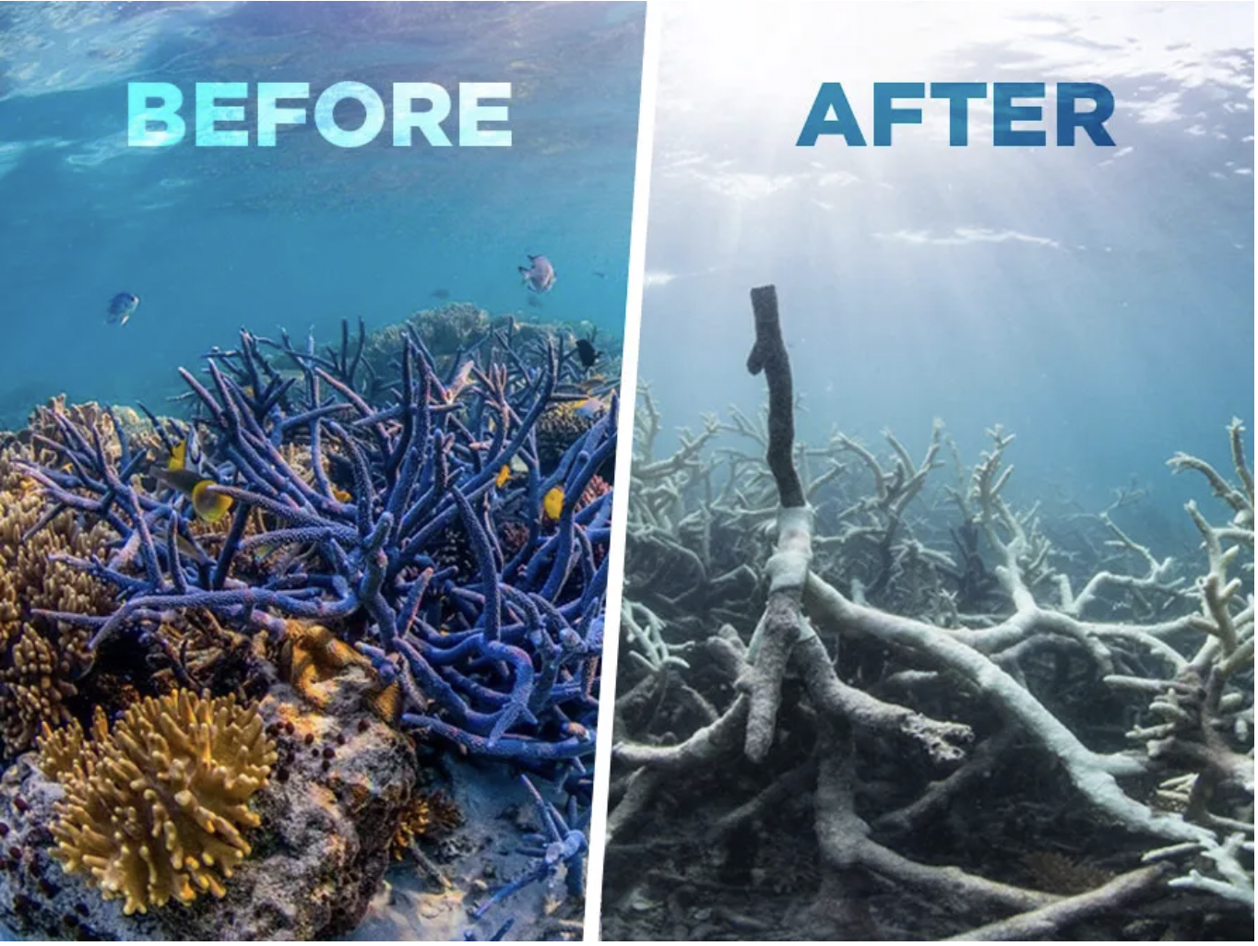

What do we see happening here?
Notes:
Write down three observations and questions in the "Before vs After" picture that follows.
On your own write down your observations
Write down at least 1-2 questions you have about this picture.
Be prepared to share and discuss with your group/class
Observations
Questions- what do you want to know about these pictures?
Teacher NOTE: 2 minutes should be ample time for them to complete this portion (adjust accordingly, as needed); I found the music distracting but students like it

Slide 3
THE CARBON CYCLE AND ITS EFFECTS ON THE GREAT BARRIER REEF
What would your life be like if you couldn't eat seafood? What would your life be like if there were no plants on earth? What about if there was not enough oxygen to breathe?
Pay close attention to what the reef is like, what is found there, who benefits, any changes to it, etc..
Complete the following prompts:
What do you SEE?
What do you THINK?
What do you WONDER?
Watch and observe: https://www.nationalgeographic.com/travel/world-heritage/article/great-barrier-reef 2:14
Notes:
Teacher note: Have a discussion about the questions. AIM for 100% student participation by asking them "thumbs up" or "thumbs down" questions.
They may need an extra minute on this one AND...I had them watch the last minute TWICE so they could come up with a good question (as a group and then a class) and a reasonable claim (based on initial observations)

Slide 4
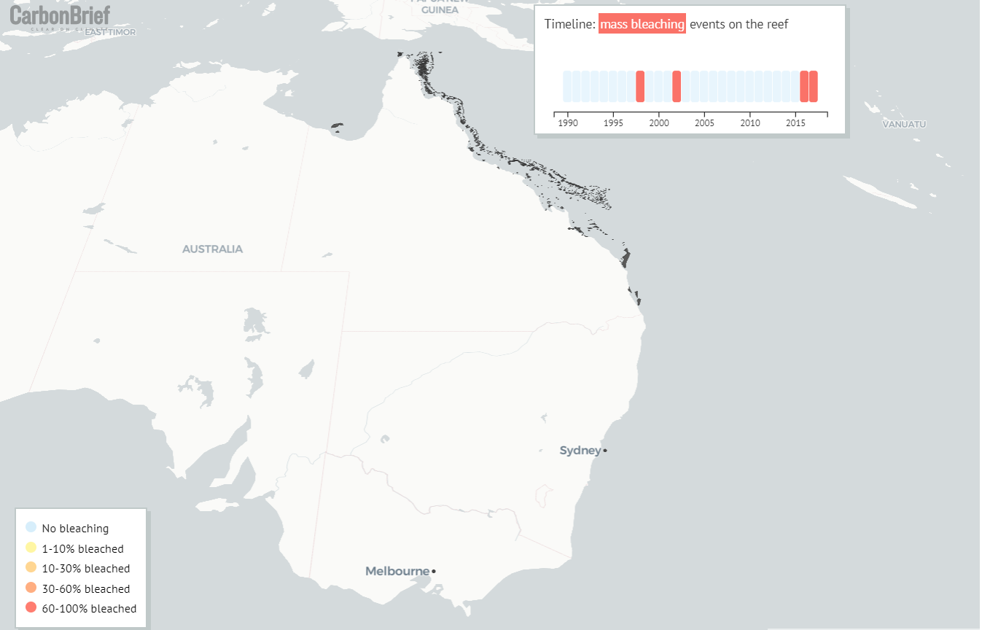
the Great Barrier Reef
What is something we can do to turn things white? (Hair color / clothes / leather)?
What is it called when there is a removal of color?
Notes:
Teacher note: the goal of this slide is for students to know that the bleaching process that is occurring in the GBR is similar to (BUT NOT THE SAME AS) bleaching at their own homes-= THE REMOVAL OF COLOR

Slide 5
Write an Initial PREDICTION or Hypothesis If...then....because
Notes:
Teacher notes: Students should write a claim that answers the question: Why is the coral reef bleaching?
If they feel they have evidence, they can write some down but they really do not have evidence at this point in time.

Slide 6

CARBON CYCLE P1:
You will be assigned a station (reservoir) to start.
Carbon Cycle Game Reservoir Stations
When you get to the station, you will roll the die ONE TIME
The number on the die determines what happens to you (as a carbon atom)
Be sure to write down on Carbon Cycle Game Data Sheet the following :
Starting reservoir
Flux mechanism- how do you change into a different form
Ending reservoir
Repeat for Round 1 (pre-industrial) till you complete the table (12 times)
Wait for teacher to prompt you to complete Round 2 (industrial)
Use your data to answer the questions HERE:
Notes:
Teacher Notes: Be sure to use this spreadsheet to distribute students among the stations according to your class size: https://app.box.com/s/42nlhxtwaldcdauknb0w5zt84j4wq7i8
STATION cards for students: https://docs.google.com/document/d/1Wr7Jv9-eiRM3QqOkIJ5tE2Hp-GAWWnMk4O5PoOOKjk8/edit?usp=sharing
Important note: make a copy of the link to the QR code for use in your class
Use the data collected to export to a spreadsheet. This is what I used to make the pie charts on the next slide

Slide 7
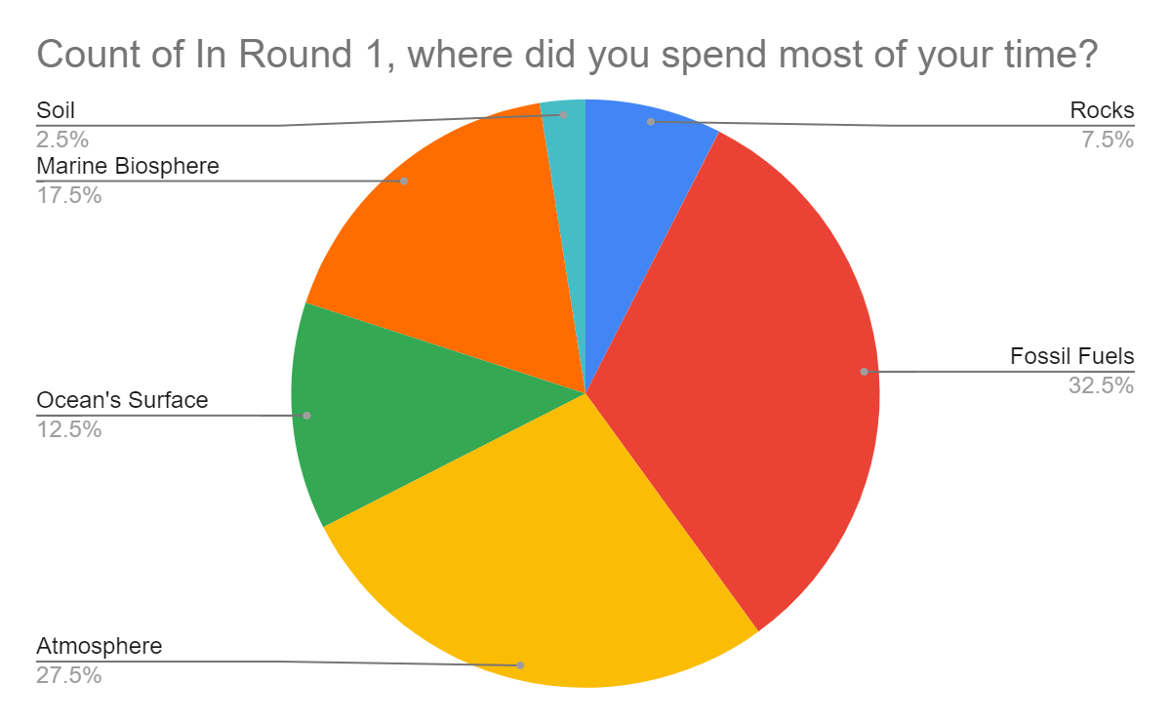
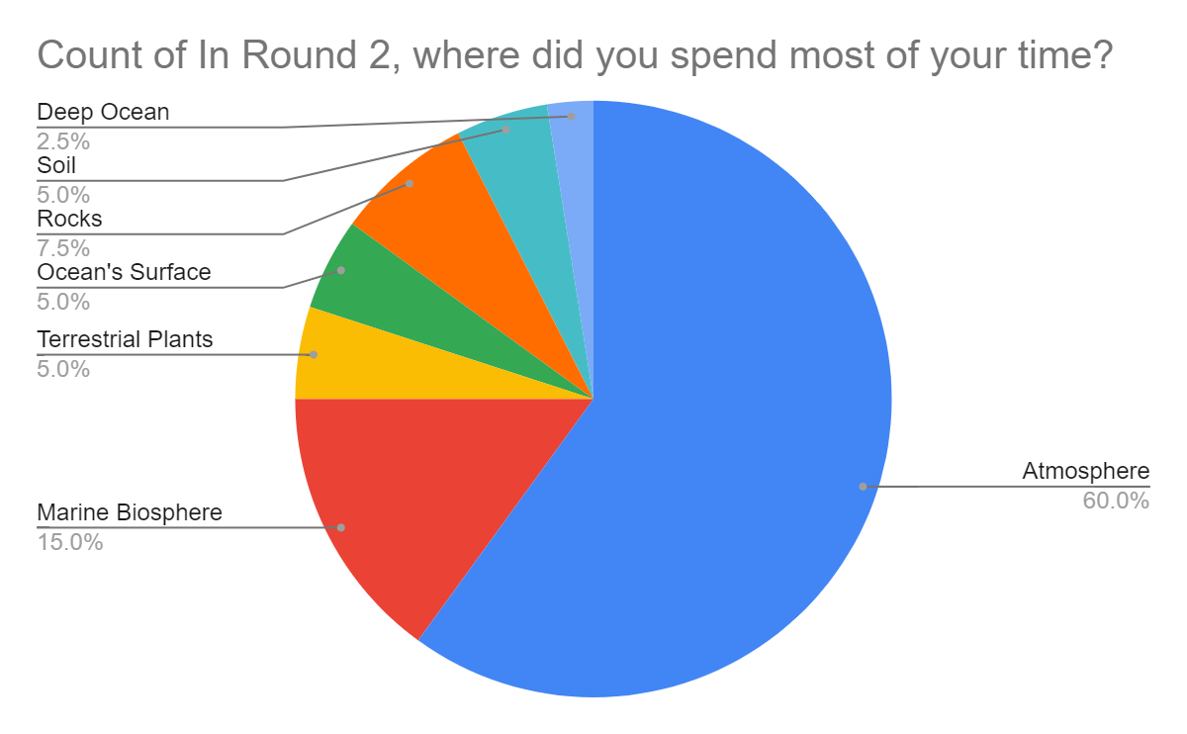
Carbon Cycle Game- review of data
Questions for discussion:
Why were there NO CARBON atoms that started in the MARINE BIOSPHERE, ROCK, or DEEP OCEAN?
Based on our data, where did MOST Carbon atoms spend their time in ROUND 1- (pre-industrial)
Based on our data, where did MOST Carbon atoms spend their time in ROUND 2 (INDUSTRIAL)?
How might where the CARBON is found in ROUND 2 be affecting the GBR or Coral reef?
Notes:
Teacher note: Use your data to make your graphs. Just highlight the column for round 1 and insert chart ; repeat for round 2

Slide 8
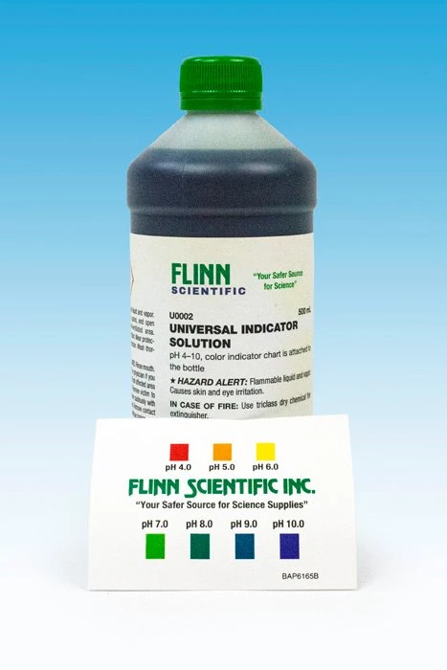
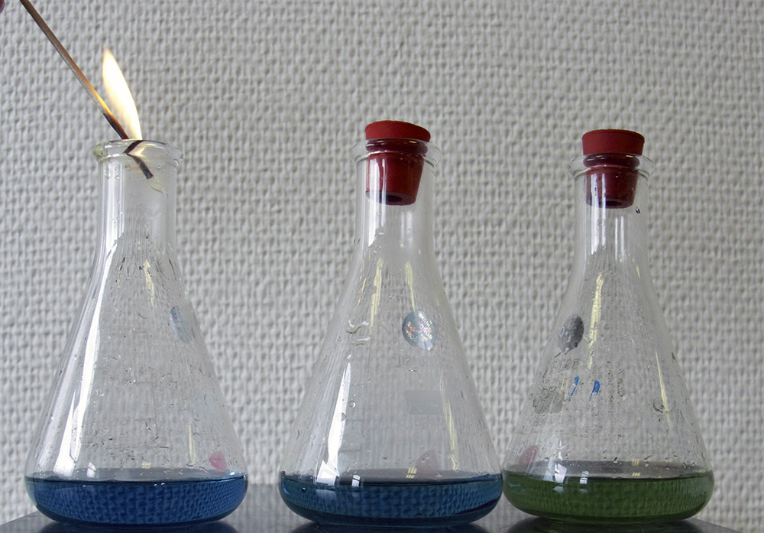
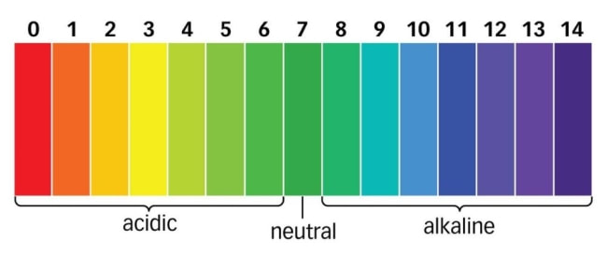
Demo- effects of CO2 on pH
Before Match vs. After Match
What do you SEE?
What do you THINK?
What do you WONDER?
Be prepared to share and discuss with your group/class on the above prompts
Notes:
Teacher notes: Prepare the solution by using 20 mL water in a flask plus 5 drops of Universal Indicator Solution.
Before: just the solution above. Have students determine the initial pH of your solution.
After: Light a match and hold it into the flask until the flame goes out. Ask students what the match is giving off and why it goes out? Close the flask with a stopper and swirl till it changes color.

Slide 9
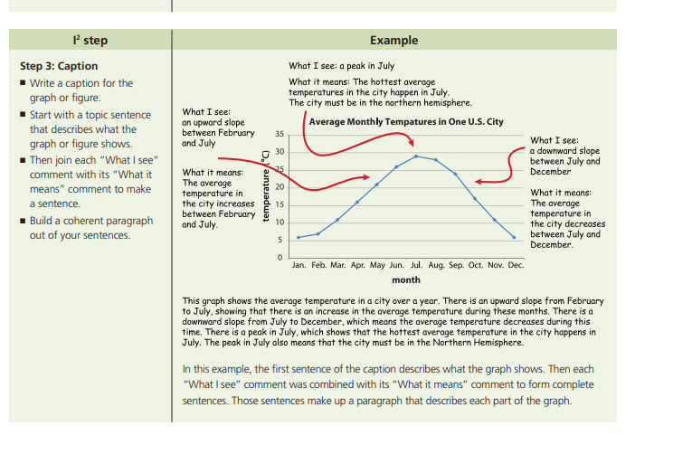
What I see.... What It means.... Caption it

Slide 10
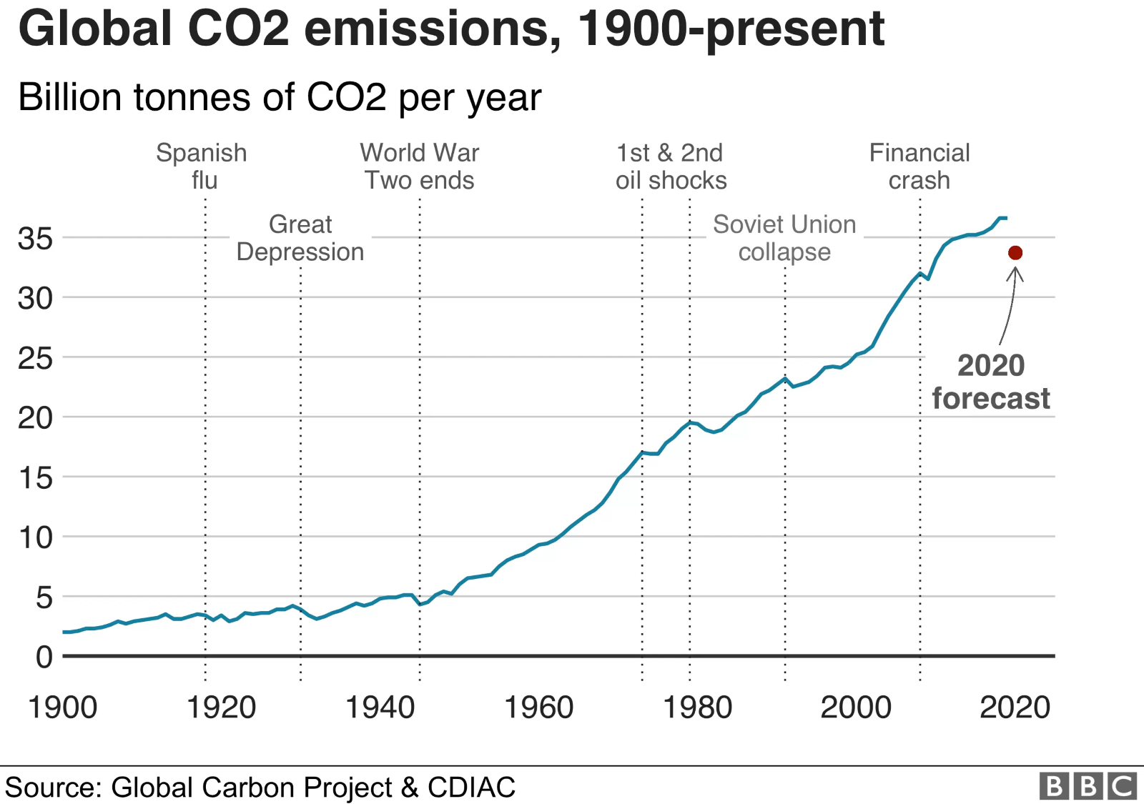
WHAT I SEE... WHAT IT MEANS... Caption IT!

Slide 11
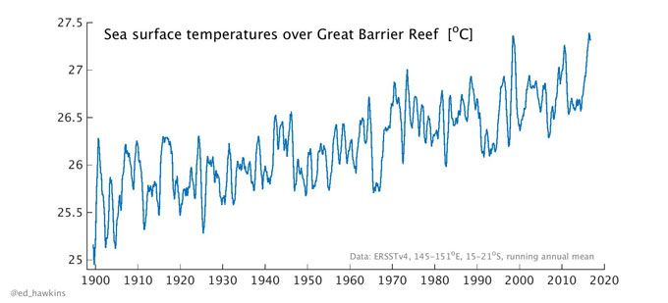
What I see... What it means... Caption IT!

Slide 12
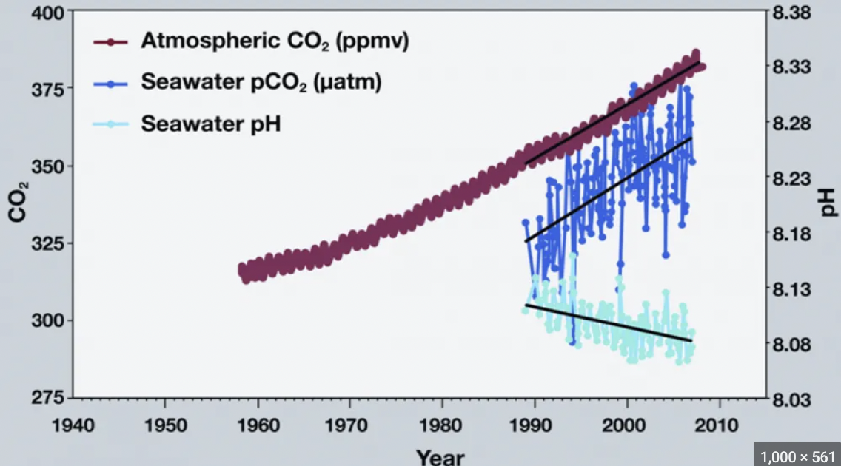
WHAT I SEE... WHAT IT MEANS... Caption IT!
Notes:
Teacher notes

Slide 13
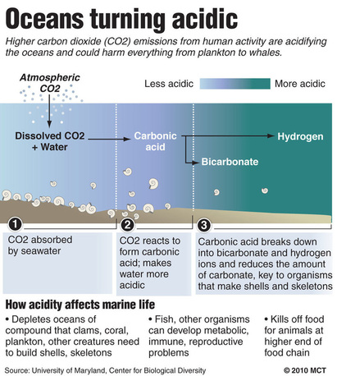
WHAT I SEE... WHAT IT MEANS... Caption IT!

Slide 14
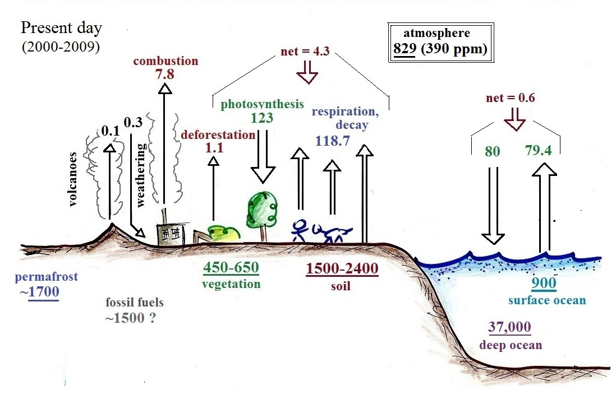
Take a look at the image above and use your experiences from the Carbon Cycle game to explain what you see.
What is the direction of the arrows telling us about Carbon?
What does the size of the arrow mean?
Which parts of the image were not part of the game but ARE part of the cycle?
What do these numbers represent?

Slide 15

Discuss: How does the burning of fossil fuels affect bleaching in the population of the Great Barrier Reef?
What did your groups notice about the following:
Temperature
"pH"
CO2 levels
Notes:
Teacher notes: For this slide, the goal is to get students to think about why the coral reef is bleaching and what the EVIDENCE is that supports it.

Slide 16
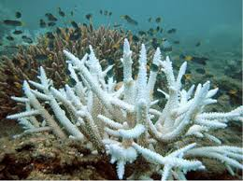
How does bleaching affect the Great Barrier Reef ecosystem?
How can a small change to the burning of fossil fuels have a big effect on the carbon cycle and ultimately the Great Barrier Reef?​
In this video you will be able to determine:
how these are all connected
why these are important elements to understanding the cause of bleaching in the great barrier reef. ​
Ocean Acidification Video 1:13
Notes:
Teacher notes: Ask the students to look for final evidence that they can add. Discuss what they saw to help them make some final connections.

Slide 17

What is the connection of changes in the CO2 levels, oceanic temperature, and the pH of the ocean to the bleaching of coral?
Write a CER (Last section on the student handout)
Make a Claim based on your evidence.
What is the Evidence that supports your claim?
Reasoning - How or why does it support your claim?
Notes:
Teacher notes: Students should revisit their initial CLAIM (which actually was more of a hypothesis and will be changed on the student sheet) that is supported by their EVIDENCE

Slide 18
Evaluate
Identify the question regarding the phenomenon
State your claim that answers the question
Provide evidence that supports your claim
Justify how or why your evidence supports the claim
Include any diagrams or images that helps you explain or support your claim
Notes:
Teacher notes: I don't think this slide is needed.

Slide 19

3D-RST is supported by the NSF under grant number #DRL-2101383

