Slide 1
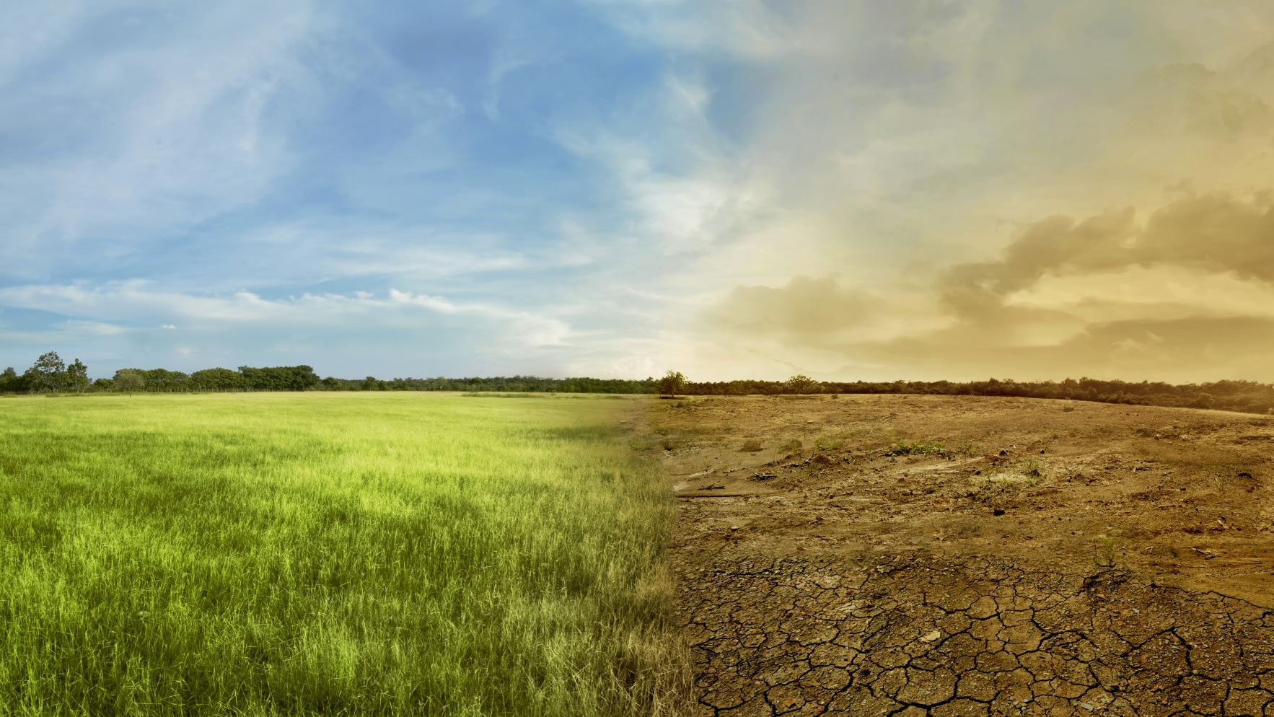
Stability of an Ecosystem

Slide 2
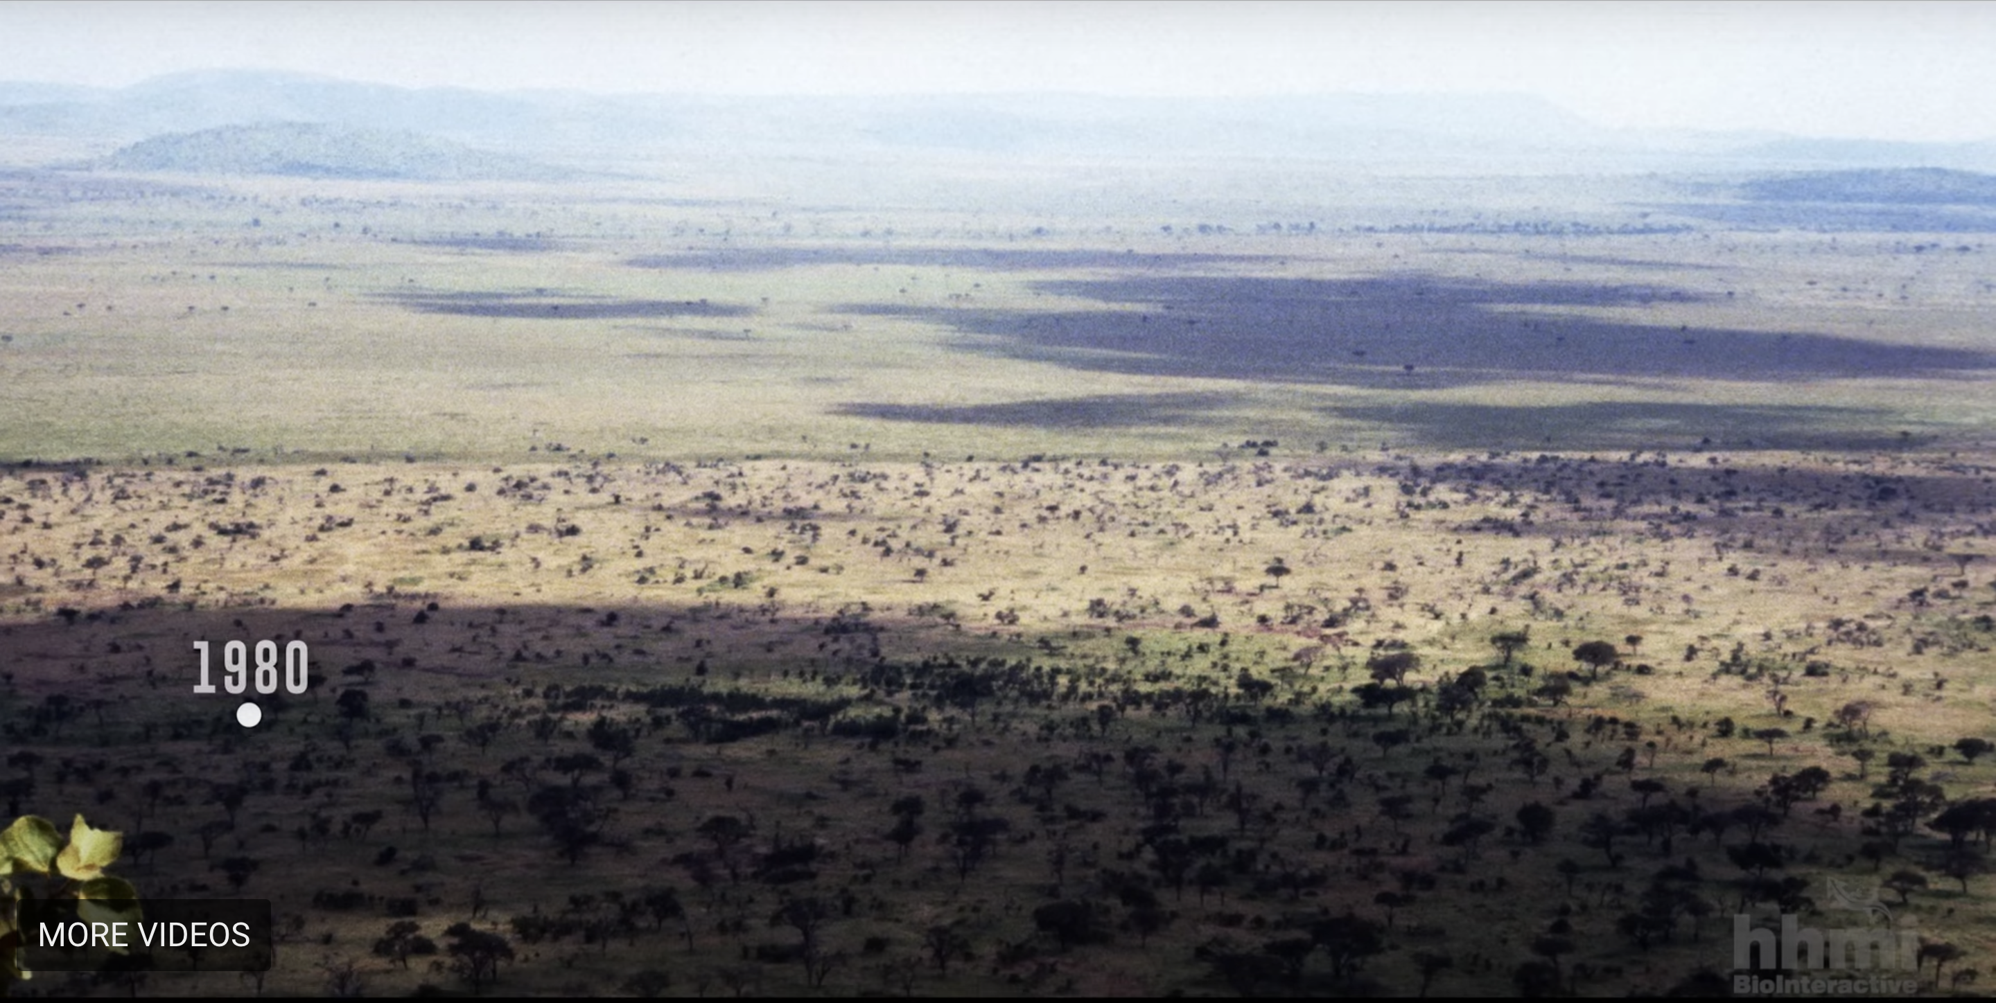
Notes:
Show the following 4 pictures, ask students to examine what is changing in all of these pictures.
NOTE- ALL OF THESE PICTURES WERE TAKEN FROM EXACTLY THE SAME SPOT

Slide 3
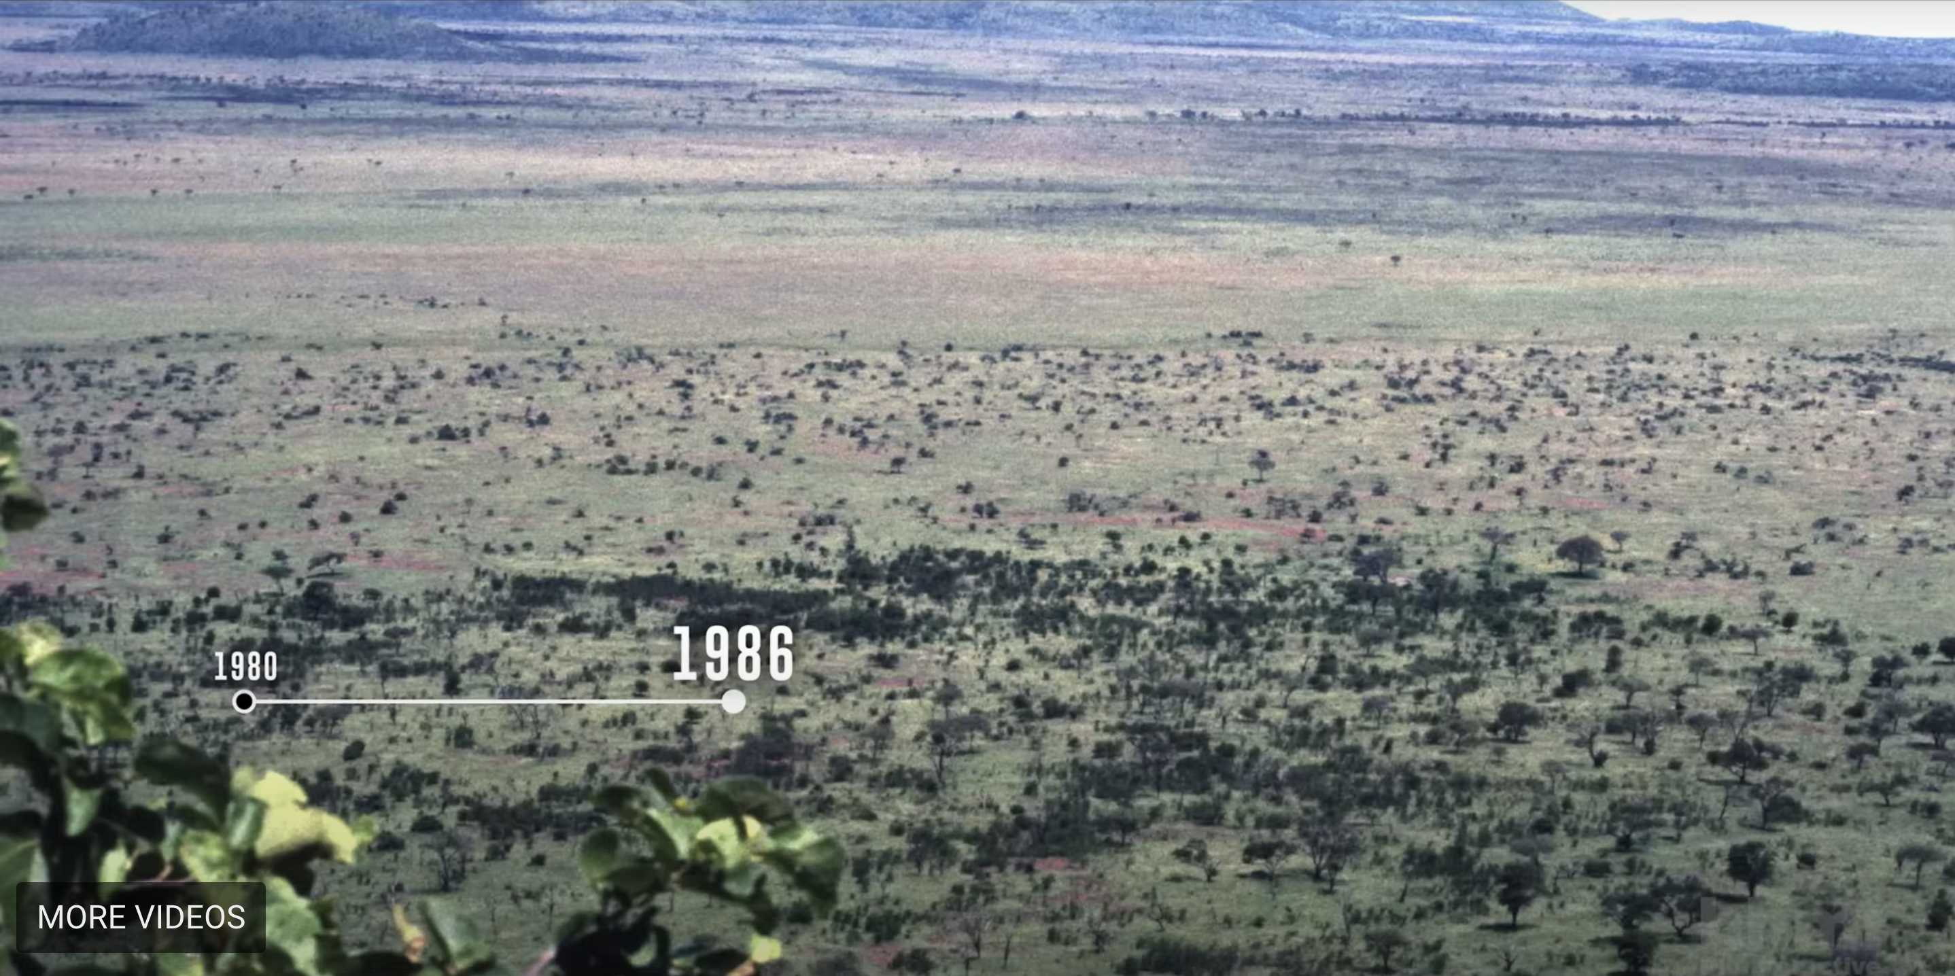

Slide 4
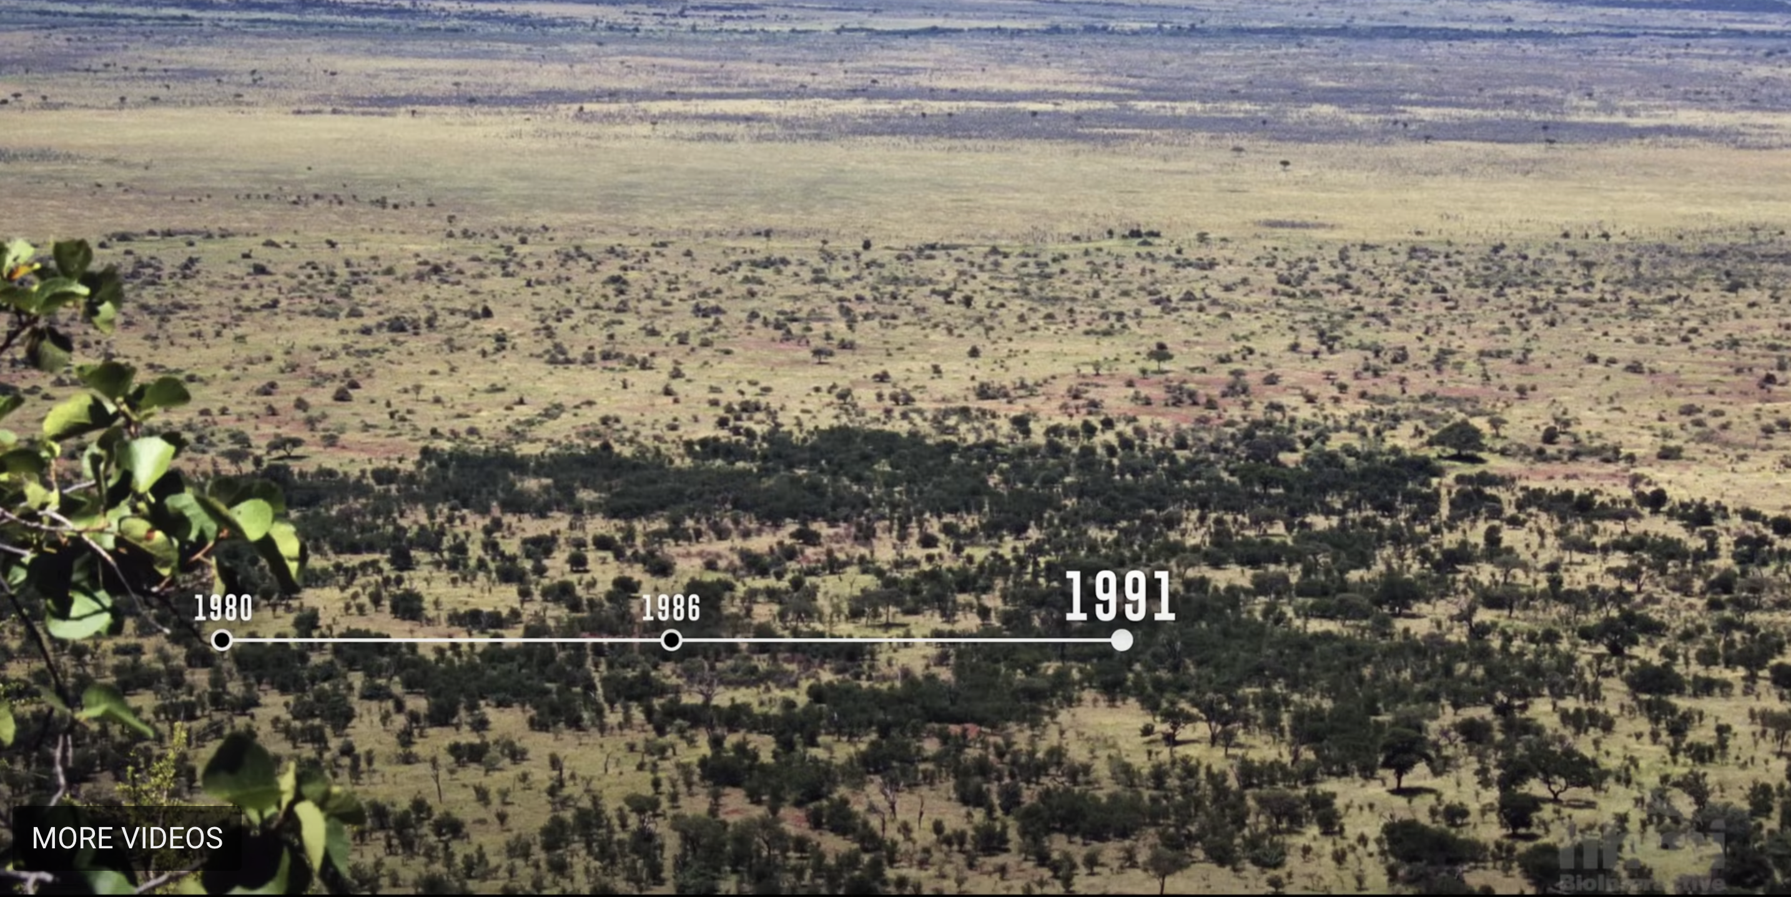

Slide 5
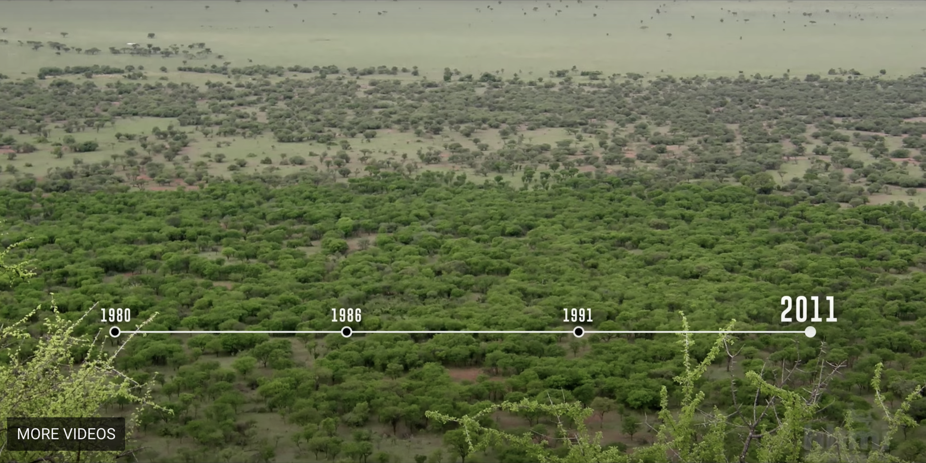
Notes:
What changes did you see between these pictures? What is the catalyst of this change?

Slide 6

Worksheet
Read the following questions and answer them on your work sheet
Write down at least 2 observations you have when looking at the time lapse pictures? (What do
you notice, what is changing)
What ideas do you have about why this is happening? What could have caused this?
Notes:
Give Students time to answer the questions on their paper, have them share with a partner, and then discuss as a class the observations and responses of the students.

Slide 7
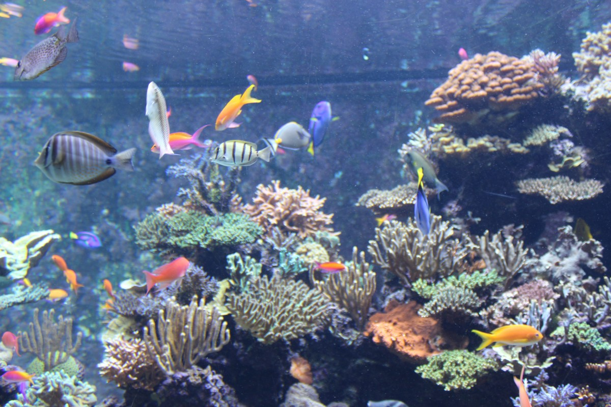
BIOTIC and ABIOTIC FACTORS
Biotic
  All living things within an ecosystem
Abiotic
  All nonliving things within an ecosystem
Notes:
- Review Biotic and Abiotic factors with students
- Have students identify some of these factors in the picture

Slide 8
!GROUP TIME!
In your groups you will . . .
Examine the fact sheet the gray wolf and its ecosystem
Investigate the roles of the animals in their respective ecosystems
Share your insight with the class and participate in class discussion
Notes:
Hand out the wolf first, review, then hand out other animal cards.

Slide 9

COMMUNITY MODEL
INSTRUCTIONS
Each of the five blocks touch at least one other block
The structure you build must be free standing (stand without anyone holding it up)
You may tape down 2 blocks to the table
If you remove any block, the entire structure will fall

Slide 10
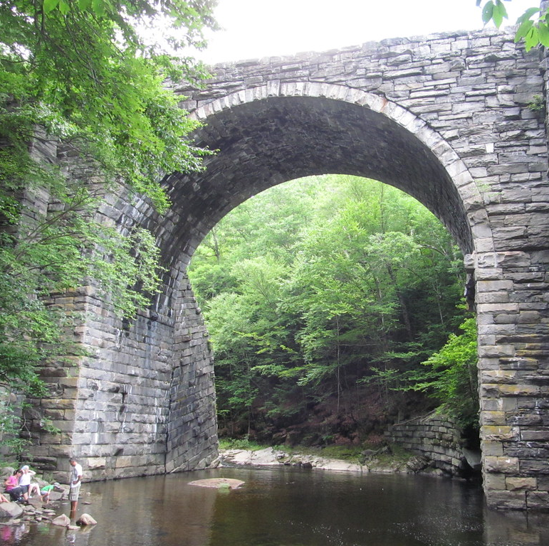
What is a keystone??
Keystone – a central stone at the summit of an arch, locking the whole together.
  OR
The central principle or part of a policy, system, etc., on which all else depends.
This Photo by Unknown Author is licensed under CC BY-SA
Notes:
Explain the principle of what a keystone is

Slide 11
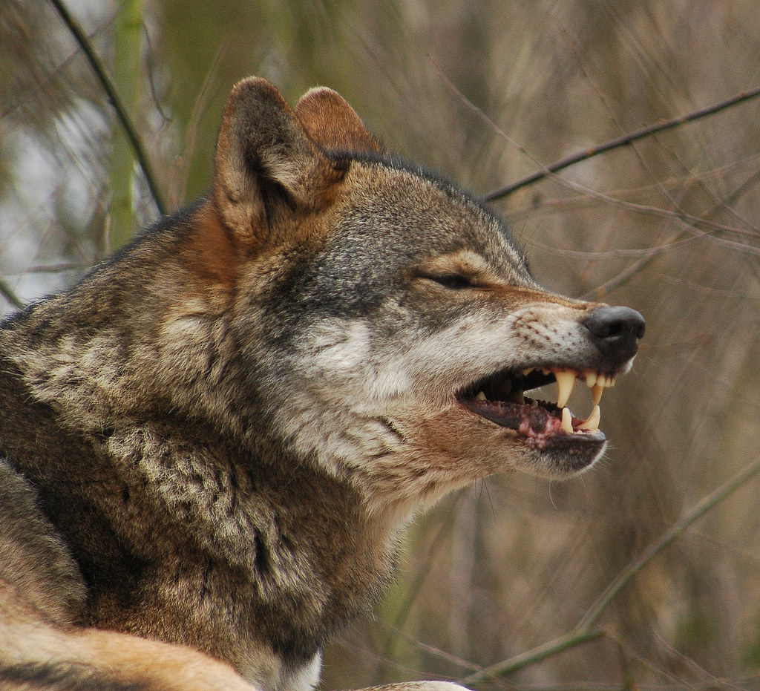
Keystone Species
A species on which other species in an ecosystem largely depend, such that if it were removed the ecosystem would change drastically.
What determines a keystone species?
This Photo by Unknown Author is licensed under CC BY
Notes:
Work through the “Wolf” as a class to help students prepare to share the other animals.
What producers and consumers are present?
a. Producers
b. Consumers
2. What biotic and abiotic factors affect the stability of this ecosystem?
a. Biotic
b. Abiotic
3. Describe or diagram the interactions among the organisms in the ecosystem.

Slide 12
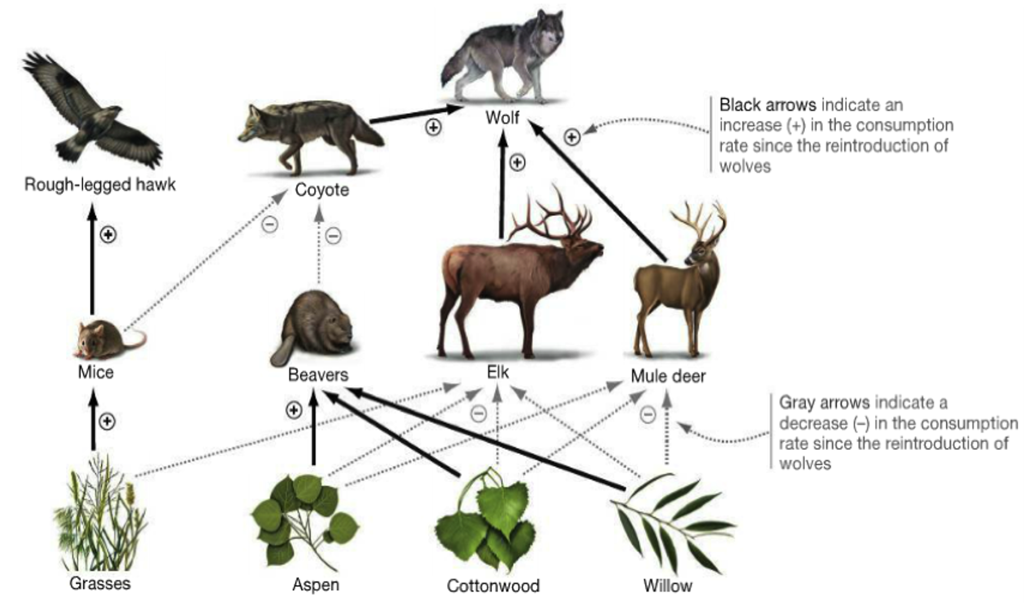

Slide 13
!GROUP TIME!
In your groups you will :
Examine the fact sheet the other 2 animals
Investigate the roles of the animals in their respective ecosystems
Share your insight with the class and participate in class discussion
Notes:
Hand out the wolf first, review, then hand out other animal cards.

Slide 14
BIOTIC and ABIOTIC FACTORS
Biotic
  All living things within an ecosystem
Abiotic
  All nonliving things within an ecosystem
What biotic and abiotic factors could be influencing this ecosystem?
Notes:
- Review Biotic and Abiotic factors with students
- Have students identify some of these factors in the picture

Slide 15
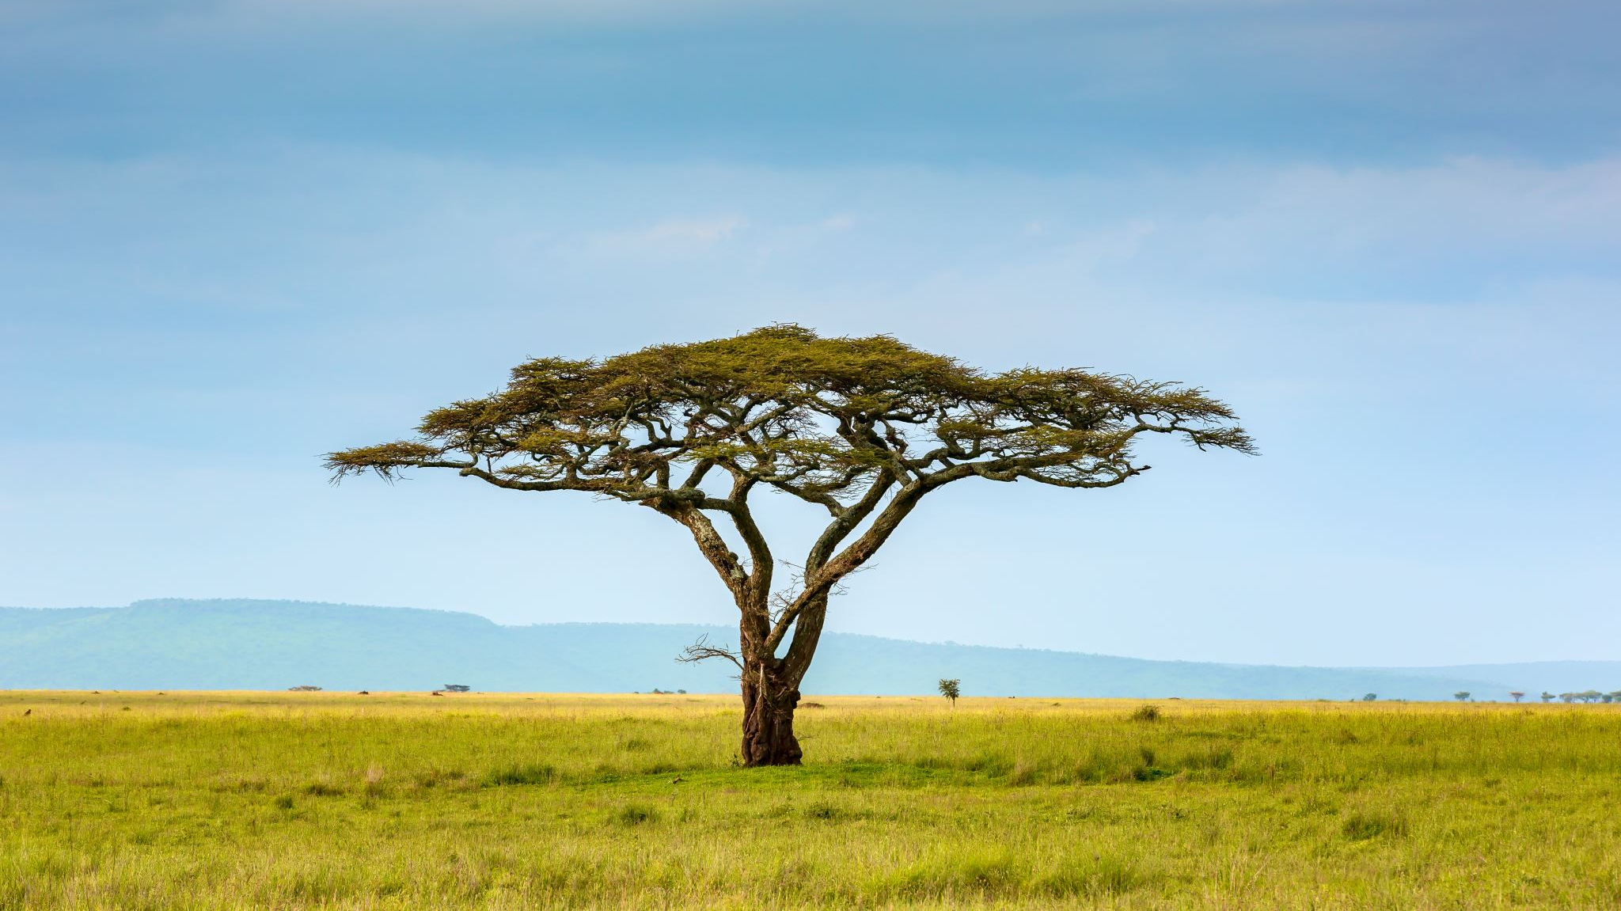
KEYSTONE OF THE SERENGETI

Slide 16
Rinderpest
Pull out a device and scan the QR code
Think of the following questions
1. What type of animal does rinderpest affect?
2. How does rinderpest affect the animal?
RINDERPEST VIDEO CLIP
3:00-5:40
Notes:
https://www.woah.org/fileadmin/Home/eng/Media_Center/docs/pdf/Disease_cards/RINDERPEST-EN.pdf

Slide 17
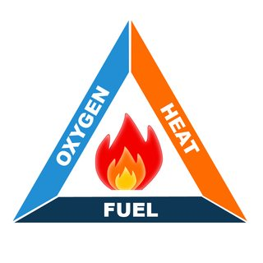
Wildfires
What causes wildfires?
This Photo by Unknown Author is licensed under CC BY-SA

Slide 18
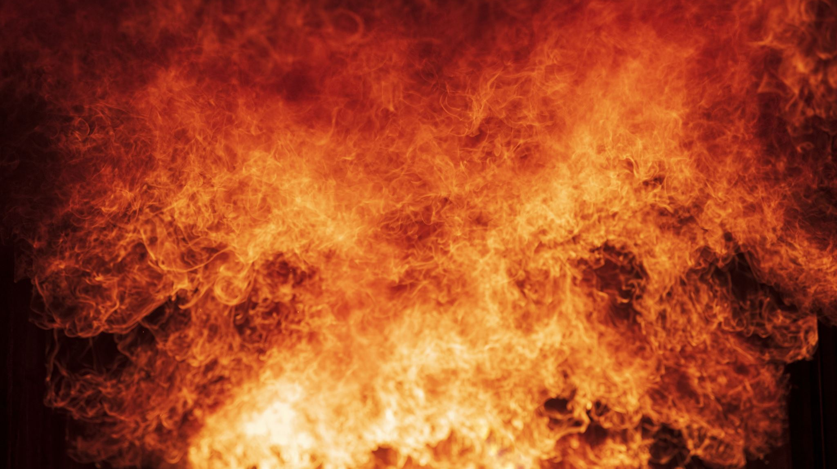
Which variable of the fire-triangle is the most likely to fluctuate on the Serengeti?
Notes:
Discuss this question as a class.
Read objective question-

Slide 19
Based on what we have explored, what species do you think is the keystone species of the Serengeti? Explain your reasoning.

Slide 20
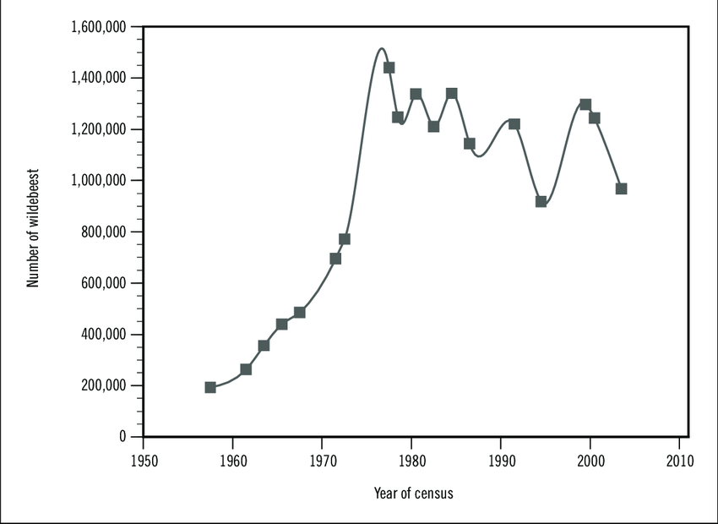
Notes:
What caused the wildebeest population to grow?

Slide 21
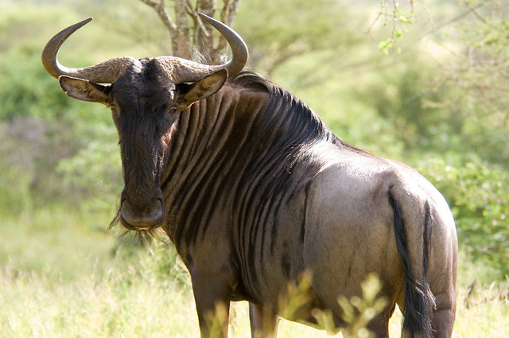
Which part of the fire-triangle does a wildebeest affect most?
This Photo by Unknown Author is licensed under CC BY
Notes:
Discuss this question as a class.
Start the video at the 29:00 minute mark and watch to the end.
Read objective question- Students will use and develop models to analyze the impact a keystone species on the stability of an ecosystem.

Slide 22
How does Wildebeest= Keystone Species? Serengeti Video
(29:00 – End)
Notes:
Ask question as a class, initiate a think-pair-share.

Slide 23

3D-RST is supported by the NSF under grant number #DRL-2101383

