Slide 1
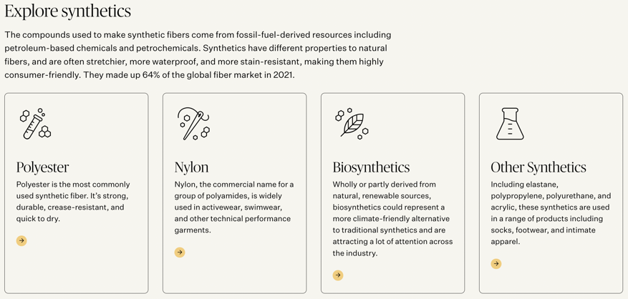
Explore Synthetics
Textiles website link
Step 1: go to textiles website
Step 2: explore the Polyester, Nylon, Biosynthetics, and other synthetics section of the website

Slide 2
Click on each of the 4 boxes to EXPLORE information on Synthetic Materials. As you explore, look for answers to the following questions:
According to the website, what qualities make Polyester so usable and important?
What is the most widely used fiber worldwide?
According to the website, what does "virgin polyester" mean?
Of all the global fiber produced, what percent is Polyester?
What percent is Nylon?

Slide 3
What is the definition of Biosynthetics?
What is elastane? And what is it mostly used for?
According to the information on the main link you clicked above, in 2021, what percentage of global fibers were actually made from synthetic fibers?
Looking to the future How do you think fabrics will change in the future? Why?

Slide 4

3D-RST is supported by the NSF under grant number #DRL-2101383

