Slide 1

What are you wearing?
Learning Objective:
Students will be able to determine why we use synthetic substances and how the structure of synthetic substances determine their functions.
Back to the future, the future of fashion.
In the movie “Back to the Future II” the main characters travel from 1985 to the far distant future of 2015. Take a few minutes to consider the clothing that people thought would be worn in 2015 (on the next slide). Record 3 observations.
Observation 1
Observation 2
Observation 3

Slide 2
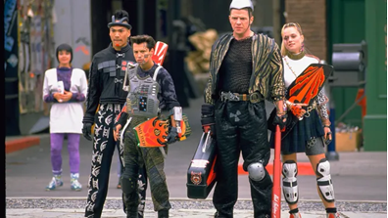
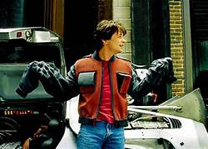
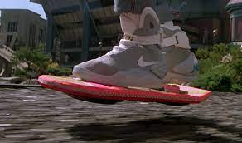
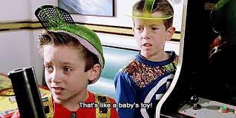
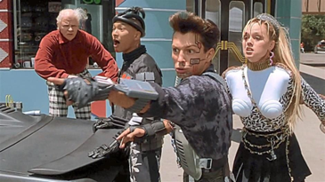

Slide 3
What type of fabrics are your clothes made of? Work with a neighbor if needed to check one anothers tags.
Why are your clothes made of these materials?

Slide 4
What are the properties of different types of fabric?
What properties should we test in different fabrics? | Independent variable | Dependent variable | How will we test for those properties?

Slide 5
Results
Properties We Want To Test
Cotton
Polyester
Polyester/cotton

Slide 6
Analysis
What are uses for the property of …
What are uses for the property of …
What are uses for the property of …
What are uses for the property of …

Slide 7
Natural Fibers
Microscope Pictures
Look at a microscope image of cotton
Draw what you see under the microscope | Explain your drawing
Look at a microscope image of wool
Draw what you see under the microscope | Explain your drawing

Slide 8
Synthetic Fibers
Microscope Pictures
Look at a microscope image of polyester
Draw what you see under the microscope | Explain your drawing
Look at a microscope image of nylon
Draw what you see under the microscope | Explain your drawing

Slide 9
Why are your clothes made of these materials? (aim for 3-5 sentences)

Slide 10
Final analysis
Structure How were the synthetic fibers different from the natural fibers?
Function How do you think those differences led to the different properties?
Natural and Synthetic Why do you think we use both natural and synthetic fibers in our clothing?

Slide 11
Rubric for What are you wearing?
Requirements | 4 Above Proficient | 3 Proficient | 2 Approaching Proficiency | 1 Showing No evidence
Doing Observations On the Phenomenon | Did all 3-4 observations | Did 3 observations | Did 2 observations | Did 0-1 observations
Create an experiment |  | Able to design and execute a well thought out experiment. | Did the experiment established by the class but didn’t contribute to the design | Experiment is not performed
Microscope observations |  | Student can postulate how the different fibers cause different properties | Student can identify the difference in the natural and synthetic fibers | No participation
Explore synthetics |  | Correctly answered the all questions | Answered most the questions correctly | Didn’t answer the questions
Final analysis |  | Students can identify how the structure of the fibers determine some of its functions | Students can identify the structure and the function of the fibers but not how they affect each other | Student can not identify differences in structure or function of fibers.

Slide 12

3D-RST is supported by the NSF under grant number #DRL-2101383

