Slide 1
Crash Test Pringle
Notes:
Links for videos in speaker notes
Change Timer on slide 12 to time you need for your class schedule.
Install extension on Chrome:

Slide 2
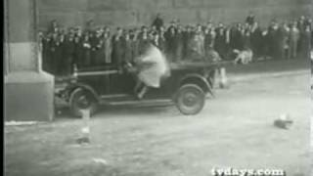
Notes:
Show video three times have students make observations after video LINK if needed. https://www.youtube.com/watch?v=Ki9fDmBTX7w

Slide 3
Answer the following questions:
What happened to the vehicle and passenger?
How are today's vehicles different?
Notes:
Observations for first question
Discussion (alone zone and then share) for second question
Make sure to draw on students’ prior knowledge

Slide 4
Newton's 3rd law
Every action (force) in nature has an equal and opposite reaction.

Slide 5
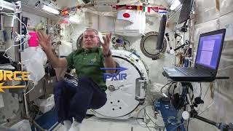
Notes:
Handout worksheet; Link if needed http://www.youtube.com/watch?v=ZkVU-bj9bDk

Slide 6
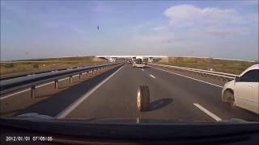
Notes:
Evolution of car safety;
Discuss what was observed; Highlight improvements
Link if needed: http://www.youtube.com/watch?v=8NEn2m0S90w

Slide 7
In the zipline system design a solution to protect “Mr. P” in a collision applying Newton’s Third Law
Objective:
Demo
Notes:
Demo the pringle crash on the longer/higher placed string with just the pringle with no protection.

Slide 8
System and System Model
The parts of the system are:
Zipline
Pringle
Wall
PVC Device
Which of these parts will we modify?

Slide 9
Describe System
Define Problem
Quick Check! (Numbers 1-3)
Notes:
Discuss as pairs/groups/class discussion. (whatever depending on time)
Fill in worksheet

Slide 10
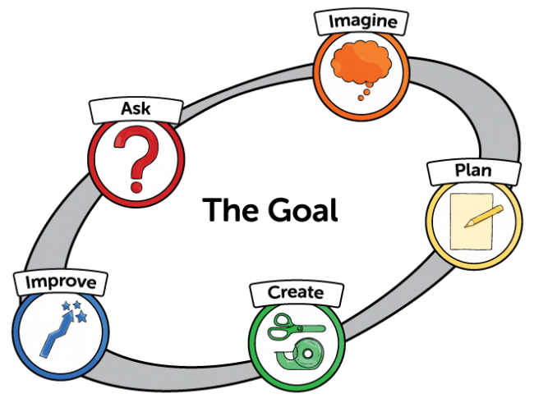
Engineering Process
Notes:
Discuss and review the Engineering Process:
Use science principles to solve engineering problems.

Slide 11
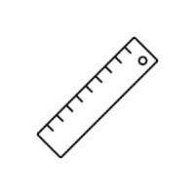


Will Mr. P survive?
Constraints
Size
Materials
Time
Design Limit: 10 x 8 x 5 (cm)
Pringle Size: 6.5 x 4.5 x 1.7 (cm)
One sheet of 8.5x11 paper
15 cm of tape
Tinfoil same size as paper
1 Straw
Final Testing begins when 15 min left in class
Notes:
Go over constraints and answer questions.
Remind students to fill out worksheet
Take Pictures

Slide 12
Draw Design Ideas:
ALONE ZONE: Draw your own design idea
Partner TIME: Share designs
Determine and draw final design
Notes:
Alone zone: 1 min
Partner share: 1 min.
Final Draw: 3 min.

Slide 13
Test and Improve
<<time>>
01
Create Prototype
Design Limit: 10 x 8 x 5 (cm)
Pringle Size: 6.5 x 4.5 x 1.7 (cm)
Make design
02
Test Station at Tables
Use fishing line and tape for zipline
03
Improve Design & Retest
Rebuild test
Notes:
Students build, test, redesign at their test stations. Students need to create their own dummy to simulate the chip. In real life, dummies are tested and not real people.
Remind students to fill in their worksheets. Take or draw pictures for each prototype;

Slide 14
Final Test
Did Mr. P survive?
Notes:
Run each groups cars while the others watch and observe.

Slide 15
Evaluate
Model (draw) the system showing the forces that saved Mr. P.
Complete and turn in Worksheet.
Notes:
Make sure worksheet is complete or assign as homework to finish.
Have a discussion on what they noticed was a good design and why it worked/or not worked.
Pull in information of collisions.

Slide 16


3D-RST is supported by the NSF under grant number #DRL-2101383

Slide 17


