Slide 1
Shift Happens
Standard 1.2

Slide 2


Phenomenon
Describe any patterns you notice about sound in regards to movement as you watch these two videos.

Slide 3
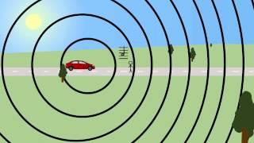

Slide 4
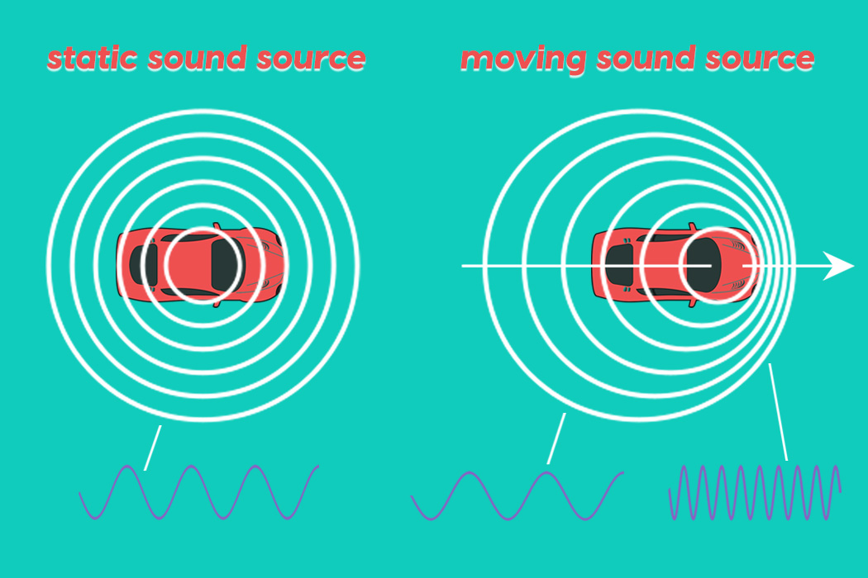
The Doppler Effect
Where have you heard this before?
2. What happens to the wavelength of a sound wave as the source of the sound moves further away?
3. How is wavelength(frequency) related to pitch?

Slide 5

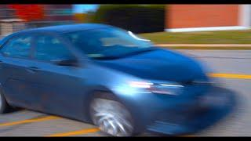
The Doppler Effect
“It’s the apparent change in the frequency of a wave caused by relative motion between the source of the wave and the observer.” -Sheldon Cooper

Slide 6
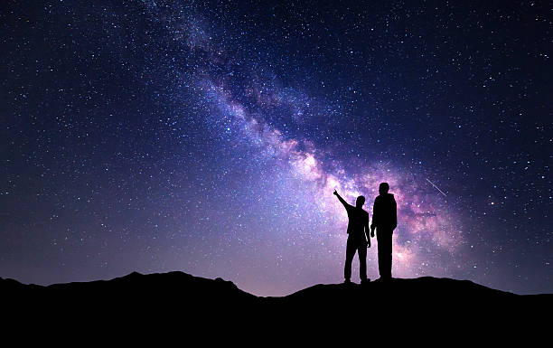
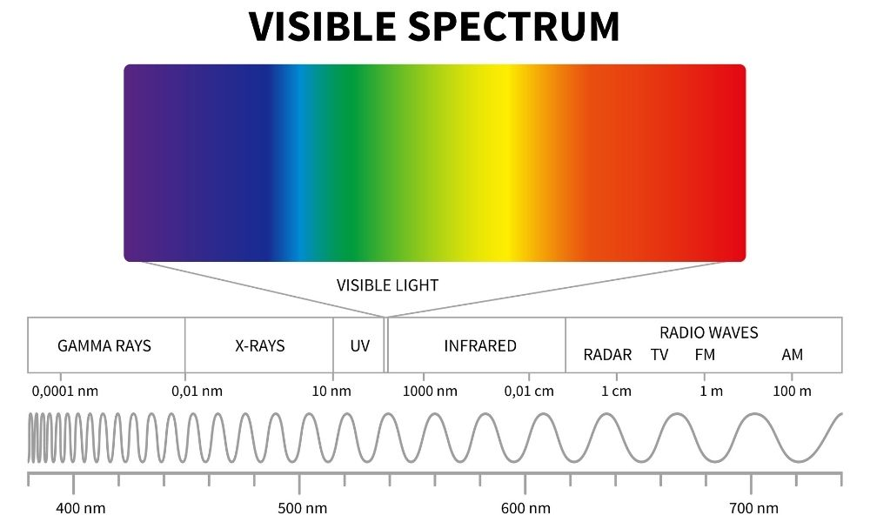
Is the Doppler Effect seen in light waves?
- Celestial objects emit light waves.
- Electromagnetic spectrum shows all wavelengths of radiation emitted by light sources.
- What happens when those lights sources are moving?

Slide 8
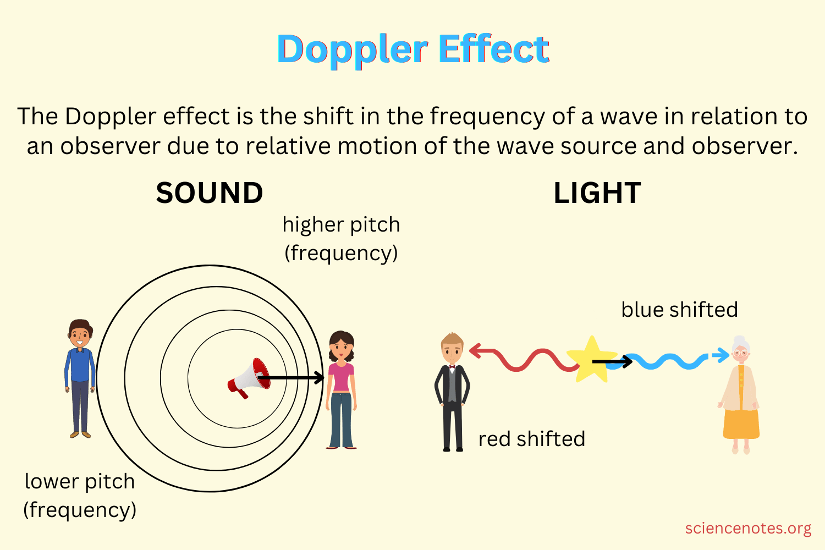
The Doppler Effect
What patterns do you observe as you compare light and sound waves emitted by a moving object?

Slide 9
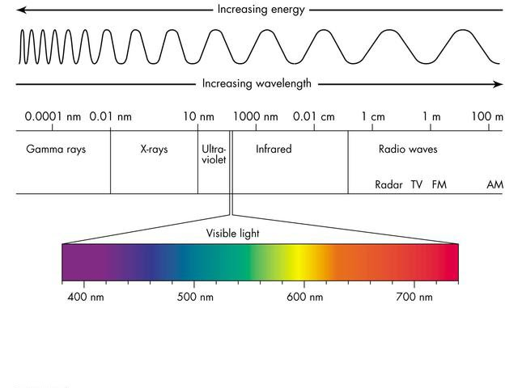
Red and Blue Shift
4. What is Red Shift?
5. What is Blue Shift?

Slide 10


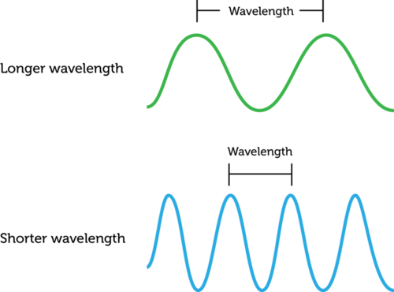
Wavelengths and Expansion
Teacher demonstration of expansion and wavelength.

Slide 11
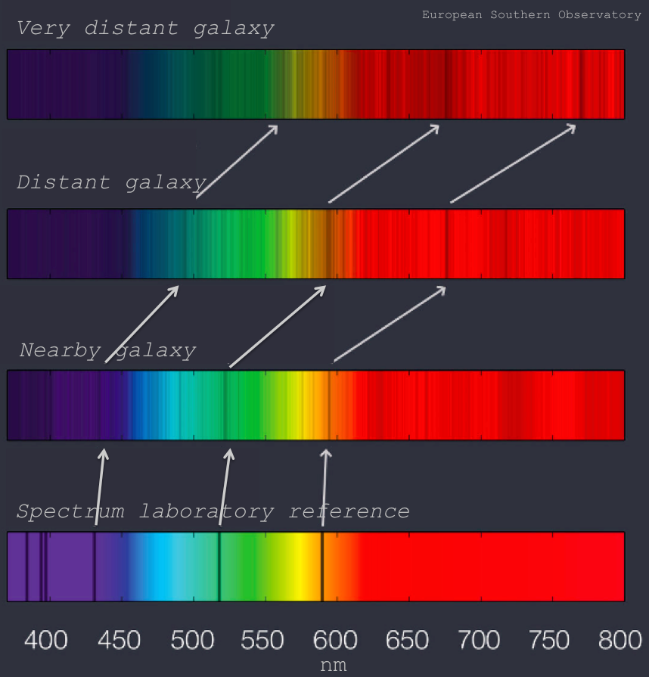
Redshift and Distance
What pattern do you notice about the amount of redshift relative to the distance?

Slide 12

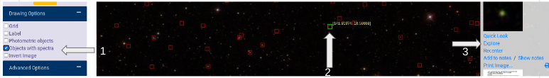
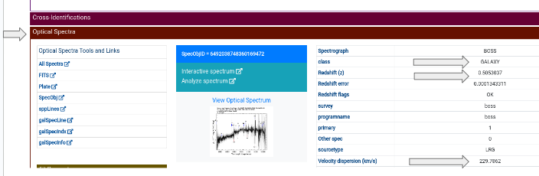
Redshift and Velocity - Sky Server

Slide 13
Wrap Up
Using Claim, Evidence, Reasoning, explain what redshift tells us about the universe.
Possible Claims:
-As an object moves away from an observer the wavelength increases.
-As distance increases, redshift increases.
-As velocity increases, redshift increases.

Slide 14
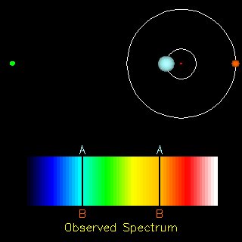
Redshift and the Mysteries of the Universe
2 Stars Oscillating - WHY???
What you see to the right is 2 stars spectral lines. They are both oscillating, shifting red, then blue, continuously.
Do you have any idea what would cause this?

Slide 15
Binary Star System:
System of two stars that are gravitationally bound to and in orbit around each other.
Center point is NOT an object, but rather the center mass.
Center of mass can be thought of as a "balancing point" between two objects of different mass.
Both stars have gravitational pull on the other.

Slide 16
Radial Velocity = Spectral “Wobble”
What can Doppler Wobble tell us?
If there is 2 stars “wobbling” it indicates a binary star system.
If there is 1 star “wobbling” it indicates that there could be an exoplanet changing the movement of the star.
  An “Exoplanet” is a planet outside of our solar system
  5,470 exoplanets are currently identified as of 7/13/23
  1,036 have been found using Radial Velocity (spectral wobble)

Slide 17
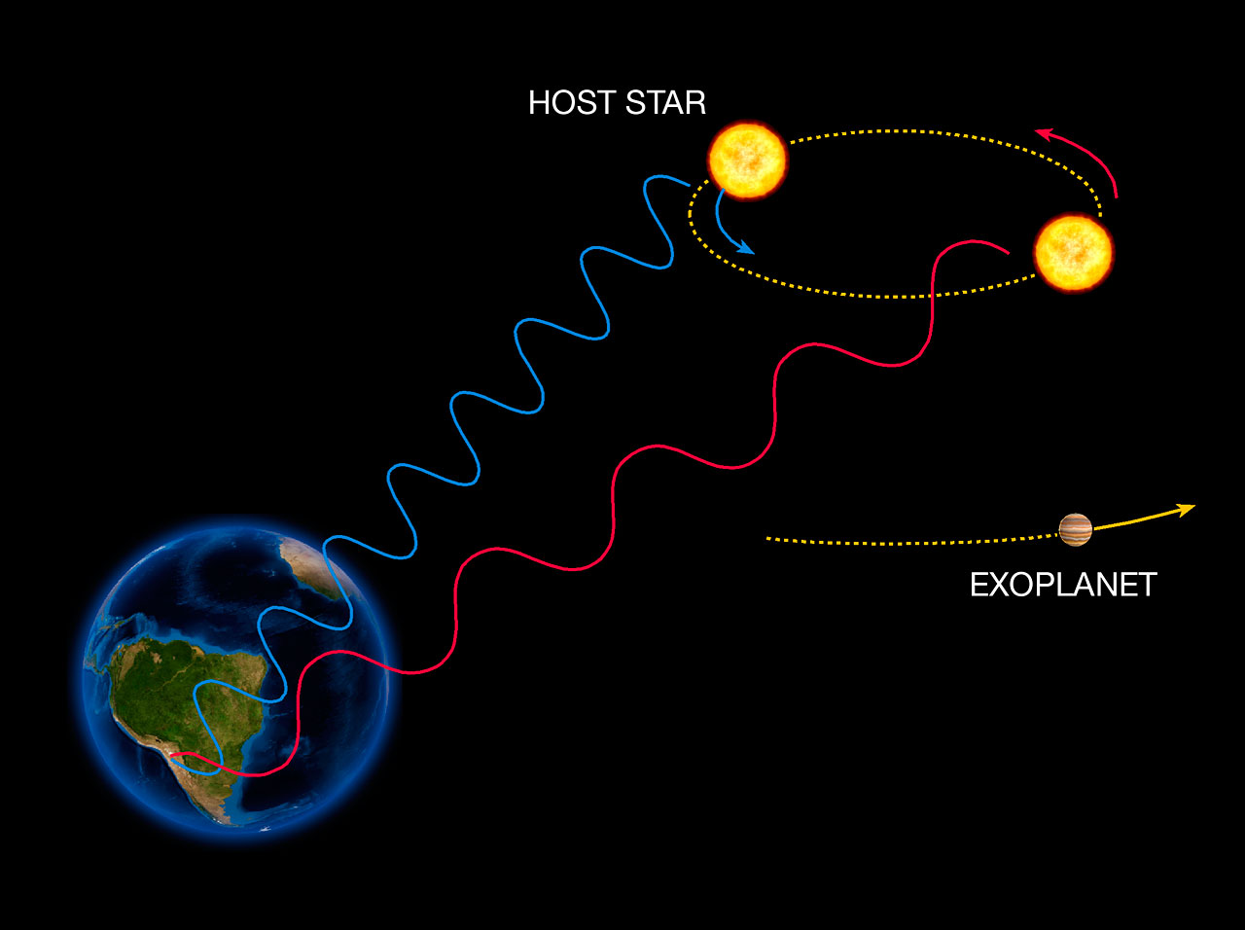
Exoplanets

Slide 18
The radial velocities for stars caused by planets orbiting around them are typically measured using the Doppler shift of spectral lines. The technique is sometimes called the Doppler wobble method, since it uses the Doppler shift to detect a tiny wobbling motion of the parent star caused by the gravity of the unseen planet.
Wobble as it relates back to sound waves (Hammond Organ)

Slide 20
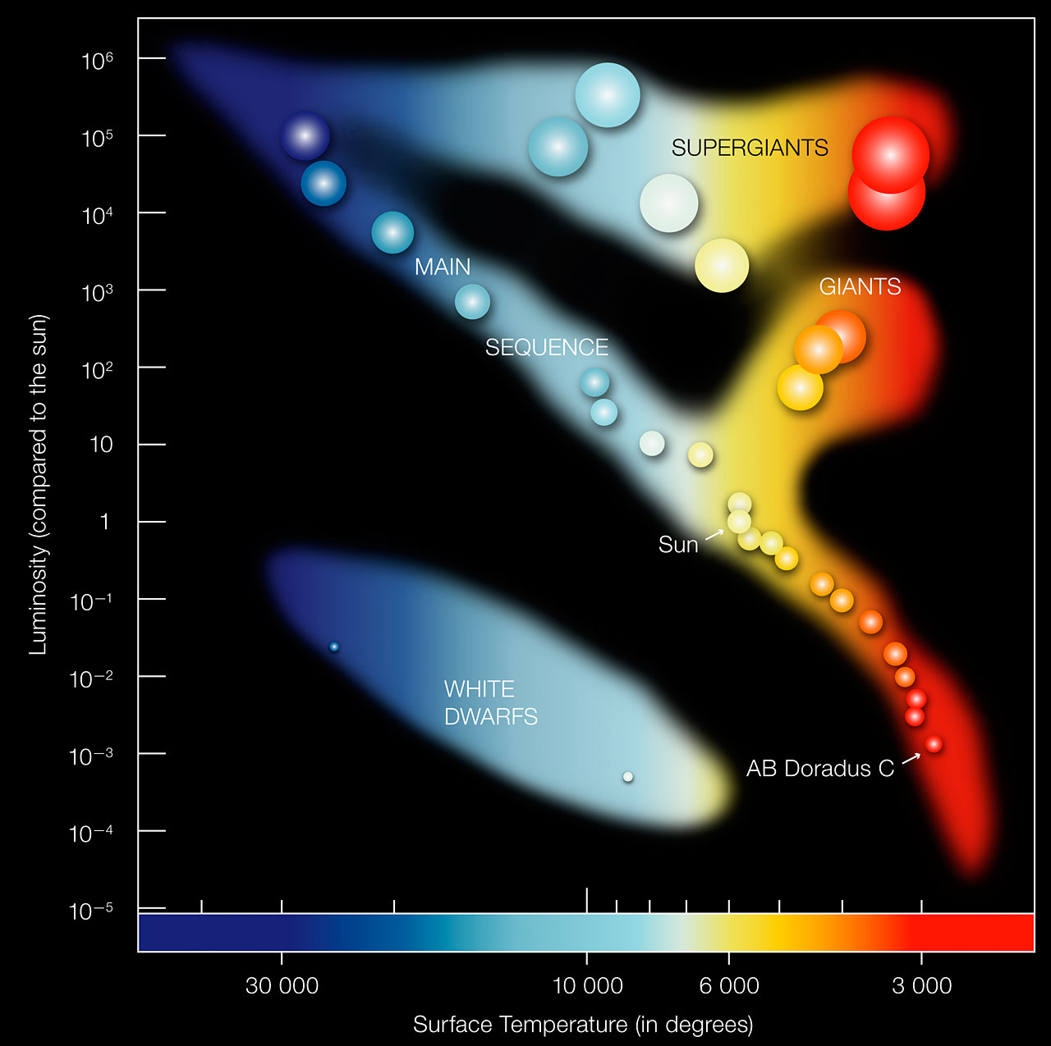
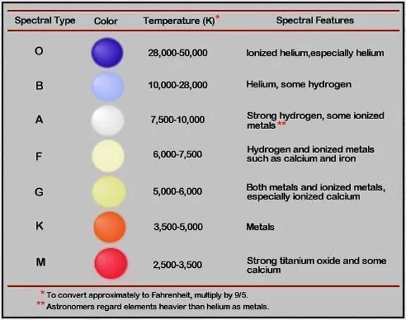

Slide 21


3D-RST is supported by the NSF under grant number #DRL-2101383

