Slide 1
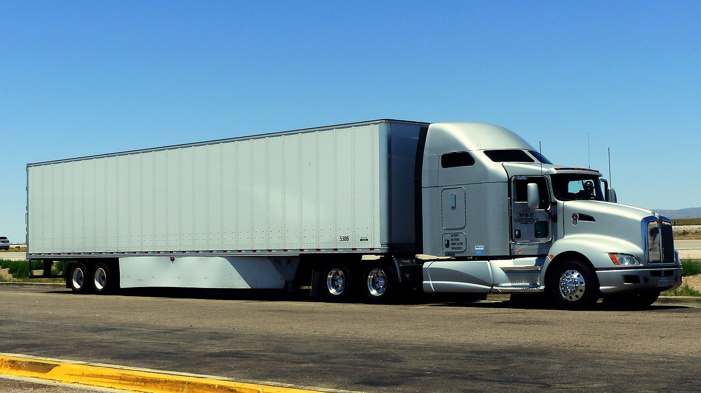

How to Get to
School on Time

Slide 2
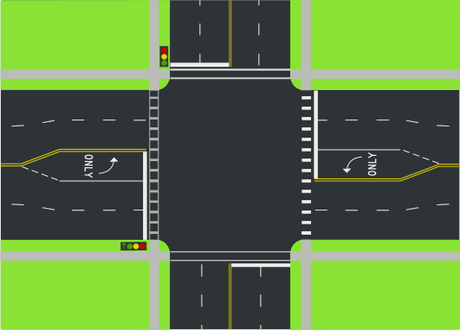

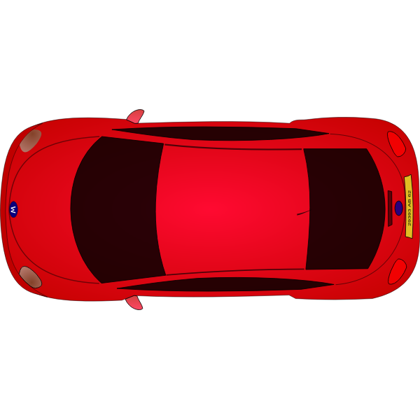
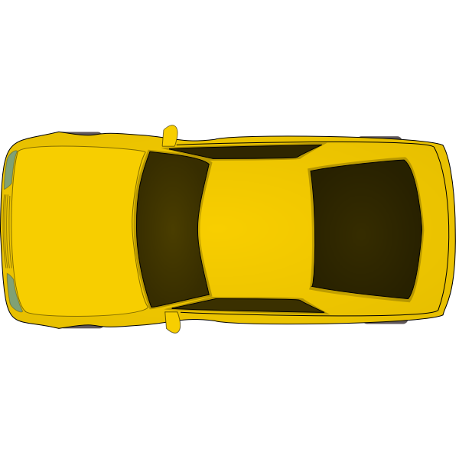

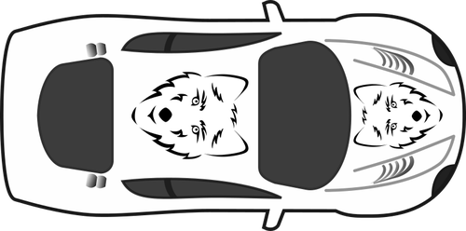

Direction to School

Slide 3
This is you
Direction to School

Slide 4
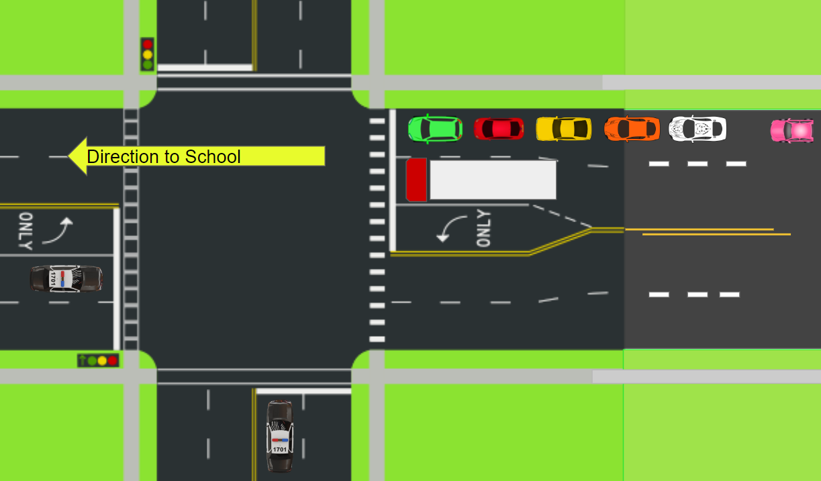
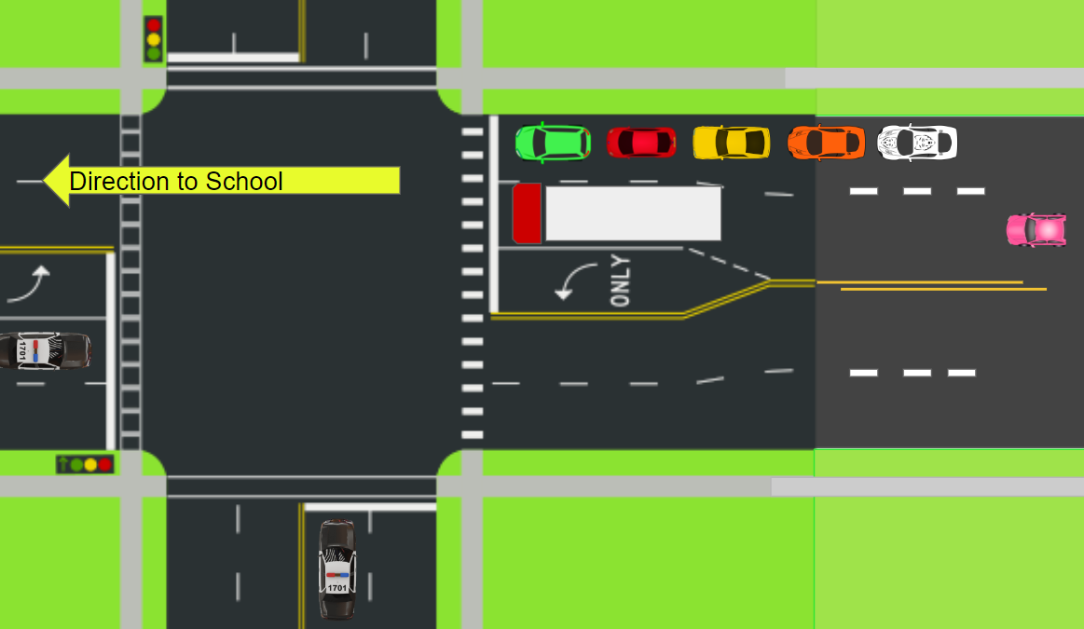
Prompt:
A
Based on the images which lane would you rather be in? Explain your reason why.
B

Slide 5


  Lab
  Investigate how mass, force, and acceleration are related to each other.

Slide 6

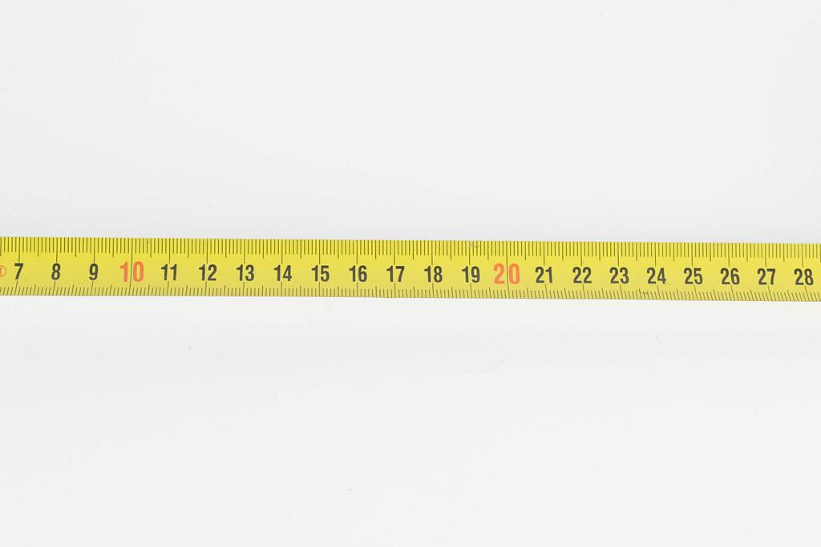
Obtaining Acceleration
Tracking motion: How can you find acceleration of the cart?
Motion sensor
Time
Pull
Cart
Rubber Band
Distance
Notes:
Explain the technology that you will be using in your classroom to find or calculate the acceleration.

Slide 7
Investigate
Change one variable at a time to see how it affects the acceleration data.
Mass
Change the mass of the cart by adding weights.
Force
Change how much you pull back on the cart.
Pull
Cart

Slide 8
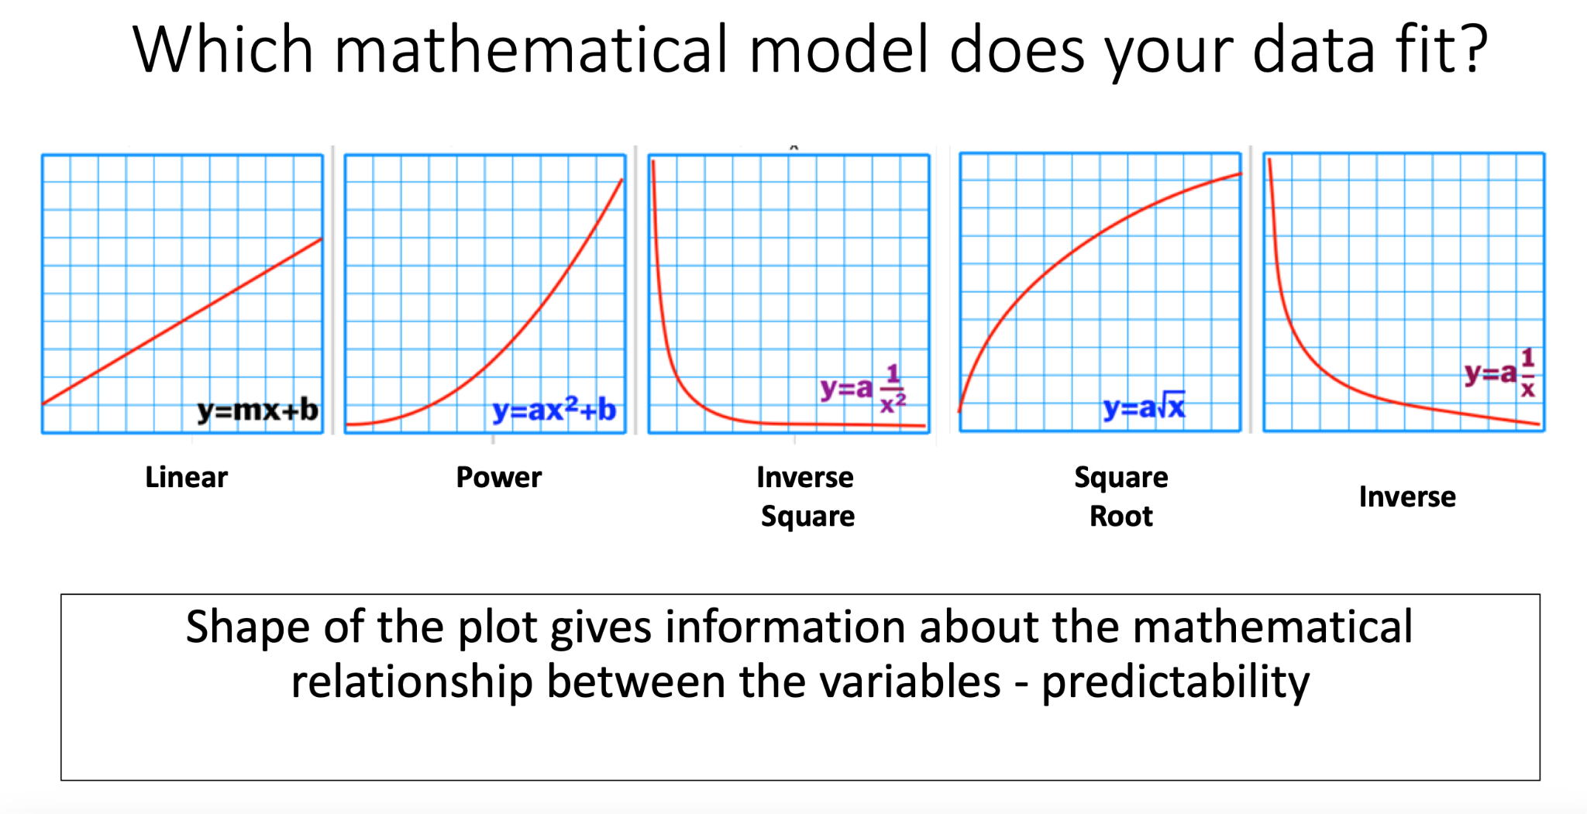
Direct or

Slide 9
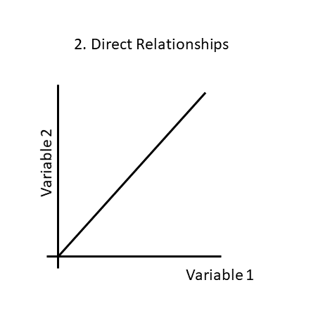
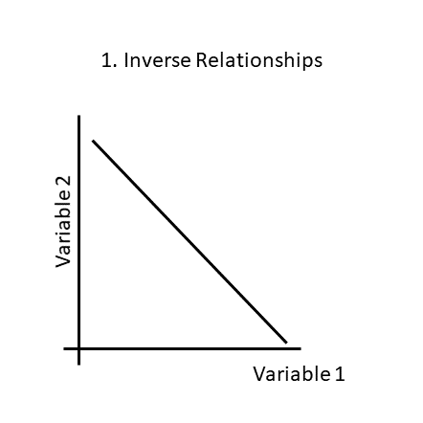
Graphs
Inverse Relationships Direct Relationships
y=k/x
y=kx
*k is for a constant
Notes:
Explain to students that y does not equal x but that the relationship is constant. The value “k” is a placeholder.

Slide 10

Graphs
Change in Mass Change in Force
Acceleration
Acceleration
Mass
Force

Slide 11
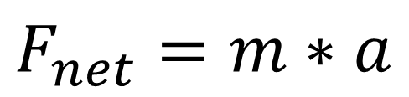
From the Lab:
We learned that the relationship between force and motion is:
This is Newton's Second law of motion!
But what does this mean?
The relationship between force and acceleration:
Directly Proportional
The relationship between mass and acceleration:
Inversely Proportional

Slide 12
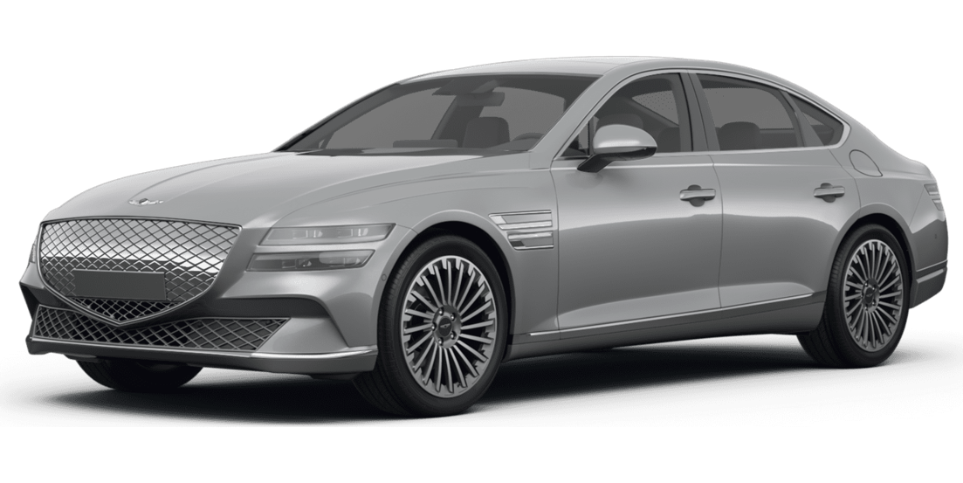
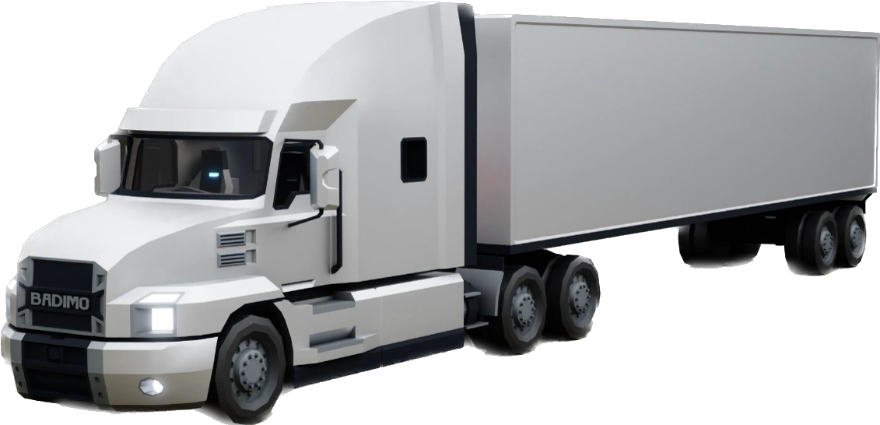
 | Small Car | Semi-Truck
Average Mass | 1,760 kg | 36,310 kg
Average Force | 8,800 N | 32,000 N
Average Acceleration

Slide 13
Stats | Small Car | Semi-Truck
Average Mass | 1,760 kg | 36,310 kg
Average Force | 8,800 N | 32,000N
Average Acceleration | 5.0 m/s/s | 0.88 m/s/s
That means the small car accelerates over SEVEN times faster than the semi!!!

Slide 14
Prompt:
A
Based on the images which lane would you rather be in? Explain your reason why.
B

Slide 15
Extra Problems

Slide 16
Newton's 2nd Law: Example Problem
Load | Force (horsepower) | Mass (kg) | Acceleration (m/s/s)
Empty Truck | 600 | 2,500
Full Truck | 600 | 5,000
Which truck has more inertia?
How did mass affect the acceleration?

Slide 17
Newton's 2nd Law: Example Problem
Load | Force (horsepower) | Mass (kg) | Acceleration (m/s/s)
Jaguar | 500 | 1,500
Toyota Camry | 200 | 1,500
What is the cause and effect of force on acceleration?

Slide 18

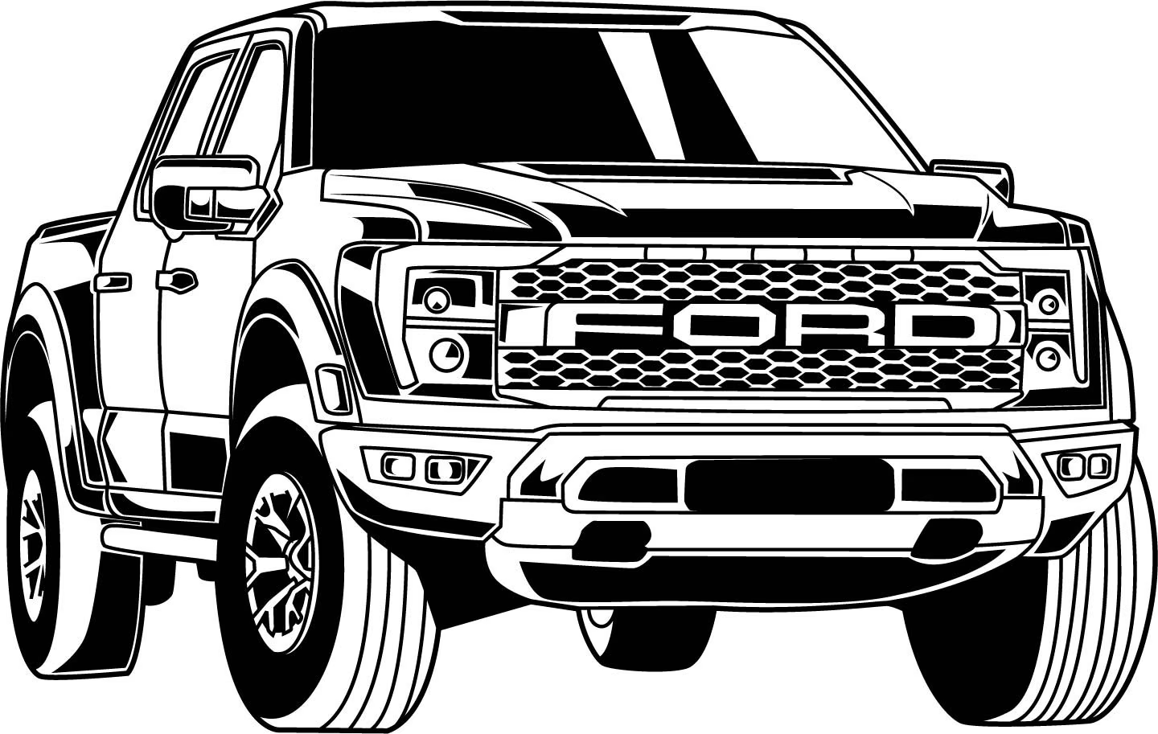
Newton's 2nd Law: Example Problem
Force (horsepower) | Mass (kg) | Acceleration (m/s/s)
0.8 | 90
600 | 2,500
Which mode of transportation will accelerate the fastest?

Slide 19
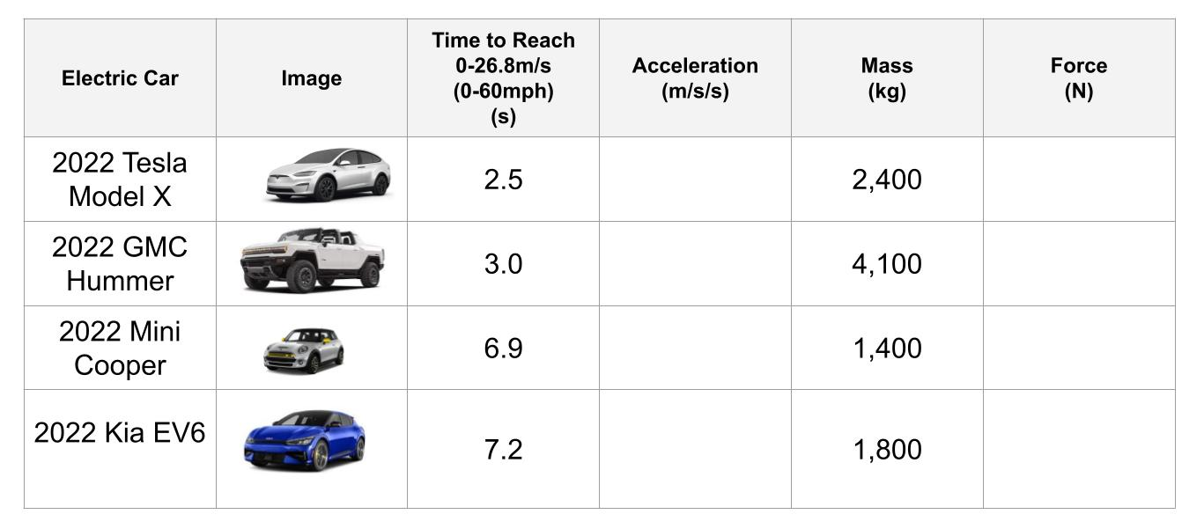

Slide 20
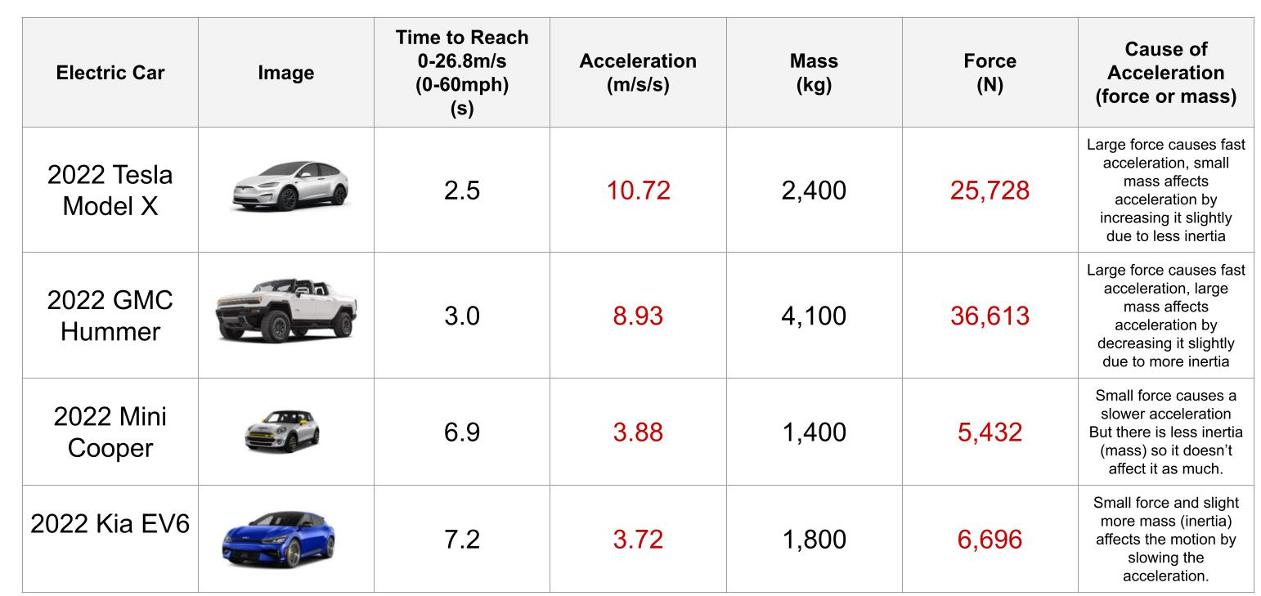

Slide 21

3D-RST is supported by the NSF under grant number #DRL-2101383

