Slide 1

Environment change and its effects
Students will be able to. . .
  Recognize changes in an environment
  Determine the effect it has on a species
This Photo by Unknown Author is licensed under CC BY

Slide 2
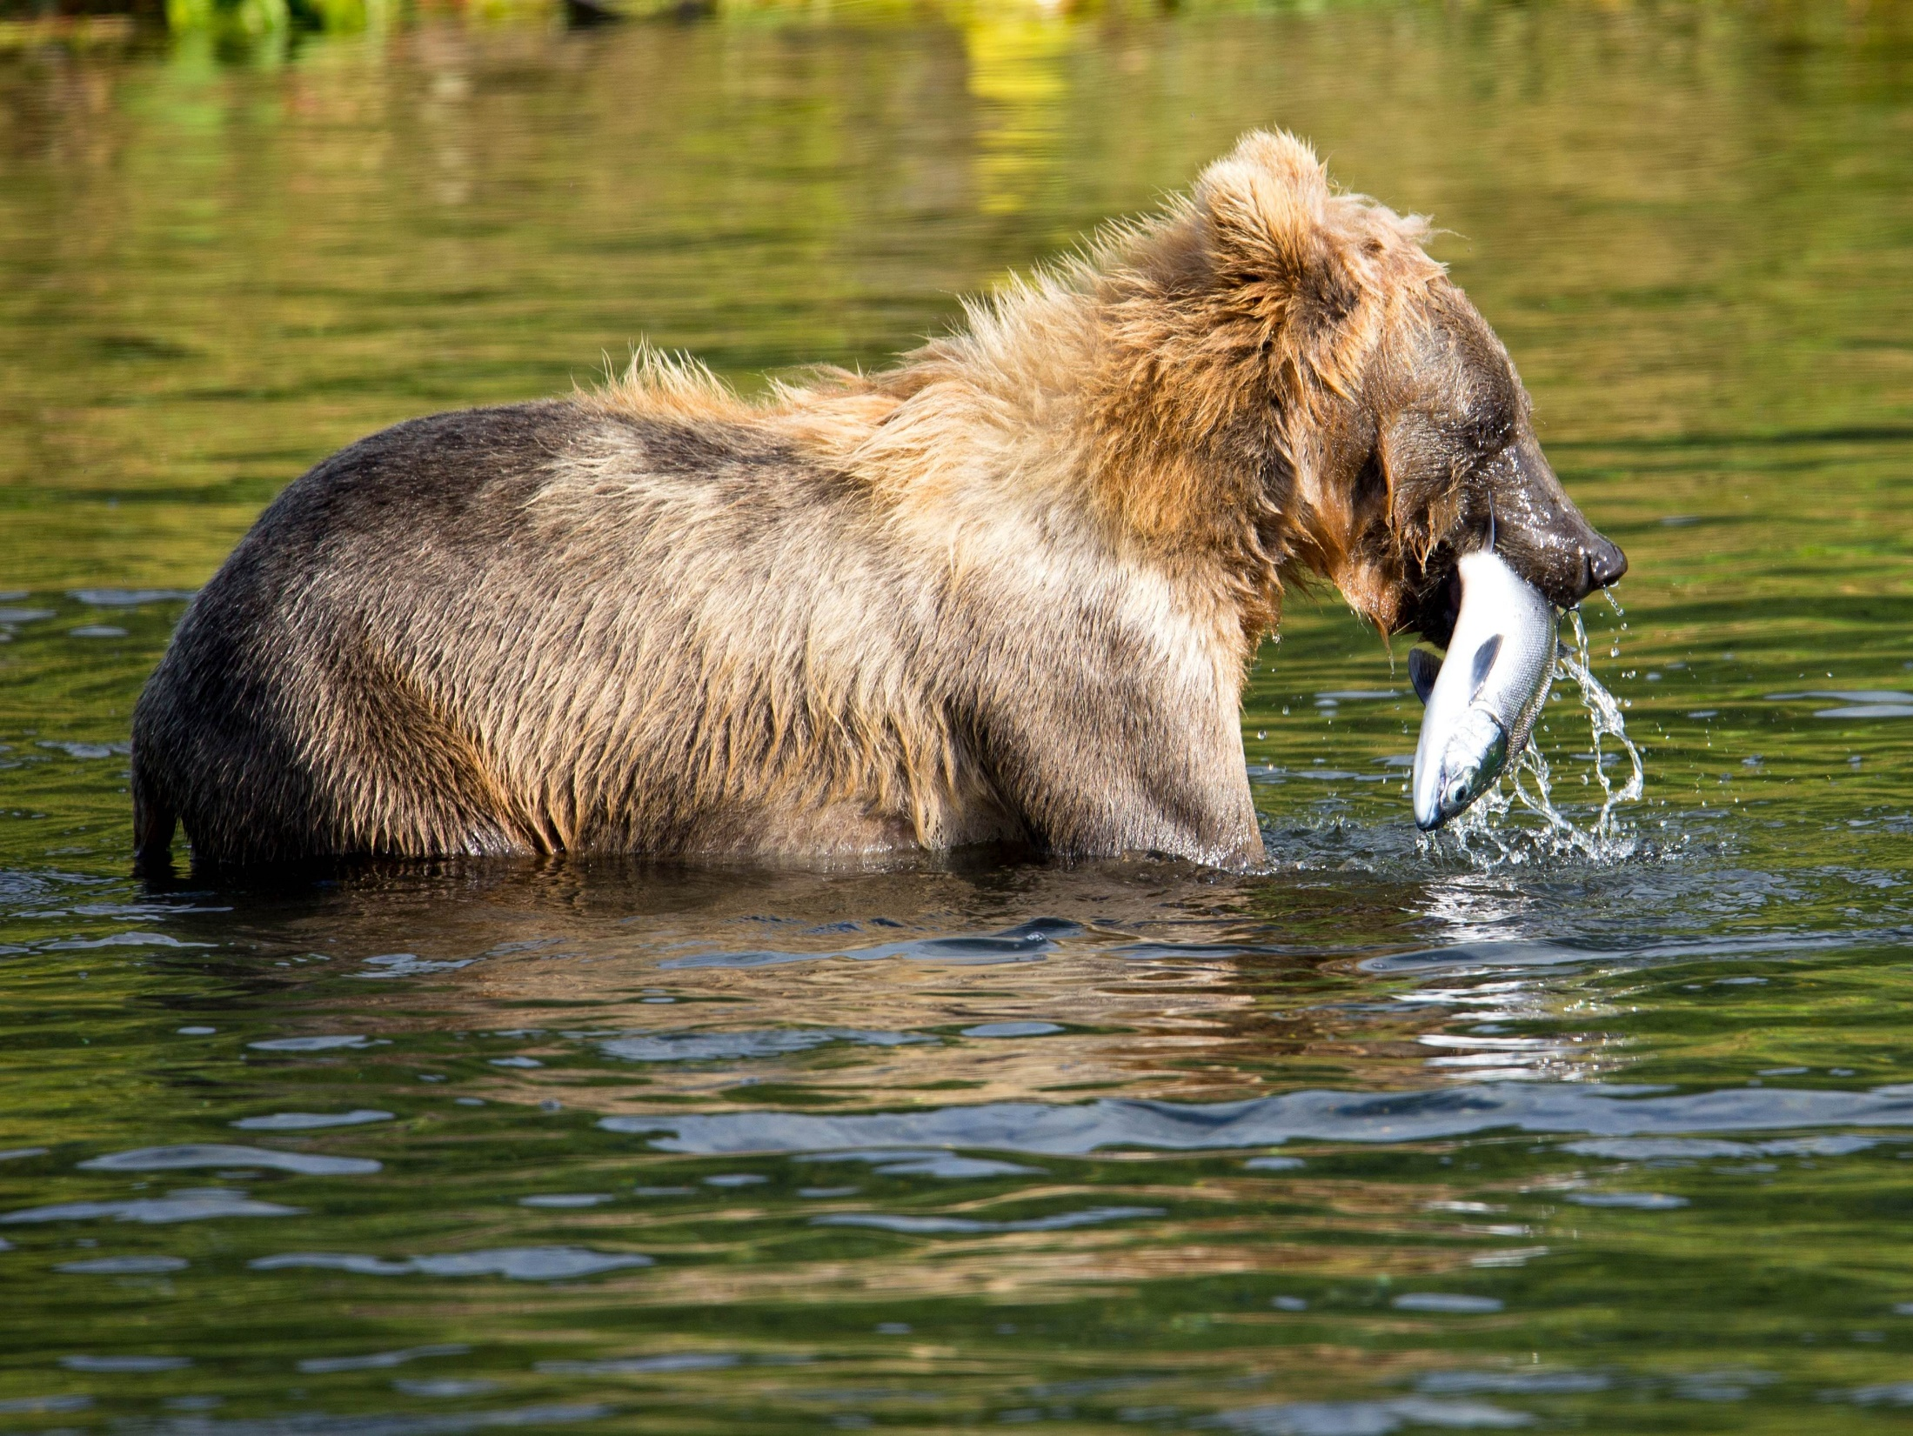
Interest Approach
Create a Successful Animal
On my mark you will do the following…
  Get into your assigned groups
  Grab a ”Successful Animal Traits” paper
  Design an organism by selecting traits that go along with your assigned food source
  Provide written reasons and justifications on why you selected those traits
  REMEMBER, YOU’RE CREATING AN ANIMAL TO BE SUCCESSFUL

Slide 3
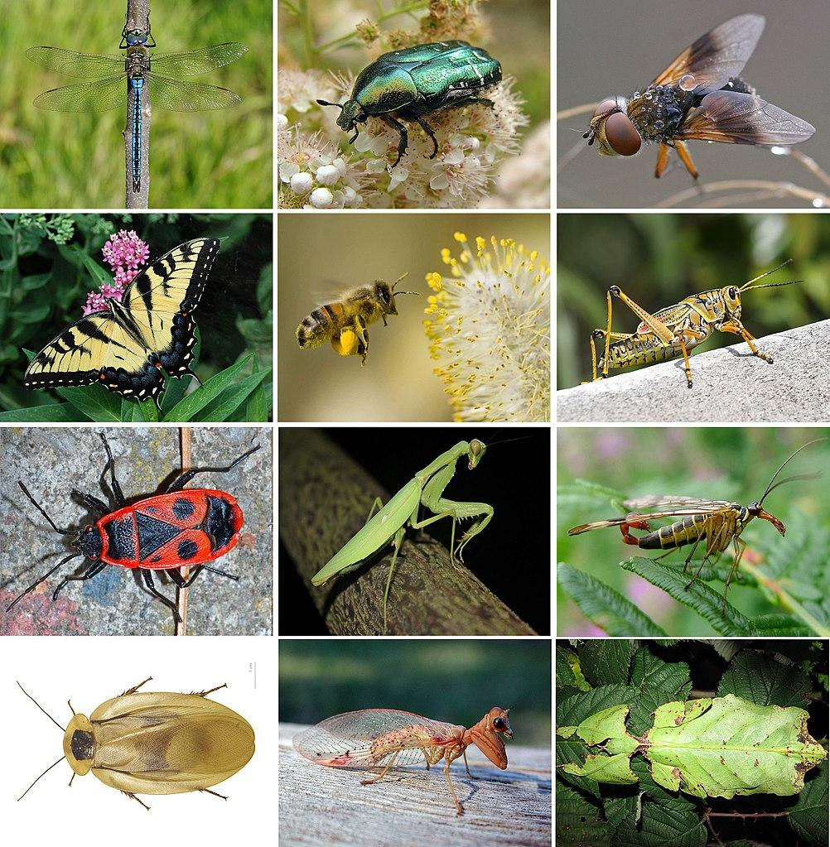
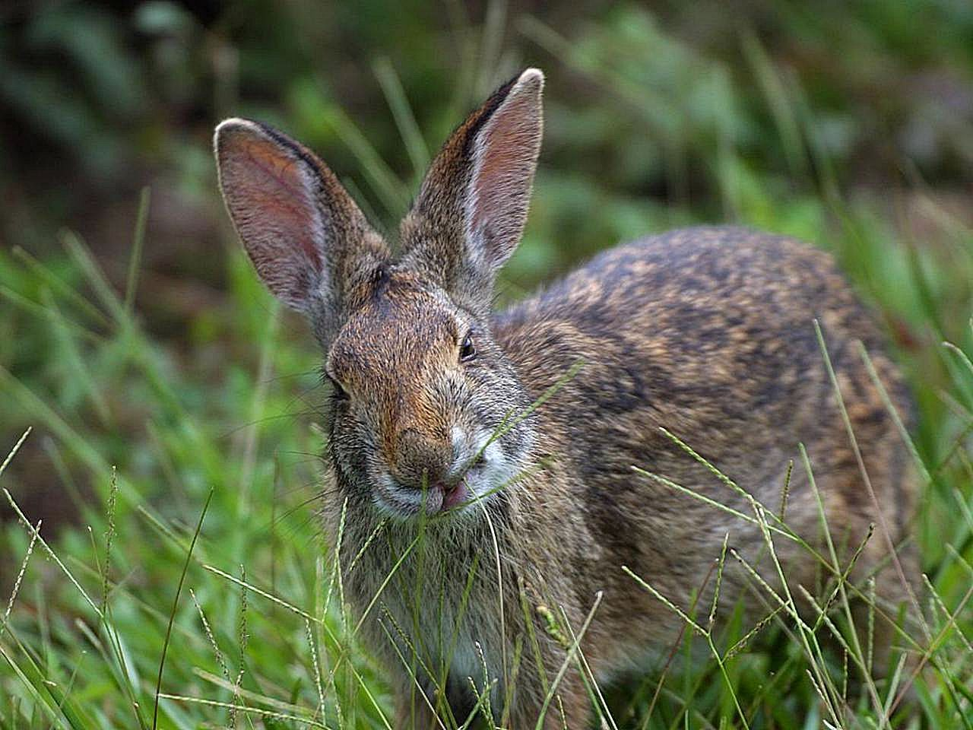
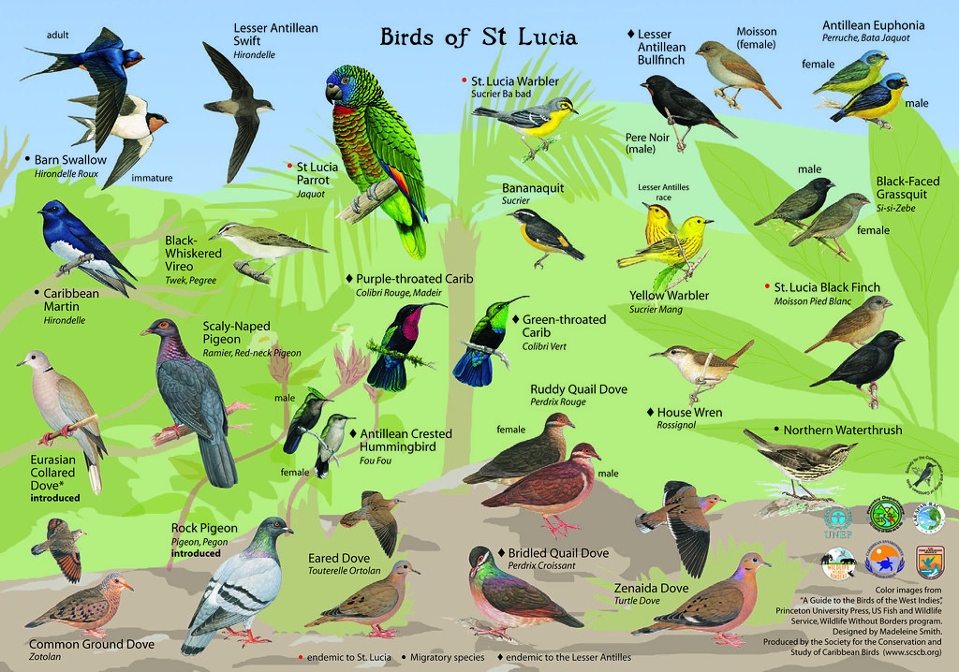
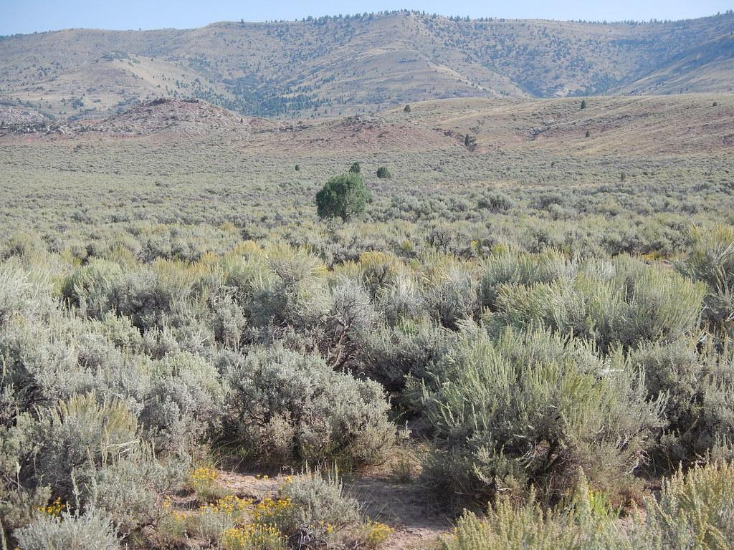
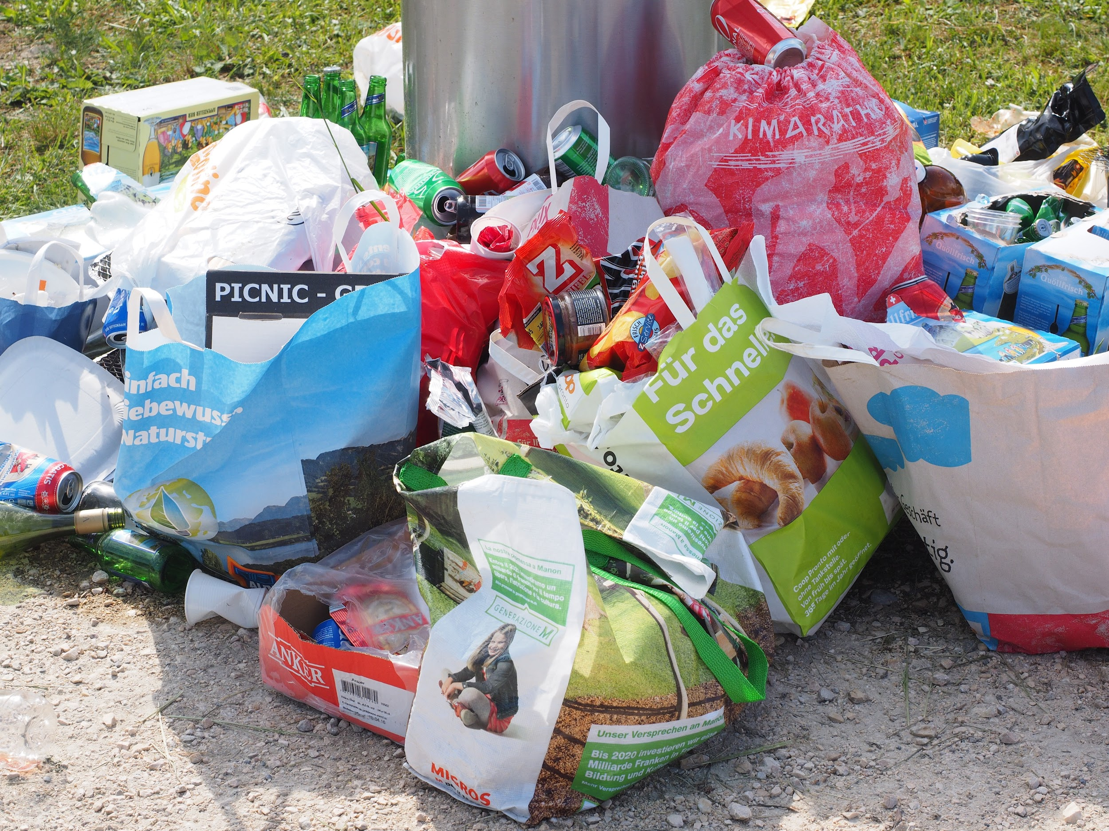
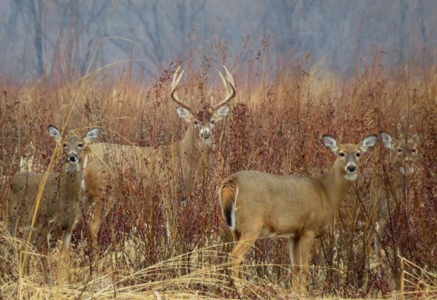
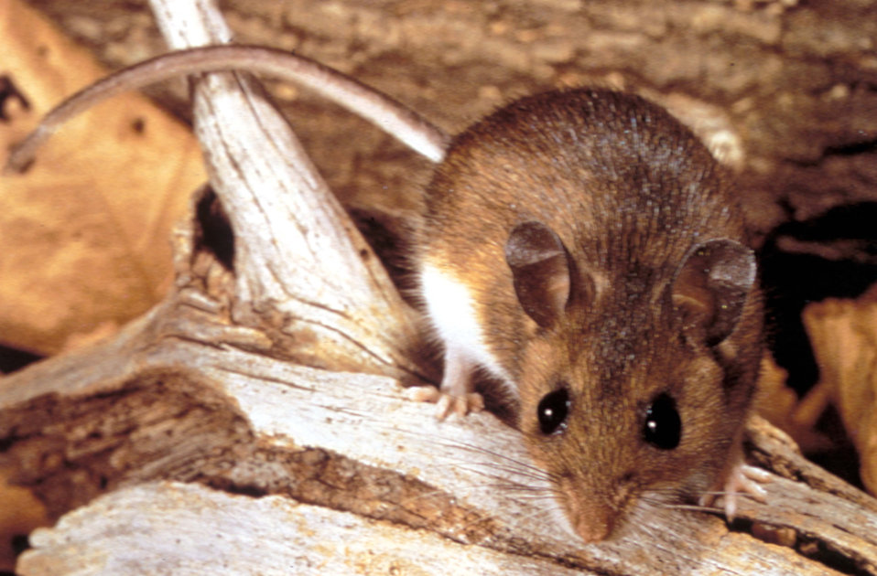

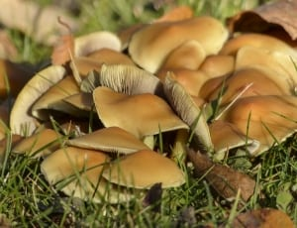
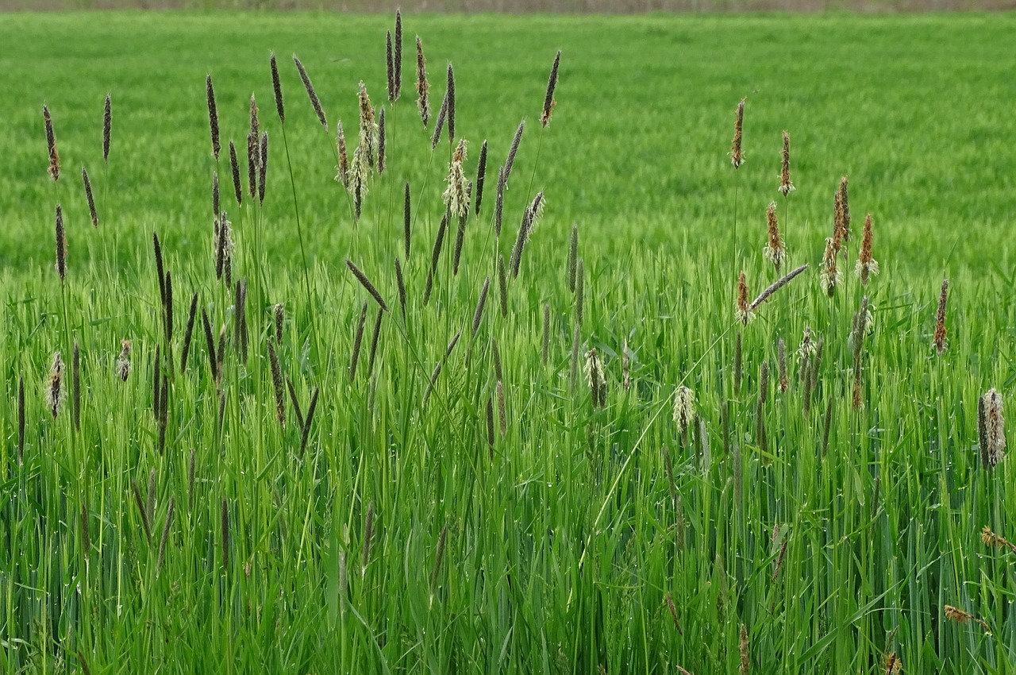
Insects
Rabbit
Birds
Sagebrush
Garbage
Deer
Mice
Wild Berries
Mushrooms
Grasses
Notes:
These are the designated food sources, assign one to each group.

Slide 4
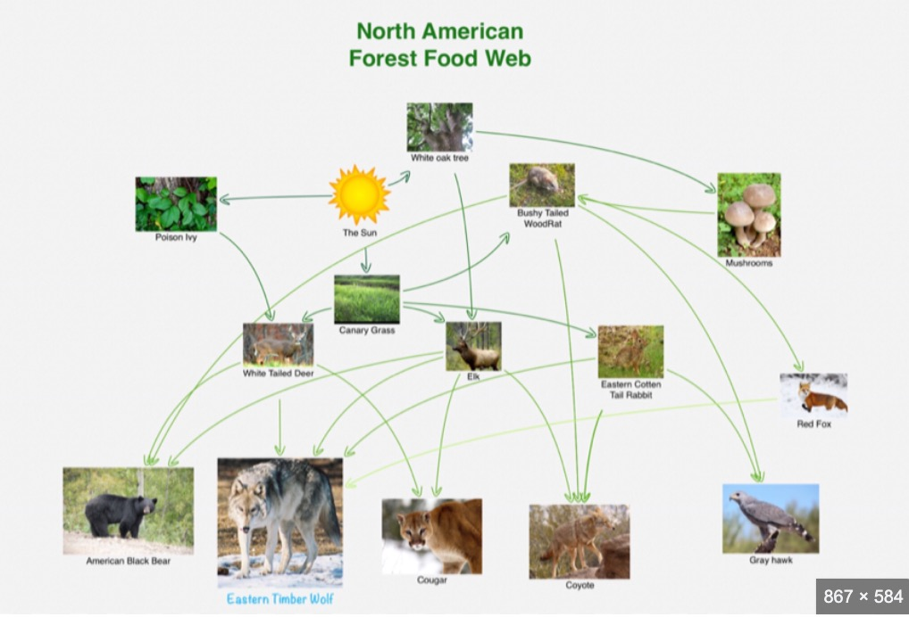
Notes:
-Ask the question, “What are the traits that make these competitors successful!”
We are going to talk about the 2 big competitors from this group.

Slide 5
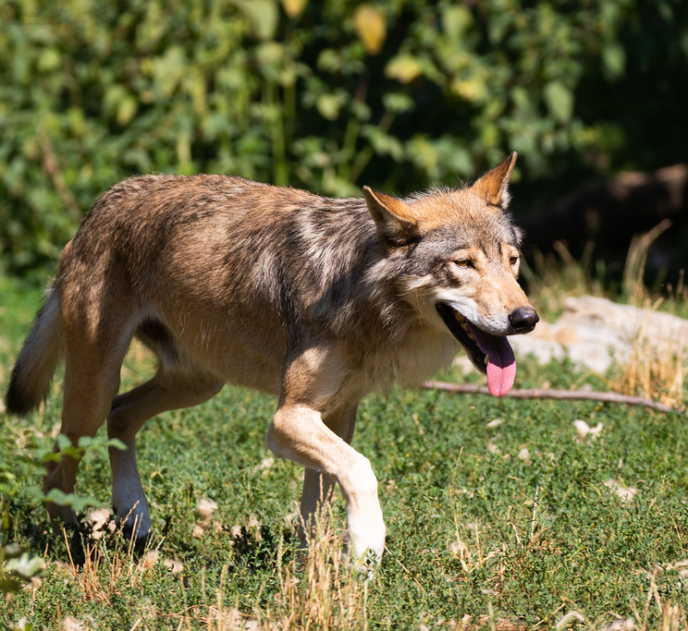
Eastern Wolf
This Photo by Unknown Author is licensed under CC BY-NC-ND
Notes:
-Ask students if they have heard of Eastern Wolf

Slide 6
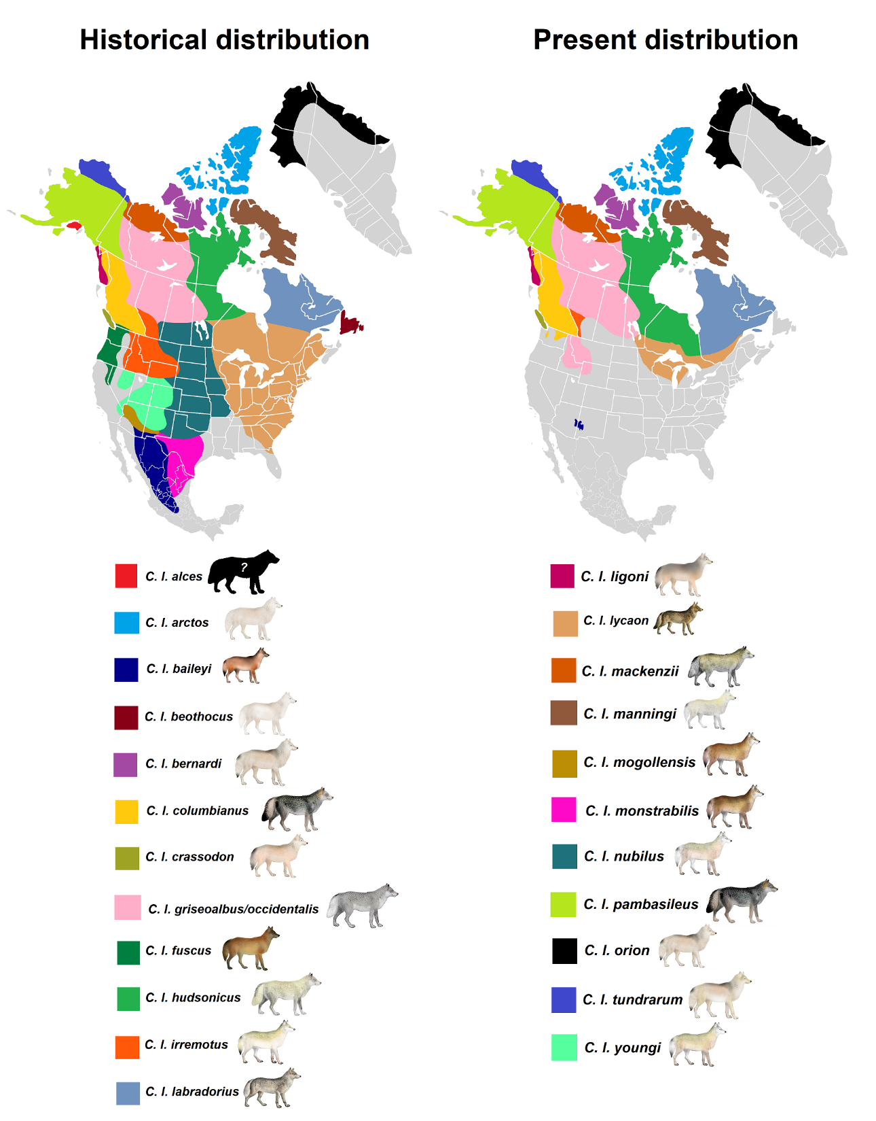
Eastern Wolf
Historic Range is the Great Lake, North-Eastern U.S., and South-Eastern Canada.
Population has declined greatly since early 1900’s
Notes:
Graphs depicting wolf populations in North America, Be sure to concentrate on the Eastern Wolf Population (TAN POPULATION ON EAST COAST, Canis Lupis Lyacon)
Think Pair Share is on next slide

Slide 7

Think-Pair-Share
What are some of the possible causes of the decreased range and population of E. Wolves?
This Photo by Unknown Author is licensed under CC BY
Notes:
Have everyone in groups talk about why they think the population of the eastern wolf has declined.

Slide 8
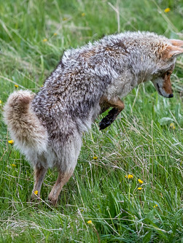
Coyote
The Western Coyote is a prolific species all across North America… but it hasn’t always been that way.
This Photo by Unknown Author is licensed under CC BY-NC-ND
Notes:
The western coyote
Prolific-A species that reproduces at high numbers or has many offspring

Slide 9
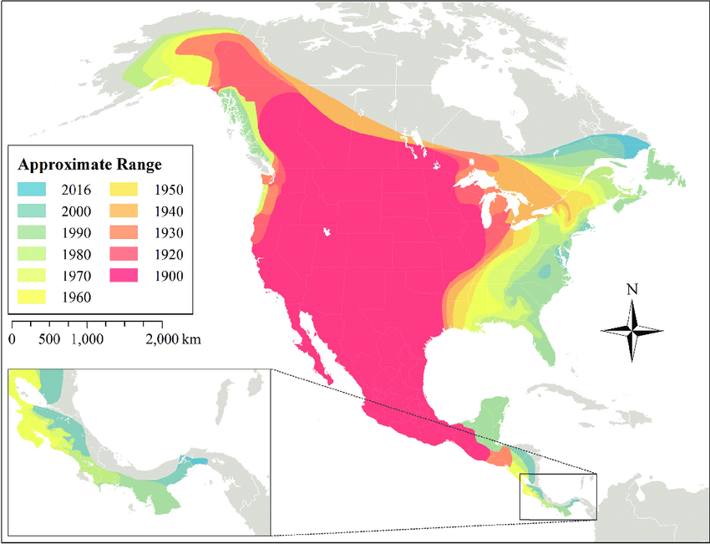
Coyote Population Map
Notes:
Hody, James & Kays, Roland. (2018). Mapping the expansion of coyotes (Canis latrans) across North and Central America. ZooKeys. 759. 81-97. 10.3897/zookeys.759.15149.

Slide 10
Think-Pair-Share
What are some of the possible causes of the increased range and population of W. Coyotes?
This Photo by Unknown Author is licensed under CC BY
Notes:
- Think-Pair-Share- What did the reduction of wolves do to the coyote population?
After this distribute Compilation of evidence

Slide 11
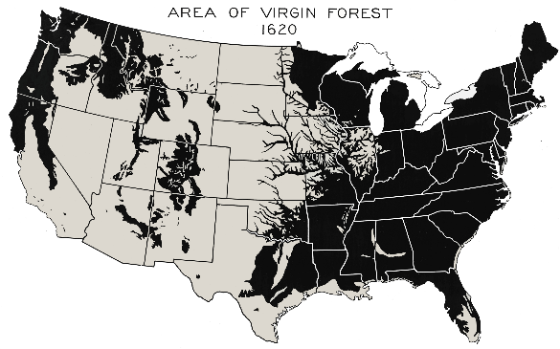
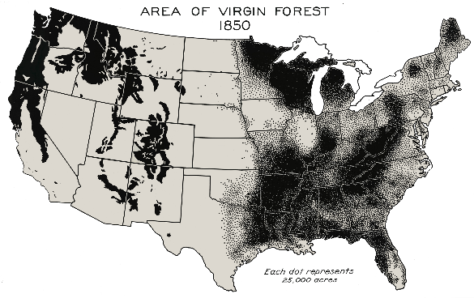
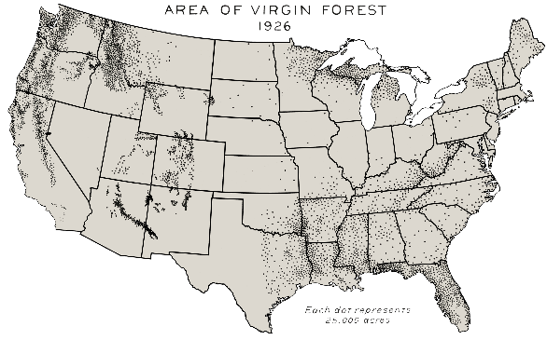
Deforestation

Slide 12
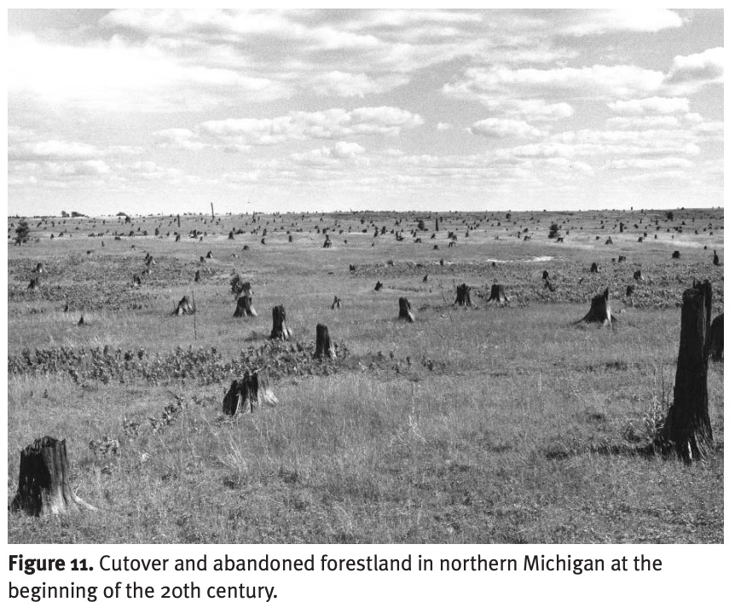
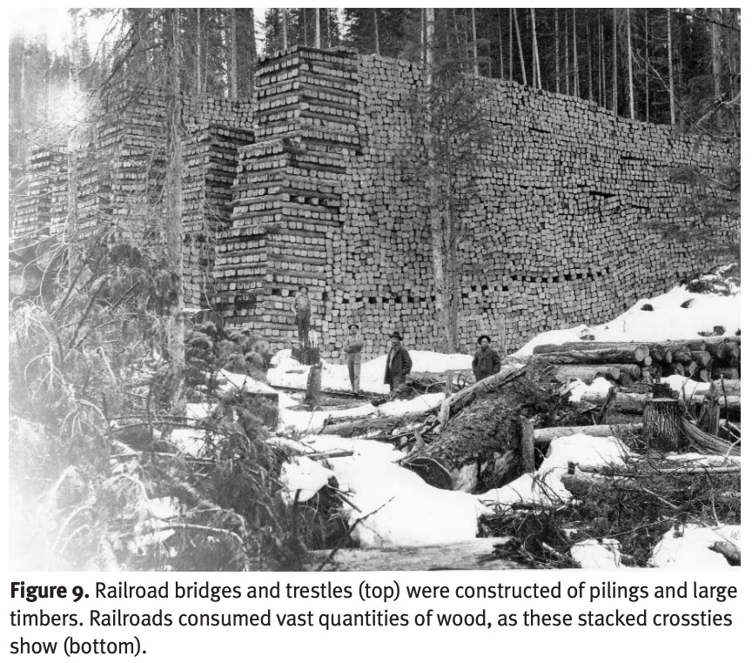

Slide 13
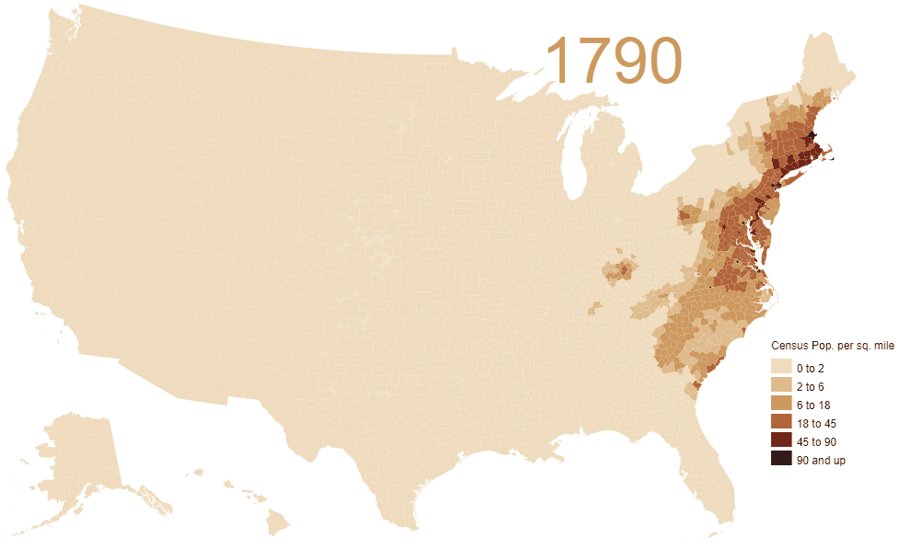
Urbanization: Census population map

Slide 14
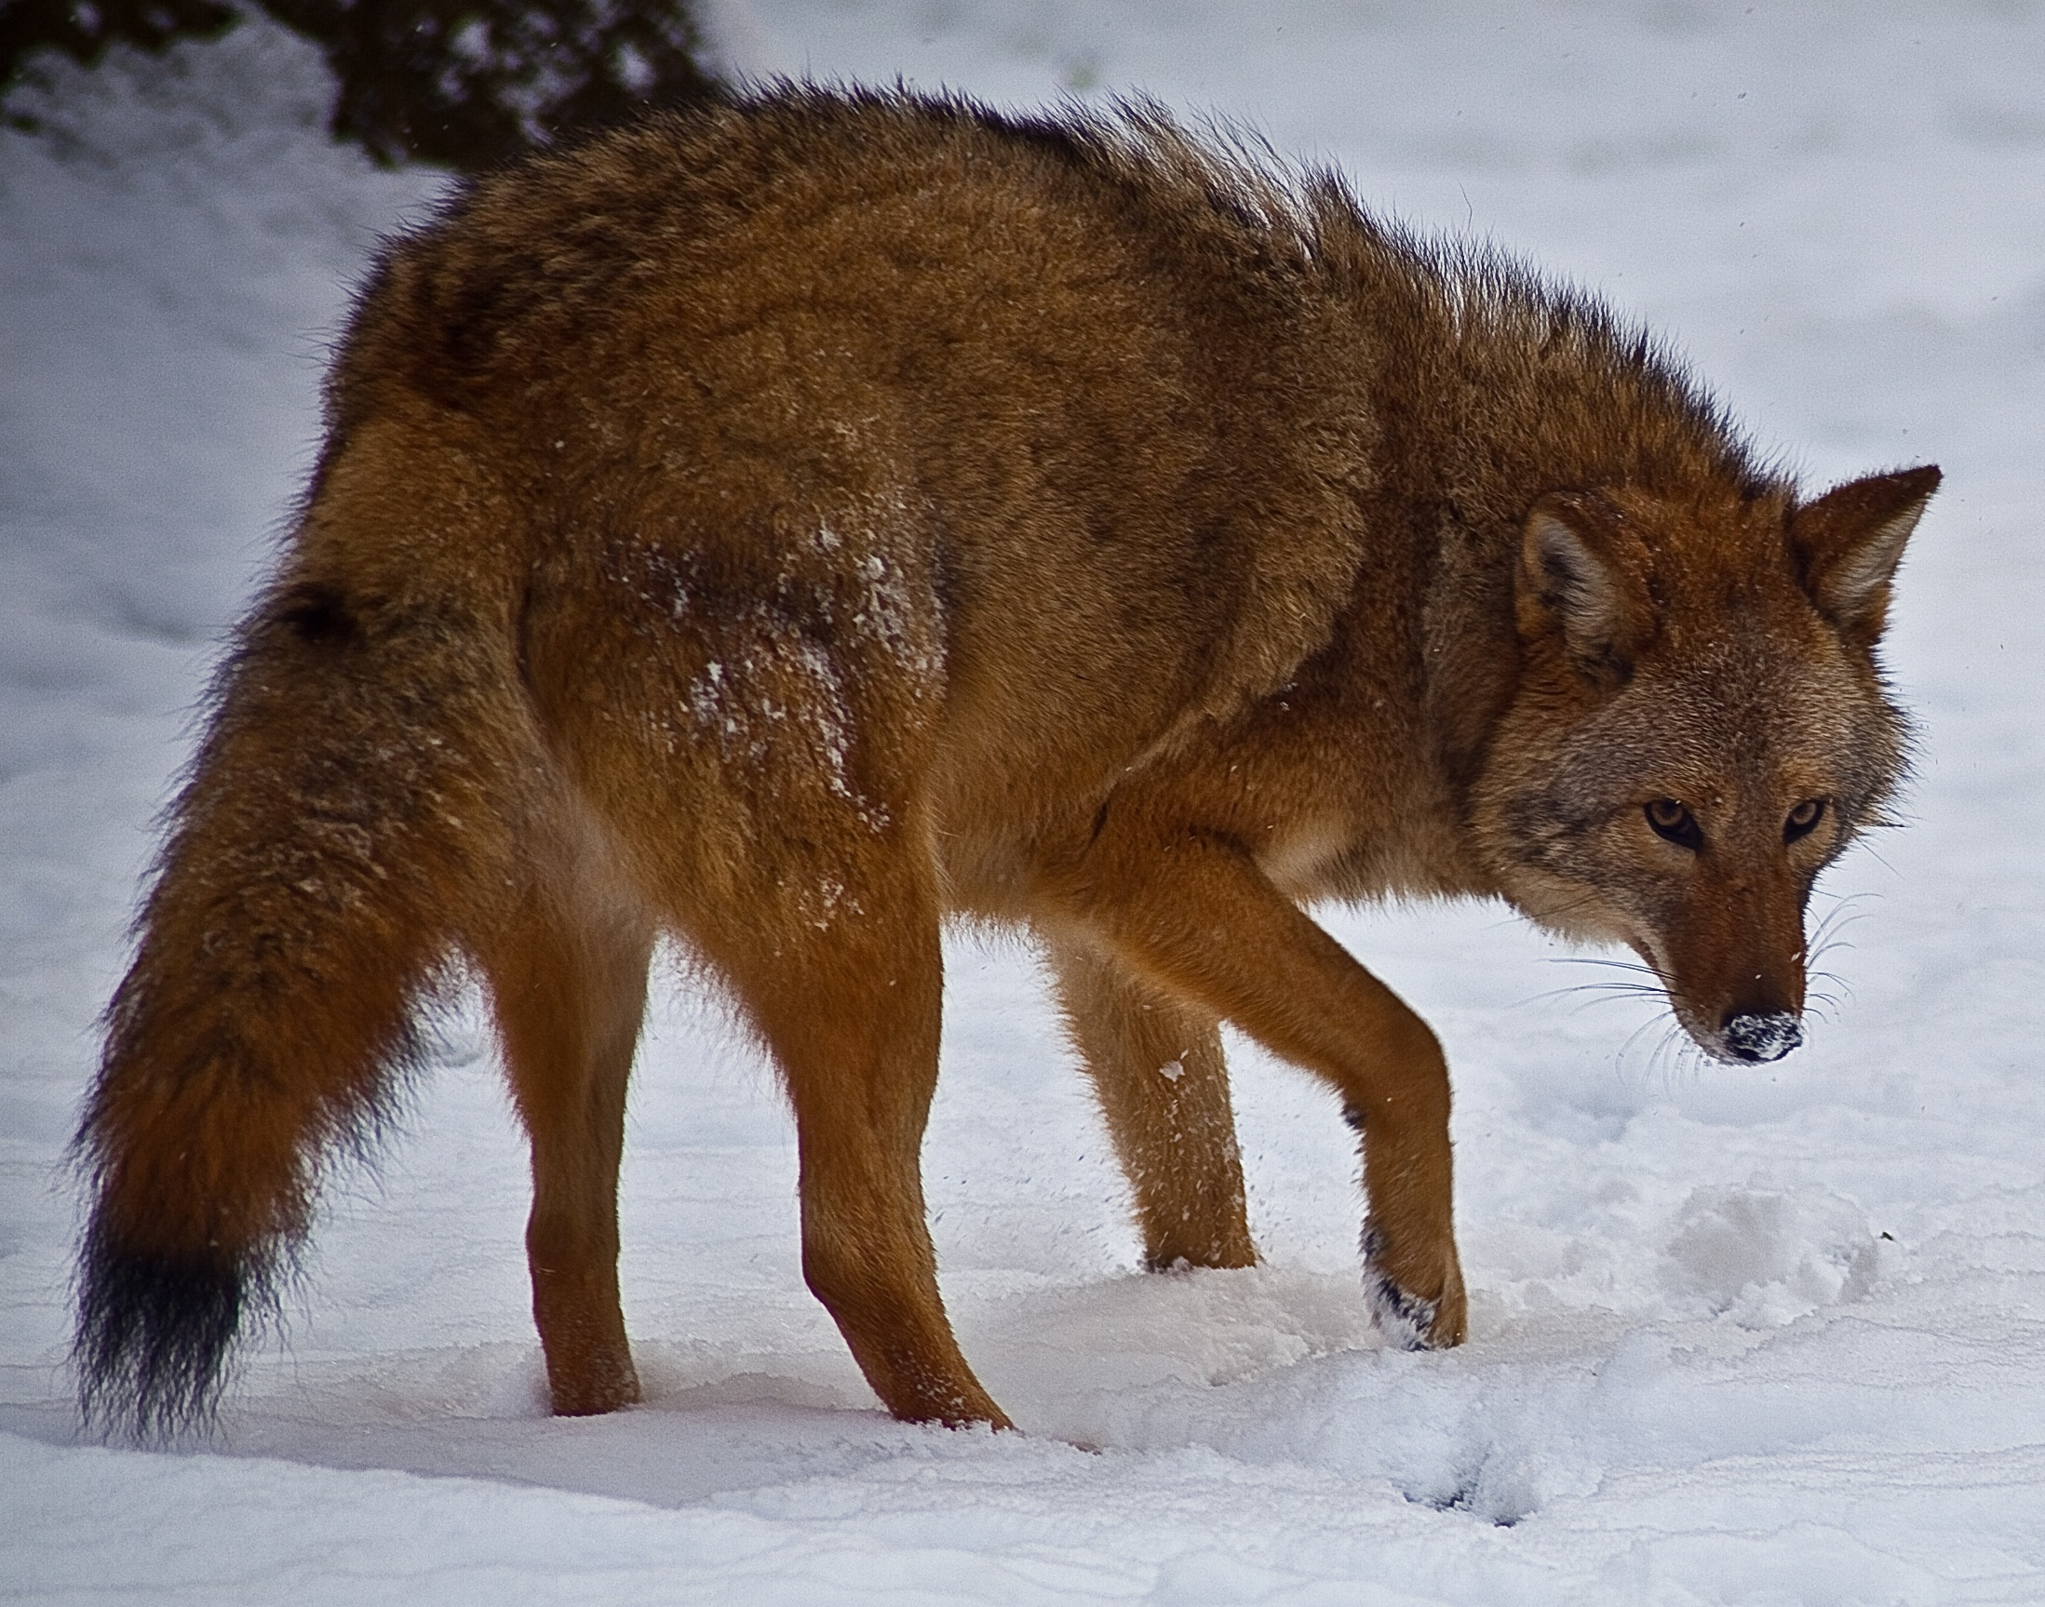
Introducing the Eastern Coyote aka Coywolf
Notes:
This is an example of the Eastern Coyote aka Coywolf.

Slide 15
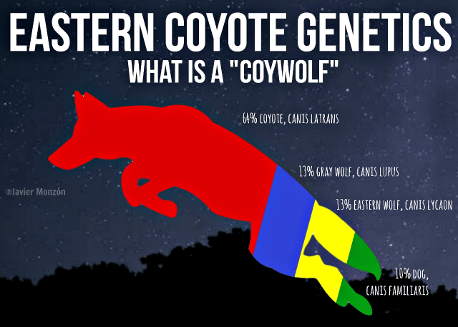
Notes:
Reference for picture- https://nywolf.org/2018/08/eastern-coyote-genetics/

Slide 16
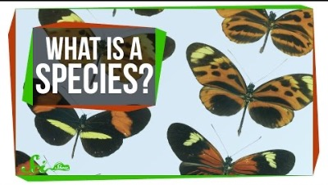
What is a species anyway?
According to the biological species concept, organisms belong to the same species if they can interbreed to produce viable, fertile offspring.
https://youtu.be/dnfaiJJnzdE
Notes:
Only watch the video until 3:08.

Slide 17

3D-RST is supported by the NSF under grant number #DRL-2101383

