Slide 1

BIOTECHNOLOGY
1. Students will evaluate design solutions where biotechnology was used to identify and/or modify genes in order to solve a problem.
2. Students will be able to recognize the use of biotechnology within their lives and the world around them.

Slide 2
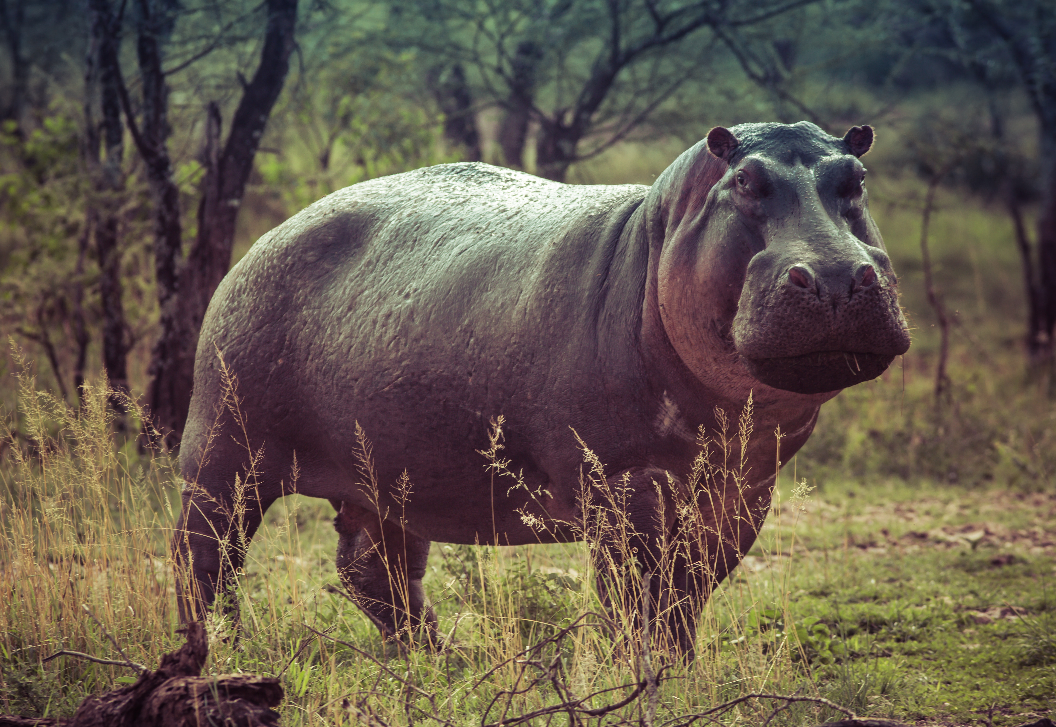
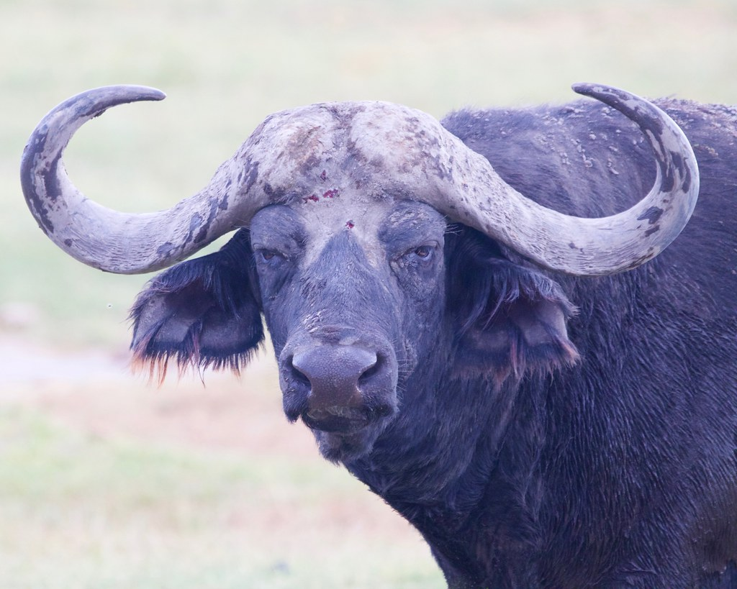
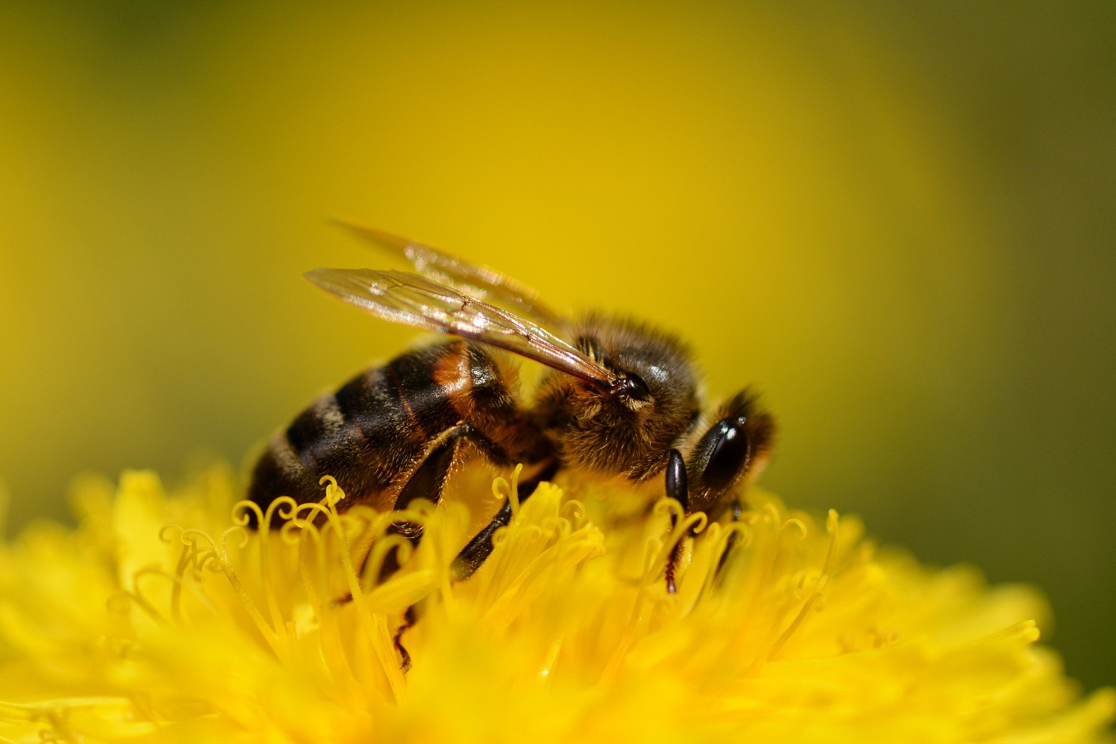
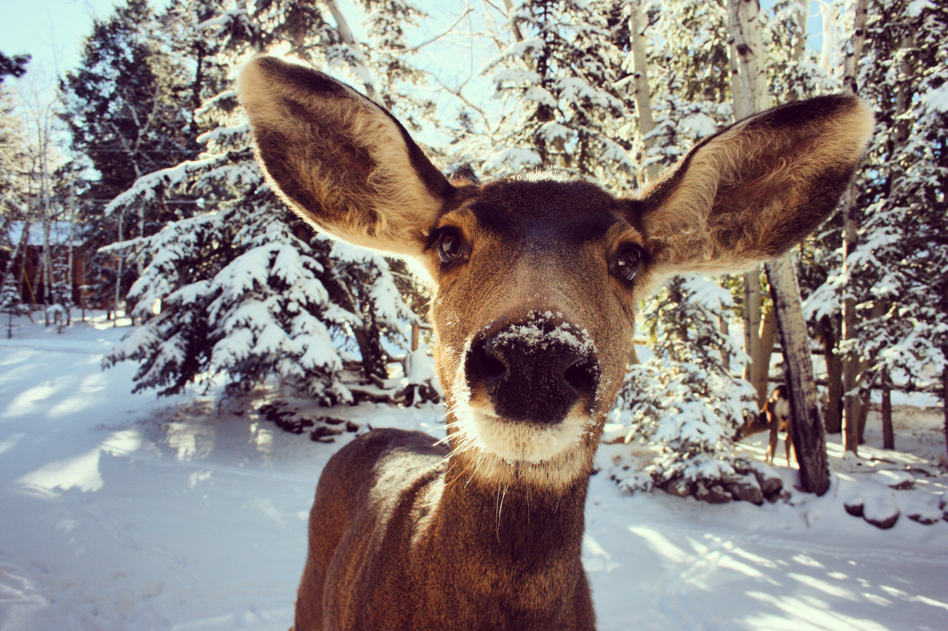
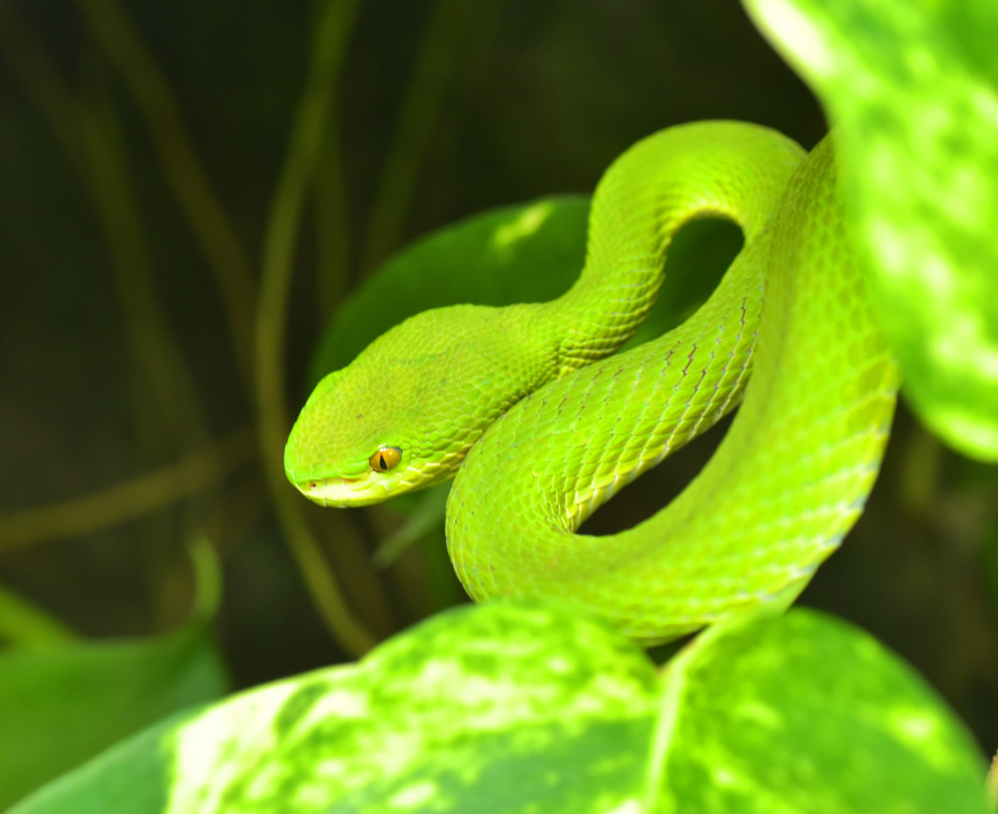
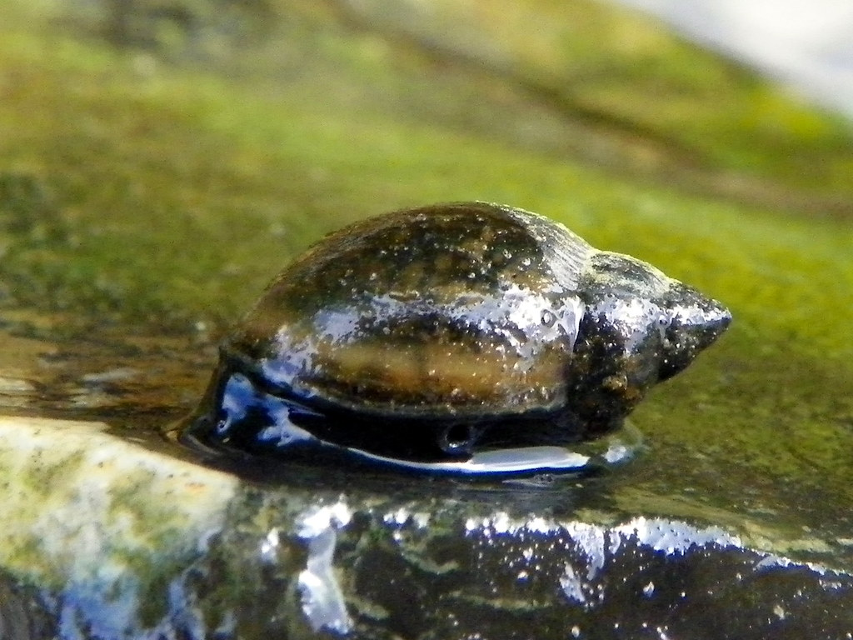
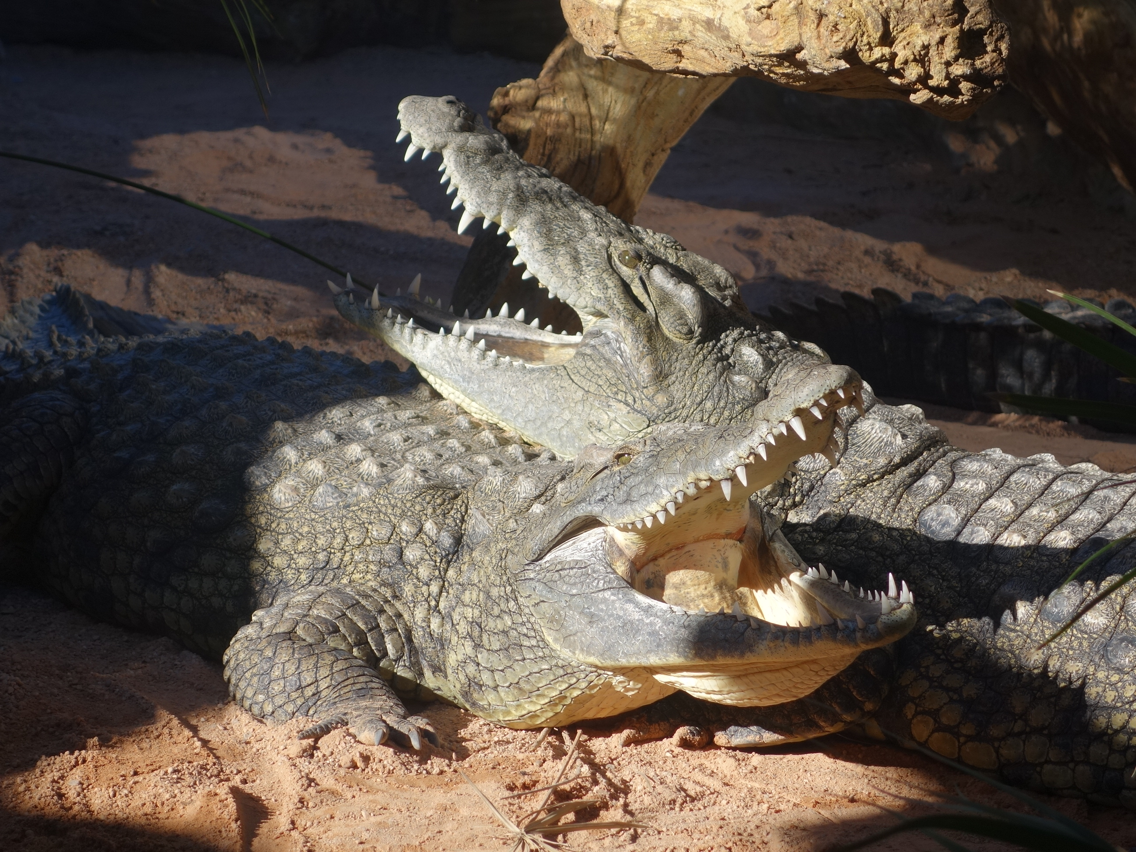
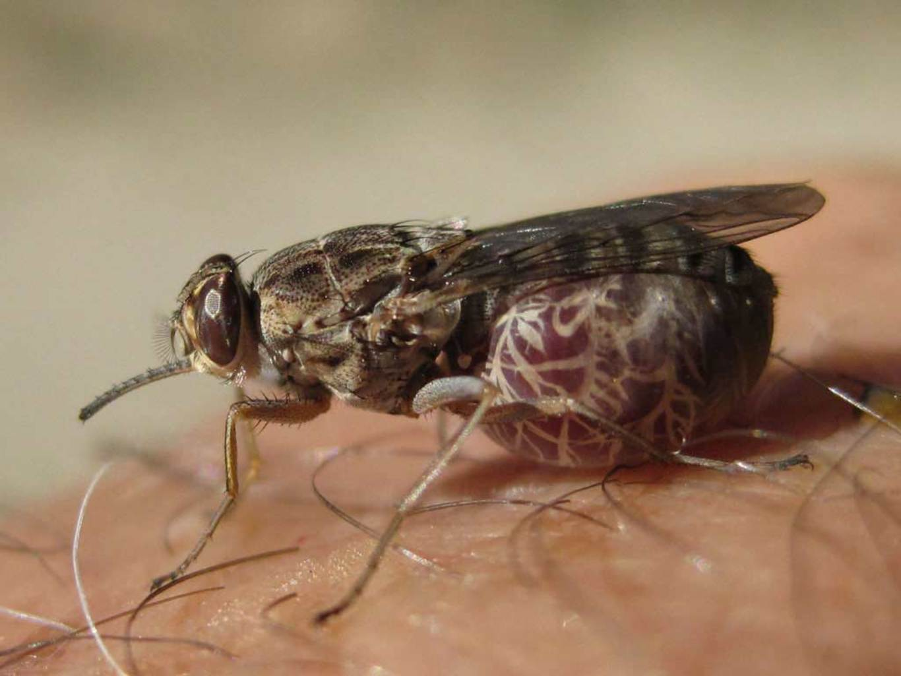
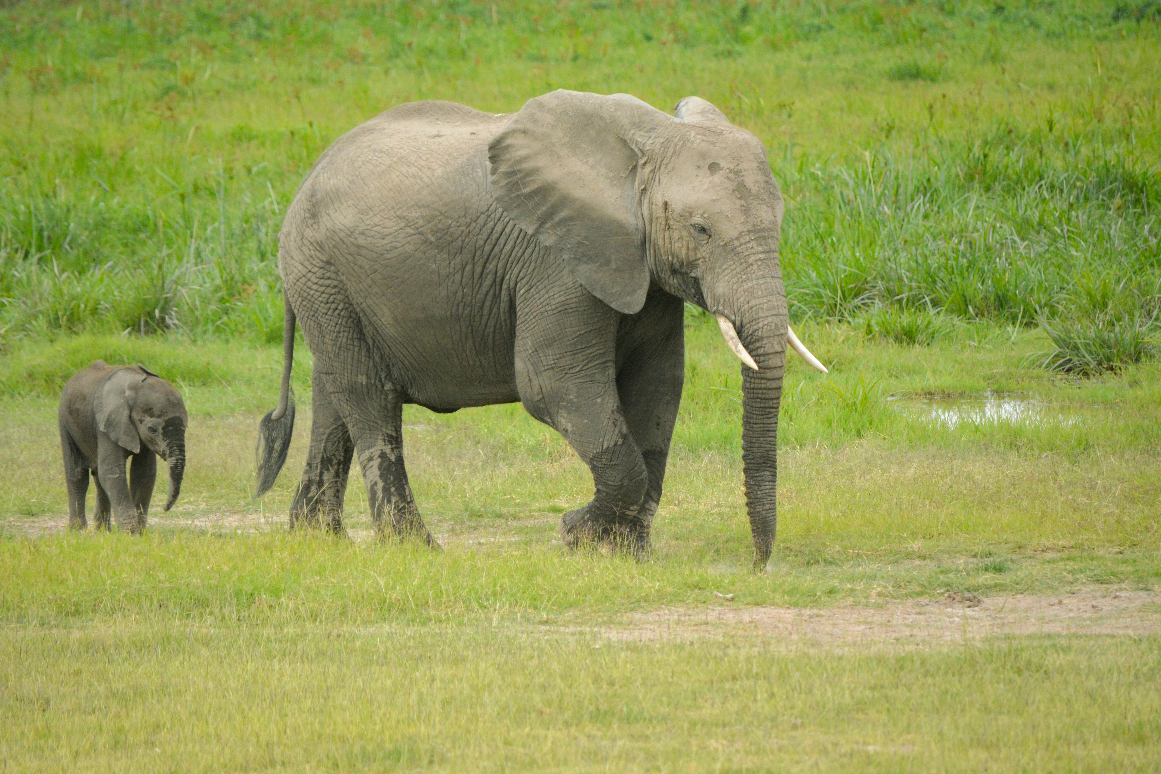
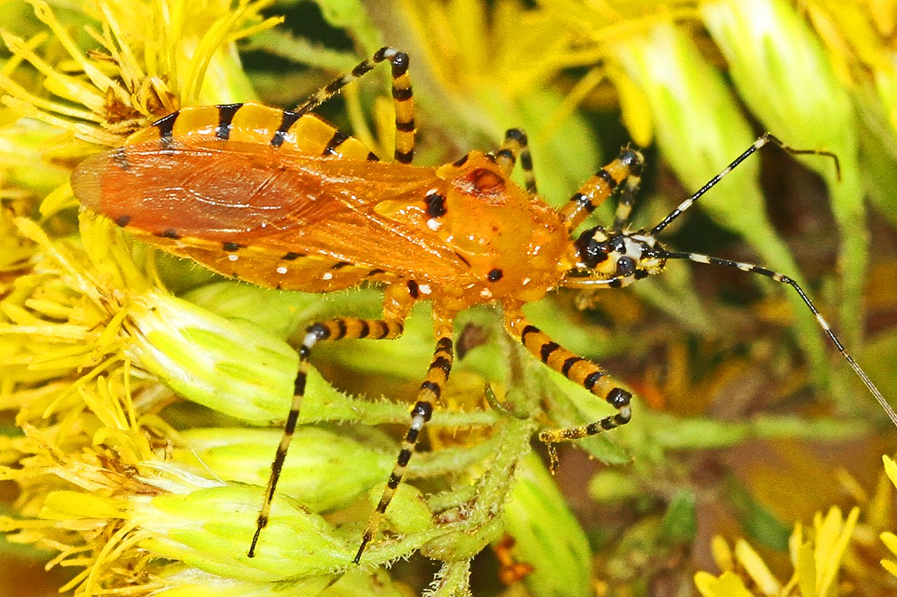
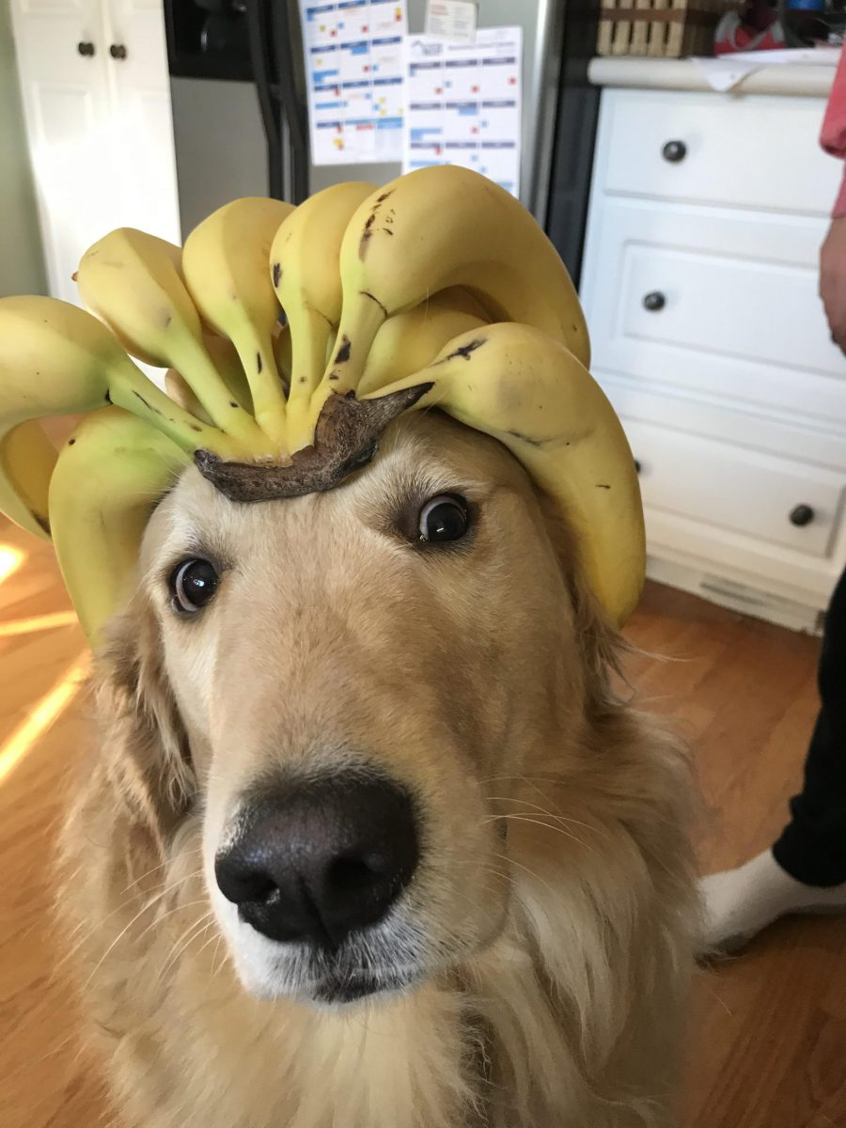
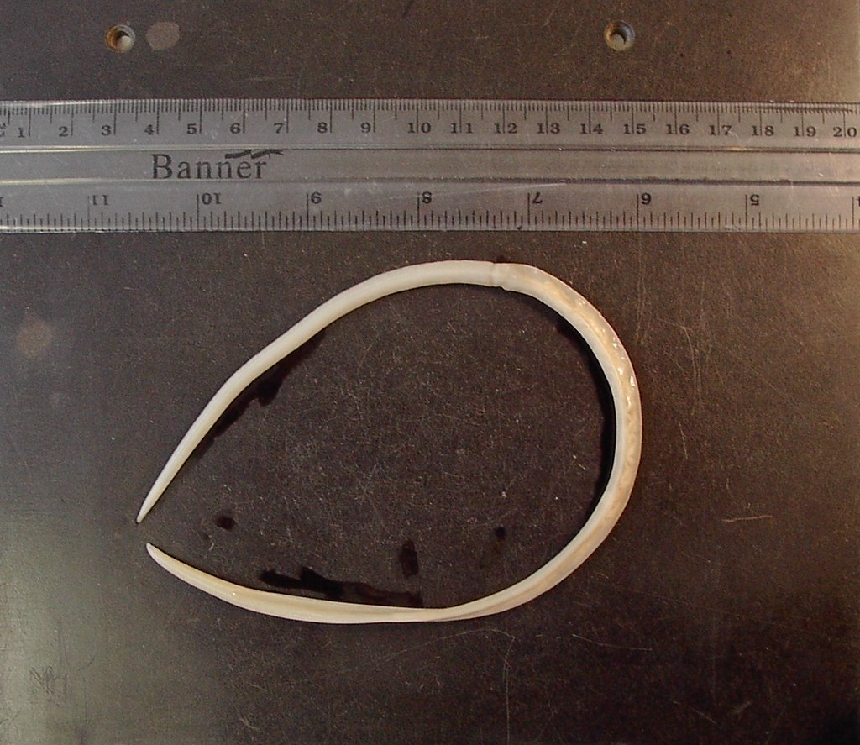
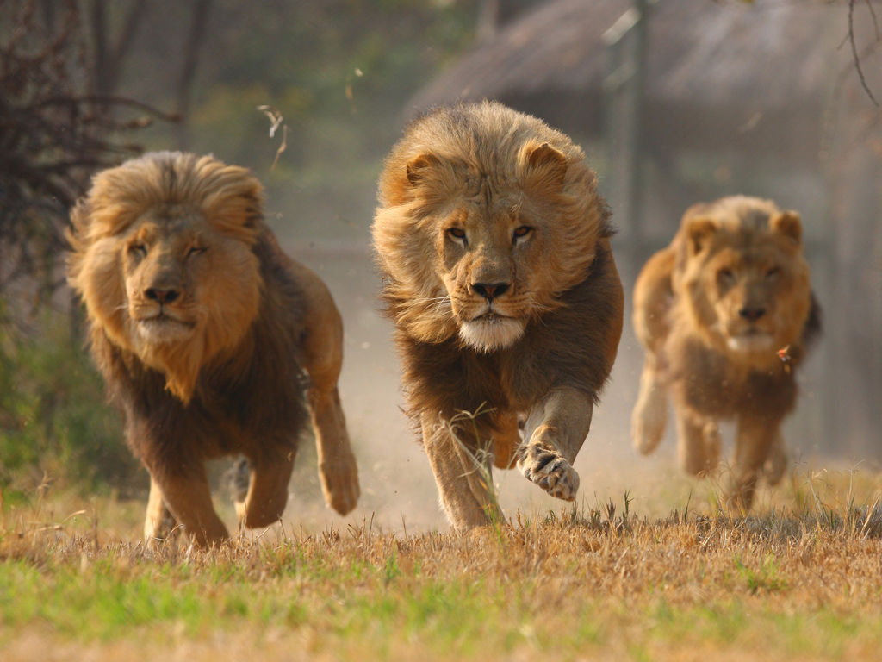
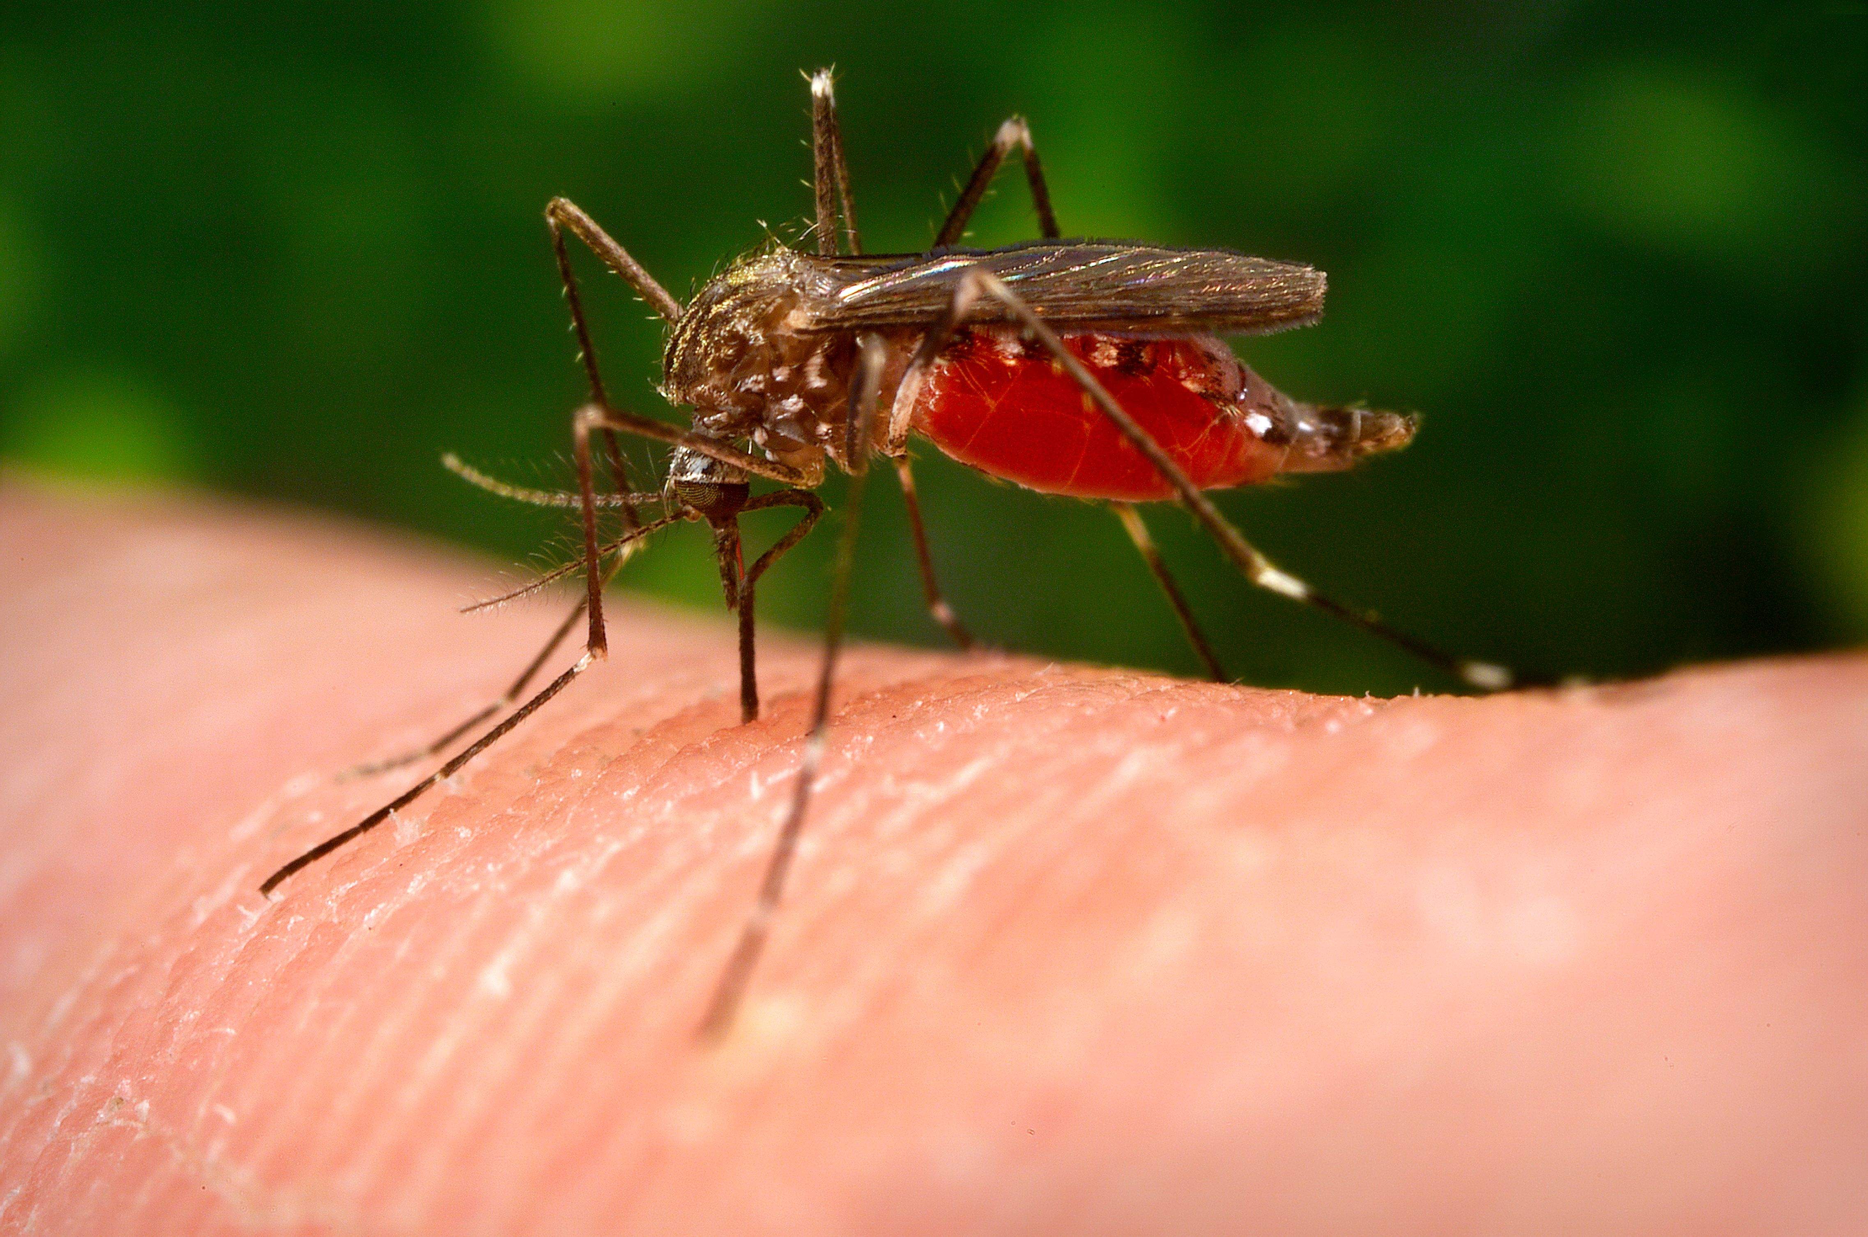
Rank the 7 Deadliest Animals
Bee
Water
Buffalo
Hippopotamus
Deer
Freshwater Snail
Crocodiles
Tsetse Fly
Snakes
Assassin Bug
Lion
Mosquito
Elephant
Dog
Roundworm
Notes:
Have the students rank these animals from least to most dangerous.
Orange bug= Assassin Bug
Snail= Freshwater Snail
Worm= Ascari Roundworm
Fly= Tsetse Fly

Slide 3
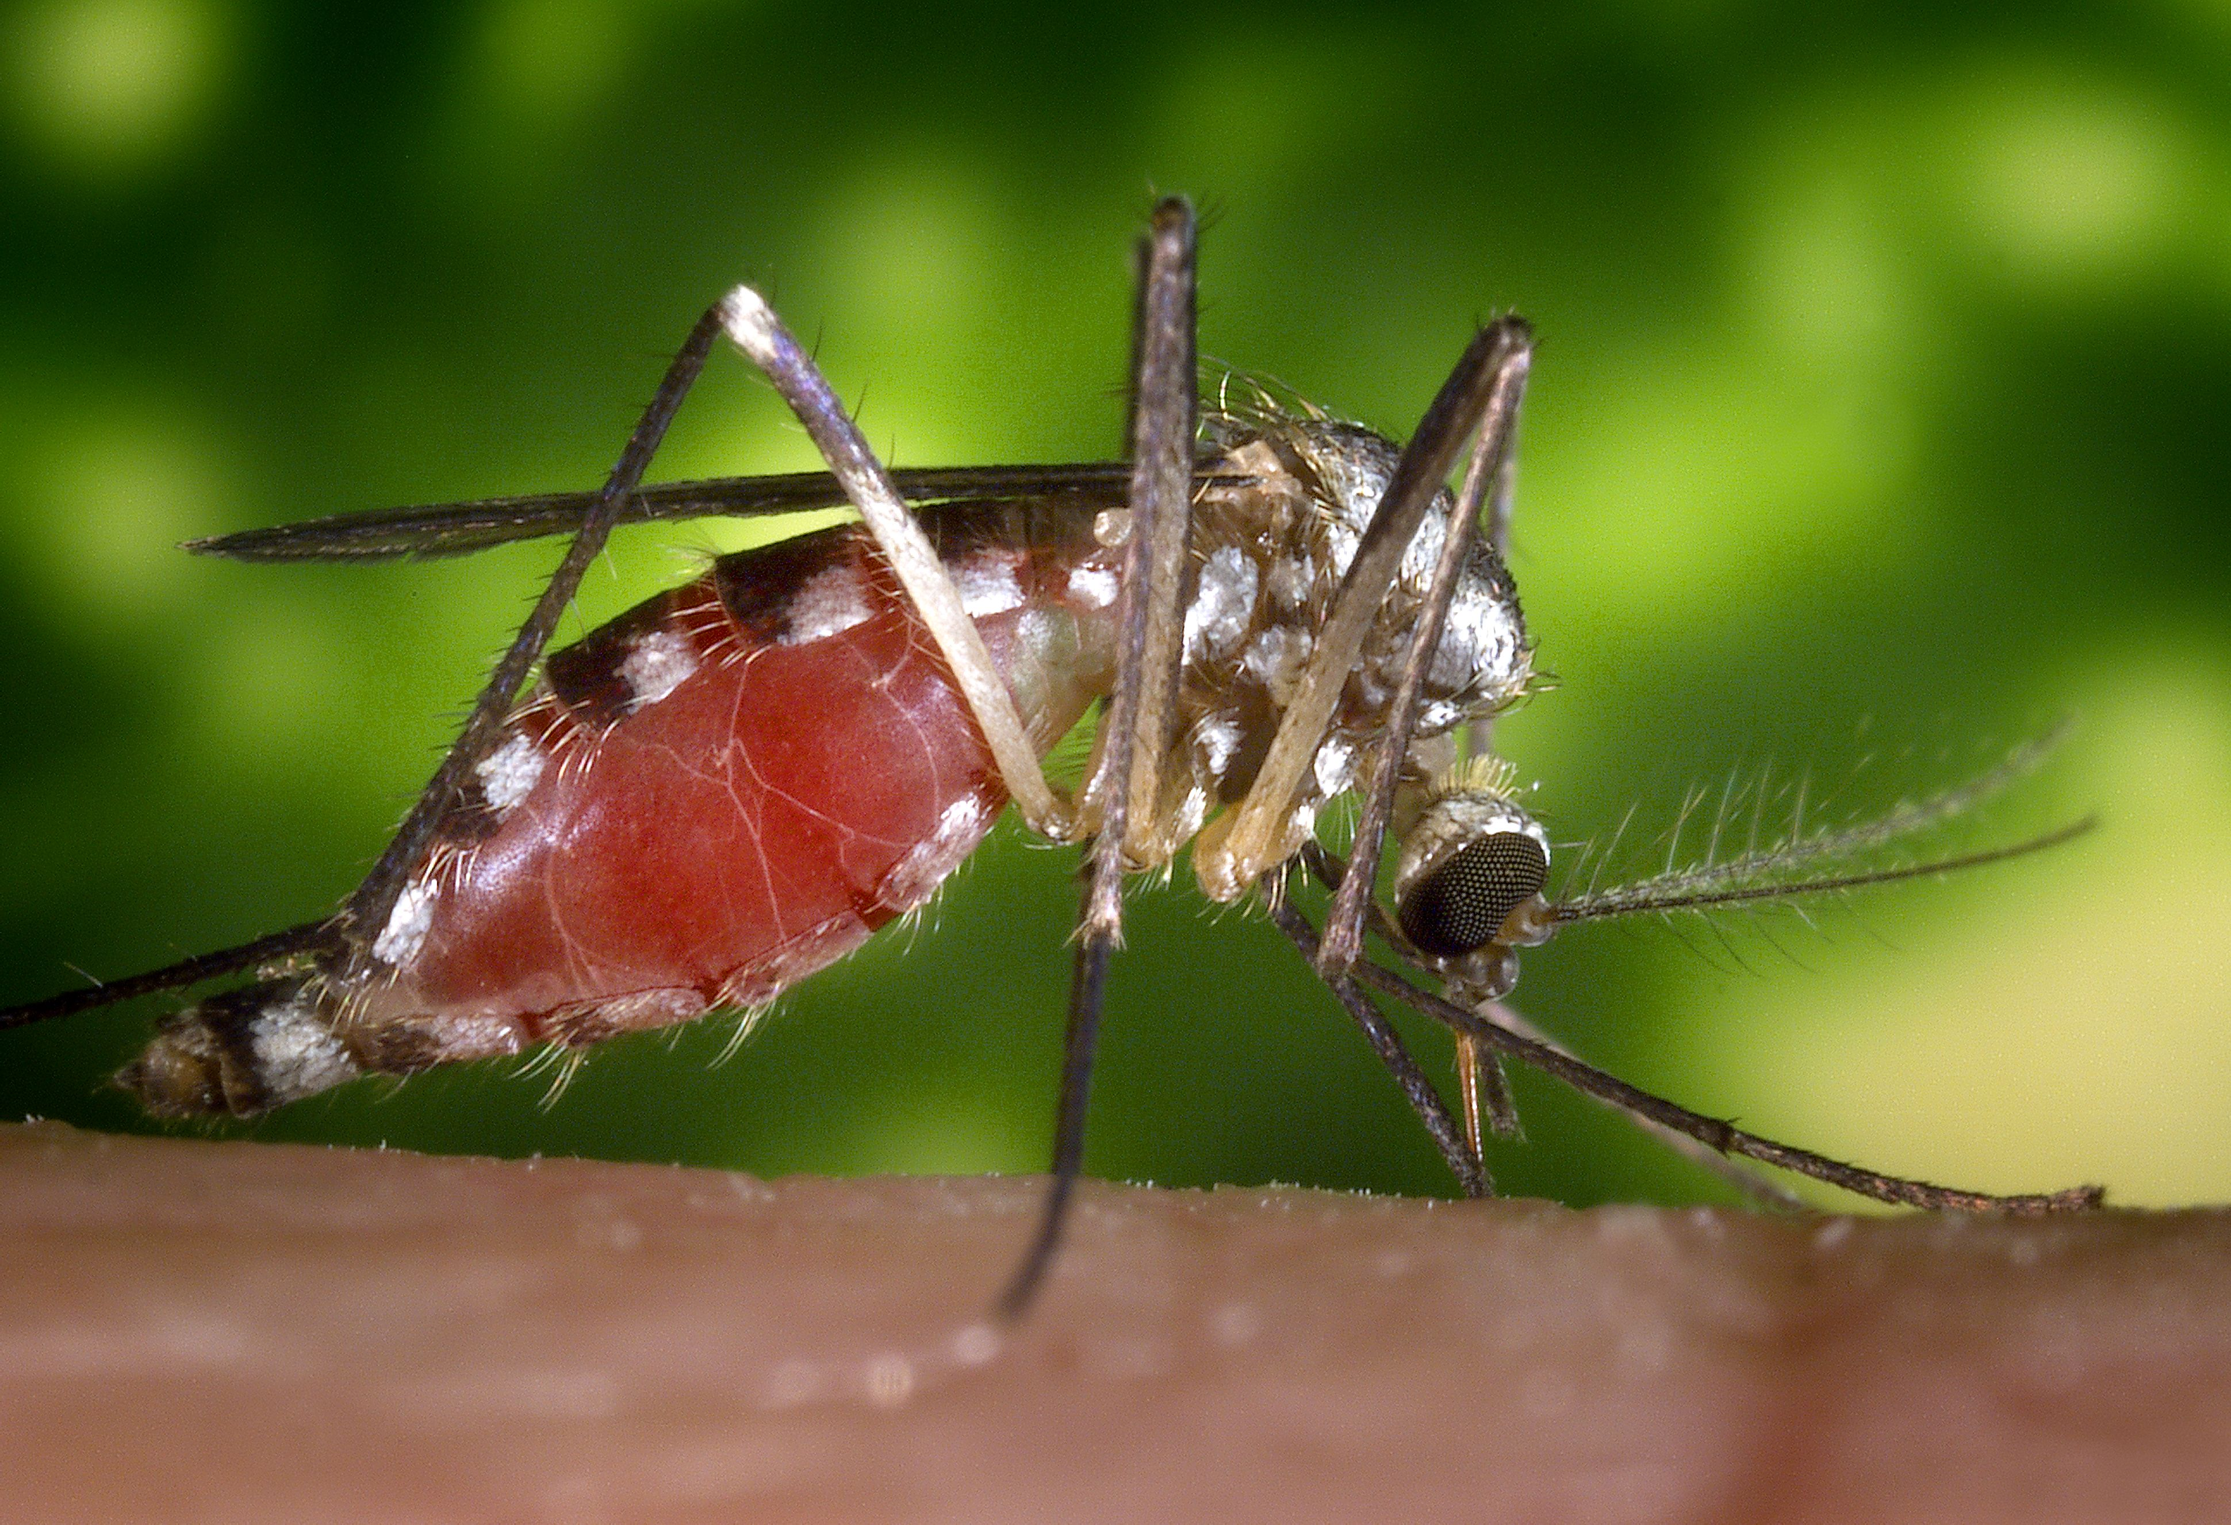
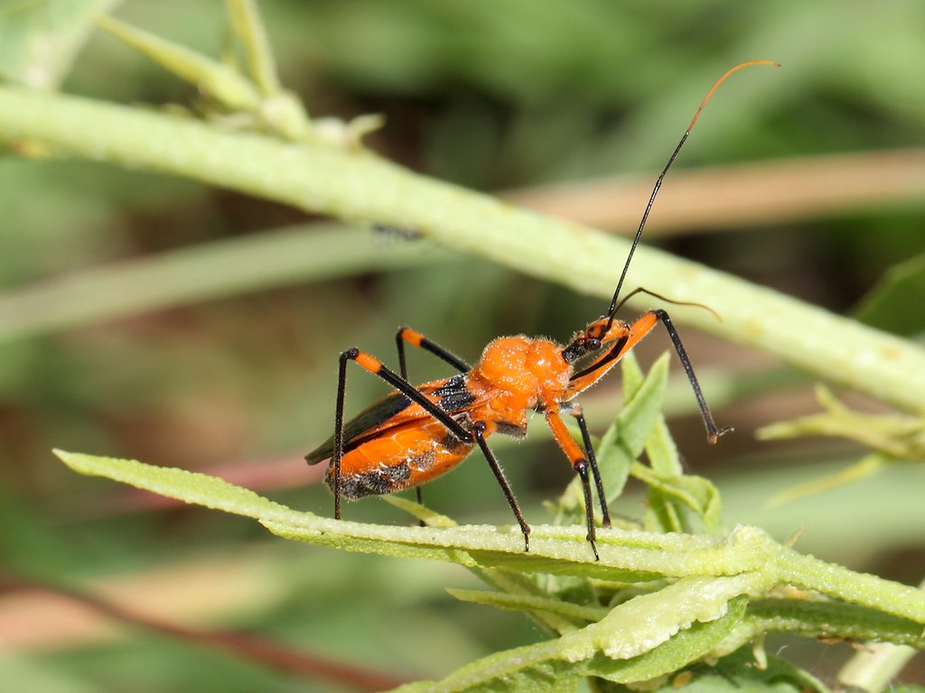
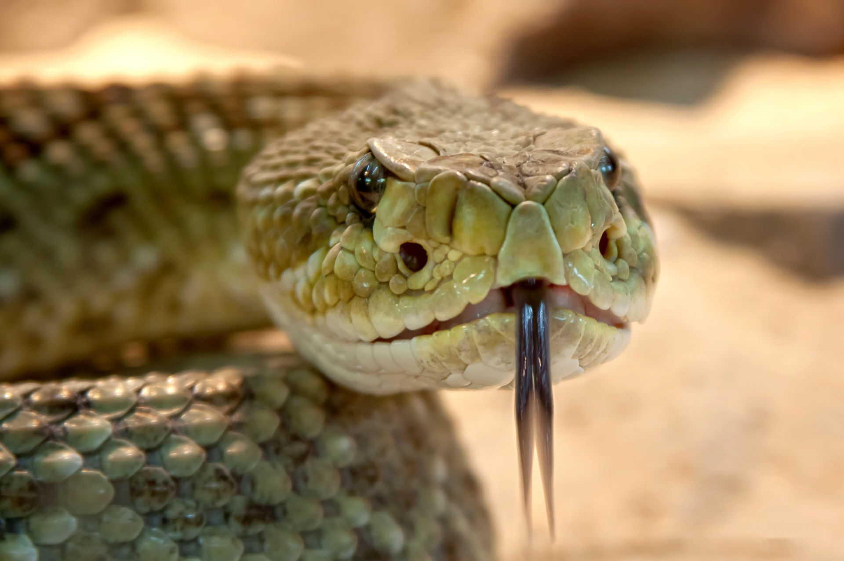
TOP 7 DEADLIEST ANIMALS
Ascaris Roundworms
Tsetse Fly
Assassin Bug
Freshwater Snail
Dog
Notes:
7- Ascari Roundworm 6- Tsetse Fly 5- Assassin Bug 4- Freshwater Snail, 3- Dog, 2- Snakes, 1- Mosquitos

Slide 4
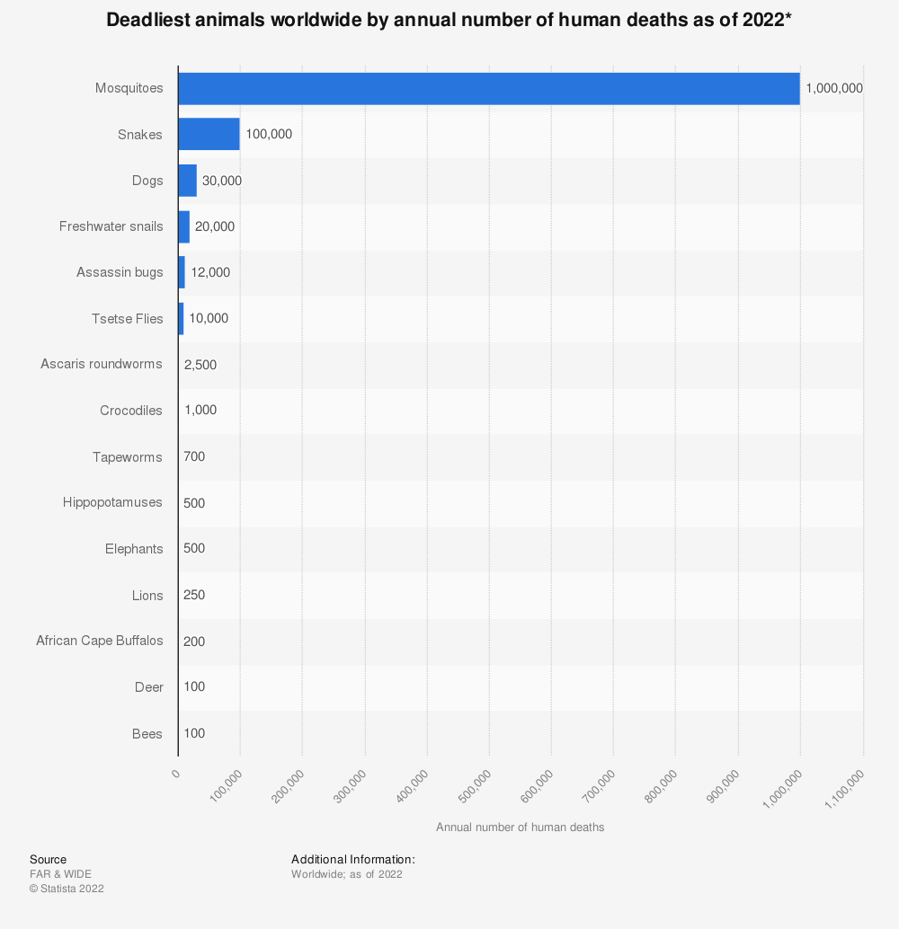

Slide 5
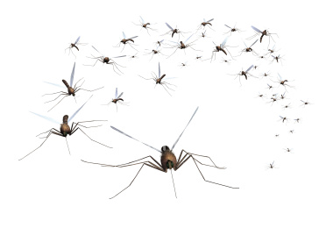
MOSQUITOES
Who hates mosquitoes?!
Notes:
!WARN STUDENTS ABOUT THE CONTENTS OF THIS VIDEO, IT HAS THE POTENTIAL TO TRIGGER PHOBIAS!
Play the video after asking the question in the slide.
. HAVE STUDENTS WRITE DOWN THER+IR THOUGHTS DURING THE VIDEO. KWL- What you know, What you want to learn, What you learned
Share some sort of personal story about mosquitos if applicable

Slide 6
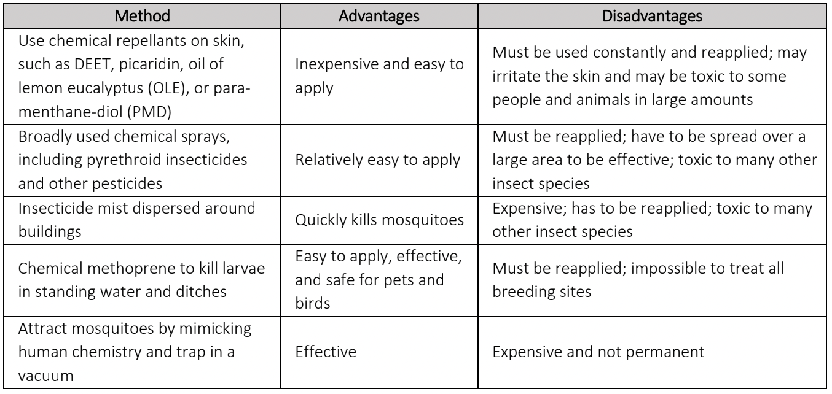
How do we solve this problem?

Slide 7

Zika Virus
Zika virus is transmitted primarily by Aedes mosquitoes, which bite mostly during the day.
Most people with Zika virus infection do not develop symptoms; those who do typically have symptoms including rash, fever, conjunctivitis, muscle and joint pain, malaise and headache that last for 2–7 days.
Zika virus infection during pregnancy can cause infants to be born with microcephaly and other congenital malformations as well as preterm birth and miscarriage.
Zika virus infection is associated with Guillain-Barré syndrome, neuropathy and myelitis in adults and children.
In February 2016, WHO declared Zika-related microcephaly a Public Health Emergency of International Concern (PHEIC), and the causal link between the Zika virus and congenital malformations was confirmed. WHO declared the end of the PHEIC in November of the same year.
Although cases of Zika virus disease declined from 2017 onwards globally, transmission persists at low levels in several countries in the Americas and other endemic regions.

Slide 8
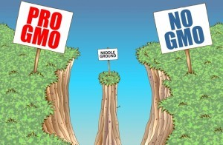
A GMO Solution to Diseases Spread by Mosquitoes
What is a GMO?
Genetically Modified Mosquitoes
This Photo by Unknown Author is licensed under CC BY-NC-ND
Notes:
!WARN STUDENTS ABOUT THE CONTENTS OF THIS VIDEO; IT HAS THE POTENTIAL TO TRIGGER PHOBIAS!
Write initial thoughts
Write thoughts during video
- HAVE STUDENTS WRITE DOWN THEIR THOUGHTS DURING THE VIDEO. KWL- What you know, What you want to learn, What you learned

Slide 9
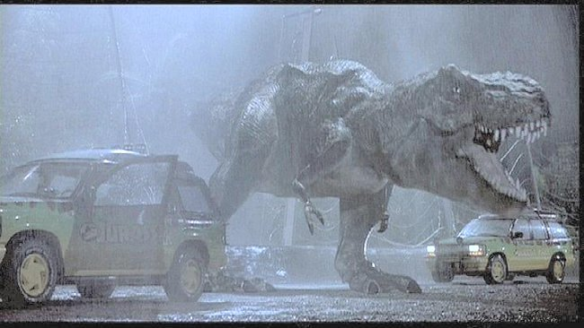
Bio Ethics?
Ethics Clip
This Photo by Unknown Author is licensed under CC BY-SA

Slide 10

3D-RST is supported by the NSF under grant number #DRL-2101383

