Slide 1
Lactose Intolerance
Lactase Persistence?
or

Slide 2
What do you know about lactose intolerance?
Discuss with a partner anything you know or have heard about lactose intolerance.

Slide 3
Do you know anyone who is lactose intolerant?
How does it affect their lives?

Slide 4

While watching the video jot down 3 questions that come to mind...

Slide 5
Is the frequency of lactose intolerance consistent worldwide?

Slide 6
Lactose Intolerance
What It Is
What It Isn't

Slide 7
Lactose Intolerance Around the World
You will visit each country around the room.
Follow the instructions at each station.
1. Make 4 draws with replacement to find the parent genotypes
2. Fill in the Punnett square on your student sheet.
3. Calculate your possible genotype ratios and percentages.

Slide 8

Add your group's data to the classroom data then add the data to your worksheet.
Answer questions 1 & 2 individually on your worksheet.

Slide 9
Is lactose intolerance dominant or recessive?
What patterns in our data helped you decide?

Slide 10
Genotypes
Phenotypes
LL
Ll
ll
Lactase persistence
Lactose intolerant

Slide 11
Worldwide Data
Country | % of Population Lactose Intolerant
Columbia | 80%
South Korea | 100%
United States | 36%
Native American | 75%
Mexico | 48%
United Kingdom | 8%
Answer questions 3 & 4

Slide 12
Read the article and answer 5 & 6
5. How might lactase persistence (being able to digest lactose as you age) be beneficial?
6. What might be the reason for differences in lactose intolerance between countries?

Slide 13
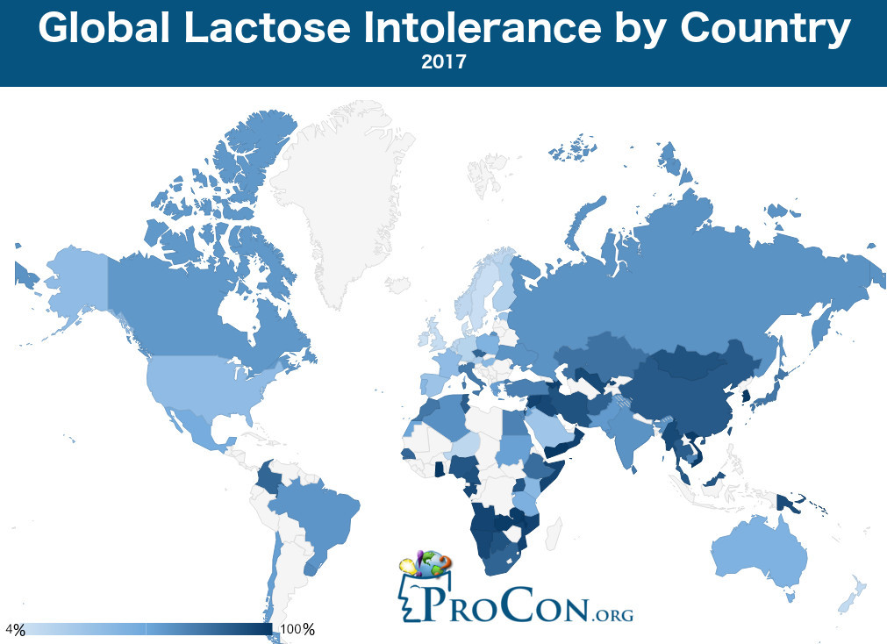

Slide 14
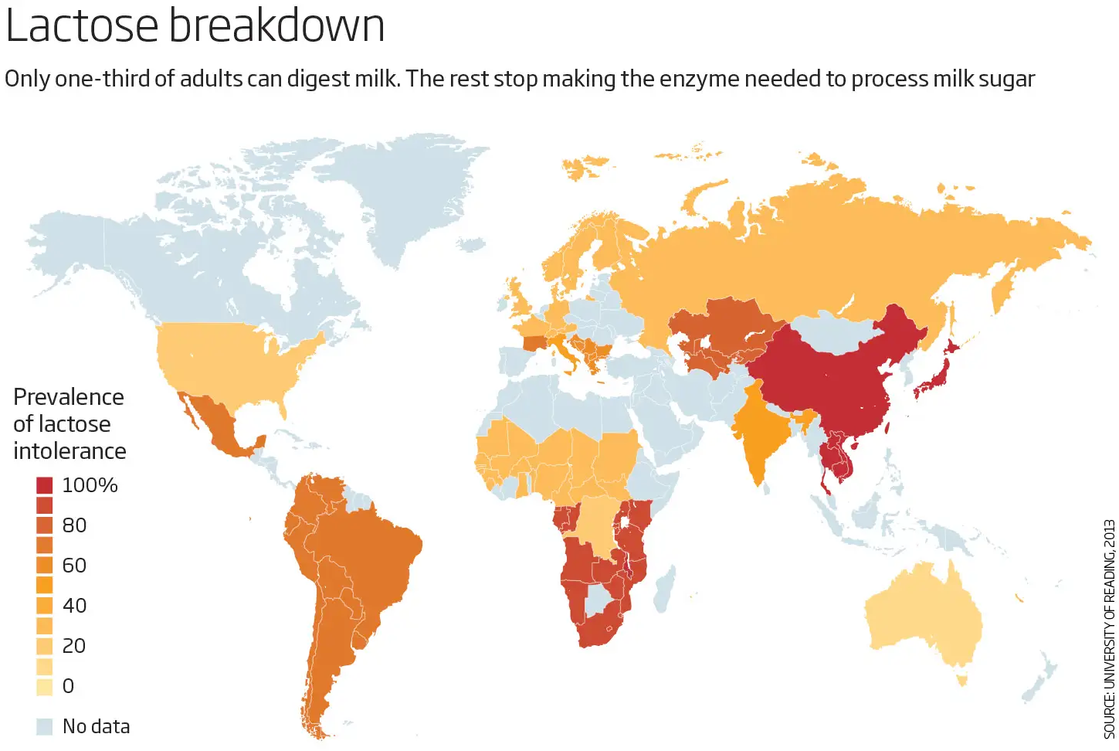

Slide 15
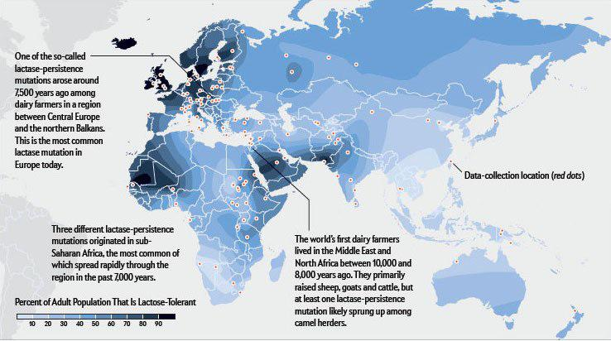

Slide 16
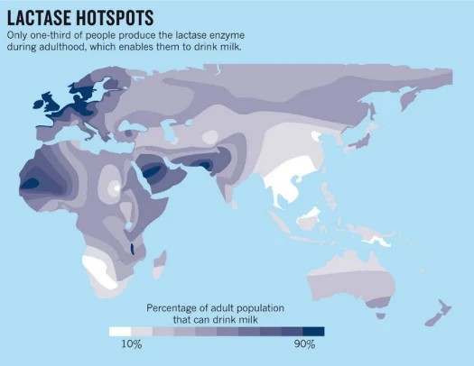

Slide 17
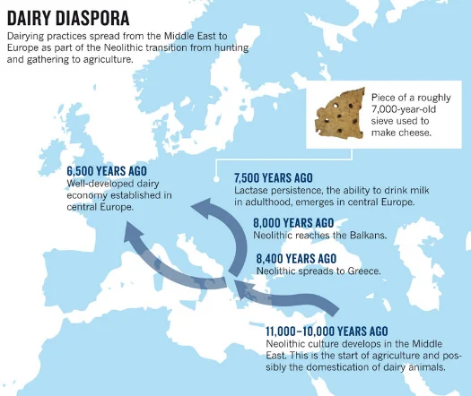

Slide 18
Evaluation
7. Choose a country from the list
  What percentage of the population is lactose intolerant?
  What percentage is lactase persistent?
  Infer the possible genotypes from the data.

Slide 19

Hardy Weinberg Principle
Work together with the class to complete the numbers for the United States.
Choose a country* and follow the steps on your worksheet to calculate the number of homozygous dominant, heterozygous and homozygous recessive genotypes in a population.
*From: https://milk.procon.org/lactose-intolerance-by-country/

Slide 20
Predict
Using everything you've learned, make a prediction about lactose intolerance in the United States.
What do you think will happen over the next 50 years?
What patterns have helped you make this decision?

Slide 21

3D-RST is supported by the NSF under grant number #DRL-2101383

