Slide 1
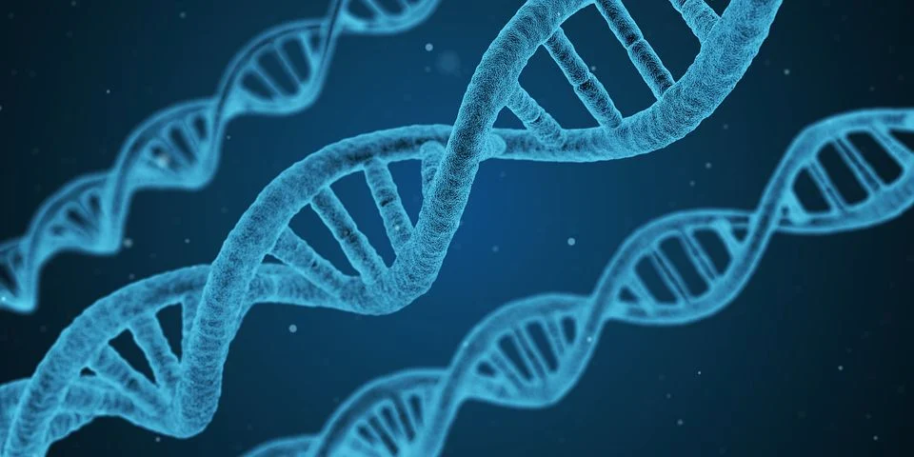
DNA Structure

Slide 2
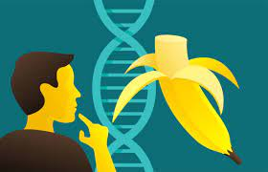
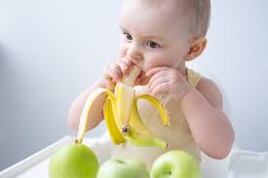
Consider what the following organisms on the next 3 slides have in common?

Slide 3
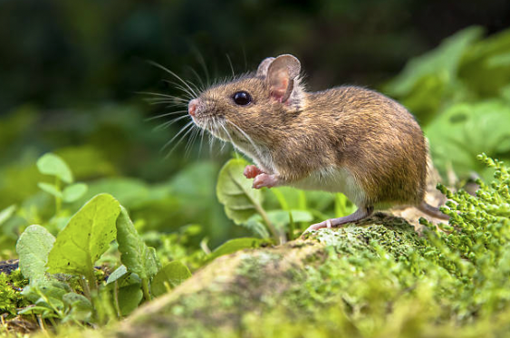
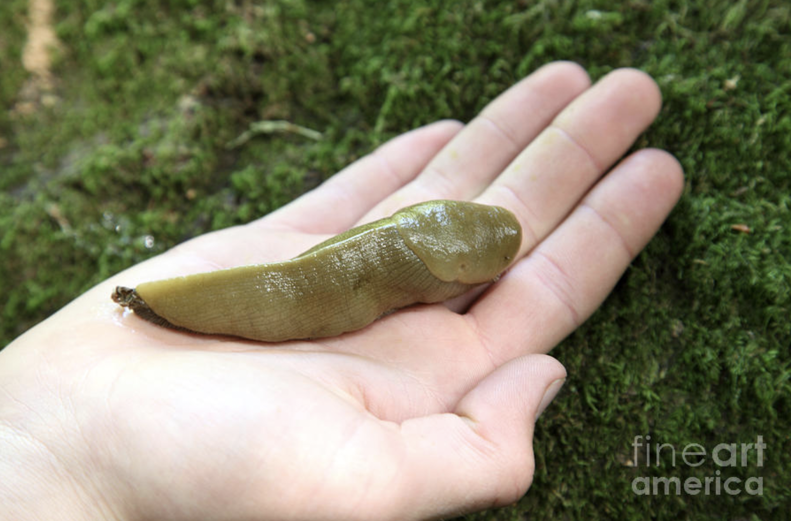
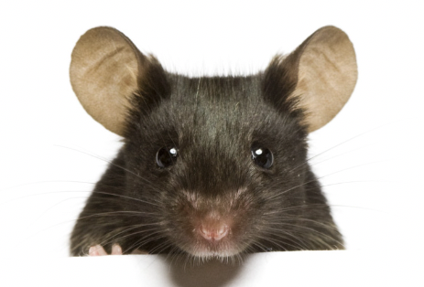
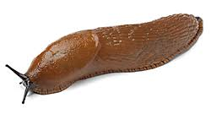
Slug
Mouse

Slide 4
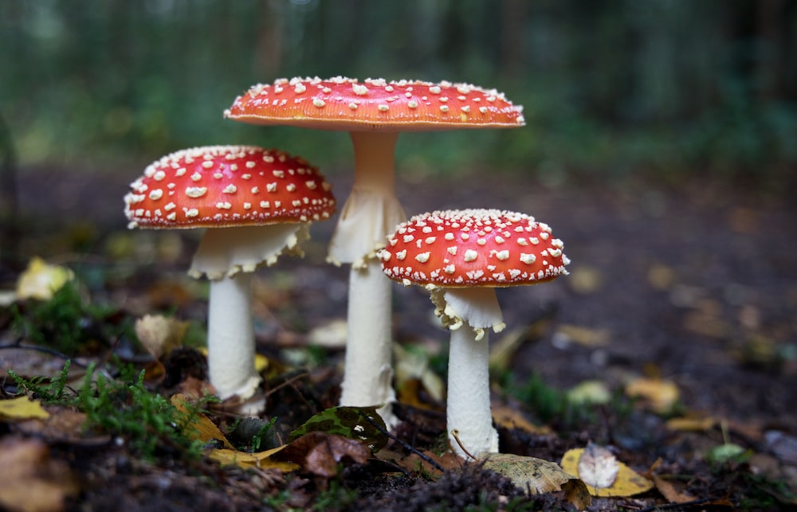
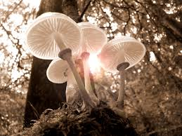
Mushroom

Slide 5

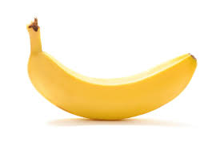
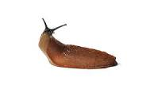
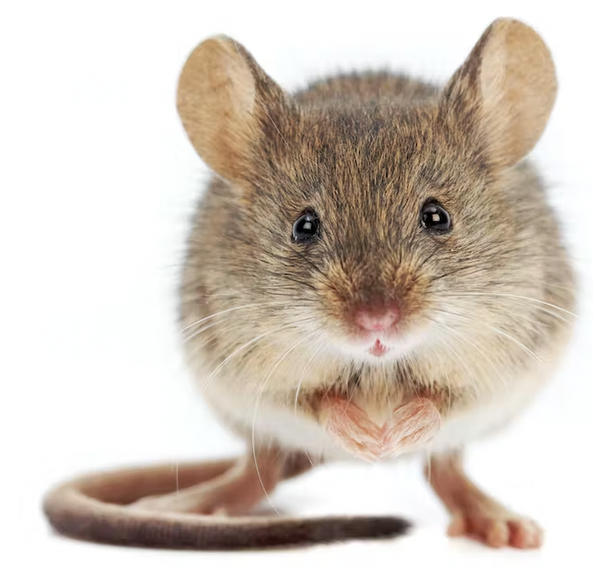
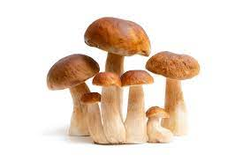
Genetically Similar Comparisons of Organisms
What are two things you observe about this phenomenon?
What are two things you wonder about this phenomenon?
Humans 99.9% Bananas 50% Slugs 70% Mouse 70% Mushrooms 50%
% of DNA which is identical to humans

Slide 6
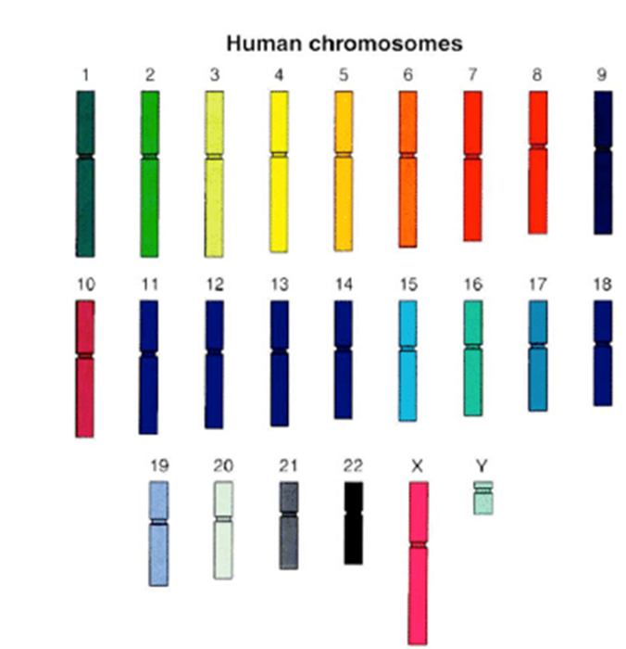

Slide 7
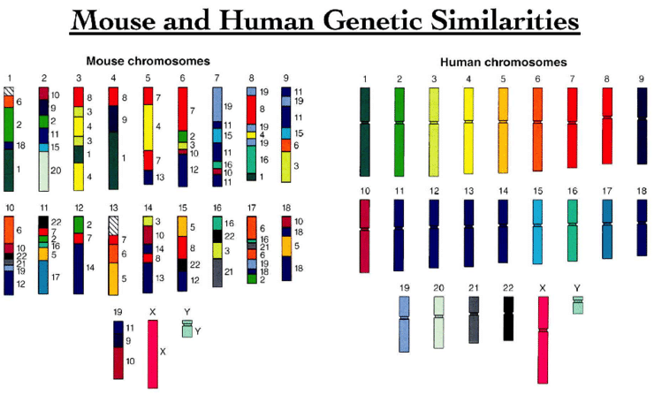

Slide 8
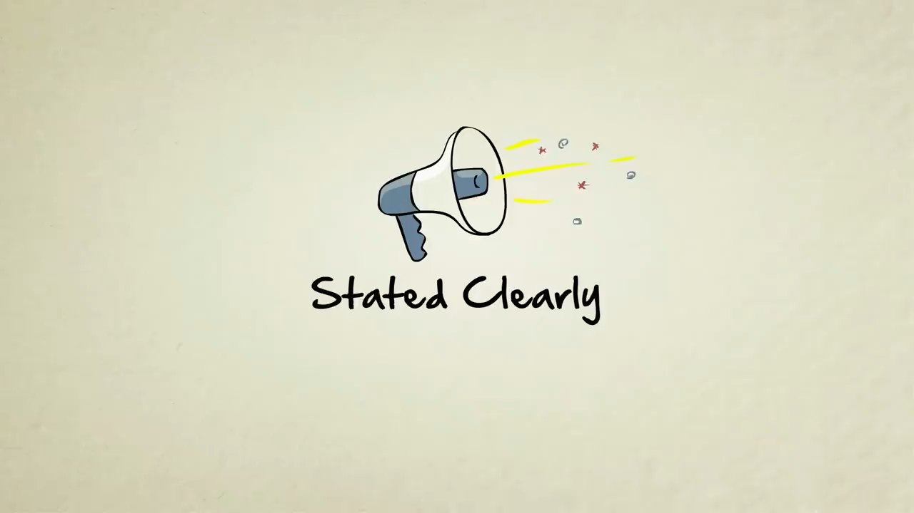

Slide 9
Construct an Explanation:
Why do we share so much DNA with other living things?
...proteins?​

Slide 10
Construct an Explanation:
If mice and humans share so much DNA, why are we so different?

Slide 11
References:
Information for images used from slide 1 to slide 6 respectively:
Creator: CreativeNature_nl | Credit: Getty Images/iStockphoto Copyright: CreativeNature_nl
Theconversation.com
Courtesy Lisa Stubbs, Oak Ridge National Laboratory
Information for the percent of the same protein-coding gene sequences:
DNA Structures: https://pixabay.com/images/search/genetics/
For the Mouse: https://health.ucsd.edu/news/releases/pages/2014-11-19-mouse-and-human-genome.aspx#:~:text=Mice%20and%20humans%20share%20approximately,percent%20of%20their%20respective%20genomes.
For the Mushrooms: https://unsplash.com/s/photos/mushroom
https://www.pexels.com/search/mushrooms/
For the banana: https://www.freepik.com/premium-photo/funny-baby-girl-sitting-child-chair-eating-banana-white-kitchen_25923244.htm, https://www.istockphoto.com/search/2/image?phrase=banana+dna,
For the Human: http://www.clipartbest.com/silhouette-of-a-man-and-woman
For the slug: https://www.istockphoto.com/search/2/image?phrase=slug+animal, https://fineartamerica.com/featured/1-banana-slug-on-hand-ted-kinsman.html

Slide 12

3D-RST is supported by the NSF under grant number #DRL-2101383

