Slide 1
Big Thick Pumpkins and where they get their mass.

Slide 2
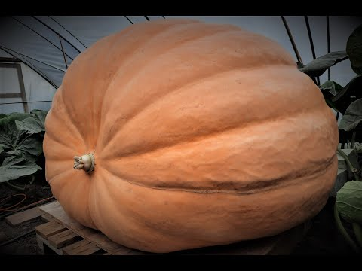
On your student worksheet, draw a sequence of pictures to show what happens to the pumpkin plant in the video.

Slide 3
HAVE YOU EVER GROWN A GARDEN?
HAVE YOU PARTICIPATED IN A COMMUNITY GARDEN?
WHAT WAS REQUIRED TO KEEP YOUR GARDEN PRODUCTIVE?
DO YOU HAVE A LAWN GROWING AT YOUR HOME?
WHAT IS YOUR FAVORITE FRUIT? VEGETABLE?

Slide 4
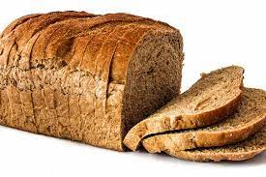
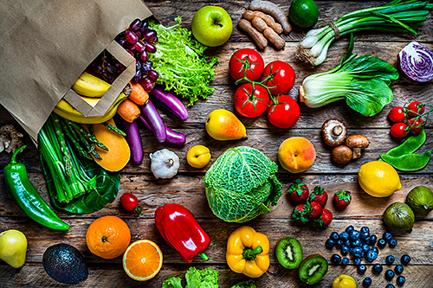
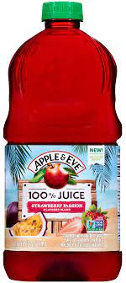

Slide 5
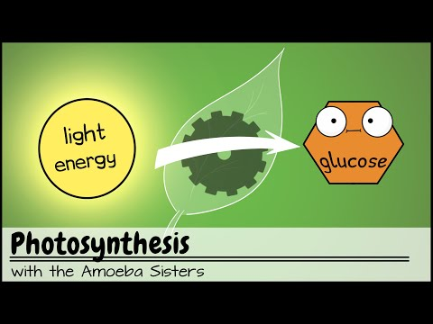

Slide 6
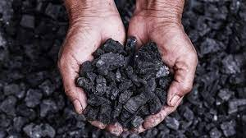
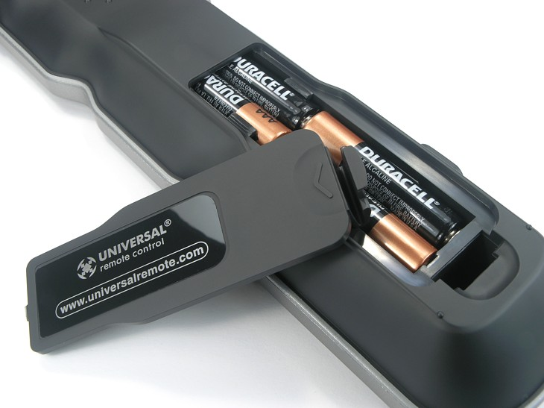
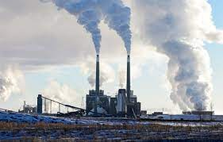
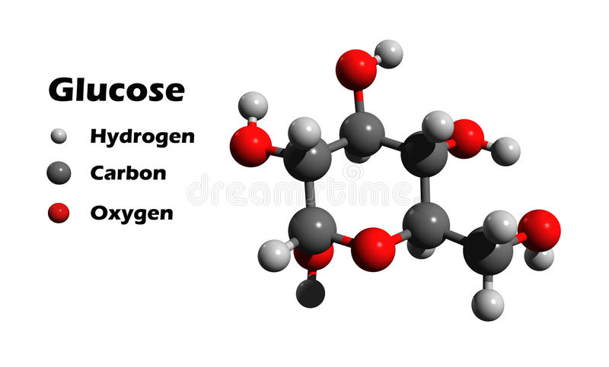
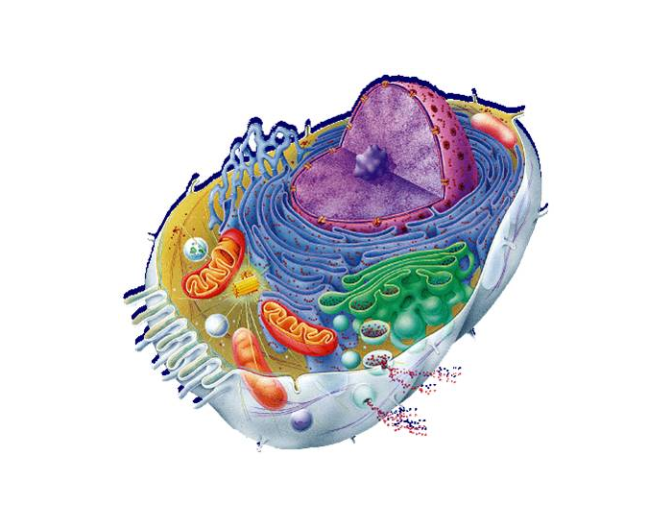
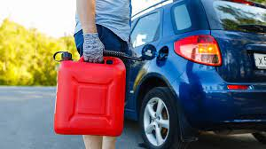

Slide 7
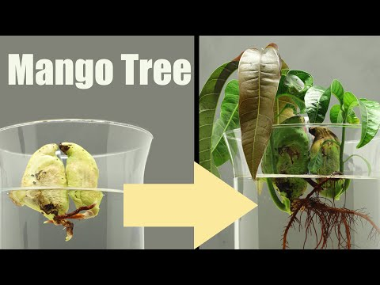

Slide 8
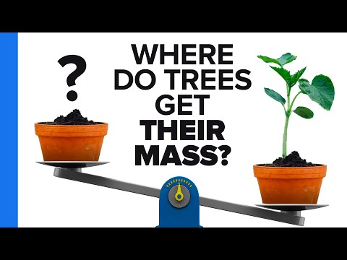

Slide 9
Final Diagram Instructions
Be sure to Include:
The energy that is used to facilitate the photosynthesis reaction
Reactants of photosynthesis
Products of photosynthesis
Where those reactants are taken into the plant (use arrows/labels)
Where products are found/given off (use arrows/labels)

Slide 10
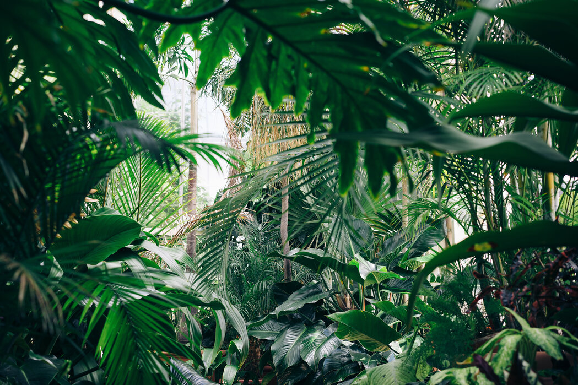
Which plants take the most CO2 out of the Air?
Look it up! Learn MORE!!!

Slide 11
https://www.ucl.ac.uk/culture-online/ask-expert/your-questions-answered/how-do-plants-produce-oxygen#:~:text=Plants%20take%20up%20the%20water,sunlight%20to%20make%20their%20food.

Slide 12

3D-RST is supported by the NSF under grant number #DRL-2101383

