Slide 1
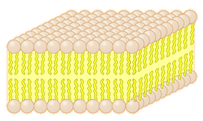
The Cell Membrane
Homeostasis & Cellular Transport

Slide 2
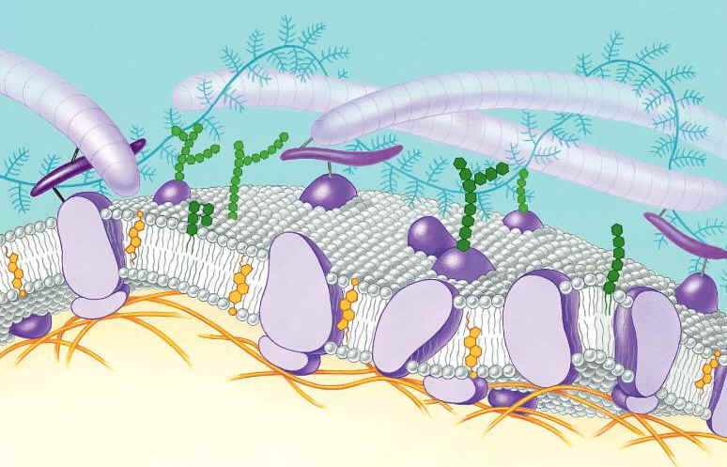
Function of the Cell Membrane:
The cell membrane separates the components of a cell from its environment—(what surrounds the cell)
It is the “gatekeeper” of the cell—regulates flow of materials into and out of cell—selectively permeable (let’s in certain things, sometimes)
Cell membrane helps cells maintain homeostasis—(stable internal balance)

Slide 3
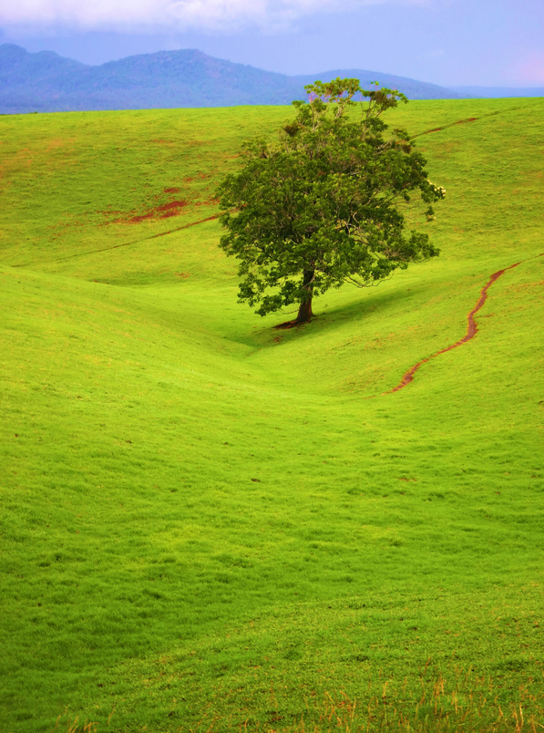
The Cell Membrane & Homeostasis
The cell membrane is responsible for maintaining homeostasis (home-E-O-stay-sis) within the cell
Homeostasis is “a stable, internal environment”
The cell membrane maintains homeostasis through balancing the pH (acid level), temperature, sugars, water purity
It does this through active and passive transport
In homeostasis, everything is PERFECT

Slide 4
Cell Membrane
ALL cells have a cell membrane made of phosphate, proteins, and lipids (fats)
protein channel
Cell Membrane
Layer 1
Layer 2
lipid bilayer
protein pump

Slide 5
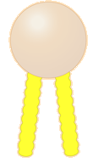
The cell membrane in detail
It’s a double layer
HydroPHILIC head
hydroPHOBIC tails
Hint: What is a “phobia?”

Slide 6
Passive Transport
--A process that mostly does not require energy to move molecules from HIGH to LOW concentration
Diffusion (movement of small molecules/ions across the cell membrane)
Osmosis (water movement)
outside of cell
inside of cell

Slide 7
Diffusion
Examples of diffusion: spraying aerosols, and perfumes.
High concentration (right where spray)—the molecules are packed tightly together….
To a LOW concentration –the molecules released start to SPREAD OUT
HIGH to LOW concentration

Slide 8
Osmosis is the movement of water through a “selectively permeable” membrane like the cell membrane
Water moves across the cell membrane from an area of high concentration of water to an area of low concentration of water.
Semi-permeable membrane might be permeable to water, but not to sugar….

Slide 9
Osmosis Concentration
What if…..the water or solution OUTSIDE of the cell is saltier than the INSIDE of the cell?
This will cause the cell to shrivel, and shrink
Ex. Pouring salt on a slug will cause it to shrink because water leaves the cells

Slide 10
Osmosis Concentration
What if…..the concentration or purity of the water or solution is greater OUTSIDE of the cell?
This will cause…. the cell to take in water, and swell

Slide 11
Osmosis Concentration
What if….the water outside of the cell has an EQUAL amount of salt as the water INSIDE of the cell.
Will cause…. NO CHANGE in cell size

Slide 12
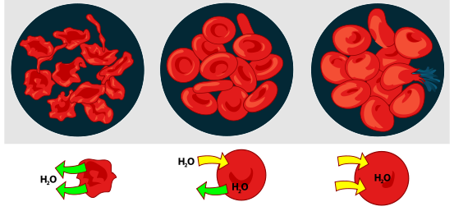

Slide 13
Active Transport: molecules moving from LOW to HIGH concentration
Energy is required as molecules must be pumped against the concentration gradient.
----If energy is required, where does the energy come from?
Ex: Body cells pump CO₂ out into surrounding blood vessels to be carried to the lungs for exhale. Blood vessels are high in CO₂ compared to cells, so energy is needed to move CO₂ across the cell membrane from LOW to HIGH concentration.
CO₂
molecules
outside of cell
inside of cell

Slide 14
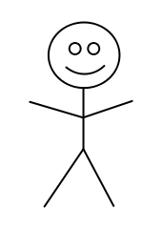
ANALOGY: Passive Transport vs. Active Transport
Active Transport: like going UPHILL
ENERGY NEEDED:
Active Transport
NO ENERGY NEEDED:
Diffusion
Osmosis
Passive Transport: Like going DOWNHILL

Slide 15

3D-RST is supported by the NSF under grant number #DRL-2101383

