Slide 1
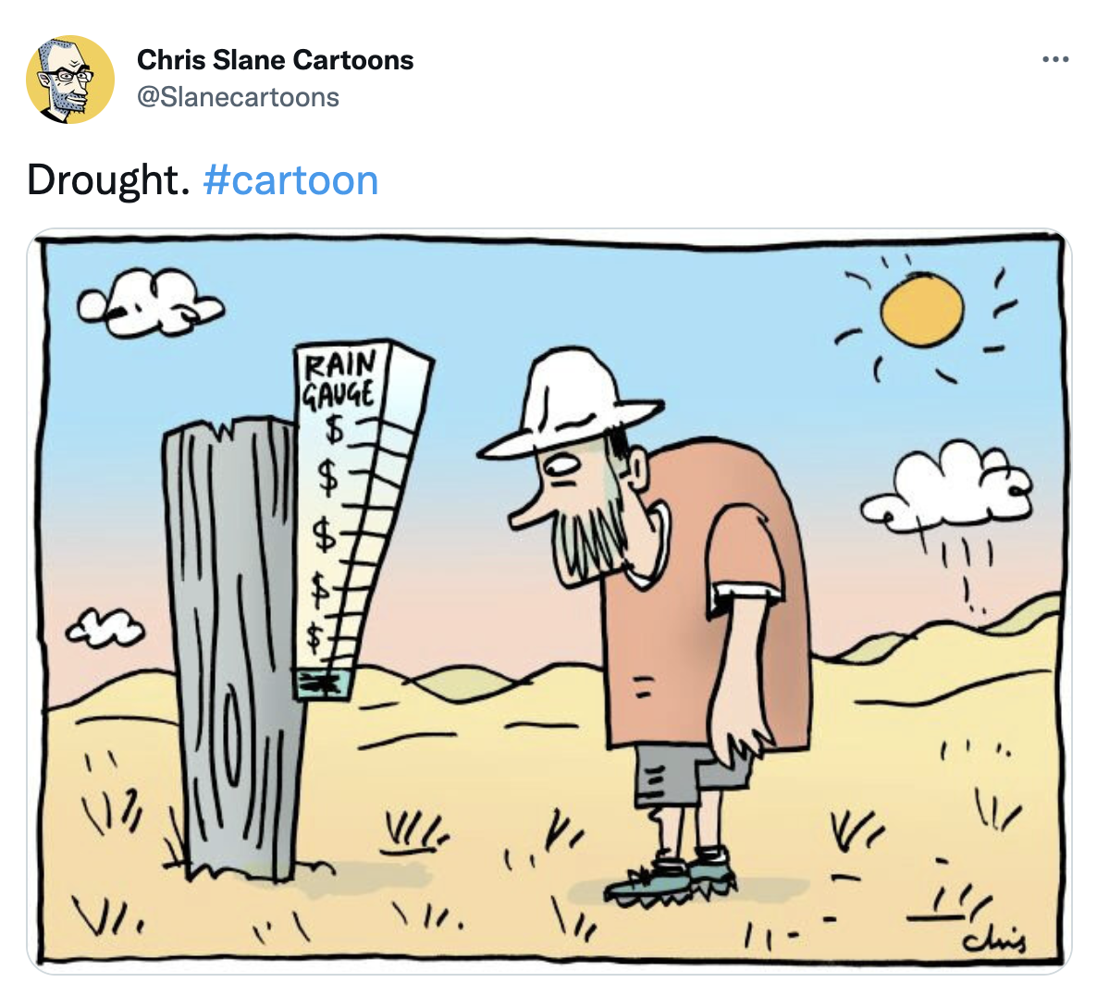
@Slanecartoons Twitter

Slide 2
What are the possible impacts of drought on a system, specifically you and your family, and the environment?

Slide 3

Objectives
Use evidence to explain how disruptions in the physical and biological components of an ecosystem can lead to shifts in the types and numbers of the ecosystem's organism.
What impact does drought have on the stability of a deer population?

Slide 4
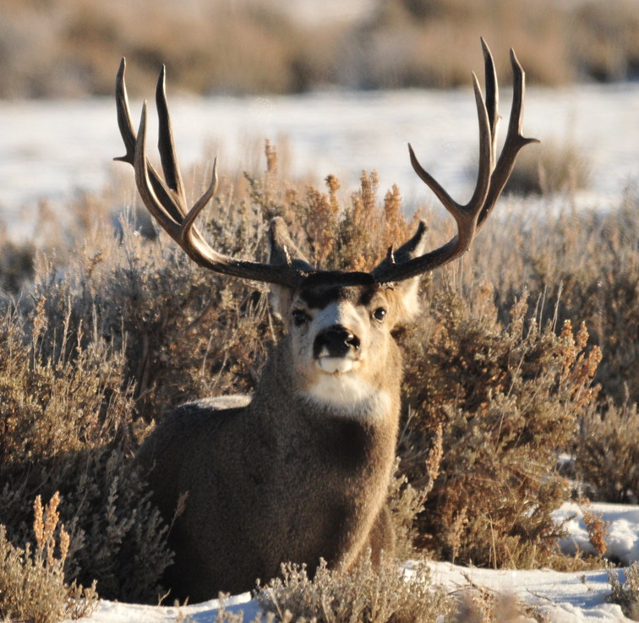
Mule Deer Population and Drought
This Photo by Unknown Author is licensed under CC BY

Slide 5
What Observations, Emotions, or Feeling do you see in the following scene. Write these down on a sticky note.
https://youtube.com/clip/UgkxerzHA1OE02w-4XJqDsYQvBlq8onZVoEo

Slide 6
Think-Pair-Share
What do you know about mule deer and droughts?
What questions do you have about mule deer population and drought?
Record these thoughts and share with your neighbor.

Slide 7
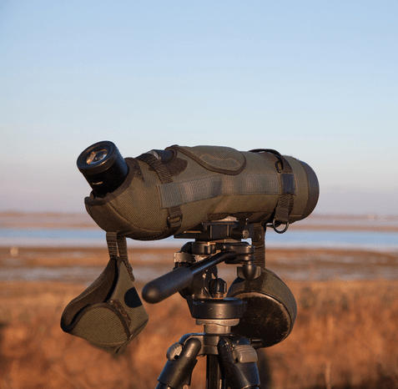
EXPLORE
Divide into 3 different groups each group will be given different information to analyze.
This Photo by Unknown Author is licensed under CC BY-SA-NC
Notes:
Once students are into the groups of your choosing pass out the materials and let them begin reading. Be sure to move about the room so you can listen to their ideas.

Slide 8
Jigsaw
One student from each group will go around to the other groups and explain what their articles were about to each group. Aprox. 5 minutes/rotation.
Have the following question in mind…. WHAT CHANGES DOES DROUGHT CAUSE TO A MULE DEER POPULATION.
Notes:
Make sure students understand what a jigsaw is, and how it will work.

Slide 9
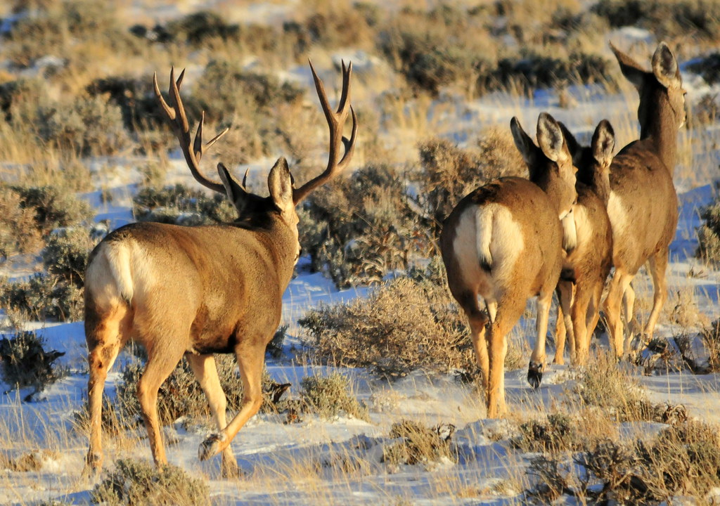
Elaborate
Watch the following video, what questions does this video answer?
Deer and drought video
This Photo by Unknown Author is licensed under CC BY
Notes:
Have class finish the video put out by the DNR to help tie everything together.

Slide 10
Trend Graph
Using the trend graph to find correlation between drought and mule deer populations.
Deer Population
Quantity of Vegetation

Slide 11

3D-RST is supported by the NSF under grant number #DRL-2101383

