Slide 1
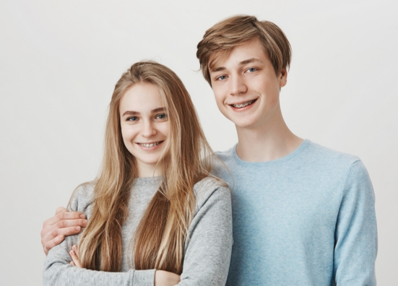

Slide 2


Slide 3
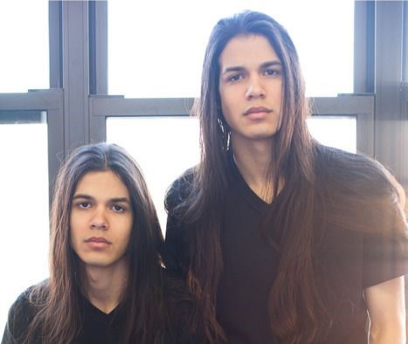

Slide 5
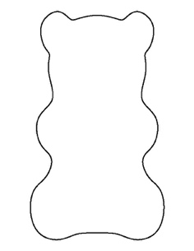


Procedure (1): F1 Generation
You should have 6 of each “parent” color gummy bears to work with.
Offspring receive roughly ½ their genetic information from parent A and ½ from parent B.
Select two different colors of gummy bears and place them on the “P” generation row on your pedigree chart.
Now, assuming you get ½ your traits from each parent, what will the model of the “F1” generation (kids of the parents) look like (phenotype) when those gummy bears “mate”?
Do this by cutting the “offspring” in half with the razor blade. Place the “offspring” in the F1 spot on your data sheet. Here is how to make the cut for the F1 Generation.
Remember knife safety!

Slide 6



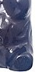
Procedure (2): F2 Generation
Find a bear from another group’s “F1” generation. Have them mate with your F1 gummy bear.
Make a copy of one of your F1 offspring.
Take the offspring copy and an extra set of “parent” gummies and trade with another group.
The other group will make a copy of their offspring for you to take back to your station.
The new gummy bear (F1 copy from the other group) will be reproducing with one of your F1 offspring.
Quarter two of your “parent” gummies and the parent gummies you received from the other group.
Your offspring (F2) must have half of the genetic material of the mom and half from the dad (F1 generation).
Create what the offspring look like after they mate (this is called the “F2” generation). Place their phenotypes in the F2 generation spot.
Make a horizontal cut!!!
(Remember knife safety)

Slide 7
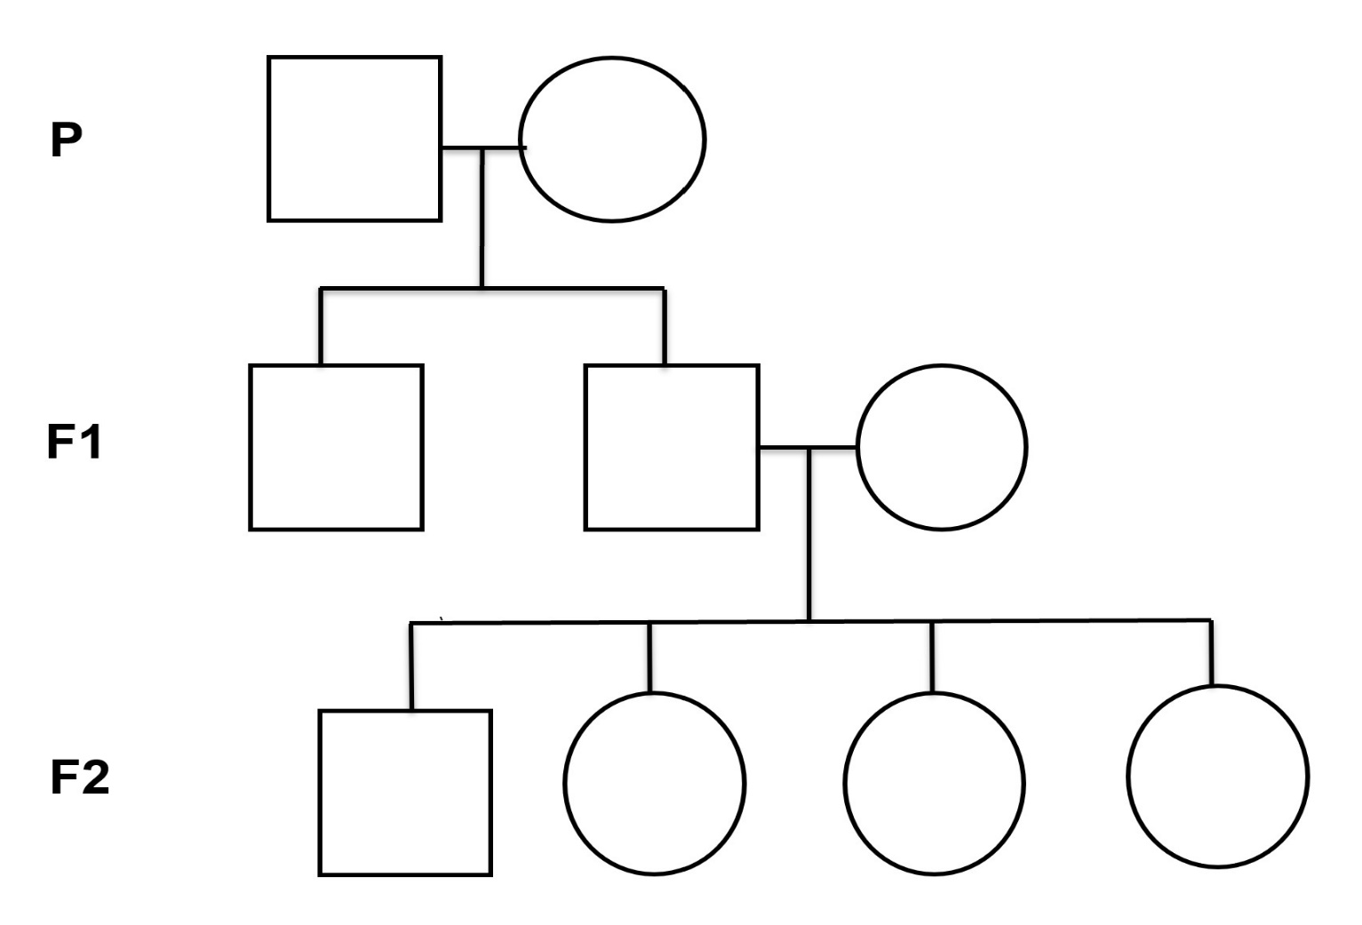






F1 Generation Illustration
Receive from another group
Trade with another group

Slide 8



F2 Generation Illustration

Slide 9

Procedure (3): F3 generation
Now that you have all 4 offspring created, walk around the class and observe the different offspring from other groups.
Try to recognize any patterns you may see
Predict what your F3 generation offspring would look like if you mated with the bear below. Color in your bear’s F2 colors in the parent spot. Color your predictions on the pedigree chart what the offspring would look like if they mated.
F2
Parent
Offspring
F3

Slide 10
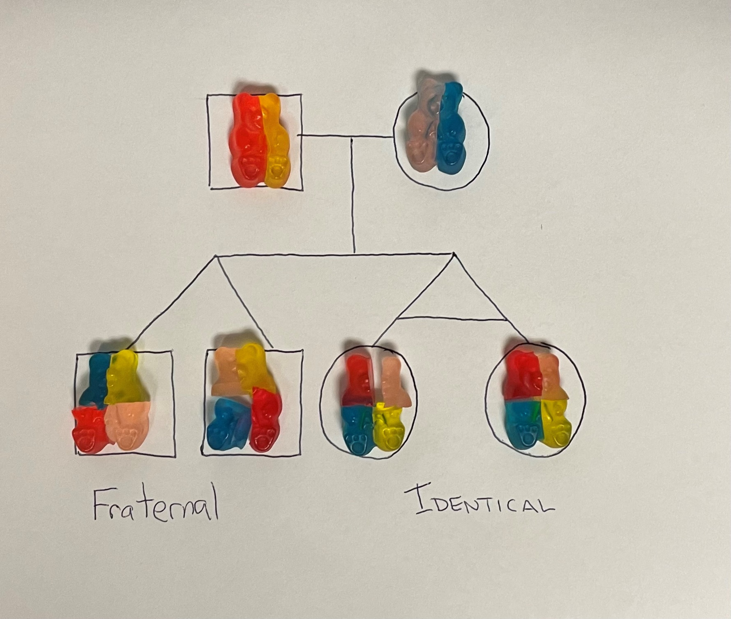
How can twins be so different? It is all about gene expression!

Slide 13
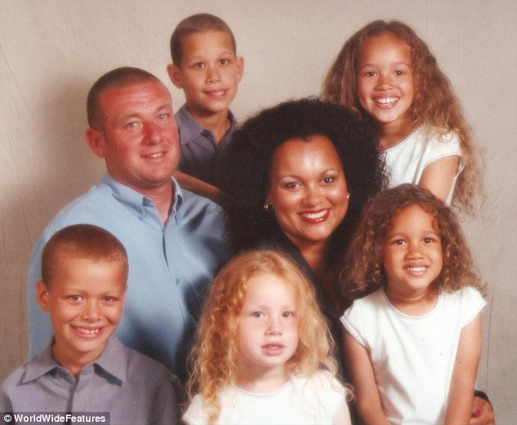

Slide 14

3D-RST is supported by the NSF under grant number #DRL-2101383

