Slide 1
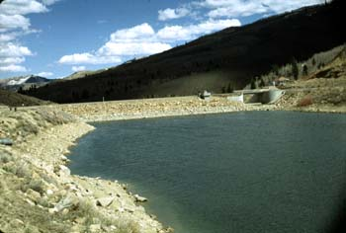
Scofield Reservoir
Harmful Algal Bloom

Slide 2
Synopsis about Scofield
Settlers came to Pleasant Valley in the 1870s because of large tracts of grazing land. Scofield was named after General Charles W. Scofield, a timber contractor who became president of the state’s first coal mining company. Mining peaked in the early 1920s when Scofield had 12 stores, 13 saloons, four large hotels, a post office, and a population of more than 6,000 residents. Today, less than 100 reside in the town.
The popularity of Scofield Reservoir brings many visitors to the park each year. Summer activities include fishing, camping, hiking, and swimming at this reservoir at an elevation of 7,616 feet. During the winter months, Scofield is one of the best places to ice fish for rainbow and cutthroat trout.
Opened to the public as a state park in 1965.
Park Elevation: 7,600 feet

Slide 3

Synopsis about Scofield, cont.
Scofield Reservoir is located in Carbon County, Utah, at an elevation of 7,618 feet. The reservoir was constructed at the confluence of several perennial streams including Fish Creek, Mud Creek (locally referred to as Clear Creek), Pondtown Creek, and other springs and small tributaries. The reservoir’s outlet feeds into the Price River, a tributary of the Green River 70 miles to the southwest.
Scofield Reservoir was listed on the State of Utah’s 303d list as partially not supporting its designated beneficial use as a cold-water fishery because of low dissolved oxygen and high total phosphorous concentrations. Nutrients, originating primarily from natural sources, are delivered to the reservoir directly during spring runoff, summer drawdown, summer storm events, and through tributary flows. The high nutrient levels cause excessive algal growth and turbidity in the reservoir. The high biological productivity results in lower oxygen concentrations. This stresses the aquatic community, and several winter fish kills have been reported within the reservoir.

Slide 4
In the News…
Algal Bloom Confirmed at Scofield Reservoir ETV News June 16, 2021, Scottie Draper
“Recreators asked to take steps to protect themselves while recreating on the water”
“Health officials have confirmed a cyanobacteria bloom, or harmful algal bloom, at Scofield Reservoir.”
Scofield Reservoir Recreational Monitoring 2022
October 3, 2022
Southeast Utah Health Department has issued a Warning Advisory for Scofield Reservoir.
Under a Warning Advisory:
Do not swim or water ski
Avoid areas of algae when boating
Clean fish well and discard guts
Keep animals away
Don’t drink the water

Slide 5
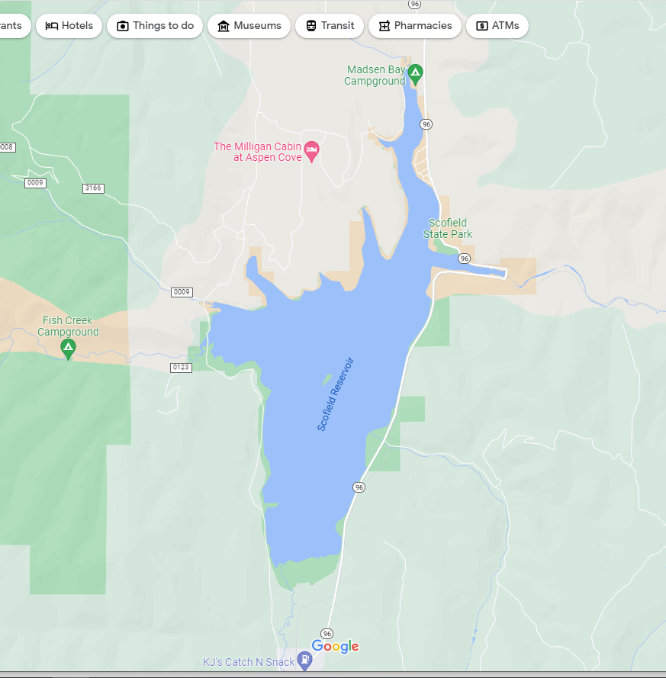

Slide 6
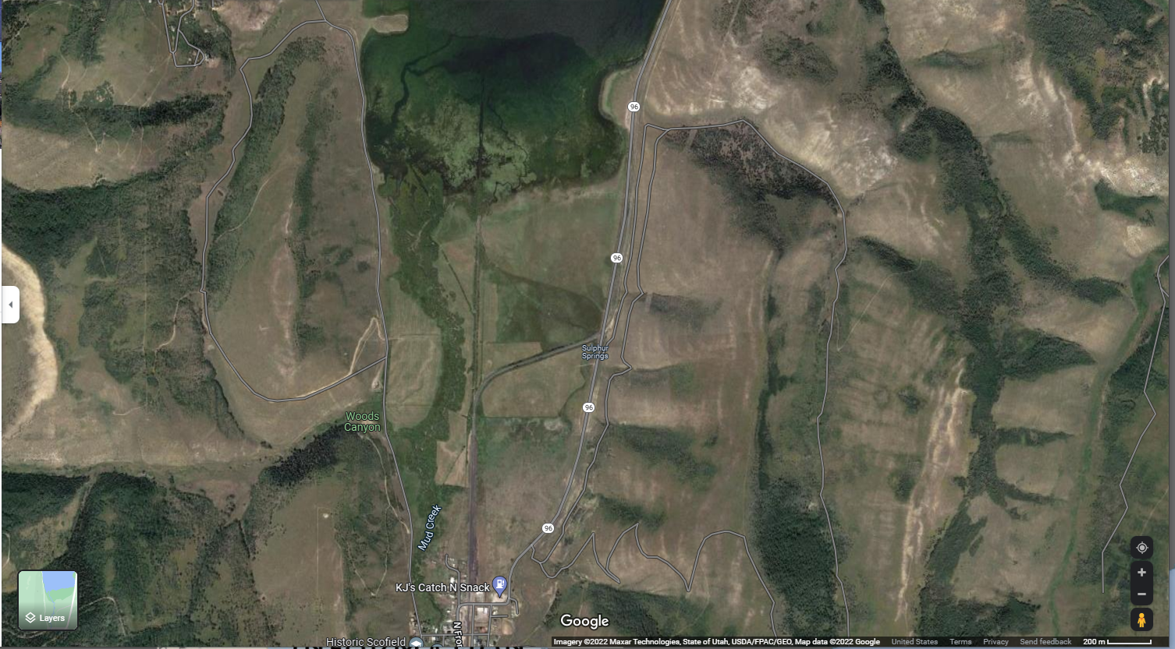

Slide 7
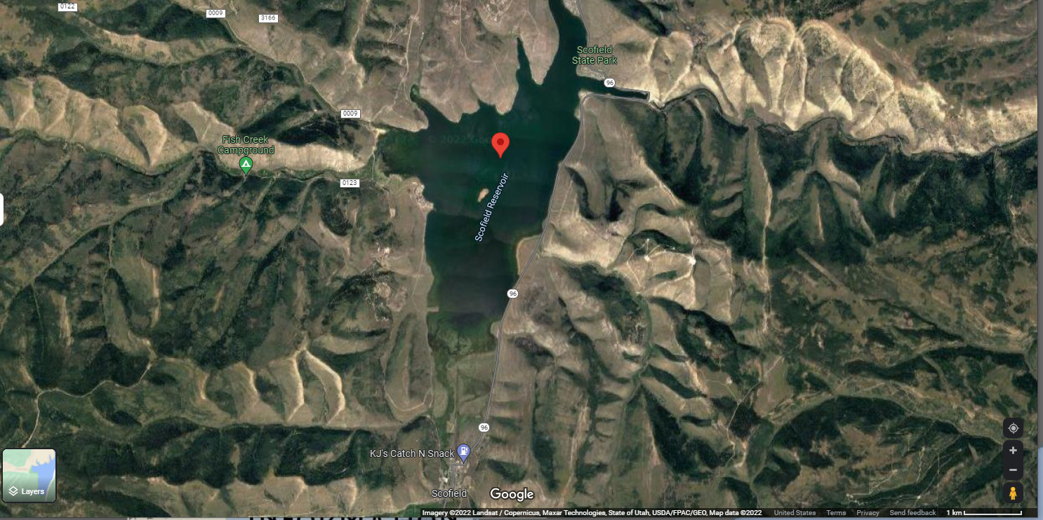

Slide 8
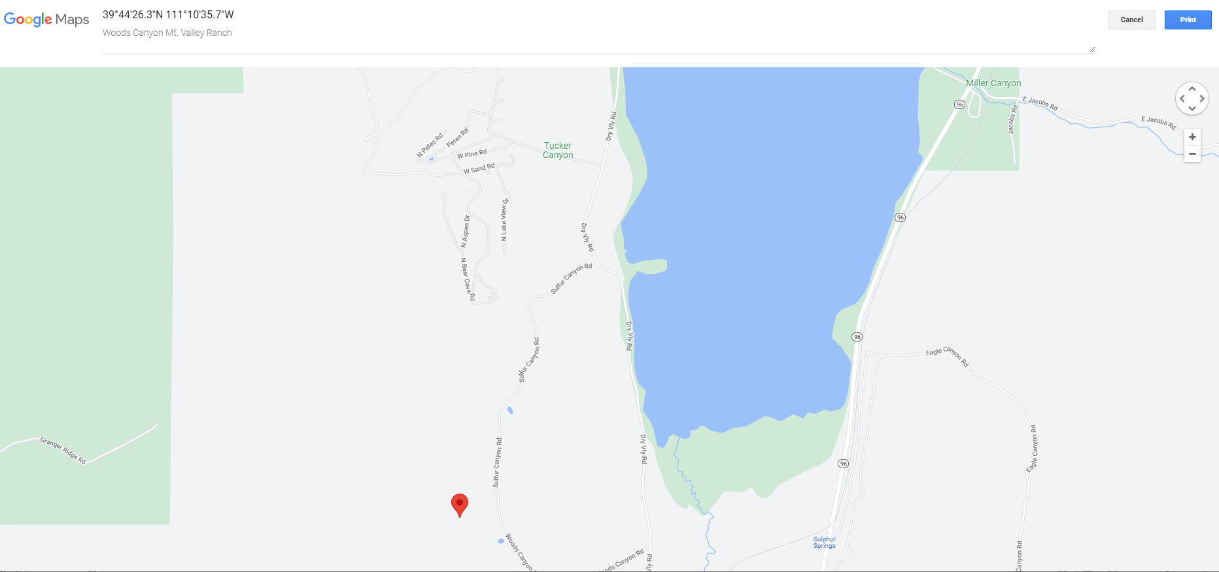

Slide 9
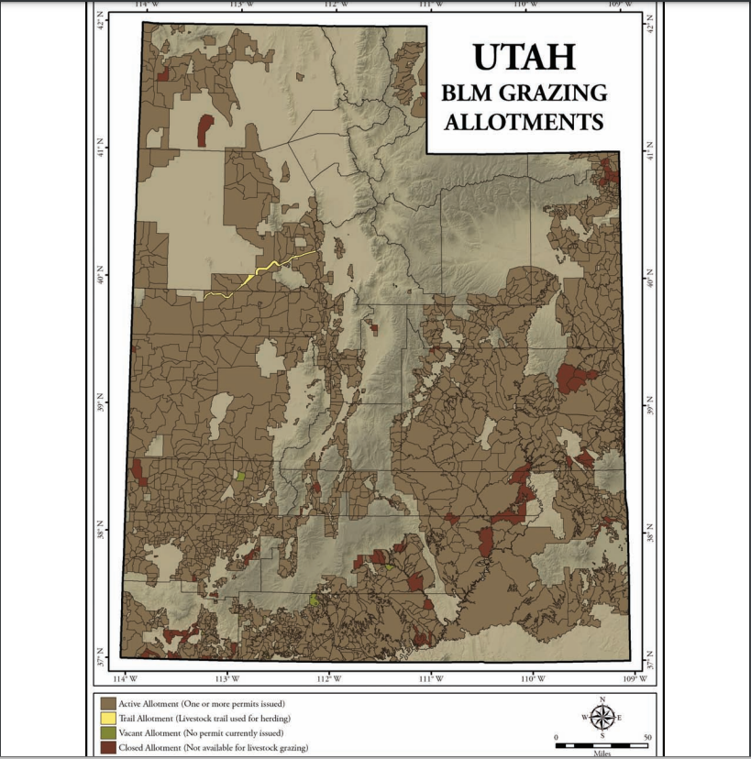

Slide 10

3D-RST is supported by the NSF under grant number #DRL-2101383

