Slide 1
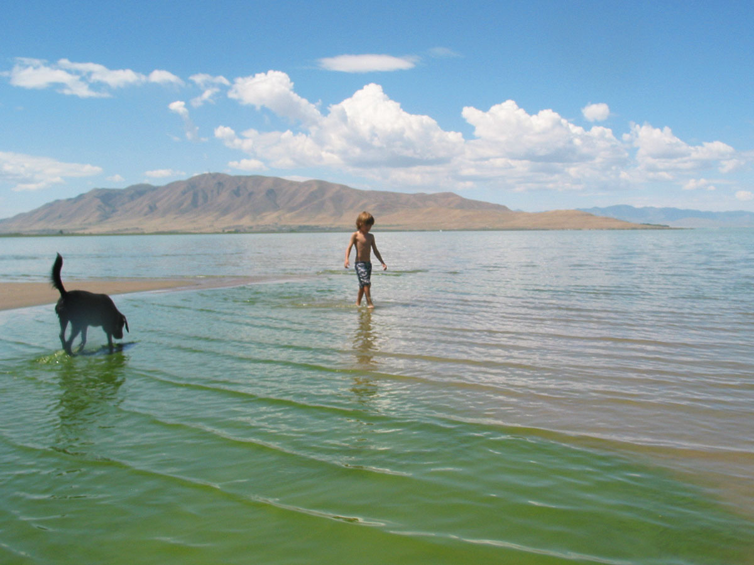
Utah Lake
Harmful Algal Blooms

Slide 2
In the News…
Utah County Health issues warning about harmful algal blooms KSL Sept 27, 2022
PROVO, Utah — The Utah County Health Department has issued a warning advisory for multiple areas of Utah Lake.
The Department said sampling had detected high concentrations of harmful algae at
American Fork Marina,
Lindon Marina,
Saratoga Springs Marina,
Lincoln Marina,
Utah Lake State Park,
Sandy Beach, and
Provo Bay.
Utah Lake algal bloom still at harmful levels says DEQ KSL Aug 5, 2022
SALT LAKE CITY — The Utah Department of Environmental Quality (DEQ) confirms that the level of harmful algal bloom at Utah Lake continues to merit a warning advisory for anybody visiting Lincoln Marina, Utah Lake State Park, Sandy Beach, and Provo Bay.

Slide 3
Synopsis
Utah Lake is unique in that it is one of the largest freshwater lakes in the West and yet it lies in an arid area that receives only about 15 inches of rainfall a year. The mouth of the Provo River, where it empties into Utah Lake, was undoubtedly a very popular camping place for the early inhabitants of Utah Valley.
Local leaders, especially boaters, had been interested in construction of a facility on the lake that would permit them to launch boats year round. In 1933, an application requesting the help of the Civilian Conservation Corps was made and a marina was completed within a few years. Upon completion, Provo City began constructing shoreline picnic and camp facilities.
Opened to the public as a state park in 1967.
Average Depth: 10.5 ft or 3.2 meters
Park Elevation: 4,500 feet
Current Algae Conditions

Slide 4
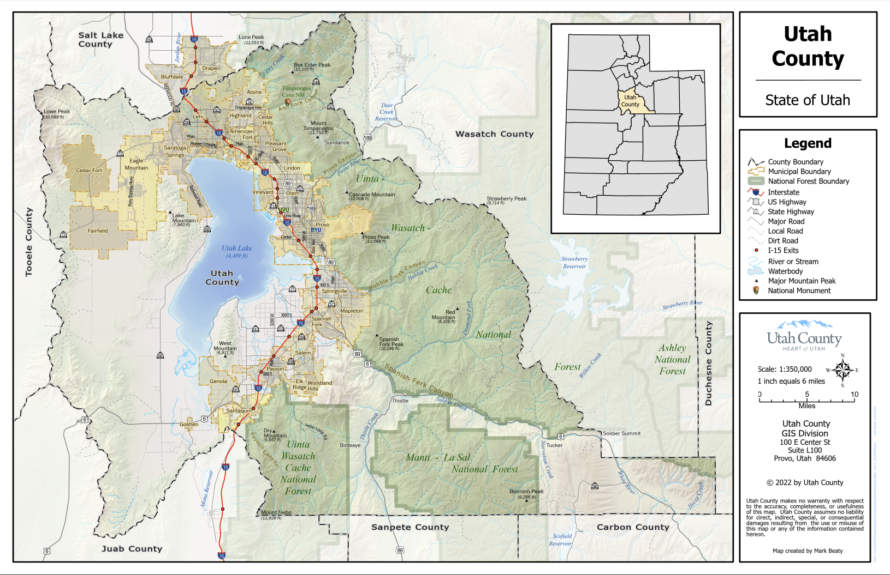
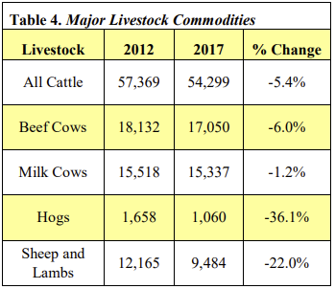
Utah County Information
Population - As of 2022, the population of Utah County was 688,000.
Agriculture - 72,669 irrigated acres of farmland.
Size and Scope of Utah County Agriculture 2019. Utah State University.

Slide 5
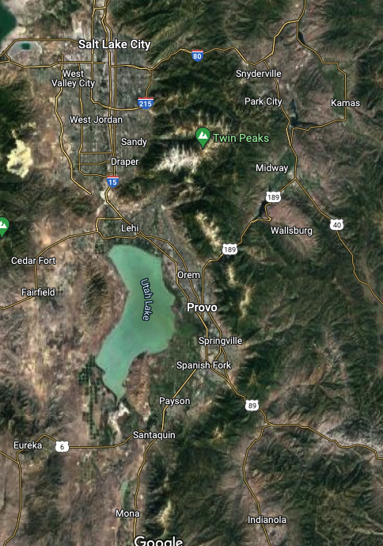
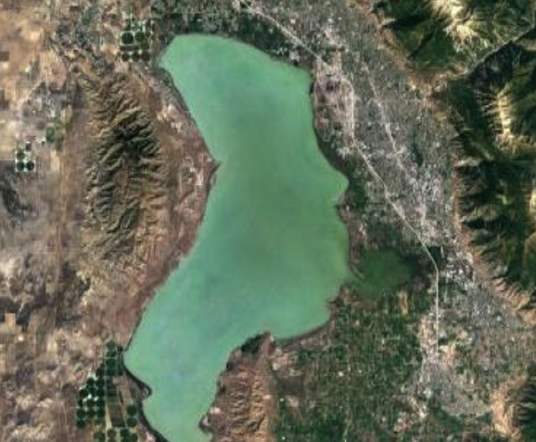
Maps

Slide 6
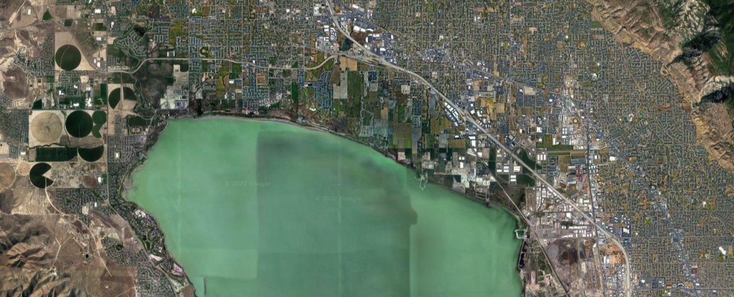
North Side of the Lake

Slide 7
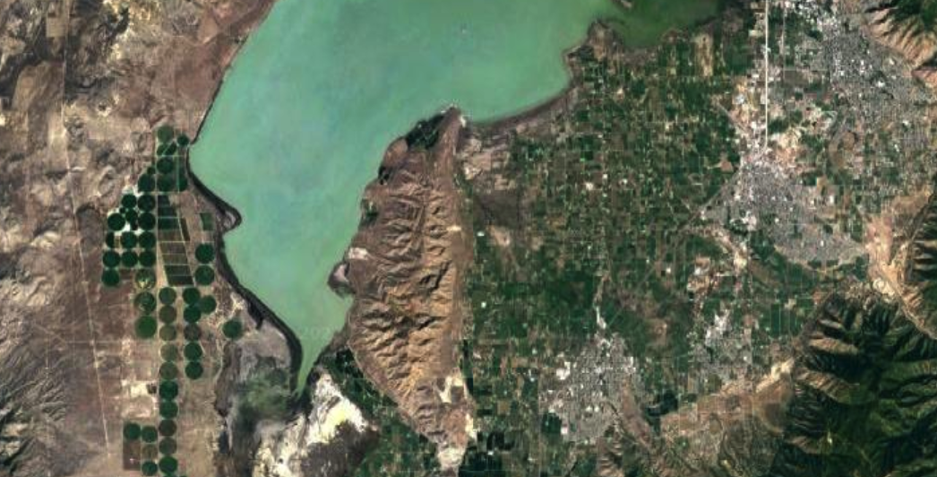
South Side of the Lake

Slide 8
Utah Lake/Jordan River Watershed
Utah Lake is part of the Jordan River Watershed. Major contributing bodies of water in the area are the American Fork River, Provo River, Mill Creek, Hobble Creek, and Spanish Fork River. Major water uses in the area include agriculture, irrigation, municipal and industrial uses, and recreation.
Much of the water in the streams is diverted for consumption, so to support the large and growing population, artificial supplies of water have been diverted from the Uintah Basin into the Jordan River Watershed. Water quality issues include metals, total dissolved solids, E. coli, high water temperatures, high levels of ammonia, and low dissolved oxygen. Major pollutant sources include: failing septic systems, industrial discharges, illegal dumping, equipment cleaning, agriculture, and stormwater from roads and parking lots.

Slide 9
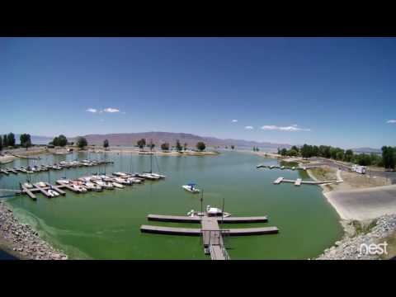

Slide 10
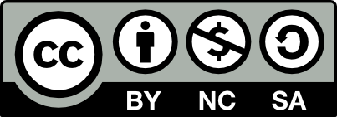
3D-RST is supported by the NSF under grant number #DRL-2101383

