Slide 1
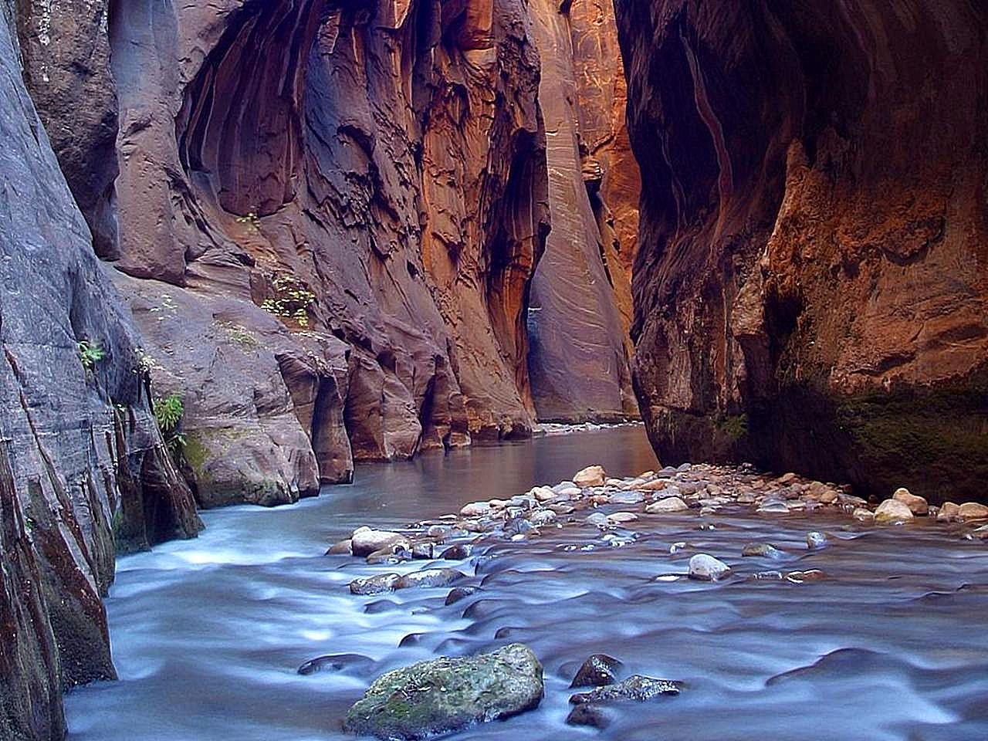
Virgin River
Zion Canyon
Harmful Algal Blooms

Slide 2
In the News…
From the National Parks Service: Toxic Cyanobacteria Bloom in the Virgin River and the Streams of Zion National Park. November 4, 2022
Zion National Park continues to monitor monthly for the presence of harmful cyanobacteria and cyanotoxins.
Monitoring efforts have detected harmful cyanotoxins in North Creek which is elevated to a Danger Advisory.
Toxin-producing cyanobacteria have been found in the North Fork of the Virgin River, North Creek, and La Verkin Creek. Colonies of cyanobacteria can be yellow, tan, green, brown, or black in color.
From the Salt Lake Tribune: Dangerous algal bloom turns up in Zion National Park after dog dies in North Fork of the Virgin River July 14, 2020
For the first time in a Utah river, toxic levels of a river-dwelling species of cyanobacteria have been detected after a dog suffered seizures and died soon after frolicking in Zion National Park’s Virgin River.
Thought to be connected to agricultural runoff and higher-than-normal temperatures
“It’s a new area for Utah. These sorts of blooms can be triggered by disturbances in the watersheds. It’s not tightly linked to nutrient loads like blooms in lakes.”
The state has previously issued health warnings for E. coli impairment in the North Fork.

Slide 3
In the News…
From the EPA: Installing Management Practices Improves the North Fork Virgin River
Flood-irrigated pastures grazed by cattle and wildlife contributed to Escherichia coli exceedances in the North Fork Virgin River watershed.
Many of the pastures in the upper watershed are irrigated through wild flood irrigation. Historically, the landowners would divert the maximum amount of water that their system would hold. This excess of water increases the potential for bacteria-laden irrigation return flows to enter the river

Slide 4
Synopsis
The Virgin River and its tributaries run through Zion National Park.
This water is the primary agent of erosion that continues to carve and shape Zion.
The Virgin River is incredibly steep. The river drops roughly 7,800 feet in the 160 miles it travels. In the park, the river drops an average of 71 feet every mile.
Though most of the year the Virgin River runs an average of 100 cubic feet per second, it transports about one million tons of sediment every year. Most of this sediment transport occurs during floods, when the river can swell to thousands of cubic feet per second.
Virgin River Watershed
Drinking water: treated water from the Virgin River, its tributaries, and springs and wells, provides Washington County’s drinking and culinary water.
Agriculture: water from the Virgin River and its tributaries continues to support farming and ranching endeavors throughout the basin.

Slide 5
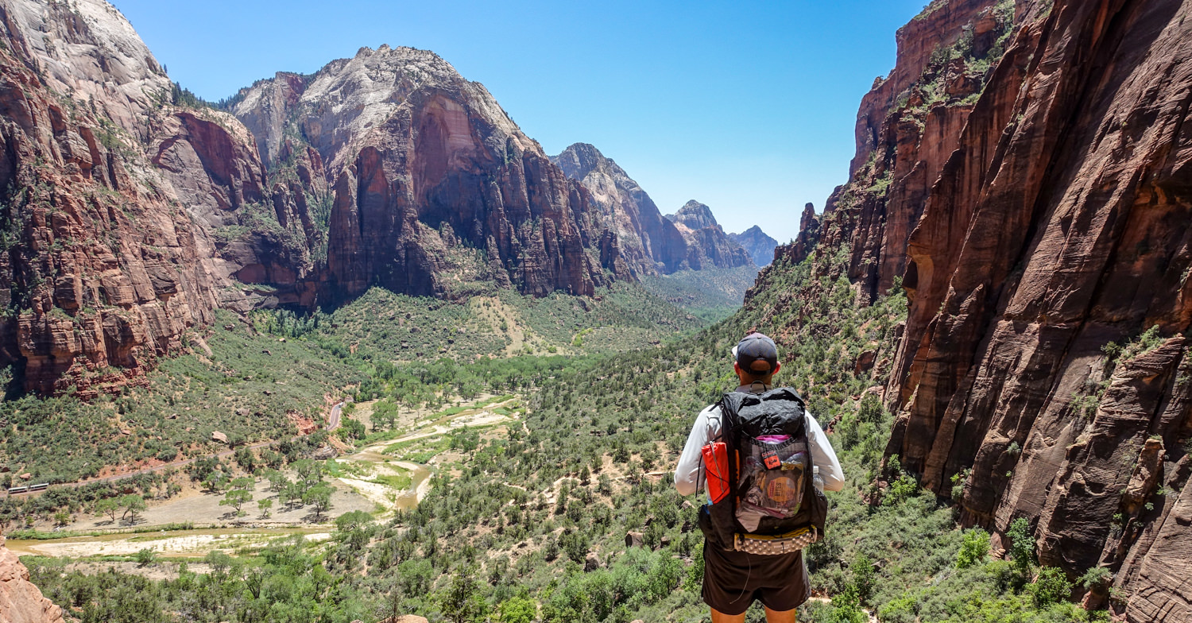
Backcountry permit agreement
Dispose of Waste Properly
Pack it in, pack it out. Carry out all trash, including food wrappers, apple cores, fruit peels, nut shells, and toilet paper. Dispose of all waste in a proper trash can or dumpster. Recycle the rest.
Use the restroom before hiking. Be prepared to pack out human waste, toilet paper, diapers, and hygiene products. Human waste disposal bags are highly recommended to transport solid waste. All human waste must be carried out of the Virgin River Narrows in waste disposal bags.

Slide 6
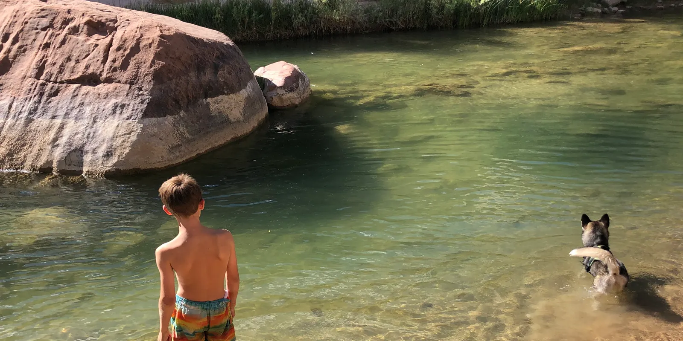
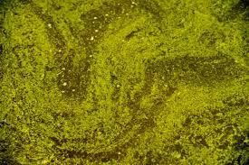
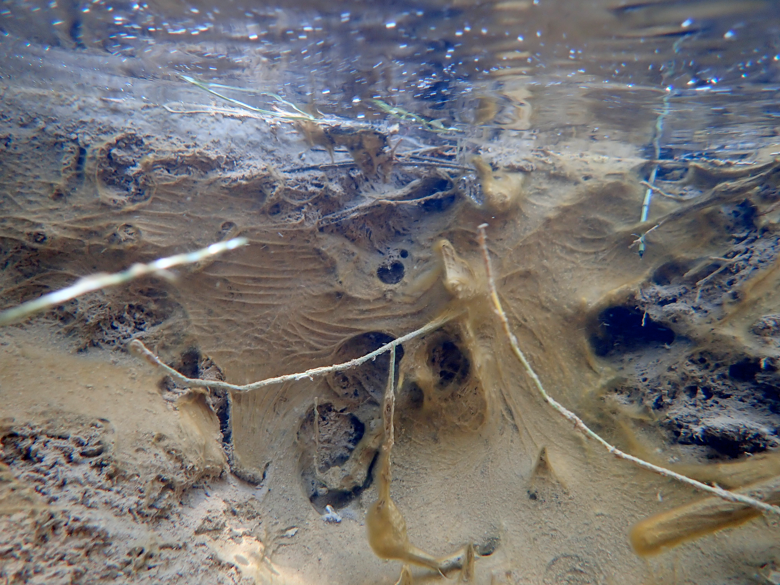
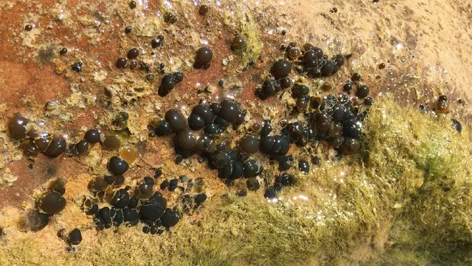

Slide 7
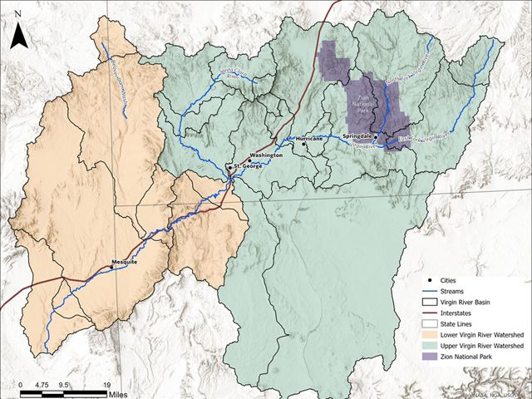

Slide 8
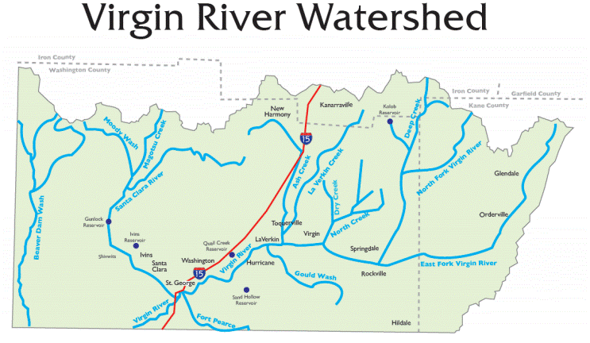

Slide 9
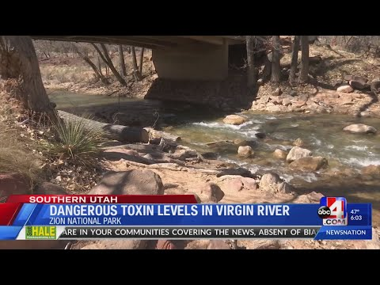

Slide 10

3D-RST is supported by the NSF under grant number #DRL-2101383

