Slide 1
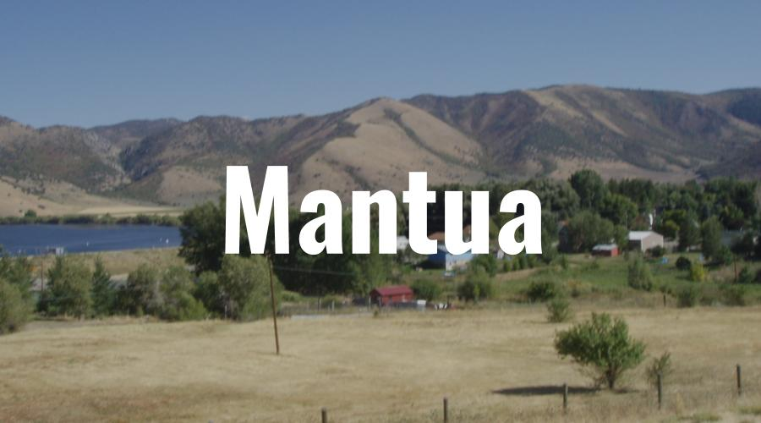

Slide 2
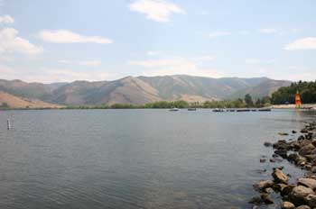
Location
Mantua Reservoir is located in sardine canyon at the edge of the small town of Mantua. The reservoir sits at an elevation of 5,000 feet and offers fishing, boating and water skiing. Mantua Reservoir. The reservoir offers a boat ramp, picnic areas, campground, swimming beach and is stocked with fish. The season for the reservoir is generally May thru October.
Directions:
Mantua Reservoir is accessible from US 89 between Brigham City and Logan. It is on the Brigham City side of Sardine Summit at the top of Box Elder Canyon, east of Brigham City. It is only about two miles long and the reservoir is very visible from the highway. At the top of the canyon, exit off the highway into the community of Mantua. Turn left at the "T" intersections, and the reservoir is on the right.
Nearby Camping:
Little Valley Country Store & Campground
Box Elder Campground

Slide 3
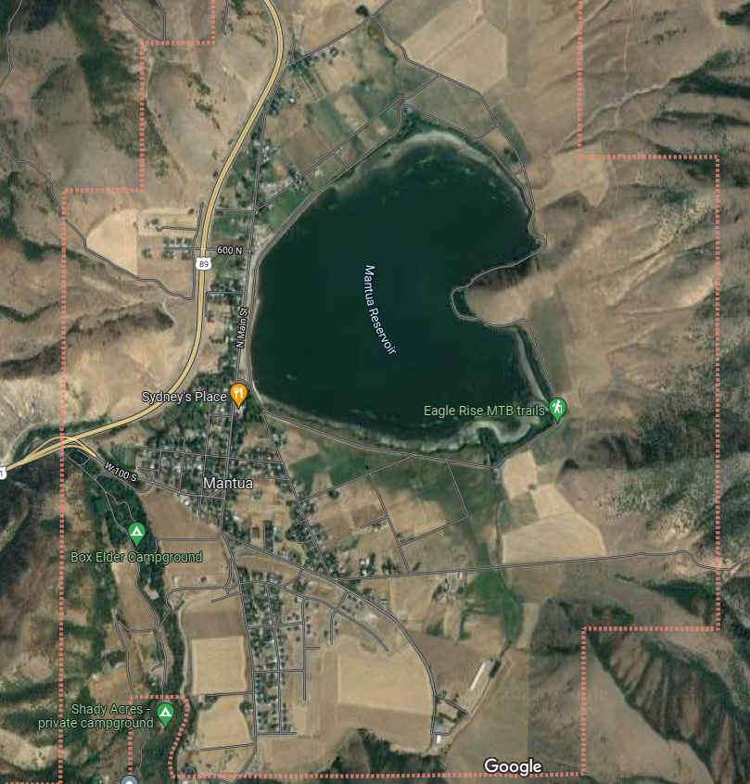
Background: Mantua Reservoir is a small reservoir located located within the community of Mantua in east Box Elder County, Utah (Figure 1.). The surface area of the reservoir is 224 ha (554 acres), with a length of approximately 1,910 meters and a width of 1,643 meters. The average depth is 4.3 meters. Brigham City is located about 5 miles west of Mantua and has rights to much of the water which originates near Mantua.
The reservoir was created in 1962 by the construction of a dam across Big Creek. Mantua Reservoir’s watershed area is relatively small. The majority of the reservoir’s inflow originate as springs. These springs are then used for irrigation, fish production and livestock watering. Two major springs surface away from the reservoir and form the headwaters of Maple Creek and Dam Creek. Other springs surface near the reservoir or they enter the bottom of the reservoir directly. The two major inflows to the reservoir are Dam Creek and Maple Creek. The outlet of the reservoir forms Big Creek. Big Creek is captured at the reservoir outlet and is piped to Brigham City where it is used for electrical power generation and for irrigation.
Mantua Reservoir is highly productive (i.e., has a large amount of nutrients such as nitrogen and phosphorus), creating problems that include dense beds of aquatic plants, algal blooms, low dissolved oxygen (DO), and high pH. The high productivity is primarily due to the lake’s shallowness and excess loading of nutrients from the watershed.

Slide 4
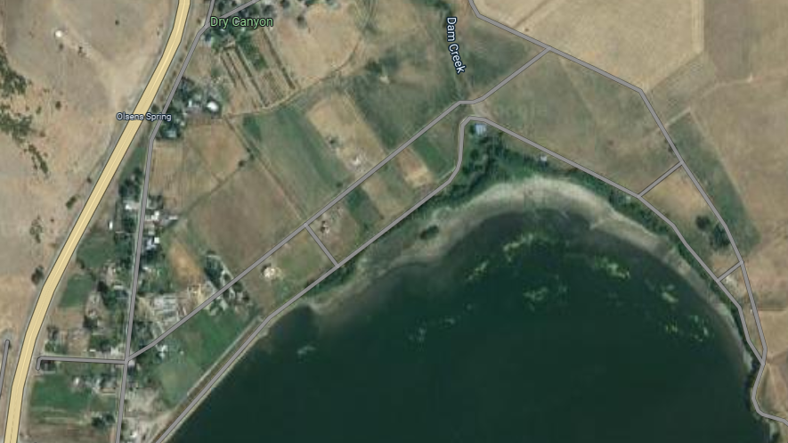
North Side of the Reservoir

Slide 5
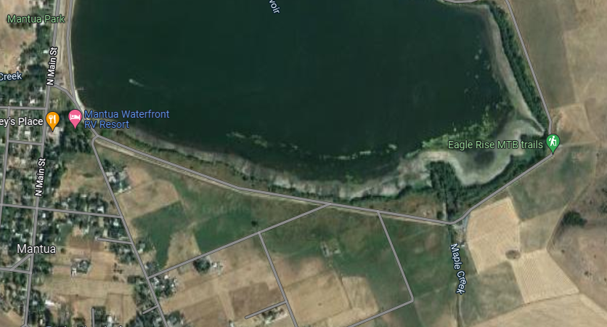
South Side of the Reservoir

Slide 6
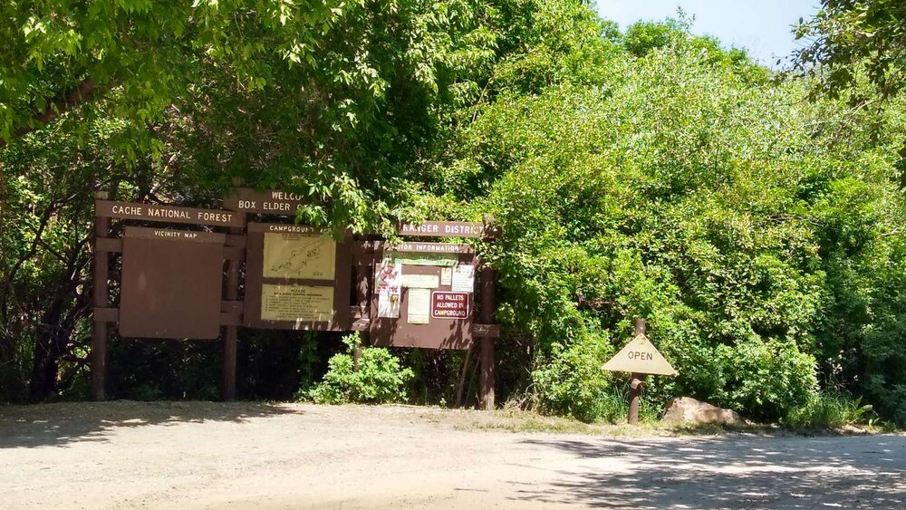
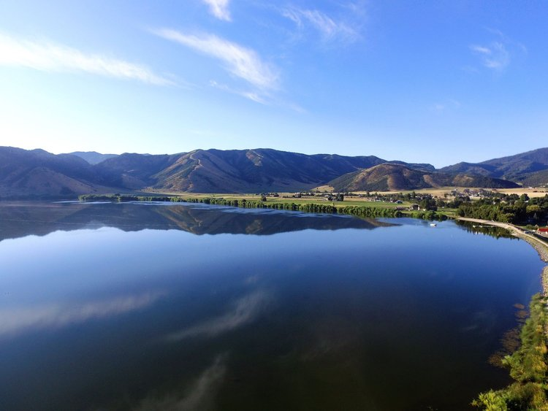
Camping
Mantua RV
Box Elder CampGround
Mantua has two campgrounds, one run by Mantua Waterfront RV, and the other is run by Box Elder County. Both are wonderful places to camp old school or pull in an RV.
Click the links on the side for more information on making reservations and pricing.

Slide 7
the Leader July 15, 2022
Newspaper Article
Health officials in northern Utah are once again warning visitors not to swim, play or allow pets in Mantua Reservoir after routine testing confirmed toxic blooms of slimy, blue-green algae have returned to the popular summer recreation spot in Sardine Canyon.
The Bear River Health Department issued a warning advisory on July 13 for the reservoir located near the Box Elder-Cache county line, informing people that water samples contained concentrations of cyanobacteria greater than what the Utah Division of Water Quality deems safe.
Cyanobacteria are microorganisms that are a natural part of freshwater ecosystems but under certain conditions can multiply rapidly, creating scums and blooms on the water’s surface and along shorelines. The bacteria typically thrive during summer months, their growth fueled by a combination of sunlight, slow-moving water and excess nutrients (phosphorus and nitrogen) from agricultural runoff and other human sources.
The multi-year drought and current heat wave might be spurring the blooms’ growth more than usual, as the bacteria tend to thrive in more stagnant and warmer water.
Mantua is the only water body in Northern Utah where hazardous levels of cyanobacteria have consistently been found in recent years. Experts say that while there’s no definitive explanation for why Mantua has been especially susceptible to the toxic blooms, the close proximity of agricultural and other human activity to its shore might account for it.

Slide 8

3D-RST is supported by the NSF under grant number #DRL-2101383

