Slide 1
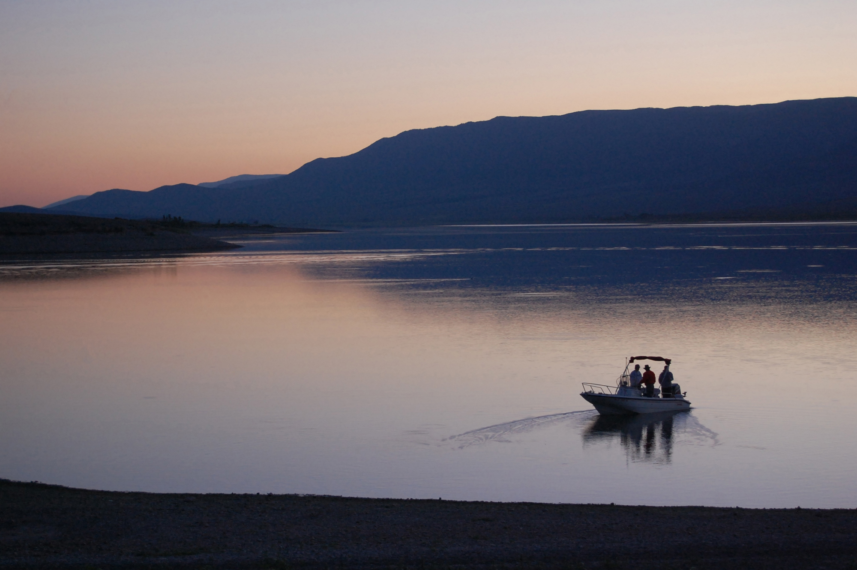
Otter Creek Reservoir
Harmful Algal Blooms

Slide 2
About…
Geography:
In the fall of 1897, construction began on one of the oldest dam projects in Utah, creating what is now Otter Creek Reservoir. Local Mormons in the area needed a source of irrigation water for farming in the area where they had chosen to live. Many of the farmers had experience with building irrigation canals, but knew nothing about constructing a dam. After applying for water rights, members of the Otter Creek Reservoir Company were denied the financial assistance they needed to take on the project.
Despite the lack of funds to build the dam, it was decided to go ahead and begin construction. Robert Dixon Young, who had no prior experience in dam construction, was appointed supervisor of the project. With the help of local volunteers and homemade equipment, construction began in 1897. A year later, financial assistance was finally approved and the proper equipment to complete the project was purchased.
Recreation:
Year-round fishing and boating on the 3,120-acre reservoir are the park's featured activities along with convenient access to three ATV trails, including the popular Paiute ATV Trail. During the spring and fall, many types of birds pass through Otter Creek on their journey along the Pacific Migratory Bird Flyway.

Slide 3
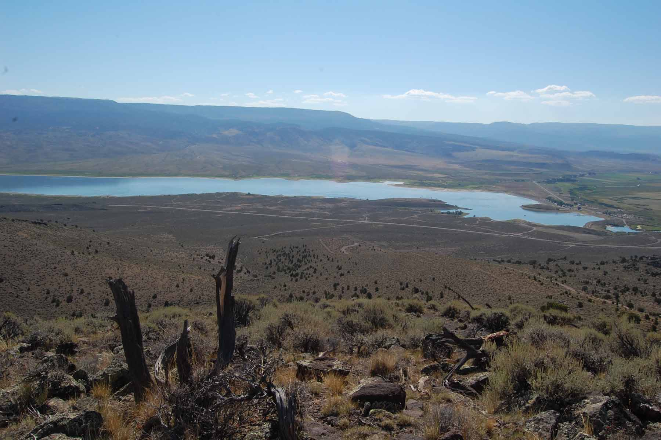
Facts about Otter Creek Reservoir…
Surface Elevation: 6,372 ft
Max Depth: 37 ft
Dimensions: 6.5 miles long by about .75 miles wide.
Current Algal Bloom Conditions

Slide 4
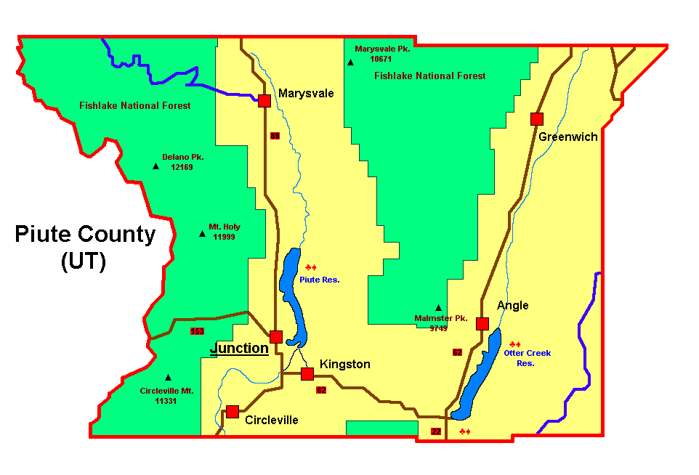


Piute County Information…
Population - As of 2021, the population of Piute County was 1,487. Its main centers of population include the towns of Marysvale, Junction, and Circleville.

Slide 5
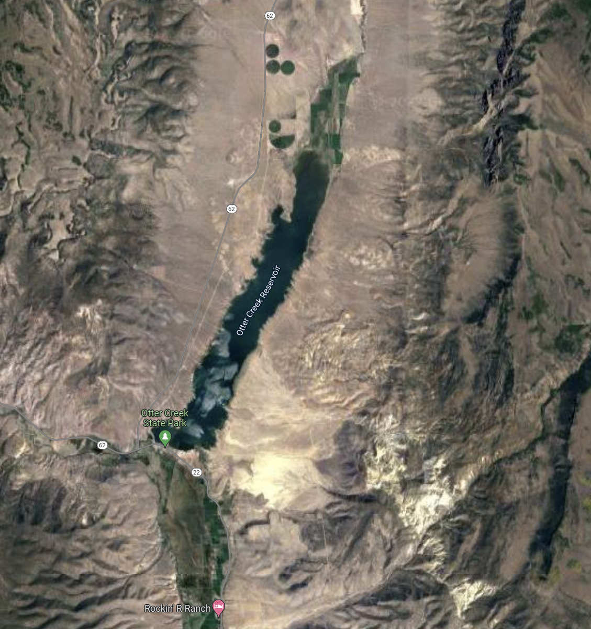

Slide 6
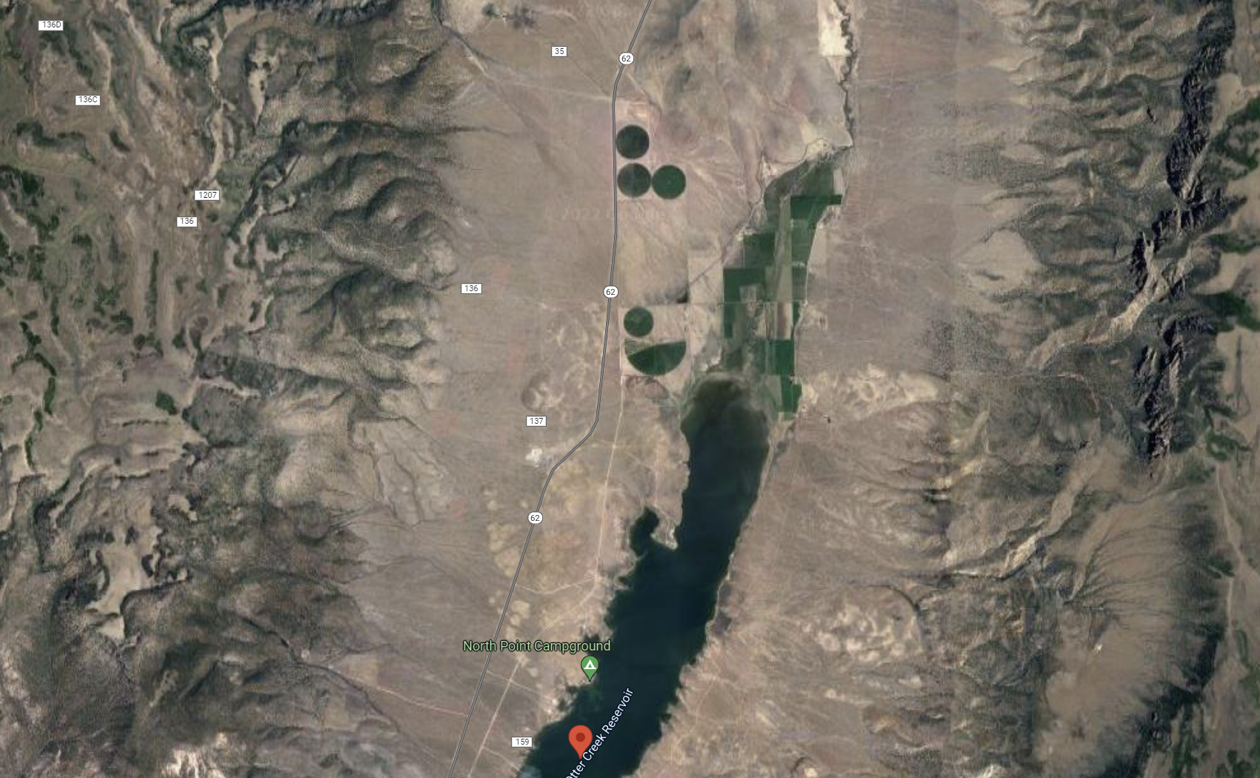

Slide 7
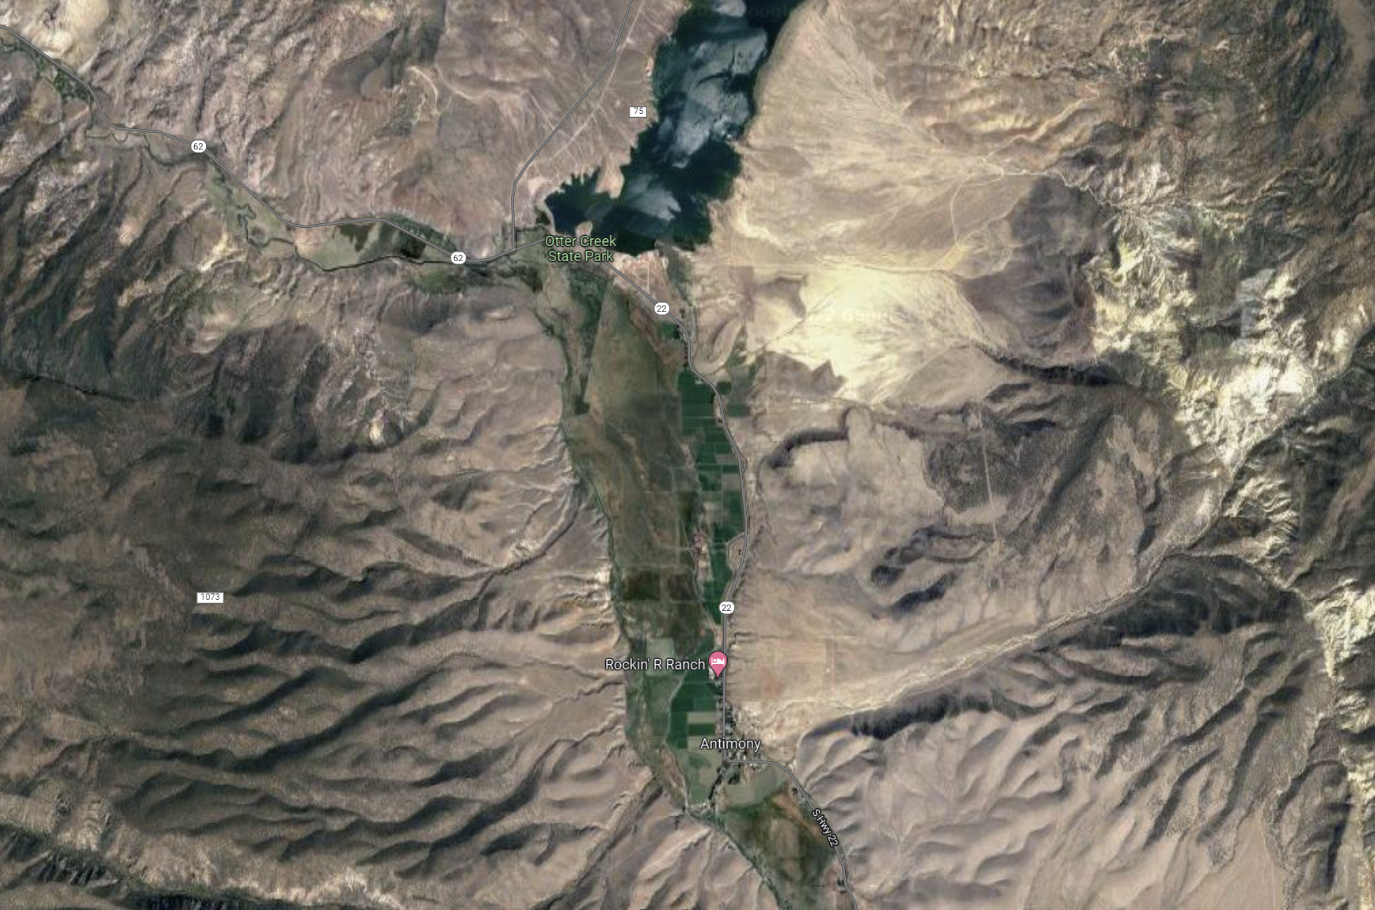

Slide 8

3D-RST is supported by the NSF under grant number #DRL-2101383

