Slide 1
When water is dangerous

Slide 2
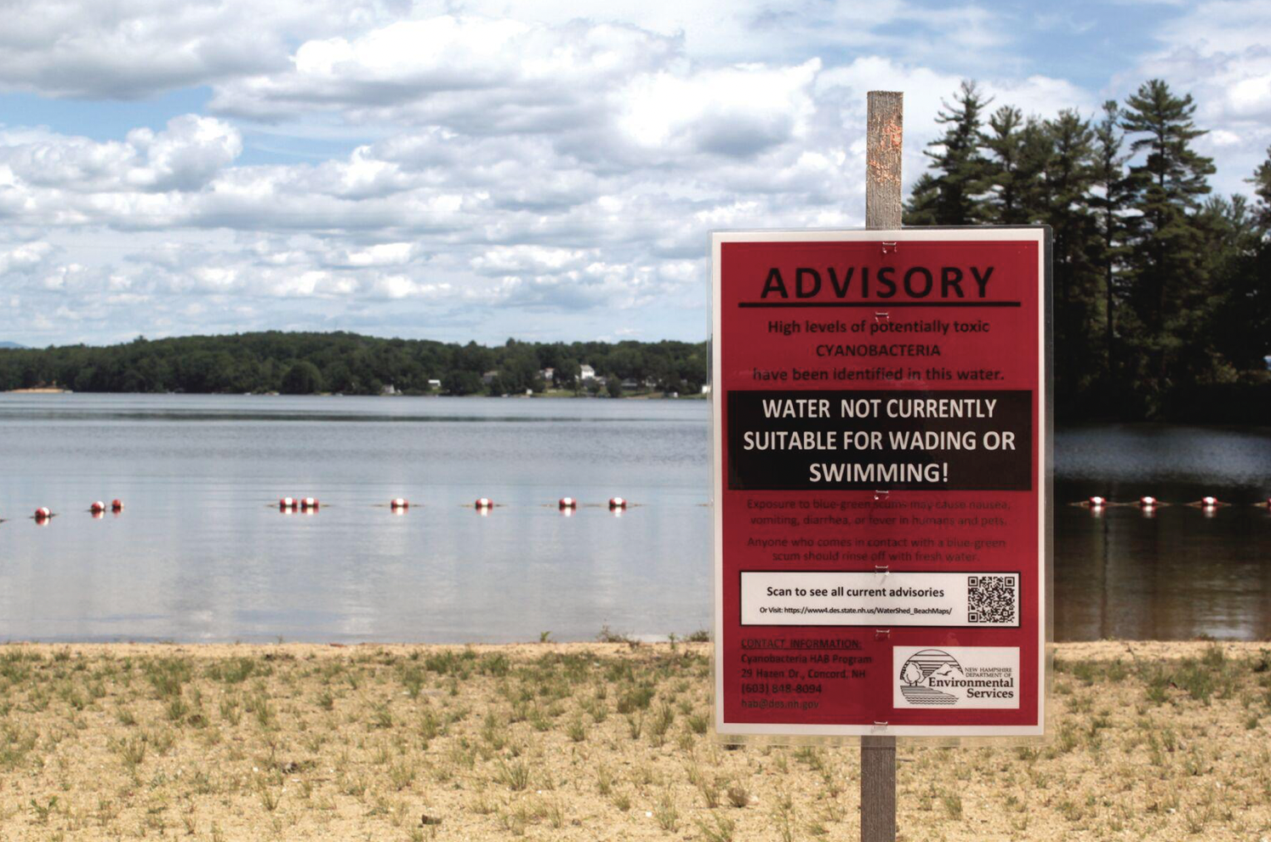

Slide 3
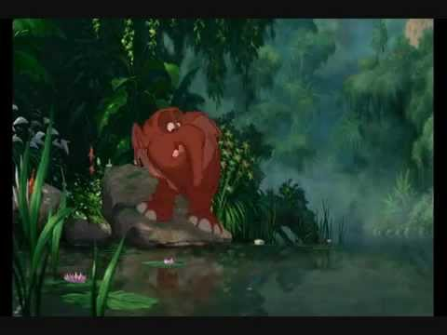
Have you ever experienced a boil order? Have you ever seen a body of water closed? Have you ever experienced water that looked, smelled, or tasted unsafe?

Slide 4
What might cause access to the lake to be restricted?

Slide 5
This lake was closed as a result of a Harmful Algal Bloom.
Also known as:
HAB
Cyanobacteria
Blue-Green Algae
Are all algal blooms harmful?

Slide 6
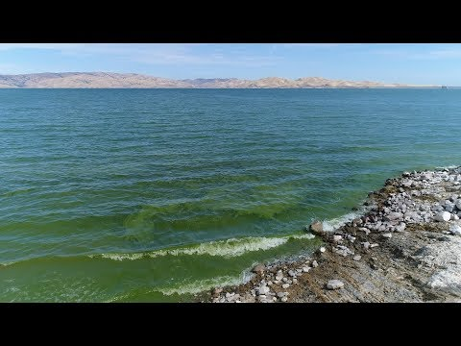

Slide 7
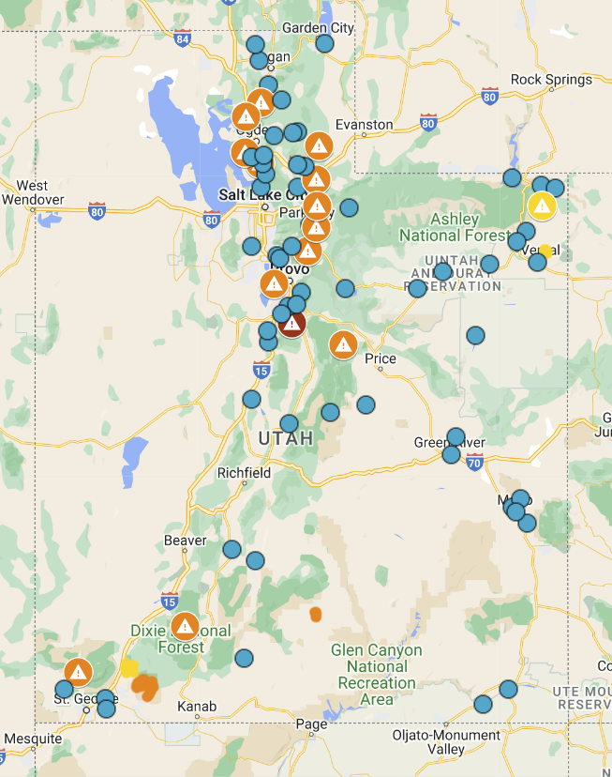
Utah HABs Monitoring Website

Slide 8
What causes Harmful Algal Blooms?
Using the provided resources, find the human influenced causes of harmful algal blooms - HABs.

Slide 9
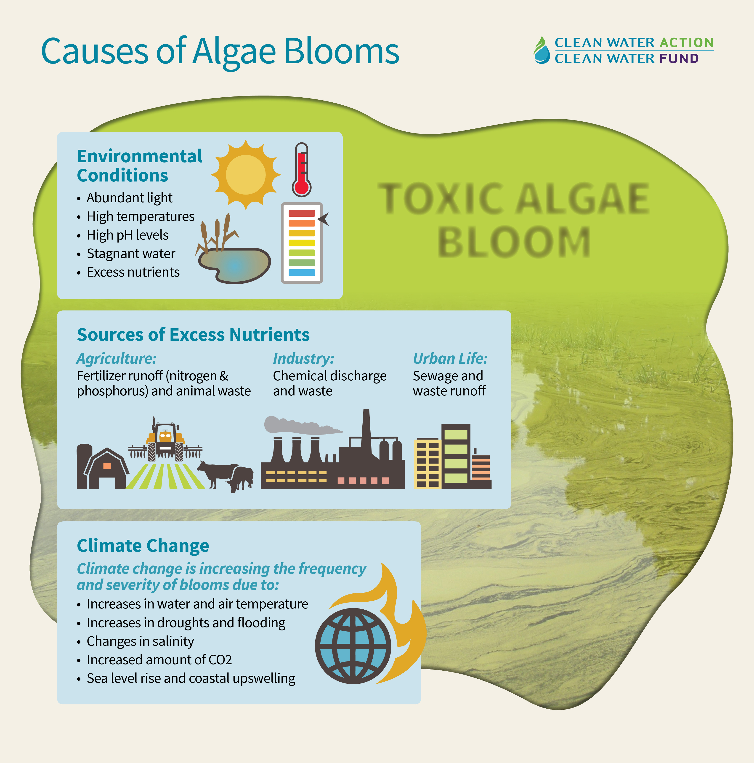
Causes

Slide 10
Harmful Algal Blooms in UTAH Each group will receive a case study on a local HAB. As you study your cases, consider what might be contributing to your specific, local problem.
Discuss with your group: What are the causes? What are the effects?
Send a member of your group to write the cause on the board.

Slide 11
What is the solution?
In a team of 2 to 4 students, you will design a solution to the problem of HABs.
This solution could be preventative or restorative.
Your solution may be mechanical, social, educational, etc...
You will design and explain/model your solution on your exit slip.

Slide 12
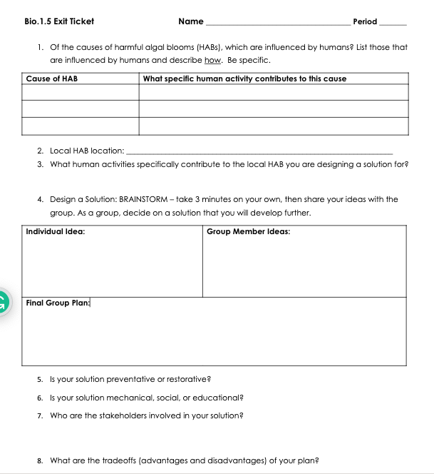
Turn in today:

Slide 13

3D-RST is supported by the NSF under grant number #DRL-2101383

